Slide 1
Financial Portfolio Tracking System (FPTS)
Joey Bovio, David Eagan, Paul Hulbert,
Sean Levorse, Nathan Oesterle, Steven Teplica

Slide 2
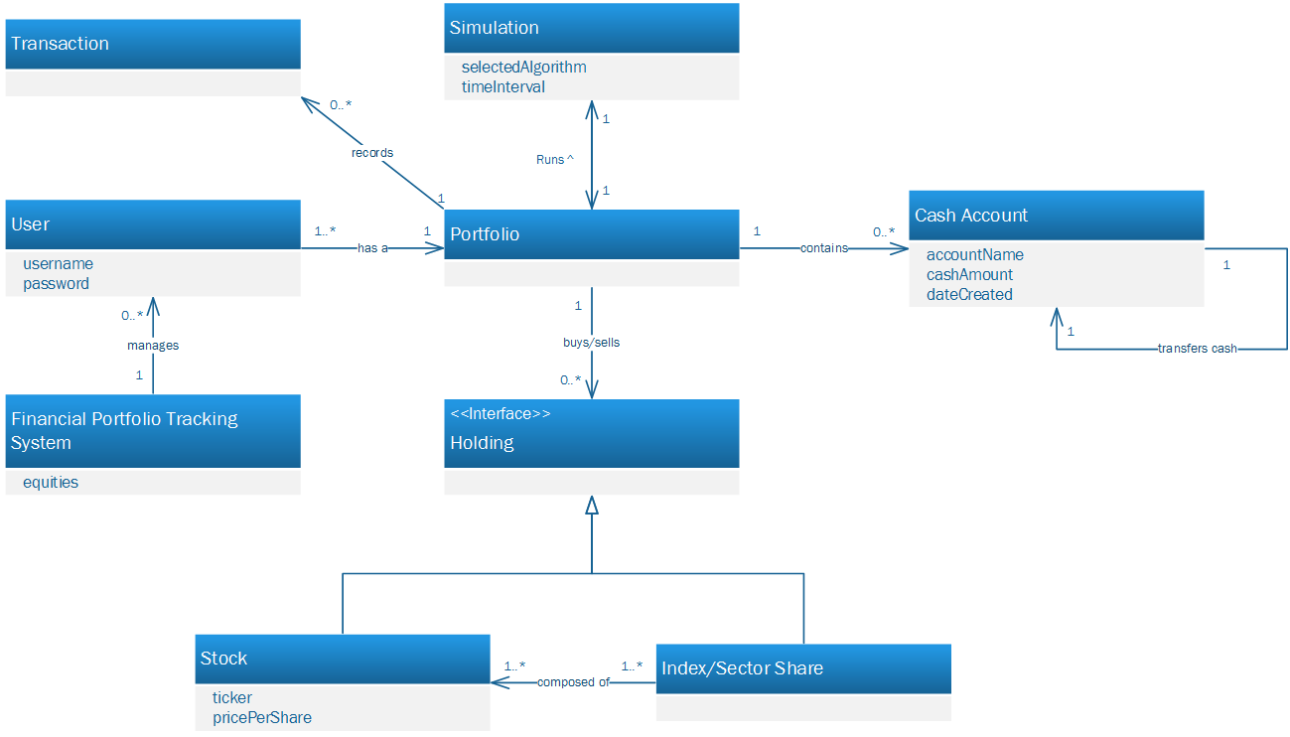
Design: Domain Model

Slide 3
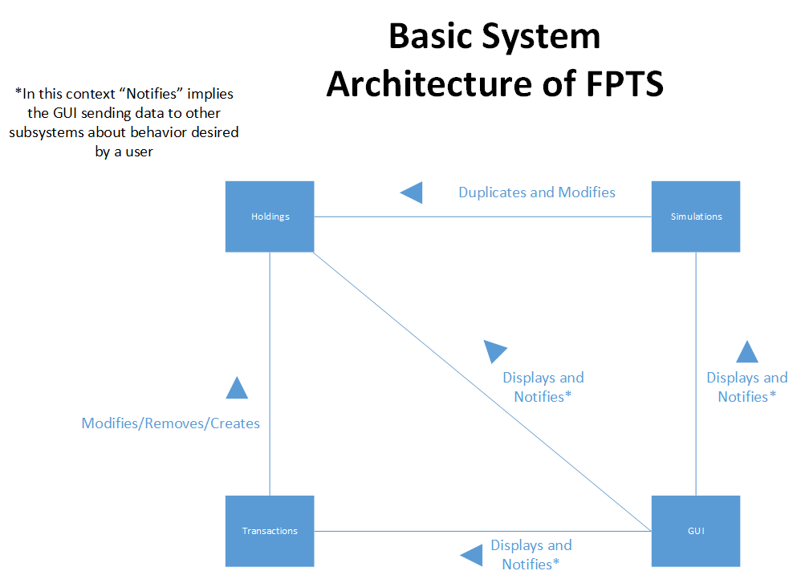
Design

Slide 4
Design Choices
Changed Simulation so that it was no longer a command
The bull, bear, and no growth market can all be represented with one class where the per annum growth rate is positive, negative, or zero
Serializing our entire FPTS to make saving simple
Having a simulation manager class
Swing over JavaFX
Swing is more documented
More experience with Swing

Slide 5
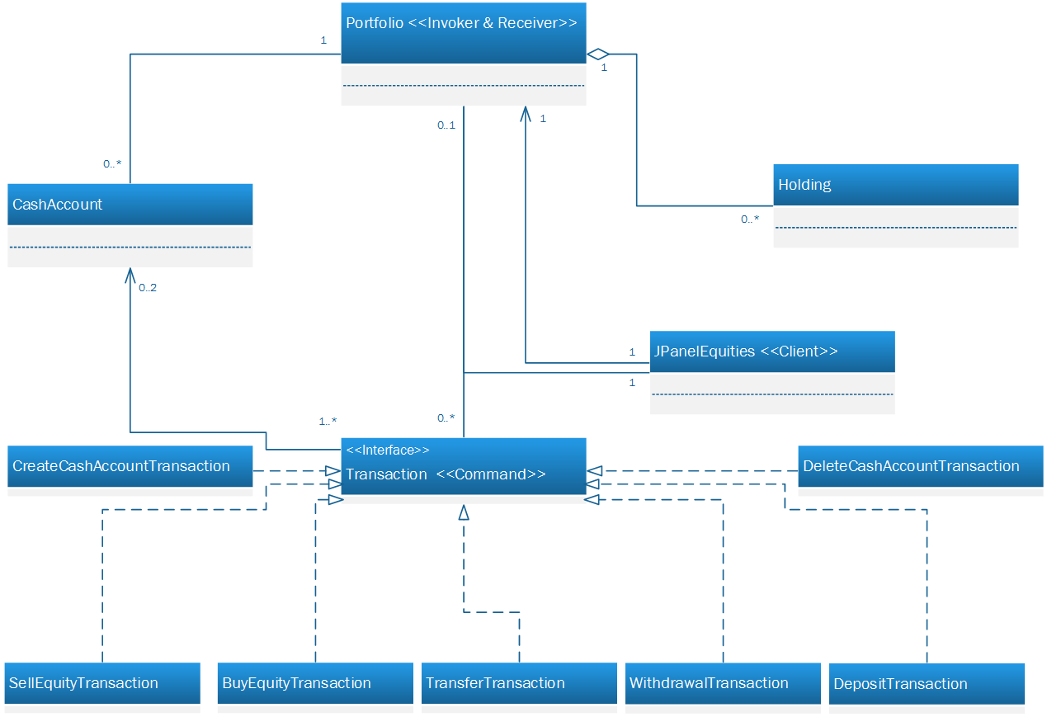
Design Pattern Usage: Command

Slide 6
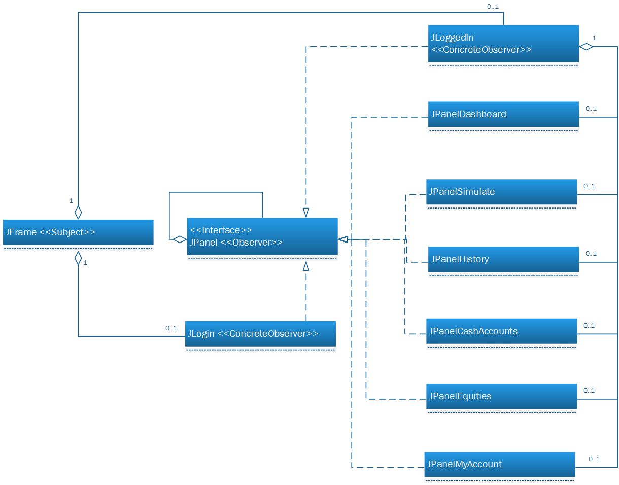
Design Pattern Usage: Observer

Slide 7
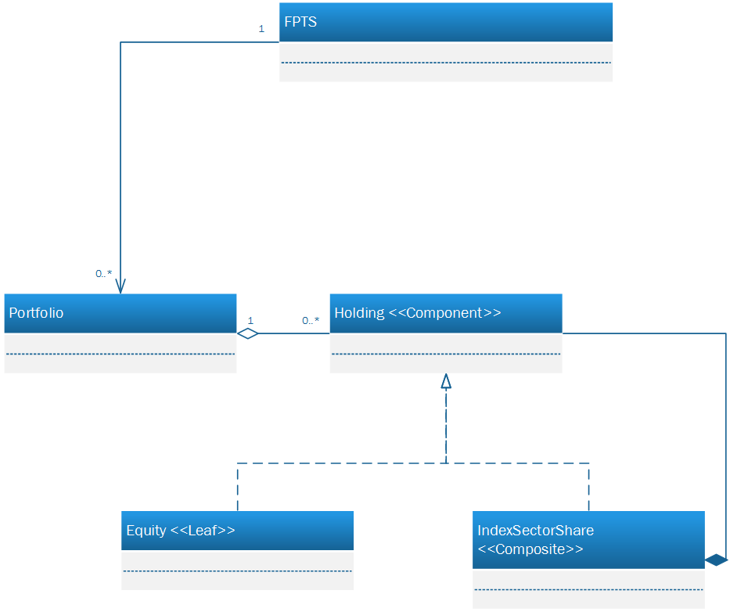
Design Pattern Usage: Composite

Slide 8
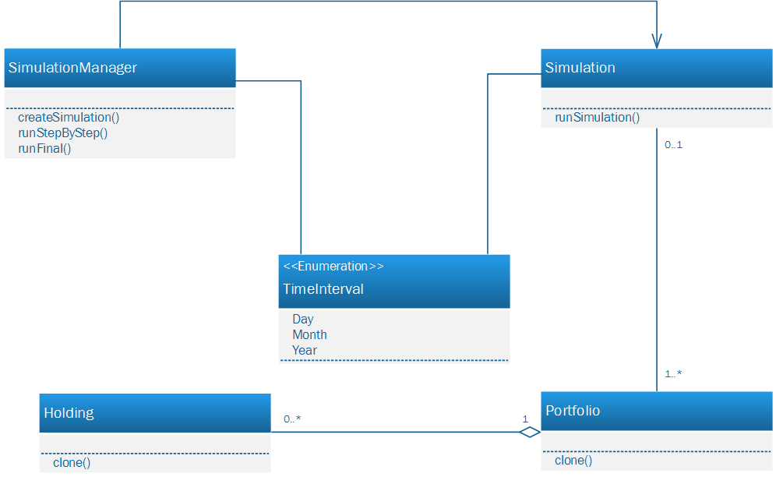
Design Pattern Usage: Memento

Slide 9
Difficulties
Integrating the various subsystems
Collaborating between 6 people
Making sure illegal transactions don’t end up in the transaction history
SVN took coordination
Privacy issues

Slide 10
Strengths
Weaknesses
Flexible interface that can be easily modified
Stable
Cohesion -> Easily expandable
We can handle large datasets
Saving everything as one file is vulnerable to data loss
Different operating systems interpret our GUI differently
Everything is in one folder, disorganized file structure

