Slide 1
Team Project #1
Statistical Process Control
Team ##
(List team members here)

Slide 2

1. Centerlines
Sample mean centerline ($\overset{̿}{x}$) =
Range centerline ($\overline{R}$) =

Slide 3
2. Control Limits
Sample mean UCL =
Sample mean LCL =
Range UCL =
Range LCL =

Slide 4
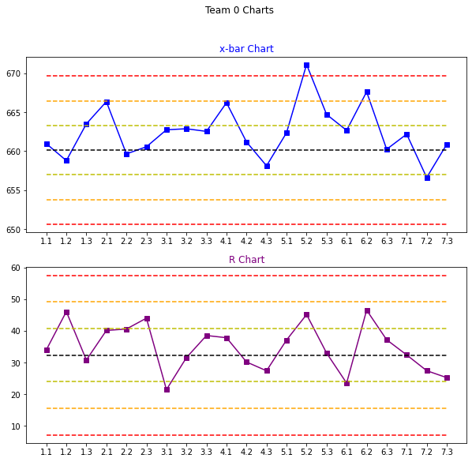
3. x-bar and R charts

Slide 5
4.A Rule #1 Signals
List the out-of-control points and briefly explain here.
Mark them on the graph here (replace this text with a graph)

Slide 6
4.B Rule #2 Signals
List the out-of-control points and briefly explain here.
Mark them on the graph here (replace this text with a graph)

Slide 7
4.C Rule #3 Signals
List the out-of-control points and briefly explain here.
Mark them on the graph here (replace this text with a graph)

Slide 8
4.D Rule #4 Signals
List the out-of-control points and briefly explain here. (Note that Rule #4 has four cases.)
Mark them on the graph here (replace this text with a graph)

Slide 9
4.E Rule #5 Signals
Discuss any out-of-control points or trends here.
Mark them on the graph here (replace this text with a graph)

Slide 10
5. Process Capability (Cp_{k})
Cp_{k} =

Slide 11
Anything you may want to add…

