Slide 1

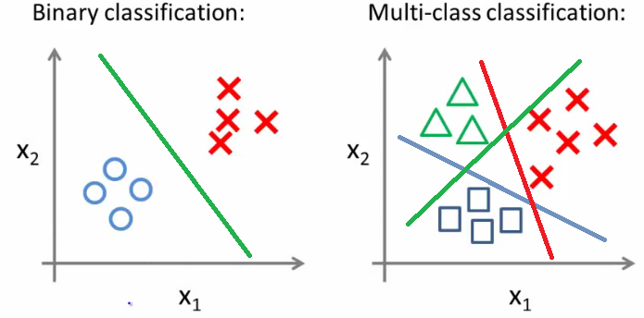
LOGISTIC REGRESSION

Slide 2
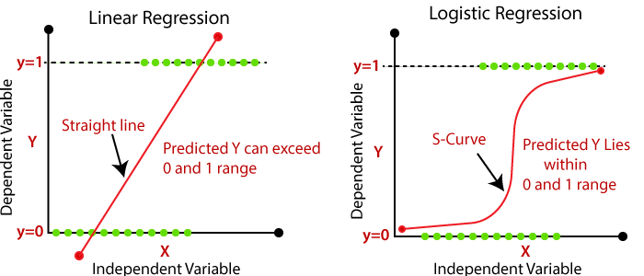
Why ?
Tip
1 ≥ h(x) ≥ 0
h(x) = P(Y|X)
Y is Binary(0 or 1)

Slide 3
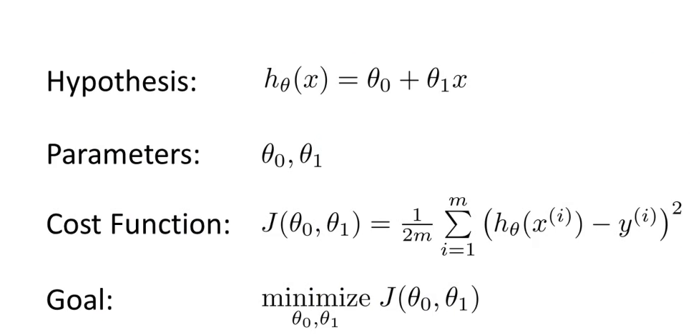
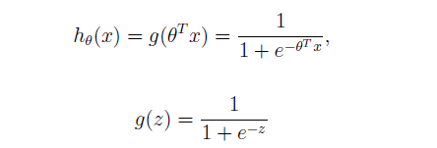
Linear Regression:
Logistic Regression:
Hypothesis:

Slide 4



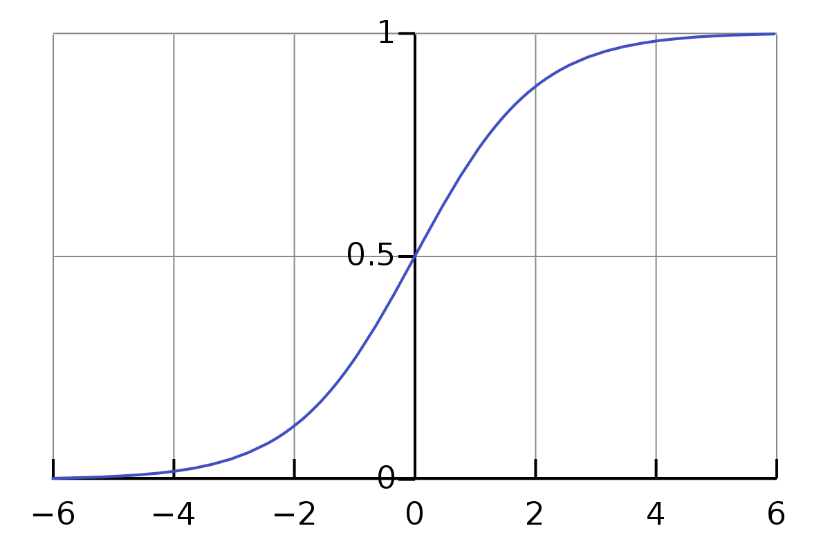
Tip
Sigmoid
Cost Function is a function that measures the performance of a Machine Learning model for given data.
!

Slide 5
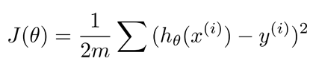

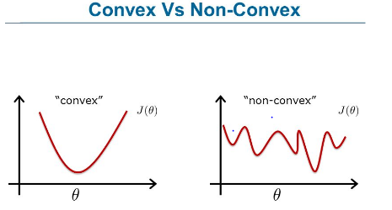
What if we use the same Cost Function ?
Mean Squared Error:
Log Loss:

Slide 6
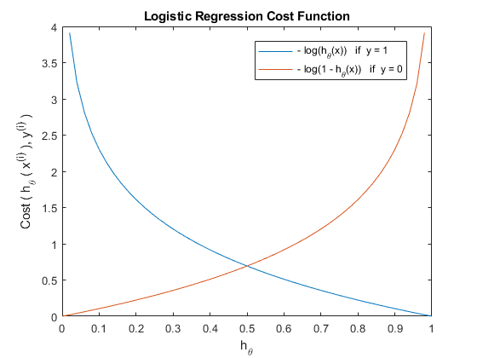
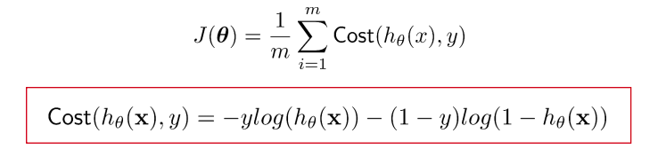
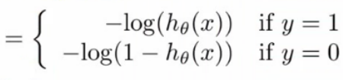
Logistic Regression
Cost Function

Slide 7
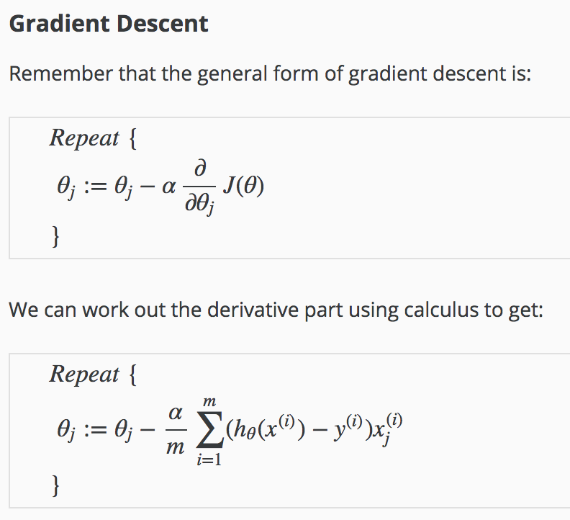
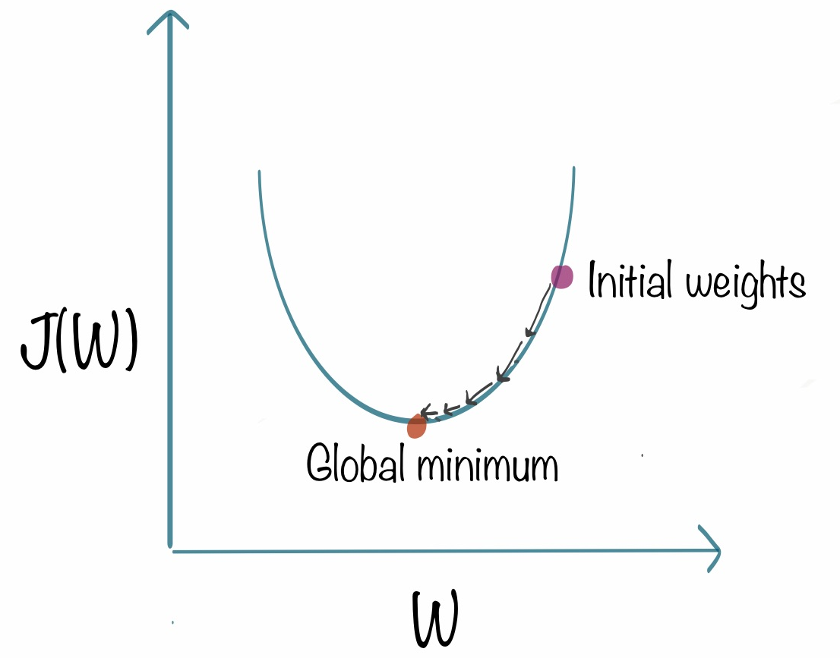

Slide 8
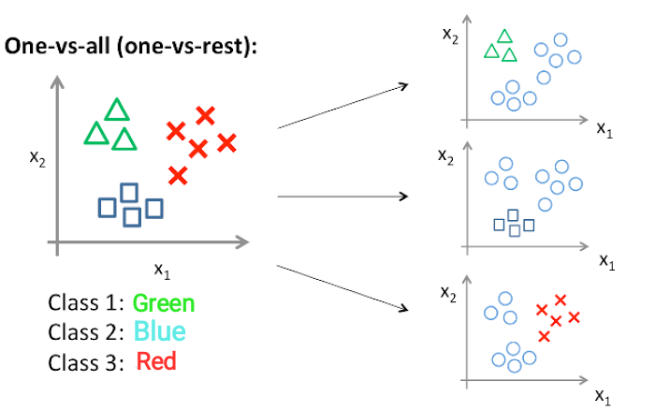
References for images: Andrew ng course

