Slide 1
NAIVE-BAYES CLASSIFIER IN MACHINE LEARNING

Slide 2
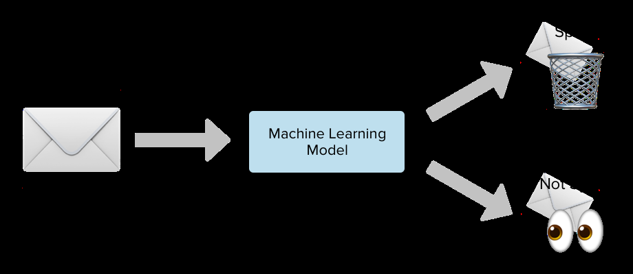
INTRODUCTION
WHAT IS NAÏVE BAYES
Naive Bayes is a probabilistic machine learning algorithm that can be used in a wide variety of classification tasks. Typical applications include filtering spam, classifying documents, sentiment prediction etc.

Slide 3
Machine learning falls into two categories:
Supervised learning
Unsupervised learning
Supervised learning falls into two categories:
Classification
Regression
Naive Bayes algorithm falls under classification.
WHERE IS IT USED?
Naïve Bayes has it’s applications in
Face Recognition
Weather Prediction
Medical Diagnosis
News Classification

Slide 4
What’s Naive about Naive Bayes?
Naive Bayes (NB) is ‘naive’ because it makes the assumption that features of a measurement are independent of each other. This is naive because it is (almost) never true.

Slide 5
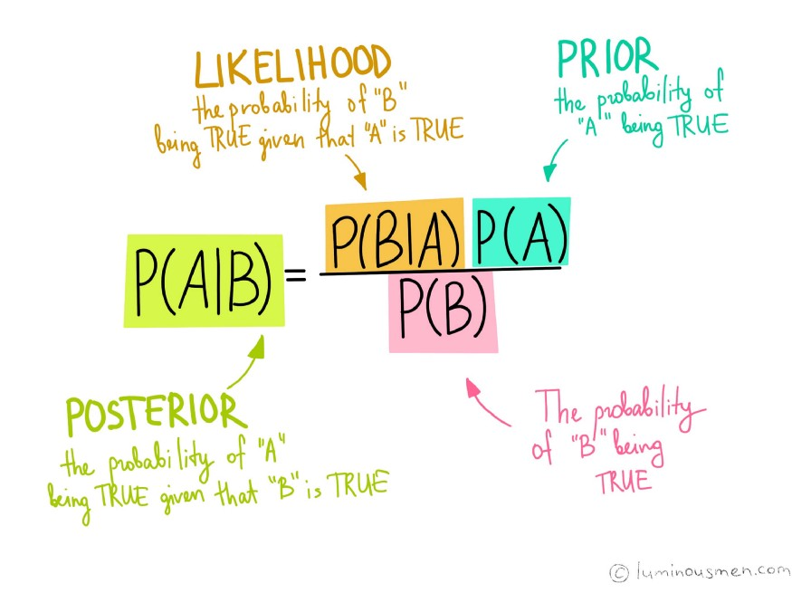
KNOW THIS FIRST!

Slide 6
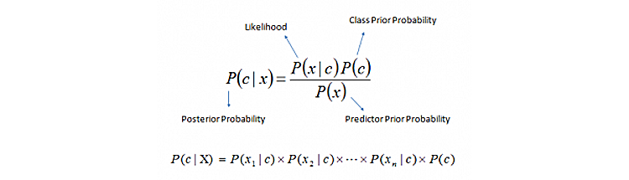
P(c|x): posterior probability of class( c, target) given predictor( x, attributes).
P(c): is the prior probability of class.
P(x|c): is the likelihood which is the probability of predictor-given class.
P(x): is the prior probability of predictor.

Slide 7
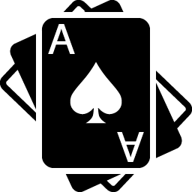
UNDERSTANDING BAYES FORMULA WITH AN EXAMPLE
A card is picked from that deck at random. The objective is to find the probability of a King card, given that the card picked is red in color.
P(King | Red Card) = ?
We’ll use,
P(King | Red Card) = P(Red Card | King) x P(King) / P(Red Card)
So,
P (Red Card | King) = Probability of getting a Red card given that the card chosen is King = 2 Red Kings / 4 Total Kings = ½
P (King) = Probability that the chosen card is a King = 4 Kings / 52 Total Cards = 1 / 13
(Red Card) = Probability that the chosen card is red = 26 Red cards / 52 Total Cards = 1/ 2
Hence, finding the posterior probability of randomly choosing a King given a Red card is:
P (King | Red Card) = (1 / 2) x (1 / 13) / (1 / 2) = 1 / 13 or 0.077

Slide 8
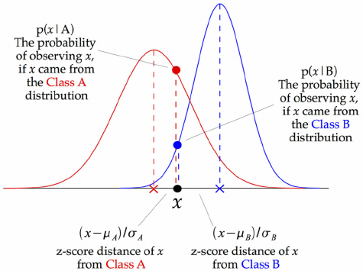
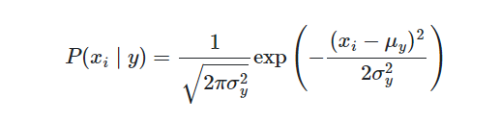
When it comes to Naive Bayes
There are 3 types commonly used:
Gaussian Naive Bayes
This type of Naive Bayes is used when variables are continuous in nature. It assumes that all the variables have a normal distribution. So if you have some variables which do not have this property, you might want to transform them to the features having distribution normal.
The parameters σy and μy are estimated using maximum likelihood.

Slide 9
Multinomial Naive Bayes
Next comes the multinomial Naive Bayes. This is used when the features represent the frequency.
Suppose you have a text document and you extract all the unique words and create multiple features where each feature represents the count of the word in the document. In such a case, we have a frequency as a feature. In such a scenario, we use multinomial Naive Bayes.
It ignores the non-occurrence of the features. So, if you have frequency 0 then the probability of occurrence of that feature will be 0 hence multinomial naive Bayes ignores that feature. It is known to work well with text classification problem.
The term Multinomial Naive Bayes simply lets us know that each p(fi|c)p(fi|c) is a multinomial distribution, rather than some other distribution. This works well for data which can easily be turned into counts, such as word counts in text.

Slide 10
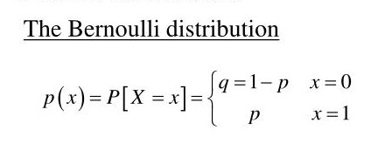
Bernoulli Naive Bayes
This is used when features are binary. So, instead of using the frequency of the word, if you have discrete features in 1s and 0s that represent the presence or absence of a feature. In that case, the features will be binary and we will use Bernoulli Naive Bayes.
Bernoulli distribution
As we deal with binary values, let's consider 'p' as probability of success and 'q' as probability of failure and q=1-p For a random variable 'X' in Bernoulli distribution.
where 'x' can have only two values either 0 or 1

Slide 11
Difference between Bernoulli, Multinomial and Gaussian Naive Bayes
Multinomial Naïve Bayes consider a feature vector where a given term represents the number of times it appears or very often i.e. frequency.
On the other hand, Bernoulli is a binary algorithm used when the feature is present or not.
At last Gaussian is based on continuous distribution.
Multinomial Naive Bayes - Widely used classifier for document classification which keeps the count of frequent words present in the documents.
Bernoulli Naive Bayes - Used for discrete data, where features are only in binary form.
Gaussian Naive Bayes - Used when we are dealing with continuous data and uses Gaussian distribution..

Slide 12
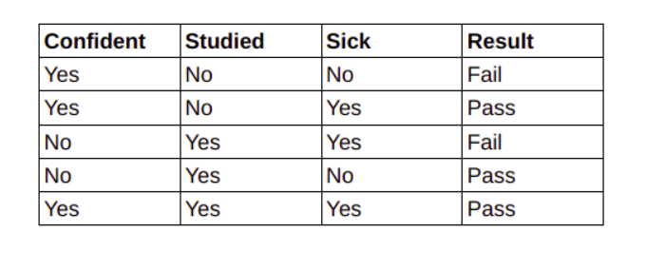
And we want to classify an instance 'X' with Confident=Yes, Studied=Yes and Sick=No
So, first we need to calculate the class probabilities i.e P(Pass)=3/5 and P(Fail)=2/5 P(Confident=Yes| Result=Pass) = 2/3 P(Studied=Yes| Result=Pass) = 2/3 P(Sick=Yes| Result=Pass) = 1/3
Similarly,
P(Confident=Yes| Result=Fail) = 1/2 P(Studied=Yes| Result=Fail) = 1/2 P(Sick=Yes| Result=Fail) = 1/2
Now we calculate,
P(X|Result=Pass)xP(Result=Pass) = (2/3) * (2/3) * (1/3) * (3/5) = 0.088 P(X|Result=Fail)xP(Result=Fail) = (1/2) * (1/2) * (1/2) * (2/5) = 0.05
Next step is to calculate the probability of estimator P(X) = P(Confident=Yes)xP(Studied=Yes)xP(Sick=No) = (3/5) * (3/5) * (2/5) = 0.144
Finally, P(Result=Pass|X) = 0.088/0.144 = 0.611 P(Result=Fail|X) = 0.05/0.144 = 0.34
As 0.611>0.31, the instnace with 'Confident=Yes, Studied=Yes and Sick=No' has result as 'Pass'.

Slide 13
Advantages
This algorithm works quickly and can save a lot of time.
Naive Bayes is suitable for solving multi-class prediction problems.
If its assumption of the independence of features holds true, it can perform better than other models and requires much less training data.
Naive Bayes is better suited for categorical input variables than numerical variables.
Disadvantages
Naive Bayes assumes that all predictors (or features) are independent, rarely happening in real life. This limits the applicability of this algorithm in real-world use cases.
This algorithm faces the ‘zero-frequency problem’ where it assigns zero probability to a categorical variable whose category in the test data set wasn’t available in the training dataset. It would be best if you used a smoothing technique to overcome this issue.
Its estimations can be wrong in some cases, so you shouldn’t take its probability outputs very seriously.

Slide 14
THANKS!

