Slide 1
NiLEX: a new approach to lexical and hierarchical analysis of domain-specific languages

Slide 2
Contents
Introduction
  Evolution of Thoughts
  History of Compilers and Grammars
  Essence of Compilation
Theory
  Lexical Analysis and Hierarchical Analysis
  Nested Syntax Highlighting
  Hybrid Analysis
  Kinds of Tokens
  Abstract vs. Concrete Tokens
  Free-From vs. Left-Side Rule

Slide 3
Contents
Generalized Grammar Syntax
  What Is Expected
  Rules
  Domains
  Precedence
  Brevity Comparison
Practice
  Hybrid Analysizer Algorithm
  Precedential Organizer Algorithm
  The Complexity Analysis of algorithms
Conclusion

Slide 4
Introduction

Slide 5
Evolution of Thoughts
Intuition, and Thinking
  External signals and internal responses
  Speech and Understanding
  Writing and Reading
  Languages
Approaching “Formalism”
  Self-consistent systems
  Logic, Philosophy, and Mathematics
Evolution of Ideas, by Greats Minds

Slide 6
Evolution of Thoughts
Mathematics
  Ancient Mesopotamian contributed base 60 numbers, circa 3400 BC
  Ancient Egypt contributed base 10 numbers, circa 3100 BC
  Ancient China contributed negative numbers, circa 100 BC
Sciences
  Ancient civilizations studied astronomical objects
  Sir Isaac Newton contributed Classical physics
Languages
...

Slide 7
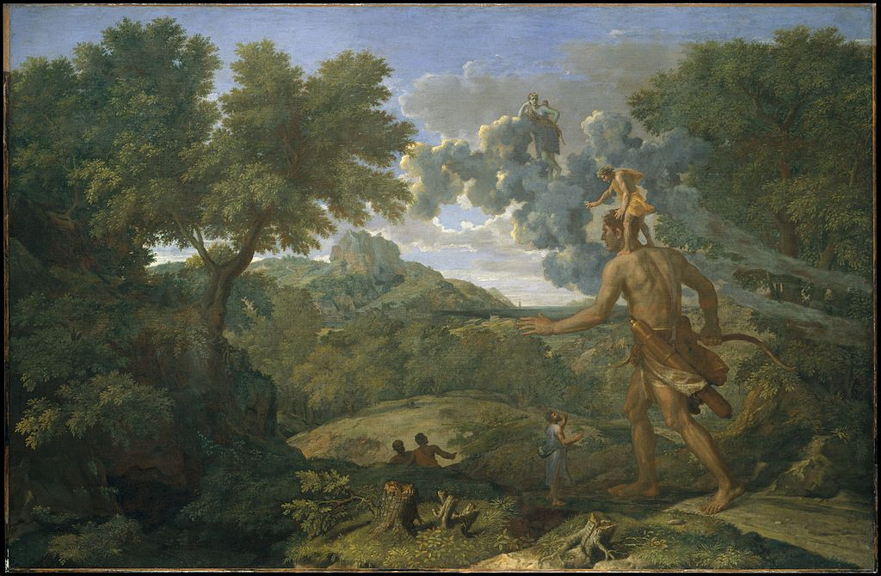
“If I have seen further, it is by standing on the shoulders of Giants.” – Isaac Newton, 1675

Slide 8

“Reinventing The Wheel”
https://medium.com/@ebrian/why-you-should-reinvent-the-wheel-periodically-if-youre-an-experienced-programmer-64505a2d51f2
https://dev.to/quantumsheep/why-you-should-reinvent-the-wheel-4ha2
https://george3d6.medium.com/please-reinvent-the-wheel-7690ccc454bf

Slide 9
Theory

Slide 10
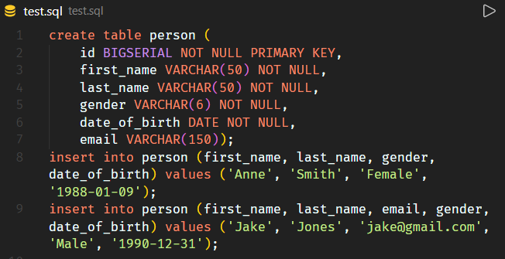
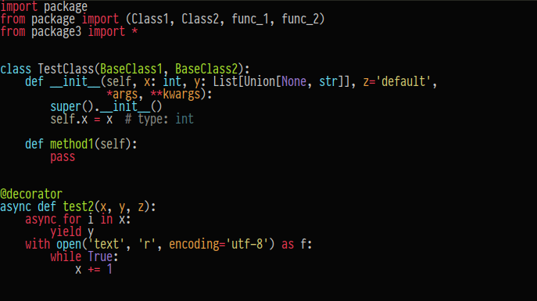
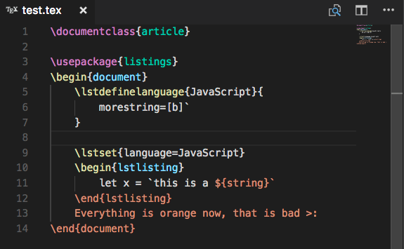
Syntax Highlighting

Slide 11
Nested Syntax Highlighting: regex in C#
// C# here
y = f(@"r(e[gx]){2}\w((h|r)e ?)+", 2*x);
g(y, "Also C# here");

Slide 12
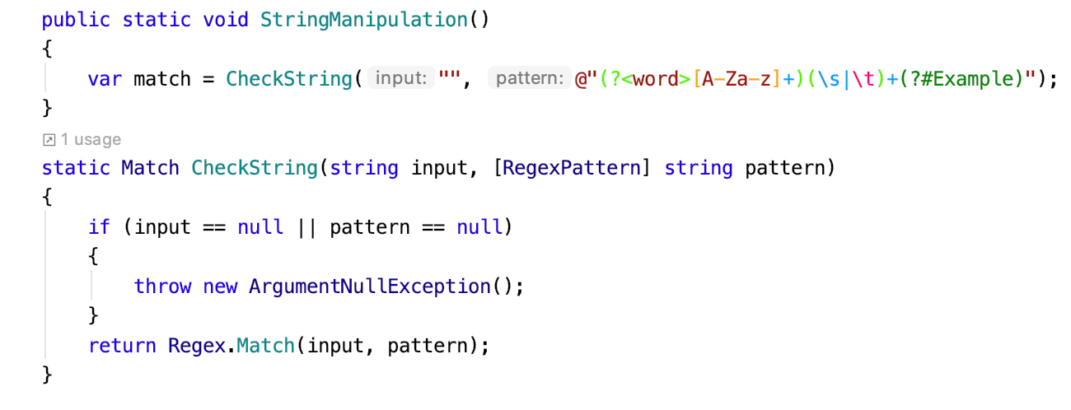
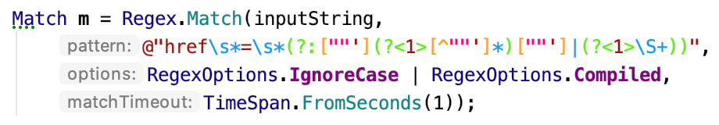
Nested Syntax Highlighting: regex in C#

Slide 13
Nested Syntax Highlighting: Inline CSS and JavaScript in HTML
<script attributes>
  /*inline JS here*/
  a = 5;
</script>
<style attributes>
  /*inline CSS here*/
  p {color: red;}
</style>
<p>HTML here</p>

Slide 14
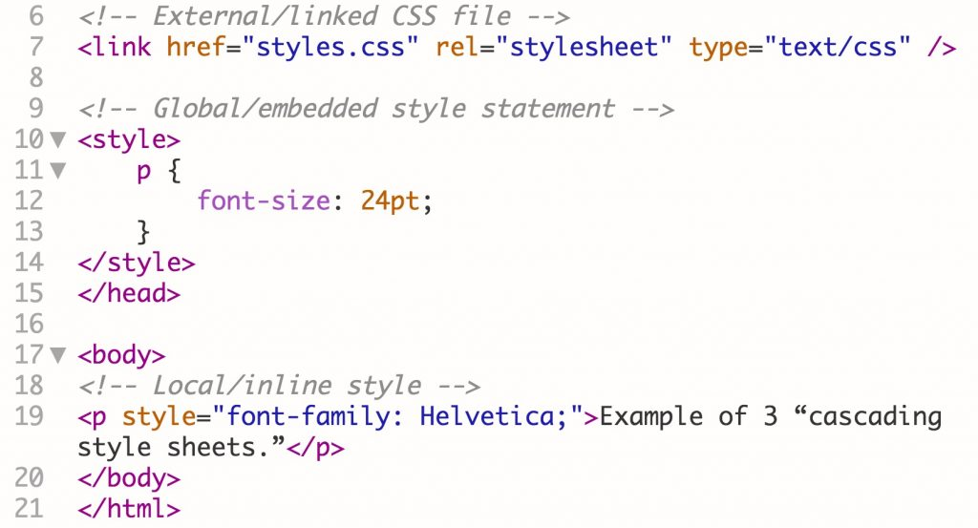
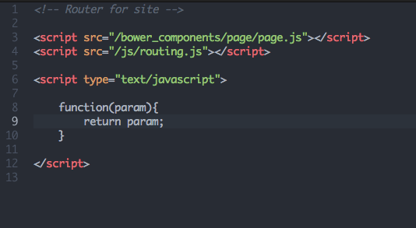
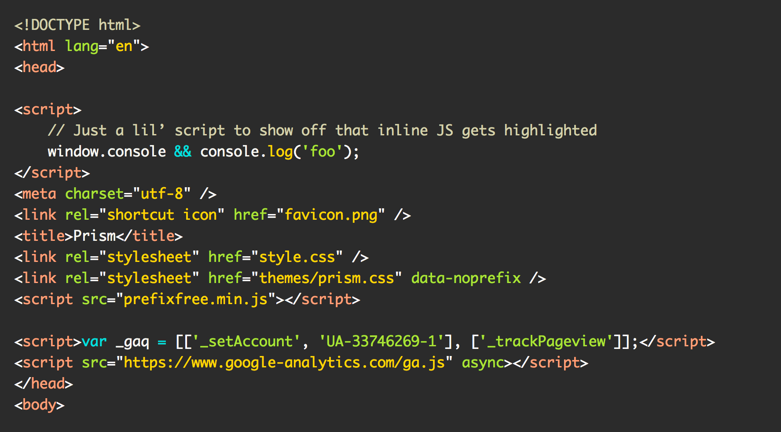
Nested Syntax Highlighting: Inline CSS and JavaScript in HTML

Slide 15
Nested Syntax Highlighting: Markdown “code fences”
# Markdown here
```language name here
syntax highlighted piece of code here
```
## also Markdown here

Slide 16
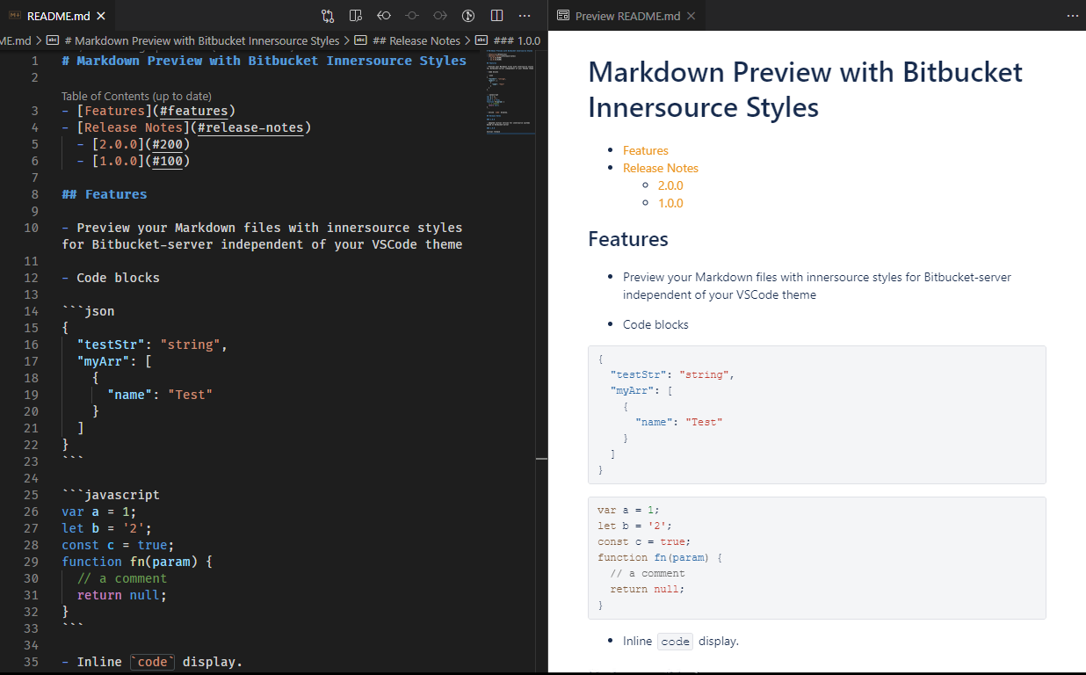
Nested Syntax Highlighting: Markdown “code fences”

Slide 17
Hybrid Analysis Steps
Pre-1. Organize based on indentation (not present in free-form)
1. KEEP and BREAK
2. ENCLOSE and SEPARATE
Ready for Syntax Highlighted preview generation
3. MATCH
Ready for Semantical analysis

Slide 18
Grammars

Slide 19
Algorithms

Slide 20
Conclusion

