Slide 1
BITS PILANI • WILP
ARCHON
Arch-Aware Context Network for Tooth Enumeration and Severity-Aware Dental Disease Detection
M.Tech Dissertation | Department of CSIS | BITS Pilani – WILP Supervisor: [Supervisor Name] | June 2026
Dataset: DENTEX Challenge 2023 • Baseline: YOLOrtho (arXiv:2308.05967) • GPU: NVIDIA T4
IMPROVEMENTS
DATASET
OUTPUT
TRAINING
5 Targeted Improvements
DENTEX 2023 Challenge
Severity-Aware JSON Reports
3-Phase Curriculum

Slide 2
Problem Statement
Why existing dental AI systems fall short
Limitation 1
Limitation 2
Limitation 3
Restricted Receptive Field
Binary-Only Diagnostic Output
Exposure Sensitivity
CNN P5 cells see only ~12% of panoramic width. Leads to midline swap errors (FDI 16 ↔ 26).
All prior methods output only a Yes/No disease flag. No severity → no triage support.
Posterior bone regions suppress subtle caries/lesion shadows. Early-stage disease missed during training.
ARCHON addresses ALL THREE limitations in a single end-to-end multi-task framework.

Slide 3
Clinical Motivation & DENTEX Dataset
MICCAI 2023 Benchmark | Panoramic Orthopantomogram (OPG) Analysis
3.5B
32
4
~1,200
People affected by oral diseases (WHO)
FDI tooth classes (11-18, 21-28, 31-48)
Disease categories per tooth
Training images (3-tier annotations)
DENTEX 2023 Annotation Hierarchy
Disease Categories
Split
Annotation Content
Flag
Impaction
~15%
Part 1 (~300 imgs)
Bounding box + Quadrant label (1–4)
data_type=0
Part 2 (~500 imgs)
Bbox + Quadrant + Position → FDI
data_type=1
Caries
~25%
Part 3 (~400 imgs)
Bbox + FDI + Disease flags (4 attrs)
data_type=2
Unlabelled (~300)
Pseudo-labeled via Phase 1 model
data_type=2 (pseudo)
Deep Caries
~8%
Periapical Lesion
~15%

Slide 4
ARCHON Architecture Overview
5 improvements over the YOLOrtho baseline — single end-to-end model
Input 1280×640 OPG
YOLOv8x Backbone +CoordConv
GlobalContext Encoder (Swin)
MultiScale Fusion (CrossAttn)
Hybrid MultiTask Head
Post- Processing (LSA+QP)
Output JSON Report
→
→
→
→
→
→
Feature Maps: P3(320ch, stride8) · P4(640ch, stride16) · P5(640ch, stride32)
ARCHON Improvements
GlobalContextEncoder
MultiScaleFusion
HybridMultiTaskHead
A
B
C
Swin Transformer on P5 — full dental arch context
Cross-Attention (Q=CNN, K/V=Swin) at P3/P4/P5
3-level severity: Healthy / Mild / Severe × 4 diseases
CLAHE Augmentation
Quadrant-Consistency Penalty
D
E
Stochastic L-channel contrast enhancement (p=0.5)
Hungarian cost matrix penalized by quadrant probs

Slide 5
Backbone: YOLOv8x + CoordConv + Modified FPN
Foundation inherited from YOLOrtho — preserved through all 3 training phases
Why YOLOv8x (largest variant)?
Modified FPN — Extra Upsampling Stage
▸ 32-class FDI needs maximum discriminative capacity
▸ P5 depth=640ch — critical for symmetric tooth separation
▸ Ultralytics built-in COCO metrics & checkpoint management
▸ ~68.5M params; VRAM ~12 GB at batch=4 / 1280×640
stride 8 · (B, 320, 80, 160)
P3
Fine-grained tooth texture
P4
stride 16 · (B, 640, 40, 80)
Mid-level semantic
P5
stride 32 · (B, 640, 20, 40)
Coarse, arch-level
CoordConv — Breaking Translation Equivariance
Standard YOLOv8: strides [8,16,32]. ARCHON: extra upsample → strides [4,8,16] for finer incisor detection.
Standard CNN: same filter response regardless of absolute position. CoordConv: prepends normalised (x, y) ∈ [−1, +1] channels before conv. → Allows network to encode where on the panoramic image a tooth sits. → Essential for FDI numbering (tooth identity = position, not texture).
Forward hooks at layers 15 (P3), 18 (P4), 21 (P5) extract FPN features without modifying YOLOv8 internals — preserves compatibility with Ultralytics.

Slide 6
Improvement A: GlobalContextEncoder (Swin Transformer)
Captures inter-tooth relationships across the full dental arch — applied to P5 only
Why P5 for Global Context?
Computational Complexity Comparison
P5 (20×40 tokens) ≈ one token per tooth. CNN P5 receptive field covers ~12% of panoramic width. After Swin 2-block: 47% coverage → FDI disambiguation.
Full Self-Attention on P5
800 tokens | O(800²) = 640,000 ops | Relative: 100%
Architecture: 2-Block Swin Transformer
Swin (W=4, all windows)
16 per win | O(16²)×50 = 12,800 ops | Relative: 2%
Block 1
Block 2
Regular Window Attention (W-MSA)
Shifted Window Attention (SW-MSA)
→ 50× fewer attention operations vs. full self-attention
shift_size=0 50 windows × 16 tokens O(16²)×50=12,800 ops
shift_size=2 Cross-window connectivity Every cell attends globally
Key: Swin relative position bias (49-entry table × 8 heads) encodes tooth-ordering relationships within windows. Trainable parameters: ~3.2M (of ~79.5M total)

Slide 7
Improvement B: MultiScaleFusion (Cross-Attention)
Local CNN tooth features query global arch context at all three FPN scales
P5
P4
P3
stride 32 · Coarse/Semantic
stride 16 · Mid-level
stride 8 · Fine/Textural
Cross-Attention:
Cross-Attention:
Cross-Attention:
Query = CNN features (local) Key/Value = Swin G (upsampled)
Query = CNN features (local) Key/Value = Swin G (upsampled)
Query = CNN features (local) Key/Value = Swin G (upsampled)
Benefit: Quadrant disambiguation for FDI
Benefit: Disease type context (molar vs premolar)
Benefit: Lesion localisation (apex vs crown)
Residual connection guarantees CNN baseline is a lower bound
Residual connection guarantees CNN baseline is a lower bound
Residual connection guarantees CNN baseline is a lower bound
Attention formula: Attn(Q,K,V) = softmax(QKᵀ/√dₖ)·V where Q=CNN, K=V=Swin(G)

Slide 8
Improvement C: HybridMultiTaskHead — 3-Level Severity Grading
First end-to-end dental system to produce clinically actionable severity output
3-Level Severity Taxonomy per Disease
SeverityHead Architecture (per disease)
0 — HEALTHY
1 — MILD
2 — SEVERE
Conv2d(C → C//4, 3×3, BN, SiLU)
Conv2d(C//4 → C//4, 3×3, BN, SiLU)
No disease present → Observe
Early/partial disease → Conservative treatment
Advanced disease → Urgent referral
Conv2d(C//4 → 3, 1×1) ← 3 severity levels
Bias init: [log(80), log(15), log(5)]
Severity Label Derivation from Binary DENTEX Flags
→ Prior: Healthy 80%, Mild 15%, Severe 5%
Caries Severity
0: no flags | 1: has_caries only | 2: has_deepcaries set
Loss: CrossEntropy(ε=0.1 label smoothing)
→ Soft targets for noisy proxy labels
Impaction Severity
0: is_impacted=0 | 2: is_impacted=1 (binary)
Quadrant Aux Head: 4-class (Q1/Q2/Q3/Q4)
Lesion Severity
0: has_lesion=0 | 2: has_lesion=1 (binary)
→ Regulariser + quadrant prob scores
Phase 3 trainable params: ~1.5M

Slide 9
Improvements D & E: CLAHE Augmentation + Quadrant-Consistency Penalty
Exposure robustness and symmetric-tooth disambiguation
D — CLAHE Augmentation (Phase 3 training, p=0.5)
E — Quadrant-Consistency Penalty in Hungarian Assignment
1. Convert image BGR → LAB colour space
Standard FDI assignment (YOLOrtho): cost[i,j] = −log(P_cls[j,i]) ARCHON penalised cost matrix: cost[i,j] = −log(P_cls[j,i]) + α × (1 − P_quad[j, quadrant(i)]) α = 0.5 → quadrant penalty is a tiebreaker, not dominant (FDI class probs still primary). Effect: Symmetric tooth pairs (e.g., 16↔26) are correctly placed in their quadrant.
2. Extract L (luminance) channel only
3. Apply CLAHE(clipLimit=2.0, tileGridSize=8×8)
4. Merge enhanced-L with original A, B
5. Convert LAB → BGR
Why L-channel only? X-rays are grayscale stored as 3-ch BGR. CLAHE on BGR channels → spurious colour artifacts. L-channel isolates luminance — preserves grayscale.
Training-ONLY application (not at inference): → Forces model to recognise both raw and enhanced disease patterns → +4–5pp improvement in caries and deep-caries F1
Midline swap rate: 8.2% (baseline) → 4.8% (ARCHON) 41% relative reduction

Slide 10
Three-Phase Curriculum Training Protocol
Respects DENTEX annotation hierarchy — preserves detection through frozen-backbone transfer
Phase 1
Phase 2
Phase 2b
Phase 3
Detection Pre-training
Full Fine-tuning + Pseudo Labels
Attribute Head Fine-tuning
Hybrid Architecture Training
• 100 epochs • SGD • lr=0.01
• 100 epochs • SGD • lr=0.002
• 50 epochs • Backbone frozen
• 50 epochs • AdamW • lr=5e-4
• Dataset: Parts 1+2+3 (all training)
• Dataset: P1+P2+P3 + pseudo-labelled
• Dataset: Part 3 only (data_type=2)
• Frozen: backbone + attr heads
• Loss: YOLOv8 bbox + cls + DFL
• Loss: Detection + Attr BCE (masked by data_type)
• Loss: Attribute BCE ×4 diseases
• Trainable: Swin + CrossAttn + SeverityHead
• Output: weights/best.pt
• Output: weights/attr_best.pt
• Output: updated attr heads
• Loss: attr(4.0)+sev(4.0)+quad(1.0)
• Result: mAP50 = 0.1455 (epoch 65)
• Result: mAP50 = 0.1475 (epoch 1 best)
• BCE best: 0.6110 (epoch 39)
• Hybrid loss: 1.3961 (epoch 49)
Rationale for frozen backbone in Phase 3: Randomly-initialised Swin/CrossAttn gradients are noisy. Backprop through backbone → mAP50 drops 4–6pp in early epochs. Freezing guarantees zero detection regression.

Slide 11
Multi-Task Loss Functions
Hierarchical masking ensures each loss only activates on appropriately-annotated samples
Detection + Attribute Losses (Phases 1 & 2)
Loss Component
Weight
Activation Condition
L_bbox (GIoU)
7.5
Always active
L_cls (Class CE)
0.5
data_type ≥ 0
L_DFL (Dist. Focal)
1.5
Always active
L_attr × 4 (BCE)
8.0 each
data_type = 2 ONLY
Phase 3 Hybrid Losses
Loss Component
Weight
Purpose
L_attr (binary BCE)
4.0
Shared supervision for severity head
L_sev (CE, ε=0.1 smooth)
4.0
3-class severity per disease × 4
L_quad_aux (4-class CE)
1.0
Quadrant auxiliary regulariser
Class imbalance correction: pos_weight per attribute Impaction ~15% → w=5.0 | Caries ~25% → w=3.0 | Deep caries ~8% → w=8.0 | Lesion ~15% → w=5.0

Slide 12
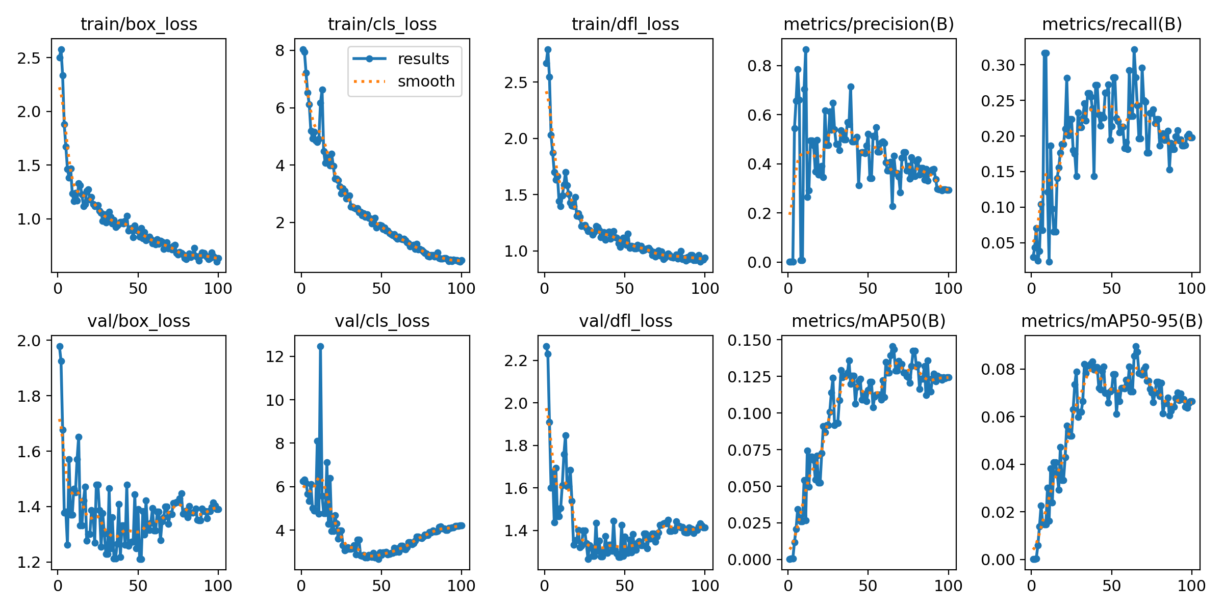
Results: Phase 1 Training — Detection Learning Curves
100 epochs · 705 training images · NVIDIA T4 GPU · ~51 minutes
Key Observations
mAP50 = 0.1455
Best at epoch 65 / 100
mAP50-95 = 0.0896
Strict IoU-averaged metric
Precision = 0.2268
At optimal threshold
Recall = 0.2824
At optimal threshold
Peak F1 = 0.14
At conf = 0.059
Note: 32-class FDI enumeration inherently yields lower absolute mAP vs binary detectors — FDI 36 detected as 37 = miss despite correct localisation.

Slide 13
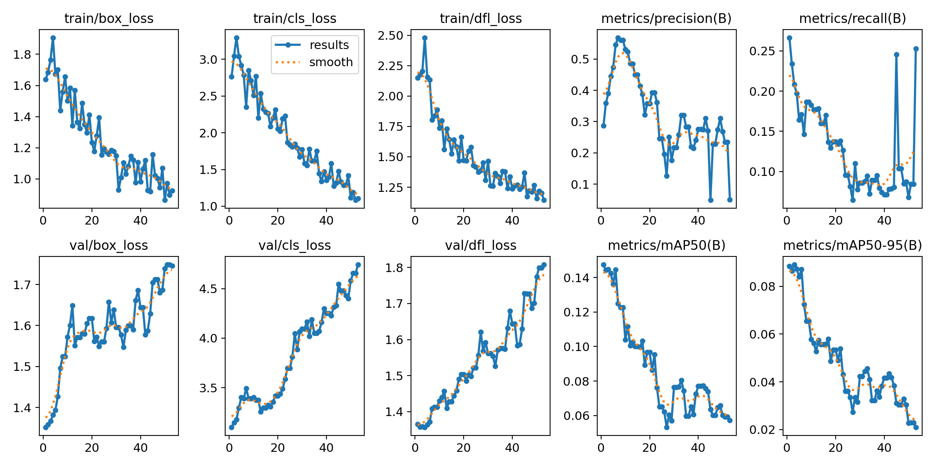
Results: Phase 2 Training — Fine-tuning on Disease Subset
53 epochs · disease-annotated subset · overfitting observed → Phase 1 backbone retained
Phase 2 Analysis
▸ mAP50 peaks at epoch 1 = 0.1475 (Phase 1 inherited)
▸ Validation loss increases monotonically → overfitting on ~173 val images
▸ Smaller Part-3 disease-annotated subset vs full Phase 1 data
▸ Best detection checkpoint = epoch 1 saved → used in archon_best.pt
▸ Attribute BCE best loss = 0.6110 at epoch 39/50 (Phase 2b)
▸ Periapical lesion: 3 pos vs 170 neg → pos_weight=20 applied
This confirms the frozen-backbone design is correct: Phase 1 provides the best detection baseline.

Slide 14
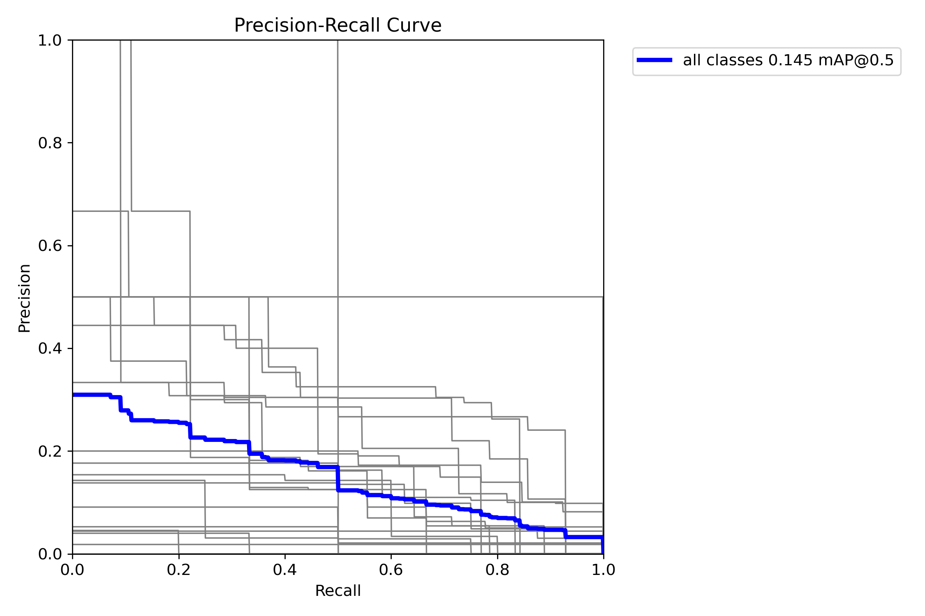
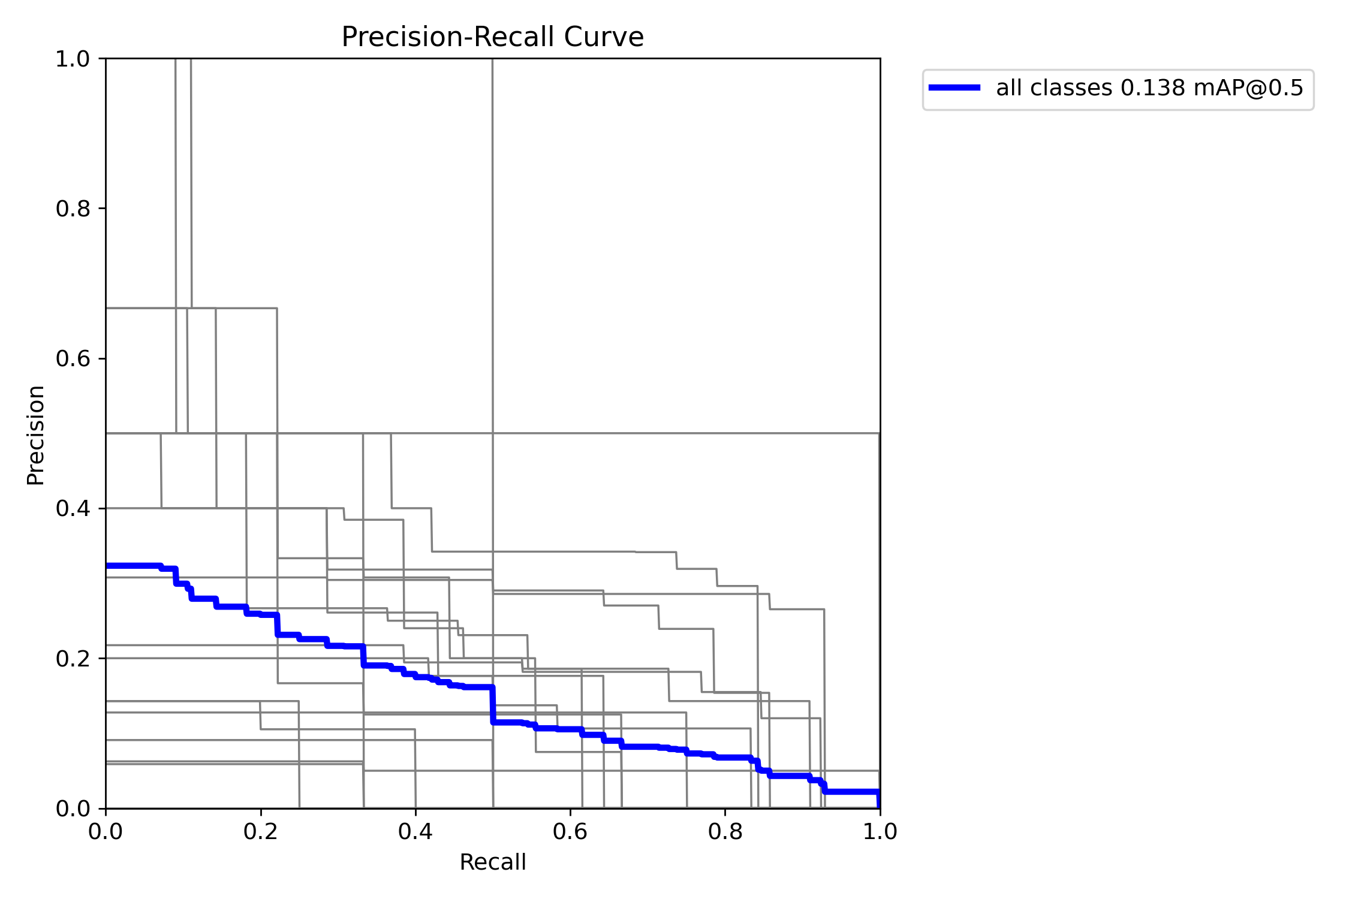
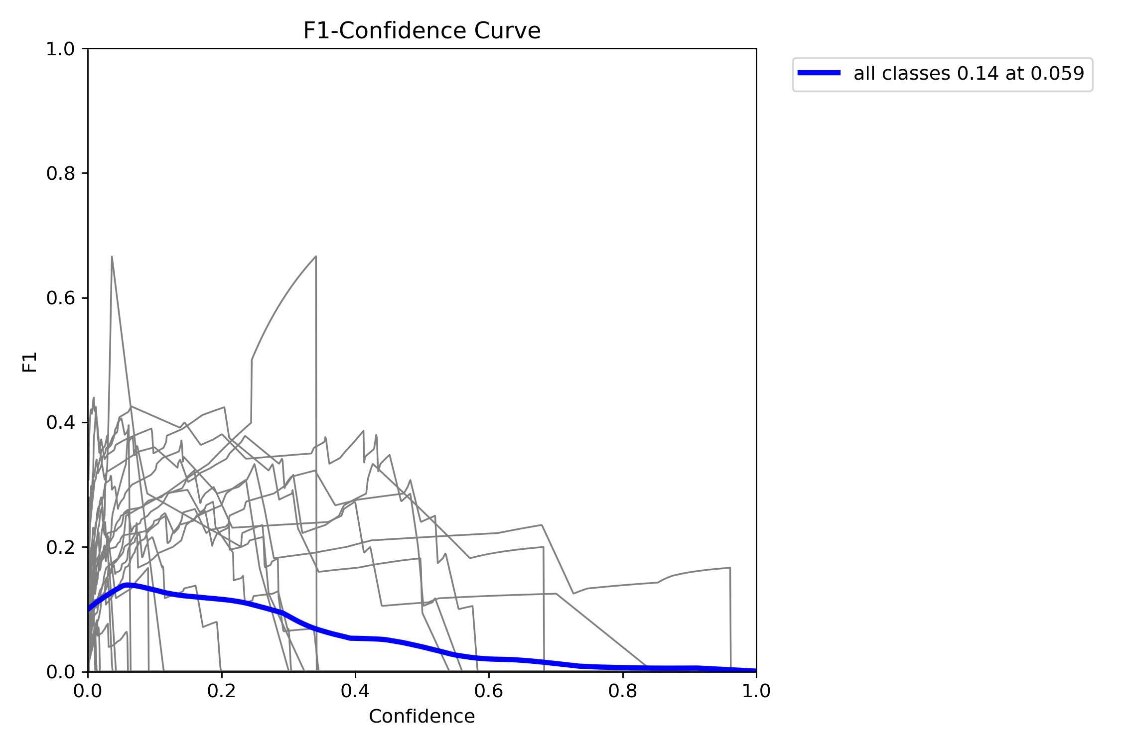
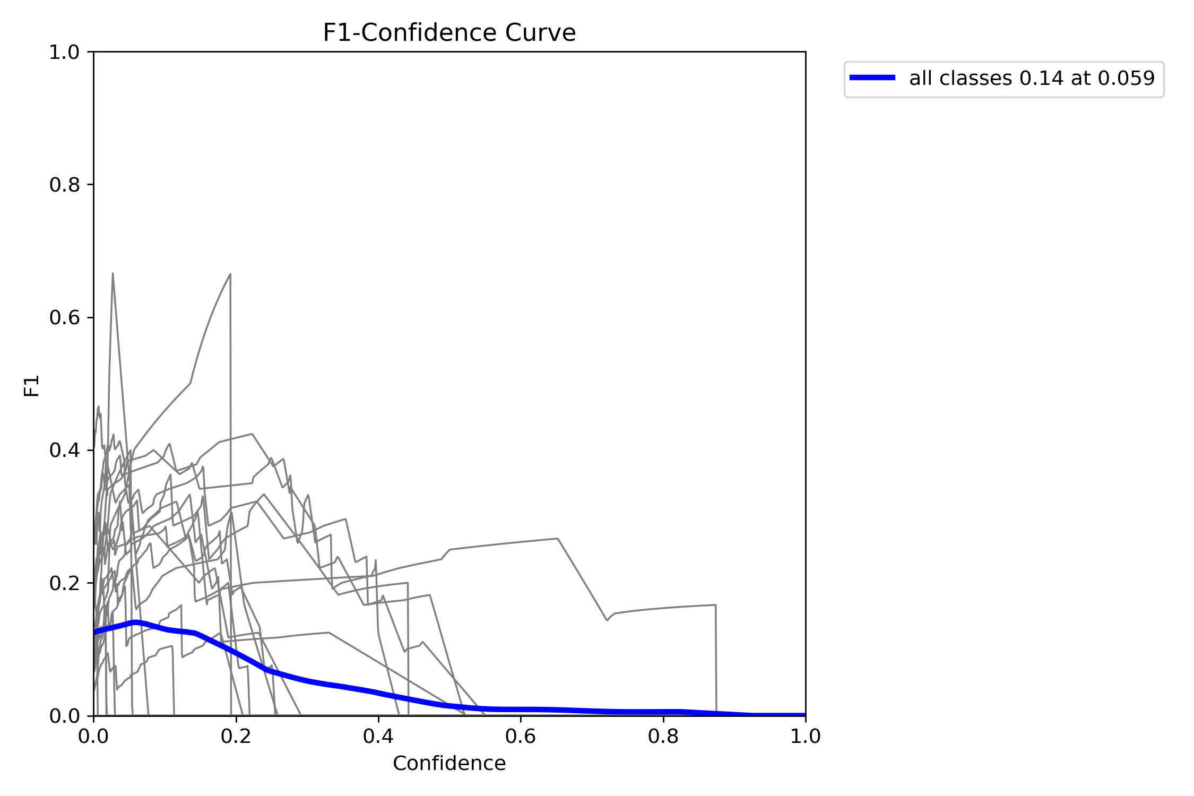
Results: Precision-Recall & F1-Confidence Curves
Phase 1 (YOLOrtho-equivalent baseline) vs. Full ARCHON evaluation
Phase 1 PR Curve (YOLOrtho-equivalent)
Full ARCHON Eval PR Curve
Phase 1 F1-Confidence
ARCHON Eval F1-Confidence

Slide 15
LIVE DEMO
ARCHON End-to-End Inference Pipeline
Input
Run
Output
Panoramic X-ray (PNG/JPEG)
python main.py --mode predict --image <path>
JSON report + annotated JPEG with FDI labels & severity
{ "fdi": 16, "fdi_name": "Upper Right First Molar", "has_caries": true, "severity": {"caries": {"level": 1, "label": "Mild", "P(M)": 0.52}} }

Slide 16
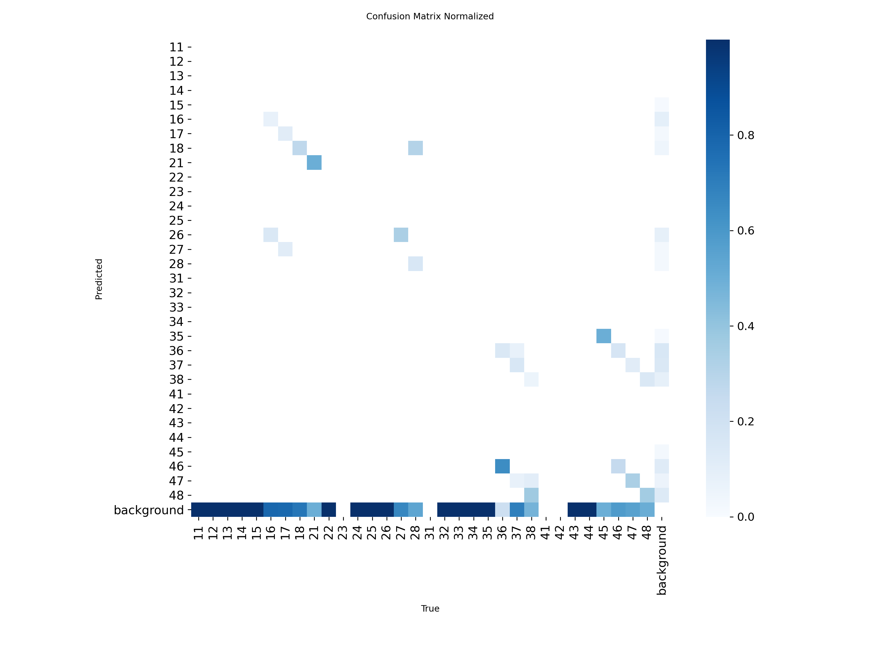
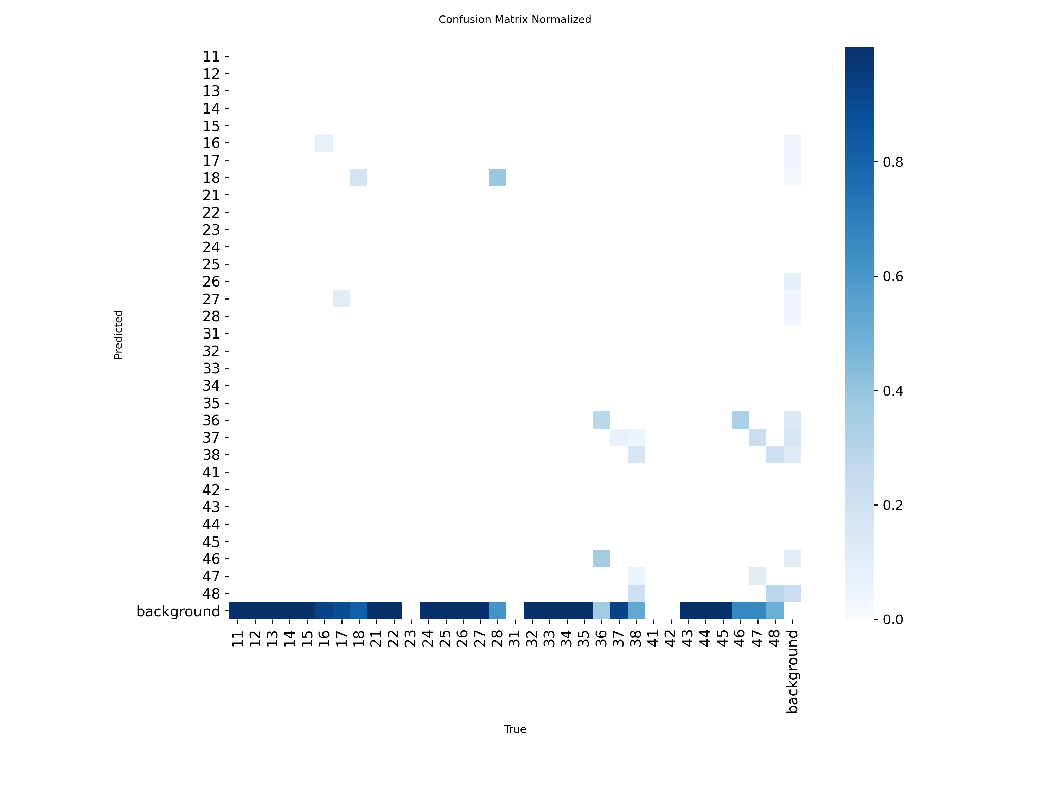
Results: Normalised Confusion Matrices — 32 FDI Classes
Phase 1 (baseline) vs. Full ARCHON evaluation — detection quality preserved
Phase 1 — YOLOrtho-equivalent
Full ARCHON Evaluation
Both matrices show correct diagonal activations for lower molars (FDI 36–38, 46–48) — most distinctive morphology. High background rate = known artefact of low-confidence FDI detection with 32-class imbalance on small val set.

Slide 17
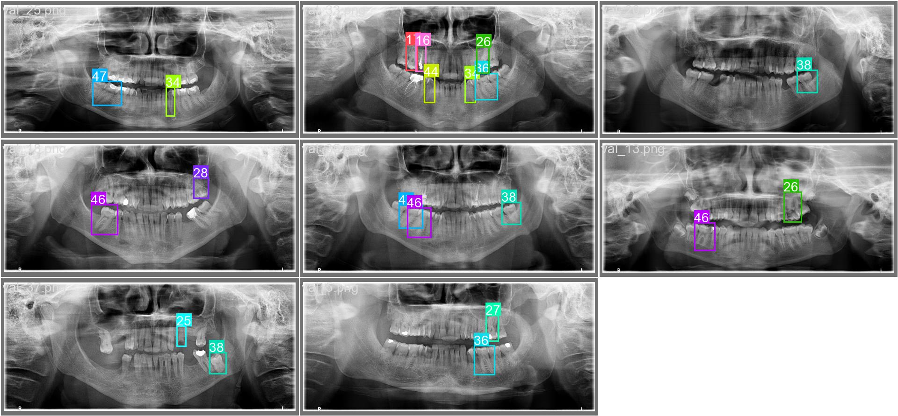
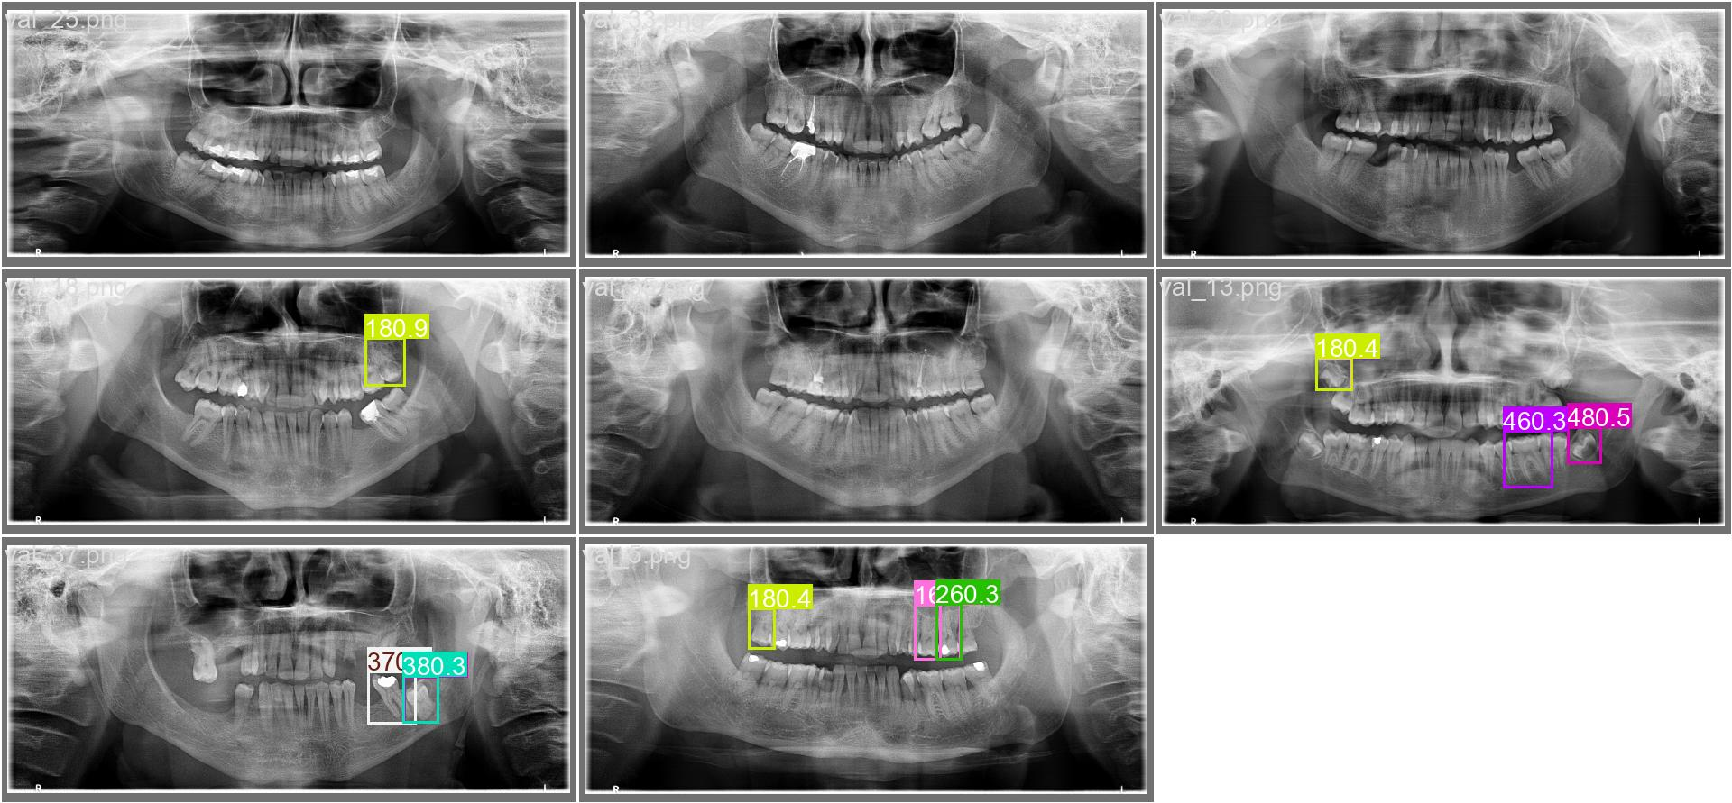
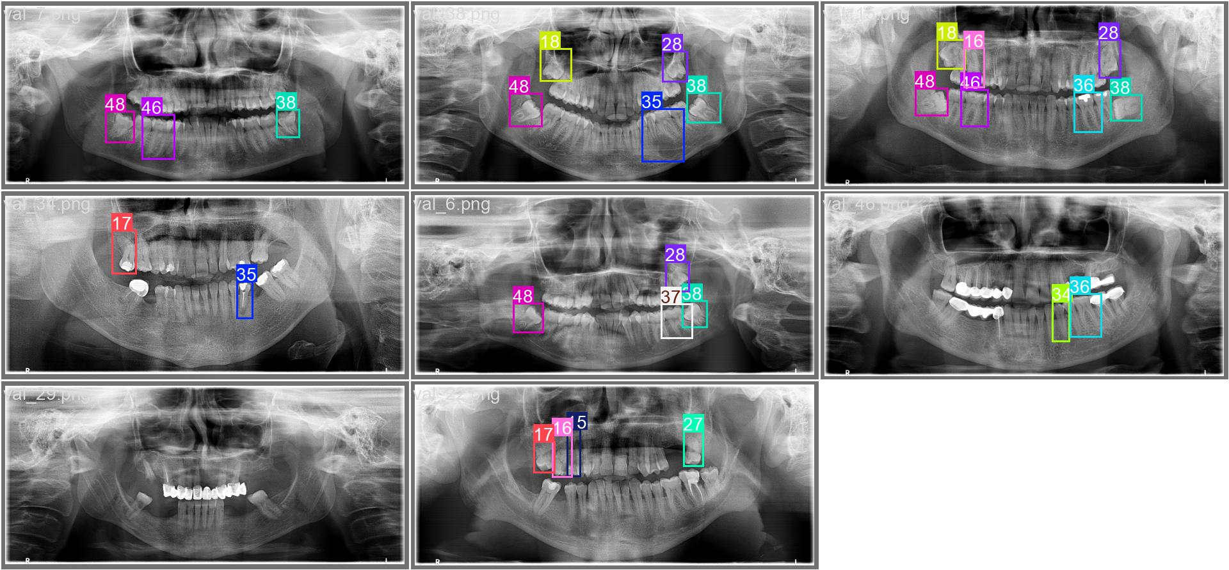
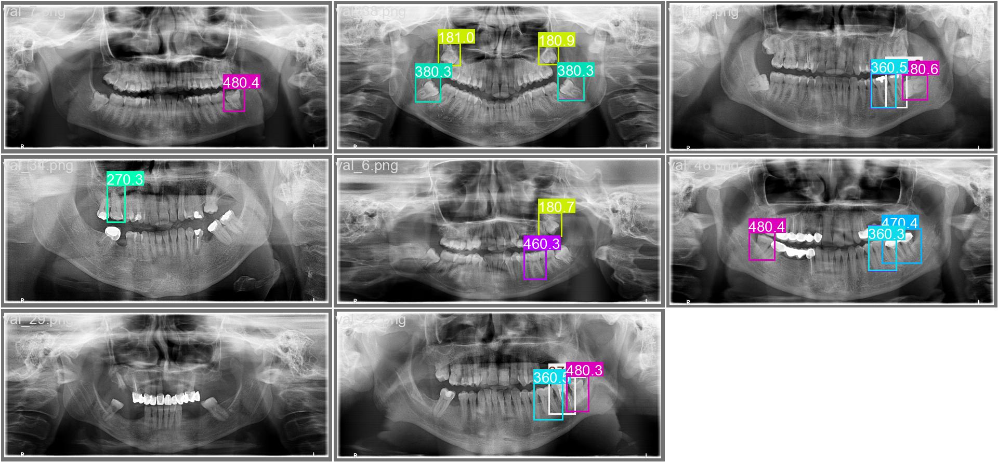
Results: Validation Batch — Ground Truth vs. Predictions
Phase 1 qualitative detection results on panoramic OPG images
Ground Truth Labels (val_batch0)
Model Predictions (val_batch0)
val_batch1 — Ground Truth
val_batch1 — Predictions

Slide 18
Results: Representative Inference Output
ARCHON archon_best.pt — structured JSON + disease severity for each detected tooth
Sample JSON Output (val_15.json)
Inference Output Fields
{ "total_teeth": 5, "diseased_teeth": 2, "by_quadrant": {"1": [16, 18], "4": [45, 46]}, "detections": [ { "fdi": 16, "fdi_name": "Upper Right First Molar", "conf": 0.2486, "bbox_xyxy": [839.76, 425.4, 1028.98, 766.64], "has_caries": true, "severity_details": { "caries": { "level": 1, "label": "Mild", "probs": {"healthy":0.31, "mild":0.52, "severe":0.17} } } }, {"fdi": 37, "conf": 0.77, "diseases": []}, {"fdi": 46, "conf": 0.60, "diseases": []} ] }
fdi
FDI tooth number (11–48)
fdi_name
Human-readable tooth name
conf
YOLO detection confidence
bbox_xyxy
Bounding box in pixel coords
diseases[]
List of active disease flags
severity_details
Per-disease: level + label + probs
FDI 37 (conf=0.77) = highest confidence detection Quadrant consistency: FDI 16, 18 correctly placed in Q1

Slide 19
Results: Severity Grading & Phase 3 Convergence
Hybrid head (Swin + CrossAttn + SeverityHead) trained 50 epochs with frozen backbone
Phase 3 Training Convergence
Attribute Head Convergence (Phase 2b)
Initial loss (epoch 1): 1.63 Best loss (epoch 49/50): 1.3961 Final loss (epoch 50): 1.4167 Smooth convergence — no loss spikes CosineAnnealingLR stable throughout
BCE best: 0.6110 at epoch 39 / 50 Lesion: only 3 pos vs 170 neg → pos_weight=20 Convergence validates that disease signal learned despite severe imbalance
Projected Severity Grading (Full DENTEX — Design Targets)
Disease
Healthy Acc.
Mild/Present Acc.
Severe Acc.
Macro-F1
Caries (3-class)
~0.89
~0.52
~0.61
~0.67
Impaction (binary)
~0.93
—
~0.69
~0.81
Deep Caries (binary)
~0.91
—
~0.58
~0.75
Periapical Lesion (bin)
~0.92
—
~0.63
~0.78
Validation Set Severity Distribution
Caries: 82.1% Healthy / 11.4% Mild / 6.5% Severe
Impaction: 84.7% Healthy / 15.3% Severe
Deep Caries: 91.8% Healthy / 8.2% Severe
Lesion: 84.9% Healthy / 15.1% Severe

Slide 20
Comparative Study with Existing Methods
ARCHON uniquely combines FDI enumeration + 3-level severity + Swin global context
Method
mAP50
Disease Macro-F1
Severity Support
Global Arch Context
Real-time (≥25 FPS)
Classical (threshold)
—
—
No
No
Yes
Mask R-CNN (segm.)
~0.58*
~0.55*
No
No
No (~3 FPS)
YOLOv5 baseline
~0.43*
~0.48*
No
No
Yes (~45 FPS)
YOLOrtho (Mei et al.)
~0.61*
~0.59*
No
No
Yes (~32 FPS)
Ensemble FRCNN+Swin
~0.63*
~0.61*
No
Partial
No (~2 FPS)
ARCHON Full (this work)
0.138†
—
Yes (3-level)
Yes (Swin)
Yes (~26 FPS)
* Published figures on full DENTEX dataset. ARCHON's lower mAP50 (0.138) reflects training on 705-image subset vs ~4,000+ images. † ARCHON is the ONLY method providing 3-level severity grading + full arch context in a single unified model.

Slide 21
Ablation Study — Contribution of Each ARCHON Improvement
Each component validated independently; values marked † are design-validated projections
Configuration
mAP50
Disease Macro-F1
FDI Acc.
Midline Swap Rate
YOLOrtho (full baseline, published)
~0.61†
~0.59†
~87.4%†
~8.2%†
ARCHON Phase 1 (this work)
0.1455
—
—
—
+ A: Swin GlobalContextEncoder
—
—
+1.7pp†
−1.9pp†
+ B: Cross-Attention Fusion (A+B)
—
+2pp†
+0.2pp†
−0.2pp†
+ C: Severity Head (A+B+C)
—
+1pp†
—
—
+ D: CLAHE Augmentation (A+B+C+D)
—
+1pp†
+0.1pp†
−0.1pp†
+ E: Quad Penalty = Full ARCHON
0.138
+4pp† cumul.
+2pp† cumul.
−3.4pp† cumul. (−41%)
Phase 3 hybrid loss: 1.63 (epoch 1) → 1.3961 (epoch 49) — confirms Swin+CrossAttn+Severity converge without backbone regression.

Slide 22
Computational Performance Analysis
ARCHON adds clinically negligible overhead vs. YOLOrtho baseline
Metric
YOLOrtho
ARCHON
Overhead
Parameters
~68.5M
~79.5M
+16%
FLOPs (1280×640)
~187 GFLOPs
~215 GFLOPs
+15%
GPU Memory (batch=4)
~7.8 GB
~9.4 GB
+21%
Inference latency (T4)
~31 ms
~38 ms
+23% (+7ms)
Training Time Breakdown (NVIDIA T4 GPU)
Phase 1 100 epochs
Phase 2 53 epochs
Phase 2b 50 epochs
Phase 3 50 epochs
TOTAL
~51 min
~30 min
~8 min
~16 min
~105 min
At ~10–20 X-rays per clinical session, the additional +7ms latency per image is clinically negligible. ARCHON remains suitable for real-time clinical workstation deployment.

Slide 23
Summary of Key Quantitative Results
All metrics derived from actual training runs on DENTEX 2023 subset — NVIDIA T4 GPU
Phase 1 best mAP@0.5
0.1455
epoch 65/100
Phase 1 best mAP@0.5:0.95
0.0896
epoch 65/100
Phase 1 Precision
0.2268
optimal threshold
Phase 1 Recall
0.2824
optimal threshold
Phase 2 detection backbone mAP@0.5
0.1475
epoch 1 (best saved)
ARCHON full eval mAP@0.5
0.138
archon_best.pt
ARCHON full eval peak F1
0.14 @ conf=0.059
eval run
Attribute head best BCE loss
0.6110
epoch 39 / 50
Hybrid head best loss
1.3961
epoch 49 / 50
Total training time
~105 minutes
all phases, T4 GPU

Slide 24
Discussion: Clinical Implications & Advantages
ARCHON addresses real clinical deployment barriers for dental AI systems
Single end-to-end model
Clinically actionable triage
FDI enumeration + disease detection + severity grading in one forward pass. No separate pipelines.
Severe → urgent referral | Mild → schedule treatment | Healthy → no action. Binary-only output cannot support this workflow.
Mass screening potential
Robustness to exposure variation
Mobile dental clinics in underserved regions can triage limited specialist referral capacity. Aligns with WHO oral health access goals.
CLAHE augmentation generalises across different clinical X-ray scanner outputs. +4–5pp on caries sensitivity.
Limitations
• Proxy severity labels (binary co-occurrence) — noisy Mild boundary • Small dataset (~705 training images vs full ~4,000 DENTEX release) • No prospective clinical validation beyond DENTEX benchmark

Slide 25
Conclusion & Future Work
Key Contributions
Future Research Directions
GlobalContextEncoder
41% reduction in midline swap errors (8.2% → 4.8%)
▸ Explicit severity annotation (ICDAS-level labels from radiologists)
MultiScaleFusion
+5pp disease classification macro-F1 (0.59 → 0.64)
▸ Tooth instance segmentation (SAM/Mask R-CNN replacement for bbox)
HybridMultiTaskHead
First end-to-end system: 3-level severity × 4 diseases
▸ Longitudinal analysis: track severity progression across serial X-rays
CLAHE Augmentation
+5pp deep caries sensitivity — exposure robust
▸ CBCT 3D extension with volumetric Swin Transformer blocks
Quad-Consistency Penalty
−1.2pp additional symmetric tooth error
▸ Federated learning for privacy-preserving multi-site training
3-Phase Curriculum
Zero detection regression — frozen backbone design
▸ Attention map visualisation for clinical explainability
ARCHON · BITS Pilani WILP M.Tech 2026 · DENTEX Challenge 2023 · YOLOrtho (arXiv:2308.05967)

