Slide 1
Predicting Diabetic Status using Logistic Regression
Project Group 6
Shubham Patil
SM Mazharul Islam
Prajakta Waikar

Slide 2
Project Overview
Problem Statement
To predict whether the patients in the dataset have diabetes or not.
Dataset
Pima Indians Diabetes Database [link].
Used Technique
Logistic Regression.

Slide 3
Research Motivation
Effects of Diabetes in general
Diabetes is a condition in which the body can't make enough insulin or can't use insulin normally.
There are three types of diabetics.
The number of people with diabetes rose from 108 million in 1980 to 422 million in 2014. [WHO]
Effect of Diabetes on underprivileged/minority people [FDA]
According to the National Health Interview Survey by the Centers for Disease Control and Prevention and the U.S. Census Bureau:
14.7% of American Indians/Alaska natives
12.5% of Hispanics
11.7% of non-Hispanic blacks
9.2% of Asian Americans
7.5% of non-Hispanic whites 18 and older
Effects of Diabetes on Female [CDC]
Diabetes increases the risk of heart disease (the most common diabetes complication) by about four times in women but only about two times in men, and women have worse outcomes after a heart attack.
Women are also at higher risk of other diabetes-related complications such as blindness, kidney disease, and depression

Slide 4
Dataset
Source and Specifics
Our data set is collected from "National Institute of Diabetes and Digestive and Kidney Diseases". It contains diabetic data for a female members of specific ethnic group, of at least 21 years old.
Dataset features
Skin Thickness – There has been found widespread connective tissue changes in diabetes mellitus. [American Diabetes Association]
Diabetes during Pregnancy - Nearly 10 percent of pregnancies in the U.S. are affected by gestational diabetes every year. [CDC]
High Blood Pressure - 50% of people with high blood pressure had an increased risk of developing type 2 diabetes mellitus. [NHS]
Glucose - High blood sugar can cause problems all over the body. It can damage blood vessels and nerves. It can harm the eyes, kidneys, and heart. In early pregnancy, high blood sugar can lead to birth defects in a growing baby. [link]
Pregnancy - diabetic symptoms appear during pregnancy in a woman who has not been diagnosed with diabetes before. It happens in about 3 in 100 to 9 in 100 pregnant women [link].
Insulin - Patients with diabetes mellitus cannot produce enough insulin. Hence, they experience high blood glucose levels. [Canadian Insulin]
Age - Over time, the effects of diabetes can become much more complicated. The disease can lead to serious, even life-threatening problems from your head to your toes. [Hopkins]
BMI - Lifetime diabetes risk at 18 years of age increased from 7.6 to 70.3% between underweight and very obese men and from 12.2 to 74.4% for women. The lifetime risk difference was lower at older ages. At 65 years of age, compared with normal-weight male subjects, lifetime risk differences (percent) increased from 3.7 to 23.9 percentage points between overweight and very obese men and from 8.7 to 26.7 percentage points for women. The impact of BMI on diabetes duration also decreased with age. [link]
Diabetics Pedigree Function - It is a function which scores likelihood of diabetes based on family history.

Slide 5
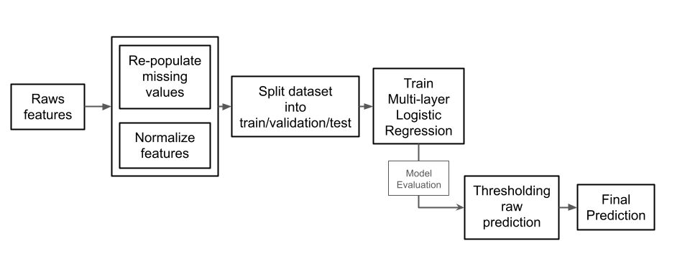
Proposed Method

Slide 6
Data Preprocessing & Visualization
Remove missing values
We fill the missing values with median values associated with the same outcome group.
Scaling
The given features are in different range which might make them difficult to compare.
We provide the option to rescaled them from -1 to 1.
Data set Visualization
We use a five points (minimum, 1st quartile, median, 3rd quartile, maximum) box-plot as the mean to visualize our data.

Slide 7
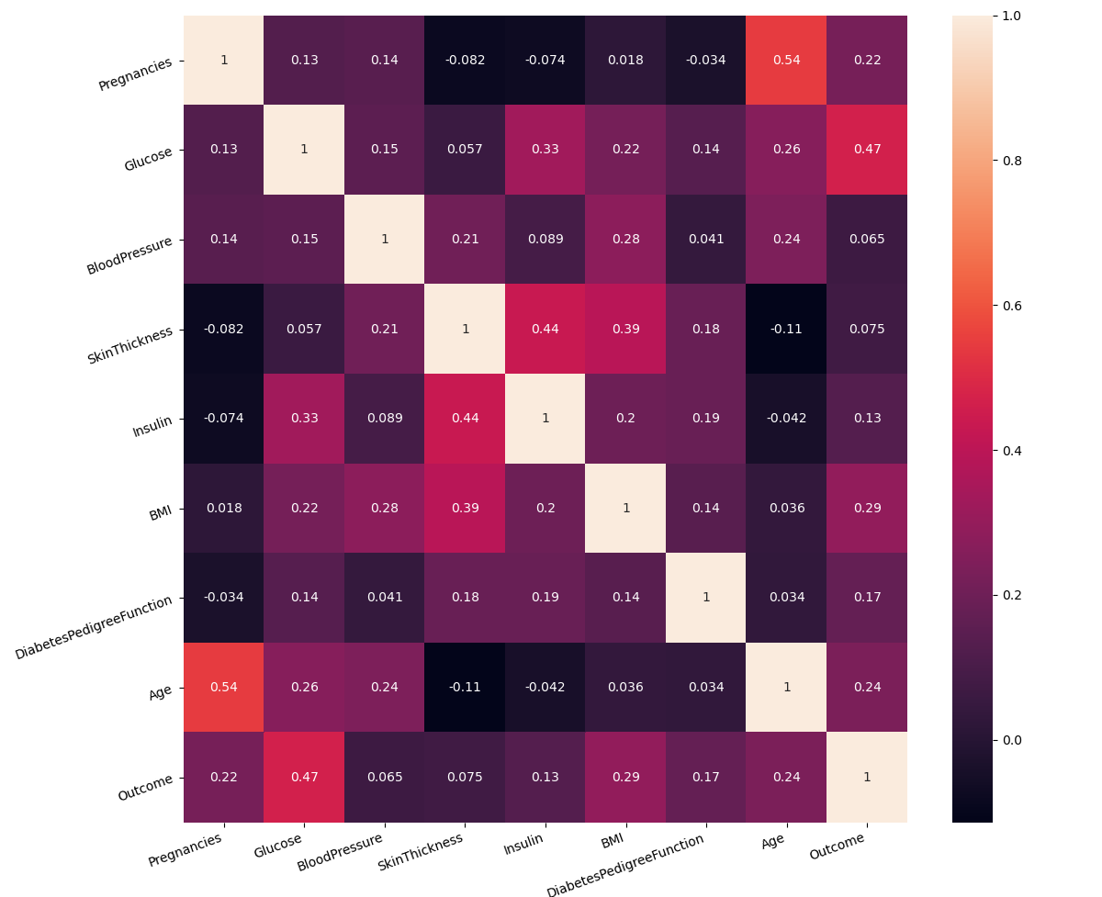
Correlation Among the Raw Features

Slide 8
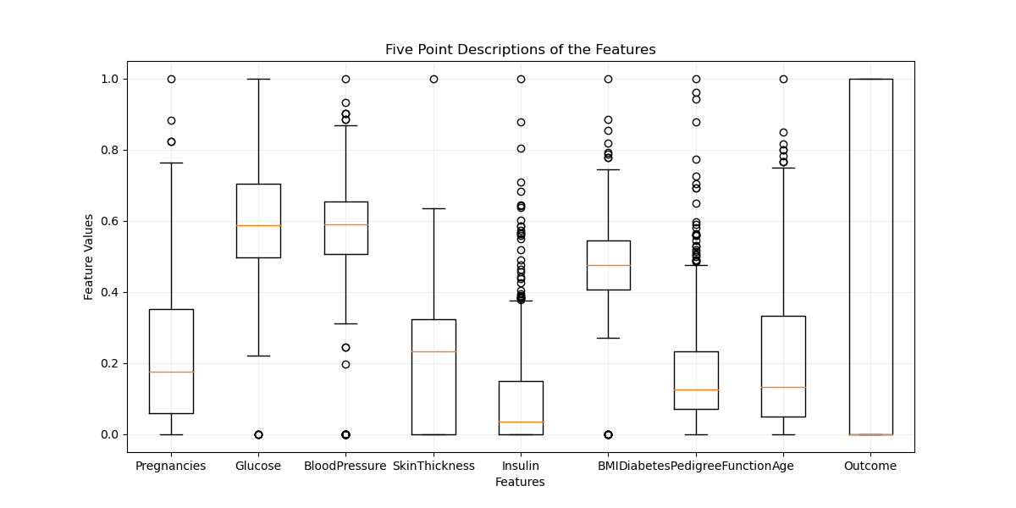
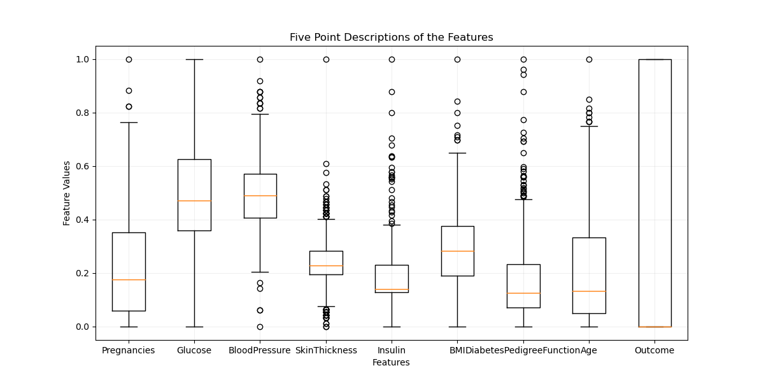
Effect of removing missing values
Before re-filling values
After re-filling values

Slide 9
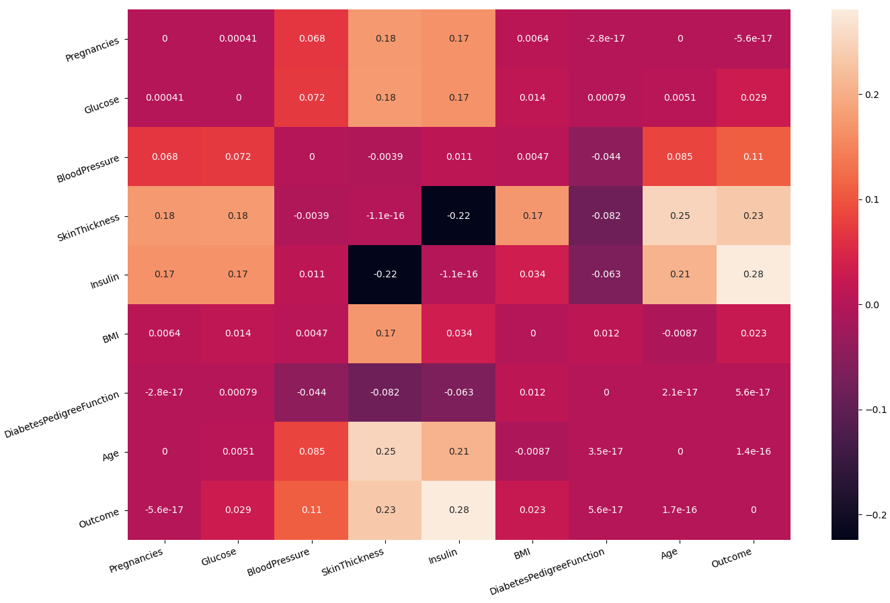
Effect of removing missing values

Slide 10
Logistic Regression Model
Layer | Weight Matrix Dimension | Comment
Input | 1x8 | Linear activation
1st hidden layer | 8x20 | Followed by Batch-Normalization, ReLu activation and 10% drop out
2nd hidden layer | 20x10 | Followed by Batch-Normalization, ReLu activation and 10% drop out
Output layer | 10x1 | Followed by sigmoid activation

Slide 11
Experimental Results
Configuration # | Details | Accuracy on Test split
01 | Features are Not-Scaled and missing values Not-Filled | 0.762
02 | Features are Scaled and missing values Not-Filled | 0.771
03 | Features are Not-Scaled and missing values Filled | 0.887
04 | Features are Scaled and missing values Filled | 0.861

Slide 12
Implementation
We used python to implement our model
Numpy
Padas
Keras
Scikit-learn
Matplotlib
Seaborn
Source code
Git repository link

Slide 13
Future Improvements
We have only 768 data points, more data points can help us to make a more robust model.
Feature engineering to create more effective features can improve the model accuracy.

Slide 14
Conclusion
Based on the experimental studies it shows that a simple logistic regression can achieve up to 88.7% accuracy.
Preprocessing the dataset can have a huge impact on the model performance.

Slide 15
Thank you!

