Slide 1
USE CASE for Agile

Slide 2
Use Case Name: Place Order
Actors:
Shopper
Fulfillment System
Billing System
Use Case Description:
After the user has selected items to purchase and then order the items, the user will provide payment and shipping information. The system will respond with confirmation of the order and a tracking number that the user can use to check on order status in the future. The system will also provide the user with an estimated delivery date for the order, which will include all selected items. The user may already have an account with the company with billing and shipping information.

Slide 3
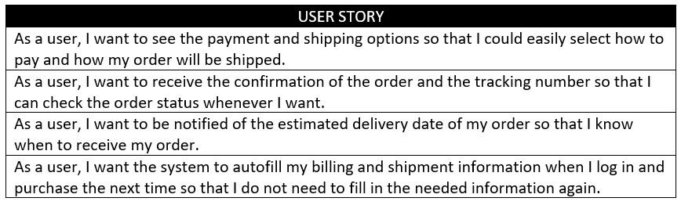
Product Backlog Creation

Slide 4
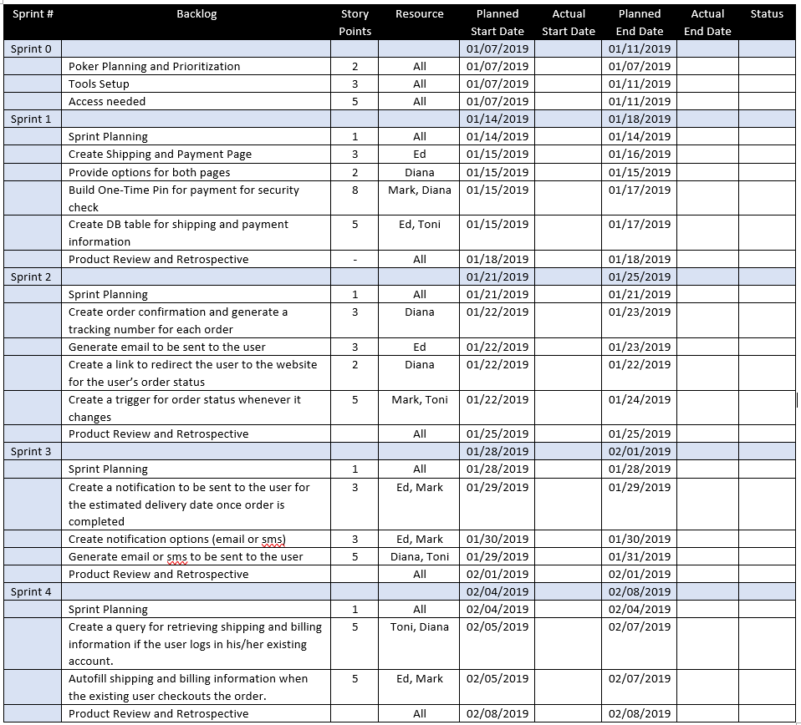
Sprint Planning and Sprint Backlog Creation

Slide 5
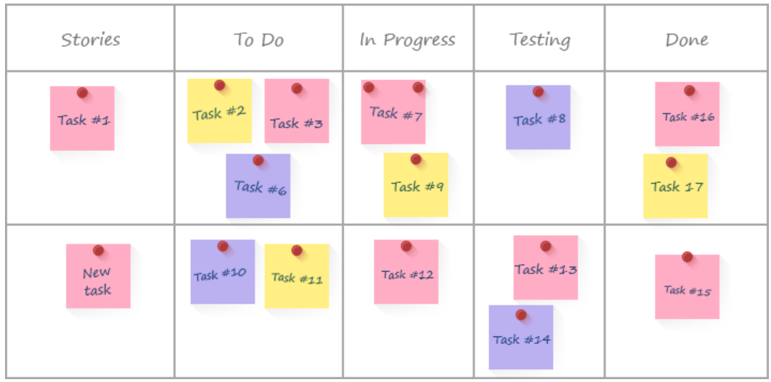
Working on the sprint and scrum meetings

Slide 6
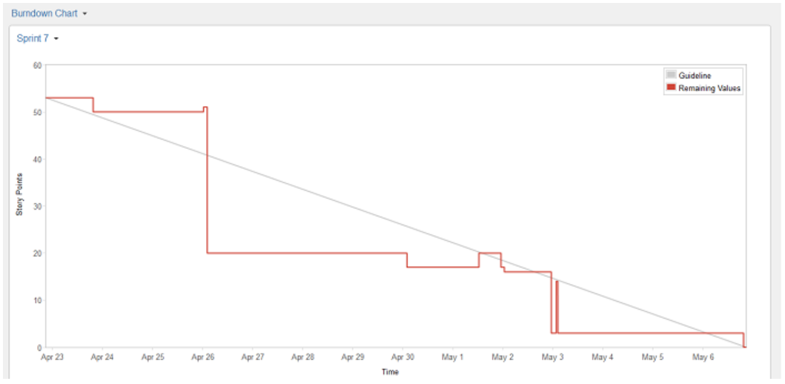
Burndown chart

