Slide 1

Project Title - Seasonal Agriculture Performance Analysis
[Student Name: S M Mohan Kumar
College Name- Kishkinda University ]
AICTE STU ID : STU6a1b027fe6df41780155007

Slide 2

PROBLEM STATEMENT
Agricultural performance varies across seasons due to differences in environmental conditions, farming practices, resource availability, and market conditions.
This project analyzes agricultural data to identify seasonal patterns, trends, relationships, and variations in crop productivity, resource usage, economic performance, and agricultural risk.

Slide 3
Project Description
Seasonal Agriculture Performance Analysis is a data analytics project that examines agricultural performance across Kharif, Rabi, and Zaid seasons.
The dataset contains information about:
Crop and farm details
Environmental conditions
Soil characteristics
Irrigation and resource usage
Crop yield and production
Revenue, cost and profit
Water efficiency
Disease and pest risk
Python, Pandas, Matplotlib and Seaborn were used for data cleaning, analysis and visualization.
The project brief describes the dataset as covering farming practices, environmental conditions, crop production, resource usage and economic performance.

Slide 4

WHO ARE THE END USERS?
WHO ARE THE END USERS?
👨‍🌾 Farmers
🌾 Agricultural planners
🏛️ Government agricultural departments
📊 Agricultural analysts
💧 Irrigation/resource management teams
🌱 Crop management organizations
🎓 Researchers and students

Slide 5

Technology Used
Technology Used
Python
Google Colab
Pandas – Data manipulation
NumPy – Numerical operations
Matplotlib – Data visualization
Seaborn – Statistical visualization
SciPy – Statistical analysis
Jupyter Notebook – Project documentation
GitHub – Project repository

Slide 6
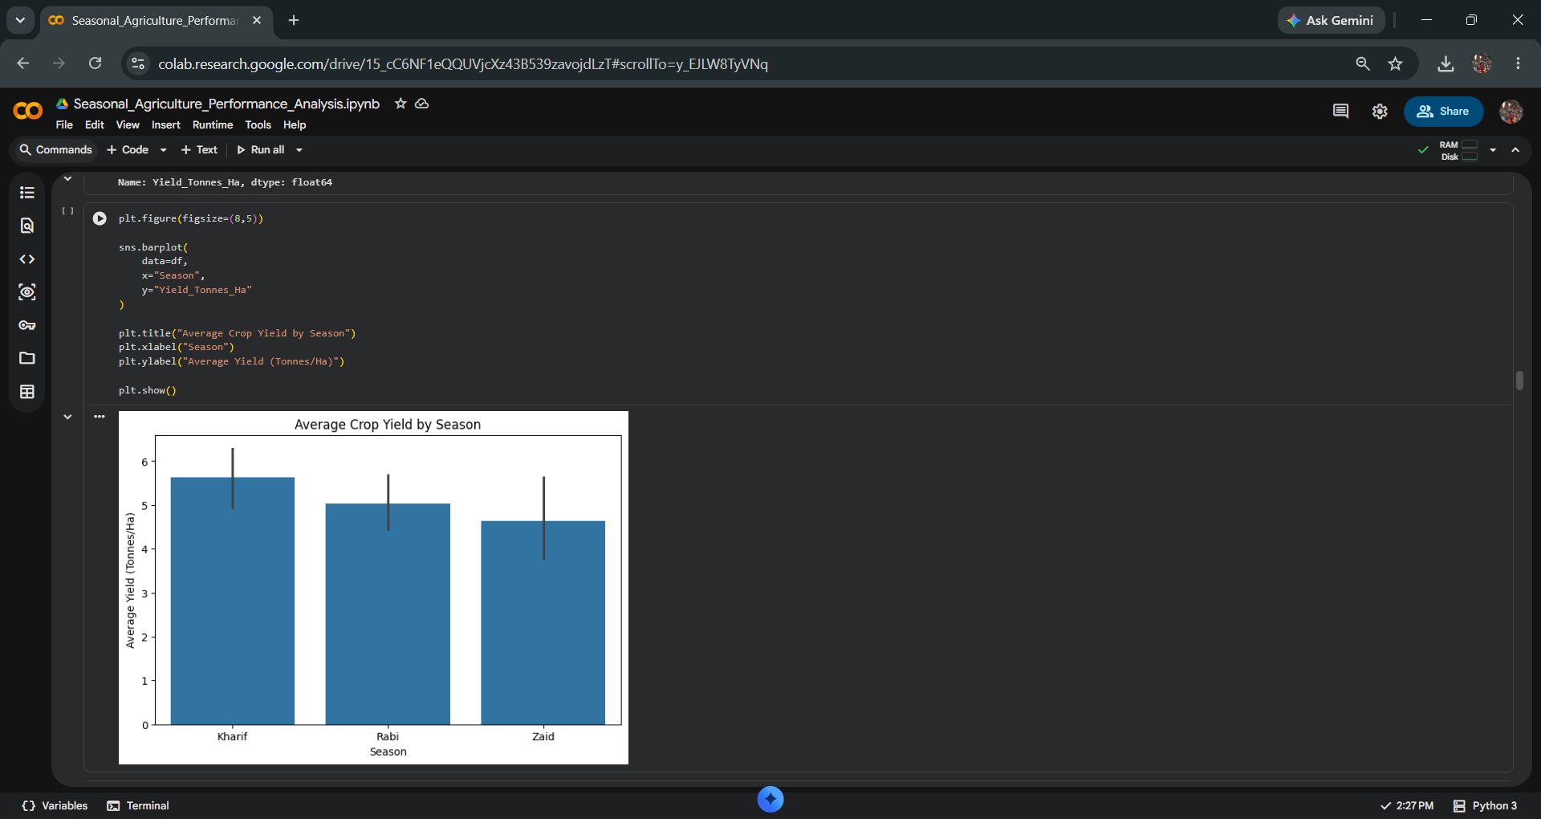
RESULTS

Slide 7
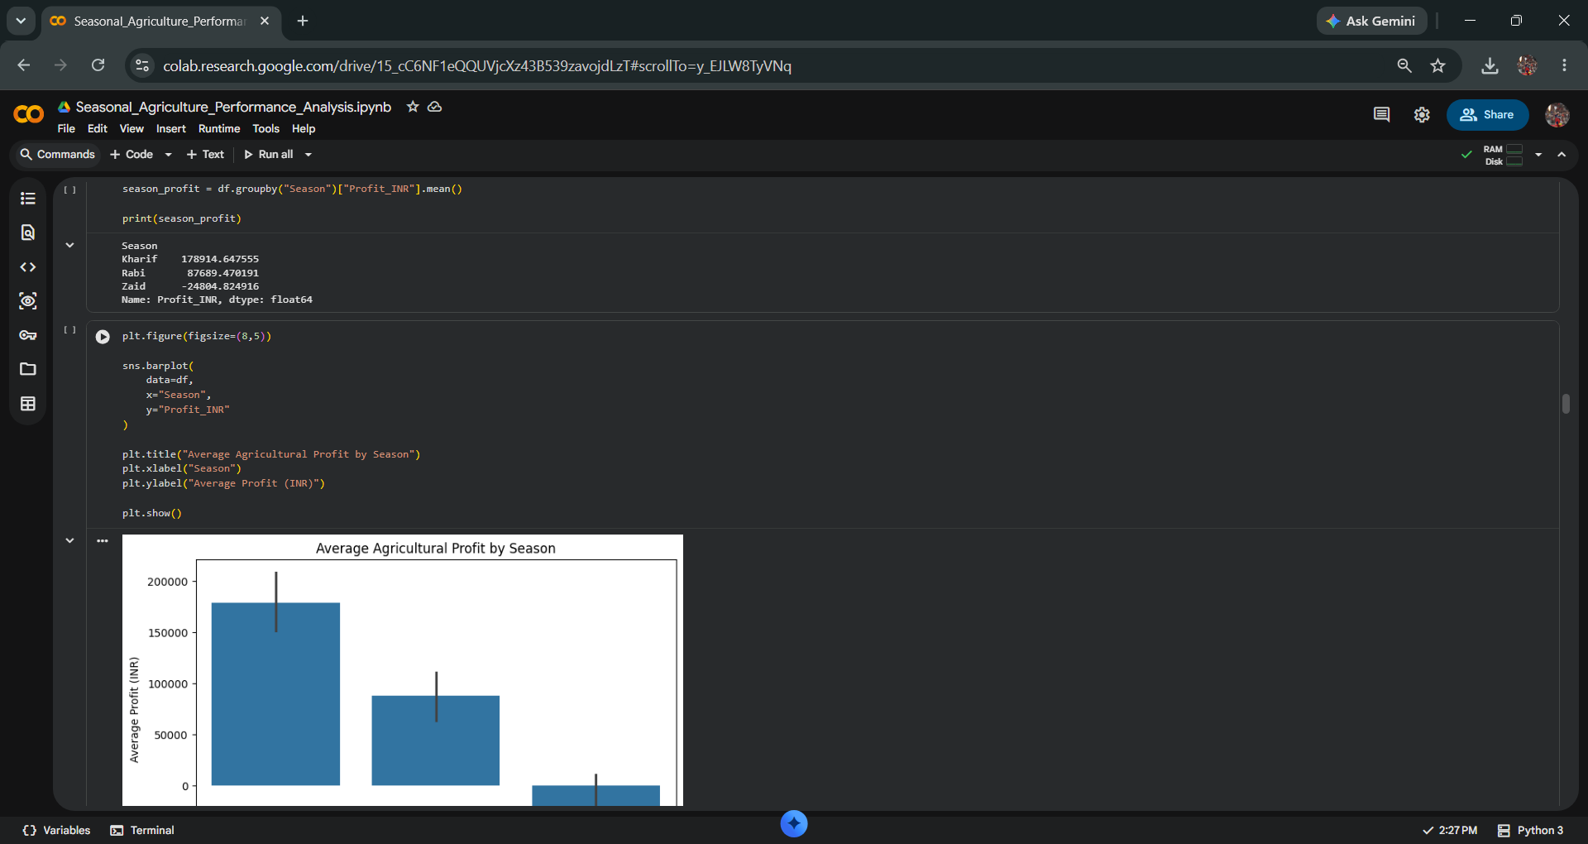
RESULTS

Slide 8
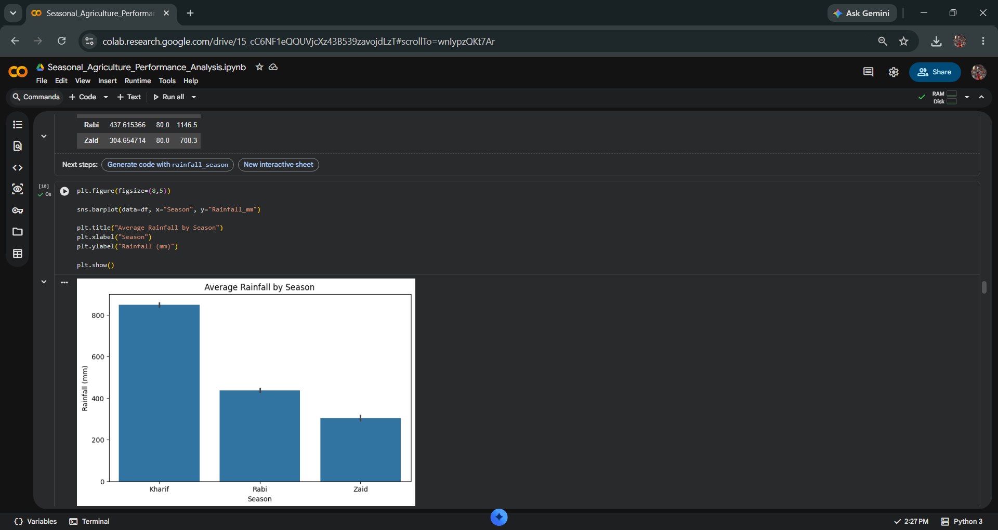
RESULTS
[Add screen shots of your code ]

Slide 9
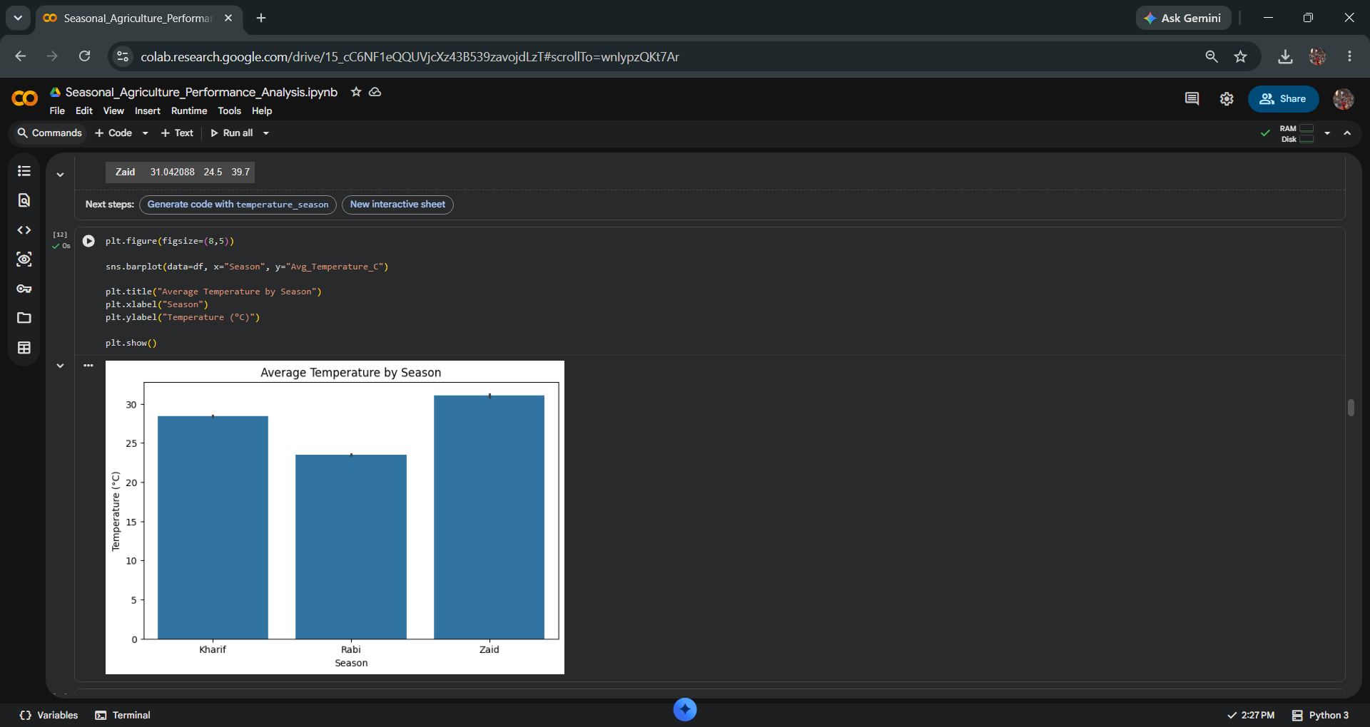
RESULTS
[Add screen shots of your code ]

Slide 10
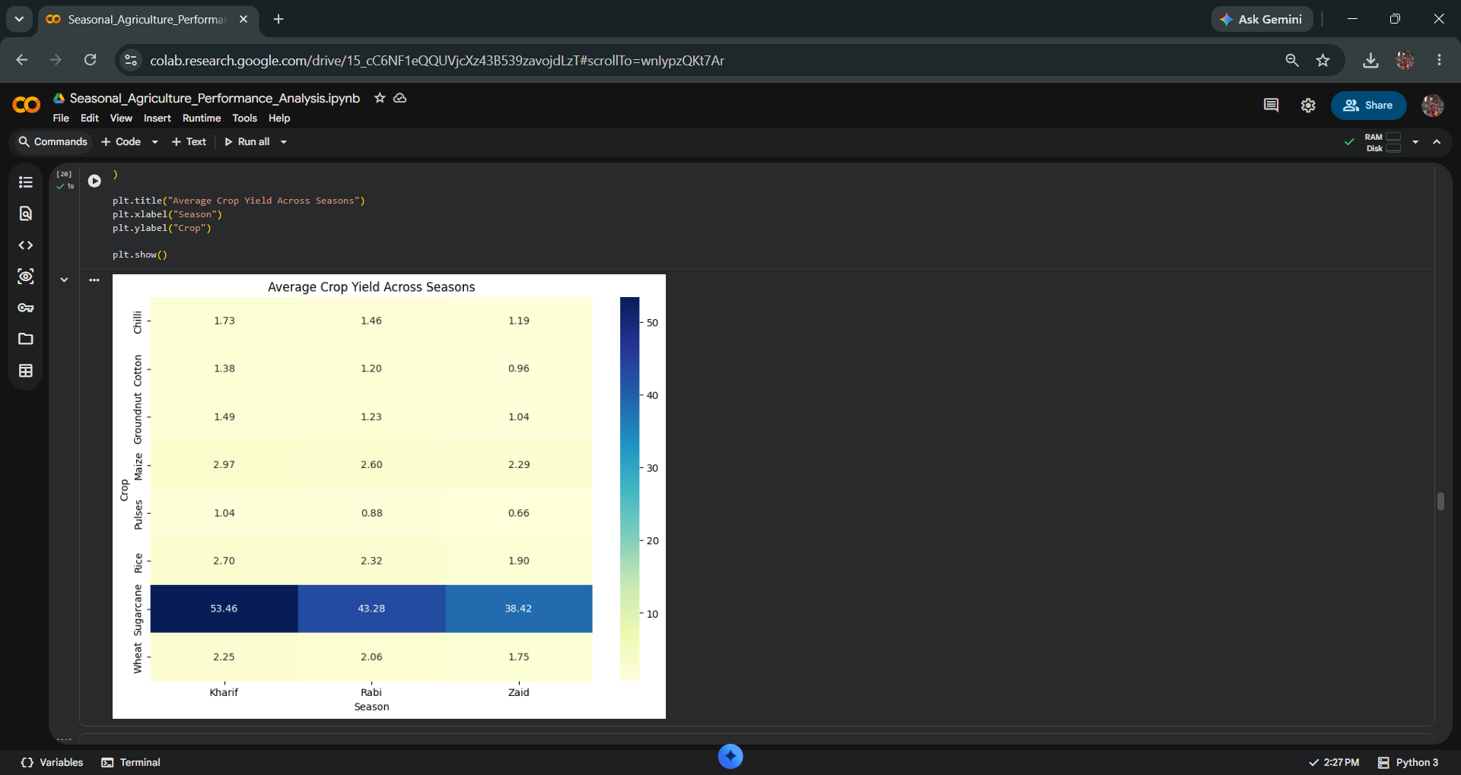
RESULTS
[Add screen shots of your code ]

Slide 11
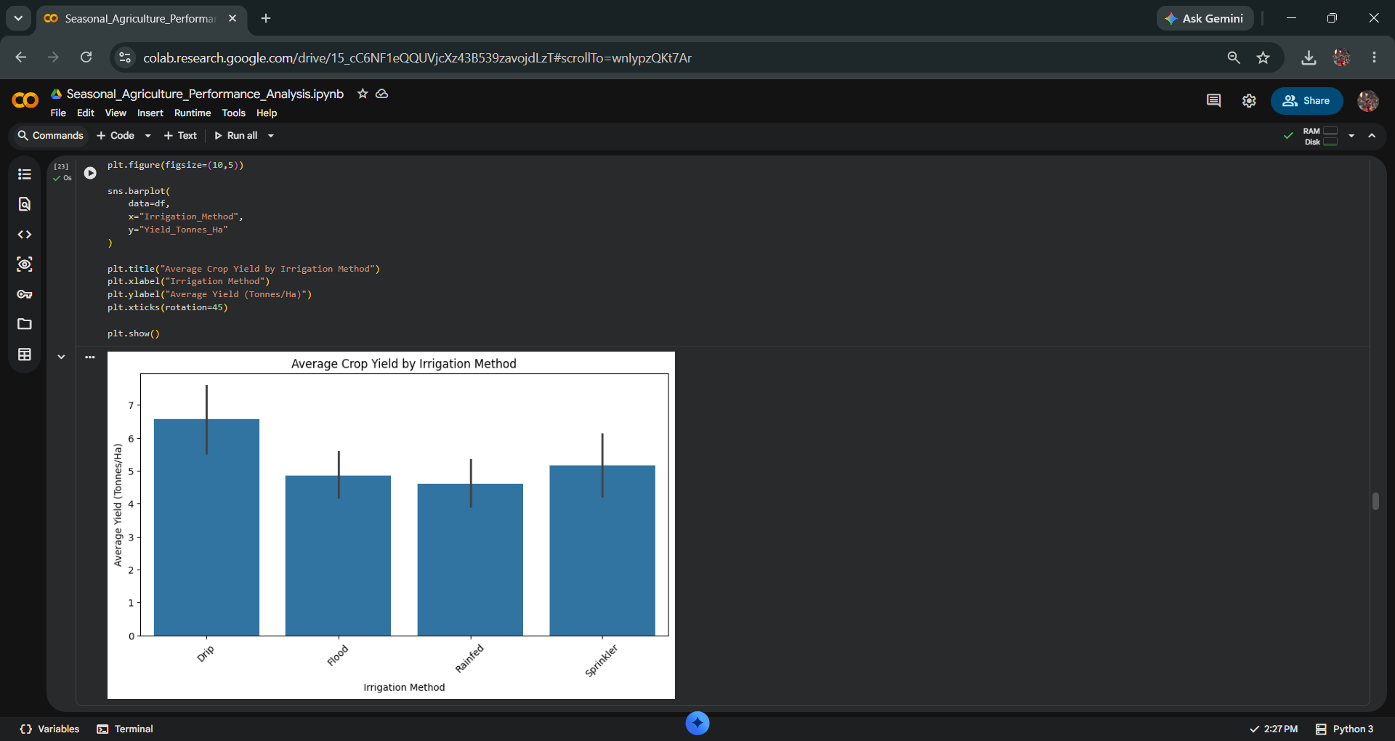
RESULTS
[Add screen shots of your code ]

Slide 12
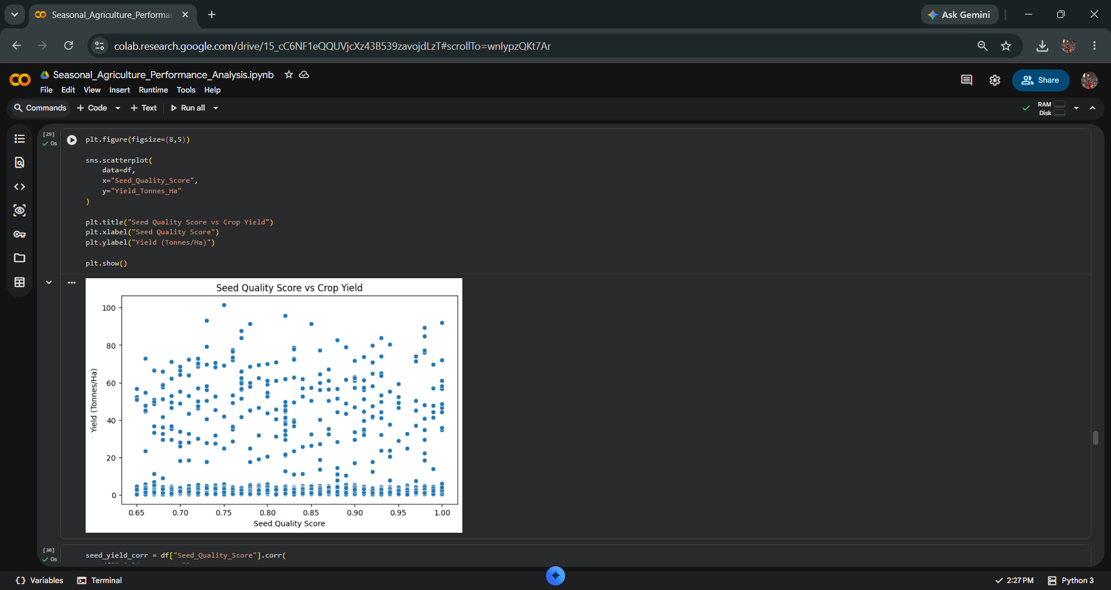
RESULTS
[Add screen shots of your code ]

Slide 13
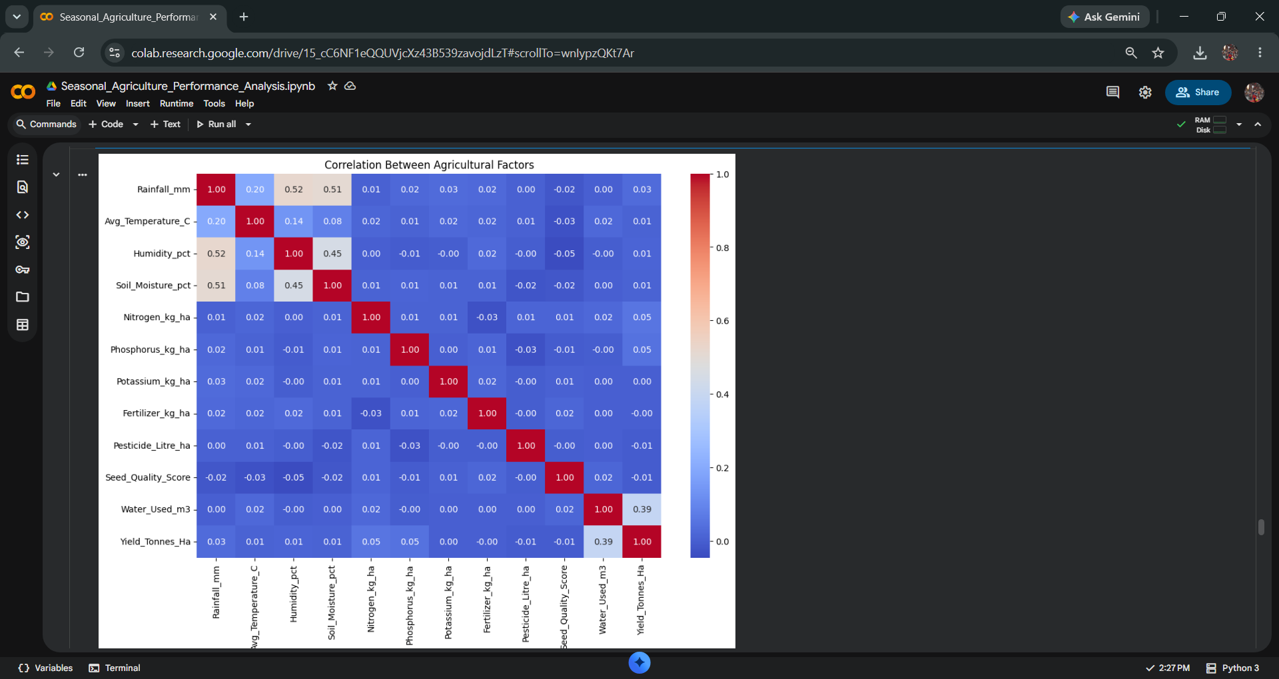
RESULTS
[Add screen shots of your code ]

Slide 14
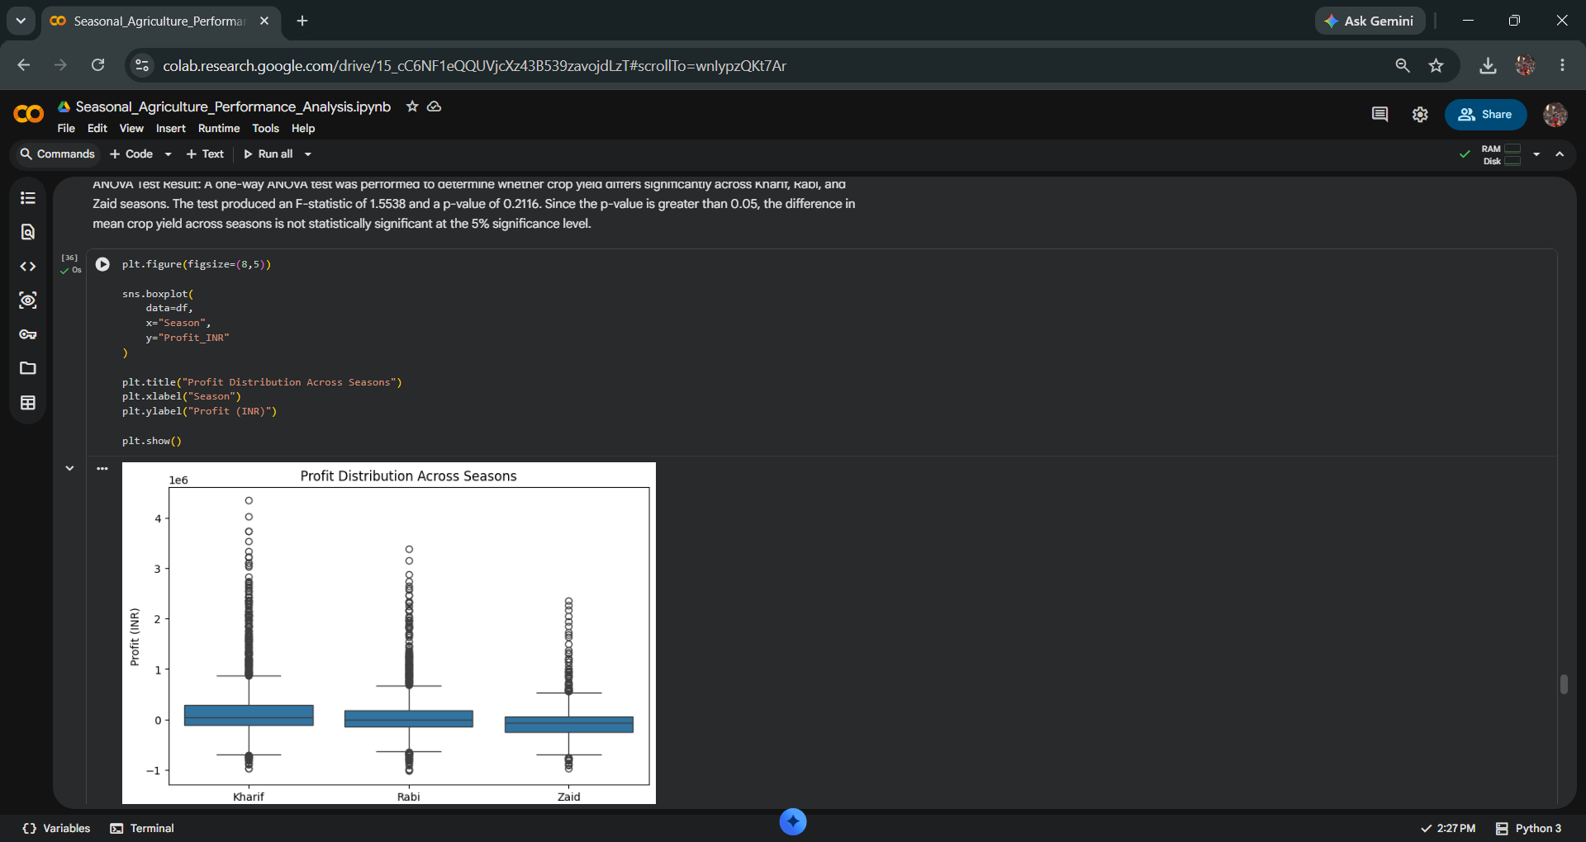
RESULTS
[Add screen shots of your code ]

Slide 15
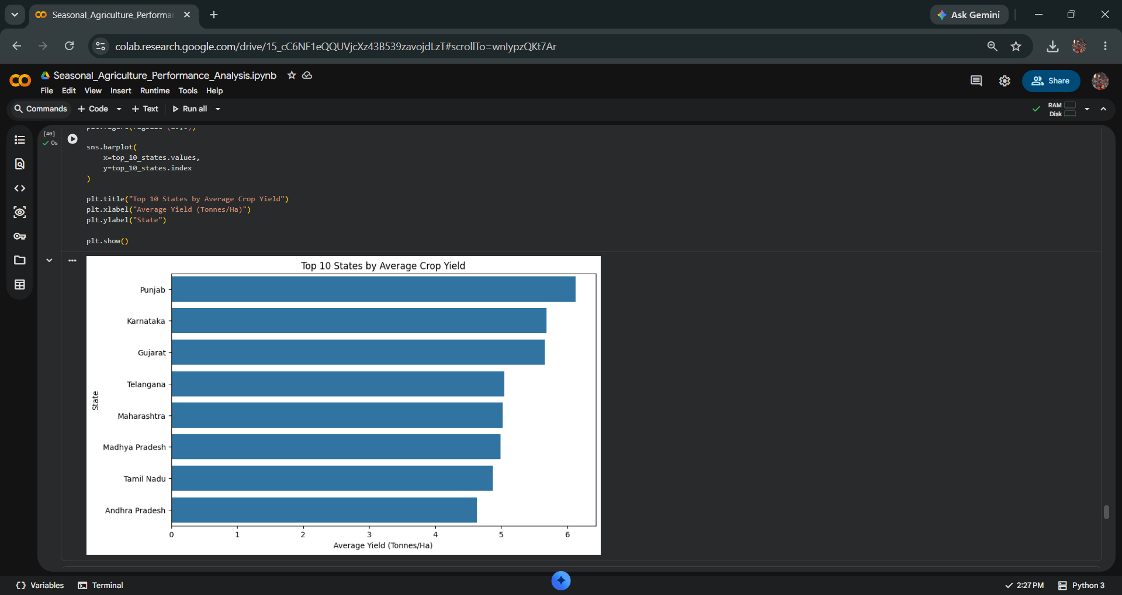
RESULTS
[Add screen shots of your code ]

Slide 16
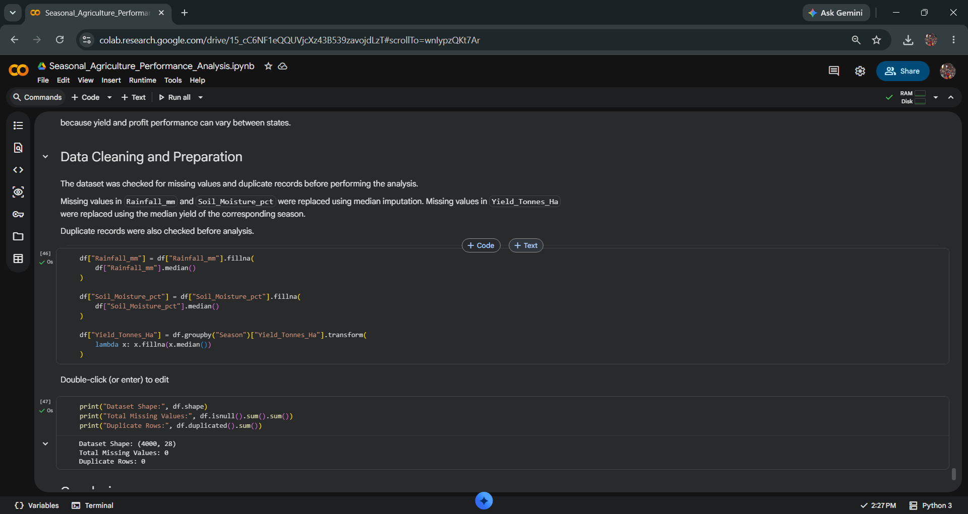
RESULTS
[Add screen shots of your code ]

Slide 17
Future scope
Develop a machine learning model to predict crop yield.
Forecast seasonal agricultural performance.
Integrate real-time weather data.
Add soil and satellite-based information.
Develop a farmer-friendly dashboard.
Provide crop recommendation based on season and region.
Improve water and resource optimization.
Extend the analysis to multiple years of agricultural data.

Slide 18
GitHub Link
https://github.com/smmohan07/Seasonal-Agriculture-Performance-Analysis

Slide 19
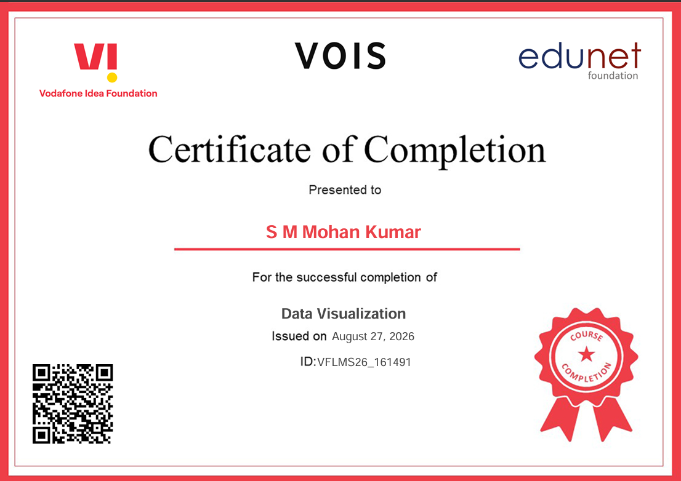
VOIS Course completion certificate - Course name- Data Visualization

Slide 20
Thank you
Presented By: S M Mohan Kumar
.
.

