Slide 1
IBM University Engagement Project Submission
“Exploring the Power of Agentic AI with IBM Granite and IBM Bob”

Slide 2

Project Tile – [ Research Agent ]
Domain of Project – [ Research & Knowledge Management ]
Student Name | Recent Passport Photo | Email ID | Mobile number [WhatsApp]
S M Mohan Kumar |  | smmohan569@gmail.com | 8867584723

Slide 3
Problem Statement -
The Challenge
Researchers struggle to find reliable papers, understand large amounts of research information, and identify gaps in existing studies. Information is scattered across journals, websites, and documents. Without intelligent assistance, reviewing literature and organizing findings can be time-consuming and difficult.
The Objective
Build an AI-powered Research Agent that assists researchers throughout the research process. The solution should:
Research Discovery – Find relevant research papers, articles, and academic resources based on the research topic.
RAG Retrieval – Retrieve reliable information from research papers, journals, and trusted academic sources.
Literature Analysis – Summarize papers, compare findings, and identify important research trends.
Research Guidance – Suggest research directions, methodologies, and potential research gaps.
Multi-Agent System – Search Agent (finds relevant research papers) Analysis Agent (analyzes and summarizes papers) Gap Agent (identifies research gaps) Writing Agent (assists with research content and references)
Dashboard – Show research papers, summaries, key findings, research gaps, references, and research progress.

Slide 4
Proposed Solution -
The proposed solution is a multi-agent AI-powered Research Agent built using IBM Bob, IBM watsonx.ai, and Granite Models to assist researchers with literature review, research analysis, and discovery.
The system uses RAG to retrieve reliable information from research papers, journals, academic publications, and trusted sources.
The system consists of four key agents:
Research Discovery Agent – Finds relevant research papers, articles, and academic resources based on the research topic.
Literature Analysis Agent – Summarizes and analyzes research papers, methods, and findings.
Research Gap Agent – Identifies gaps, limitations, and unexplored areas in existing research.
Research Guidance Agent – Suggests research directions, methodologies, and potential topics.
A dashboard displays research papers, summaries, key findings, research gaps, references, and research progress.
IBM Bob orchestrates the agents, watsonx.ai supports AI and RAG, and Granite Models provide reasoning, analysis, and research recommendations.
Overall, the solution helps researchers discover relevant studies, understand existing research, identify research gaps, and develop new research directions.

Slide 5
Technology Used
Technologies Used – Research Agent
IBM Bob Platform – For designing and managing multi-agent research workflows.
IBM Granite Model – For understanding queries, reasoning, summarizing, and generating research responses.
IBM Cloud – For securely building and deploying the Research Agent.
RAG – Retrieves reliable information from research papers, articles, and online sources before generating answers.
IBM watsonx.ai – For AI model deployment, embeddings, and AI governance.
Vector Database (FAISS/Chroma) – For storing and retrieving research documents efficiently using RAG.

Slide 6
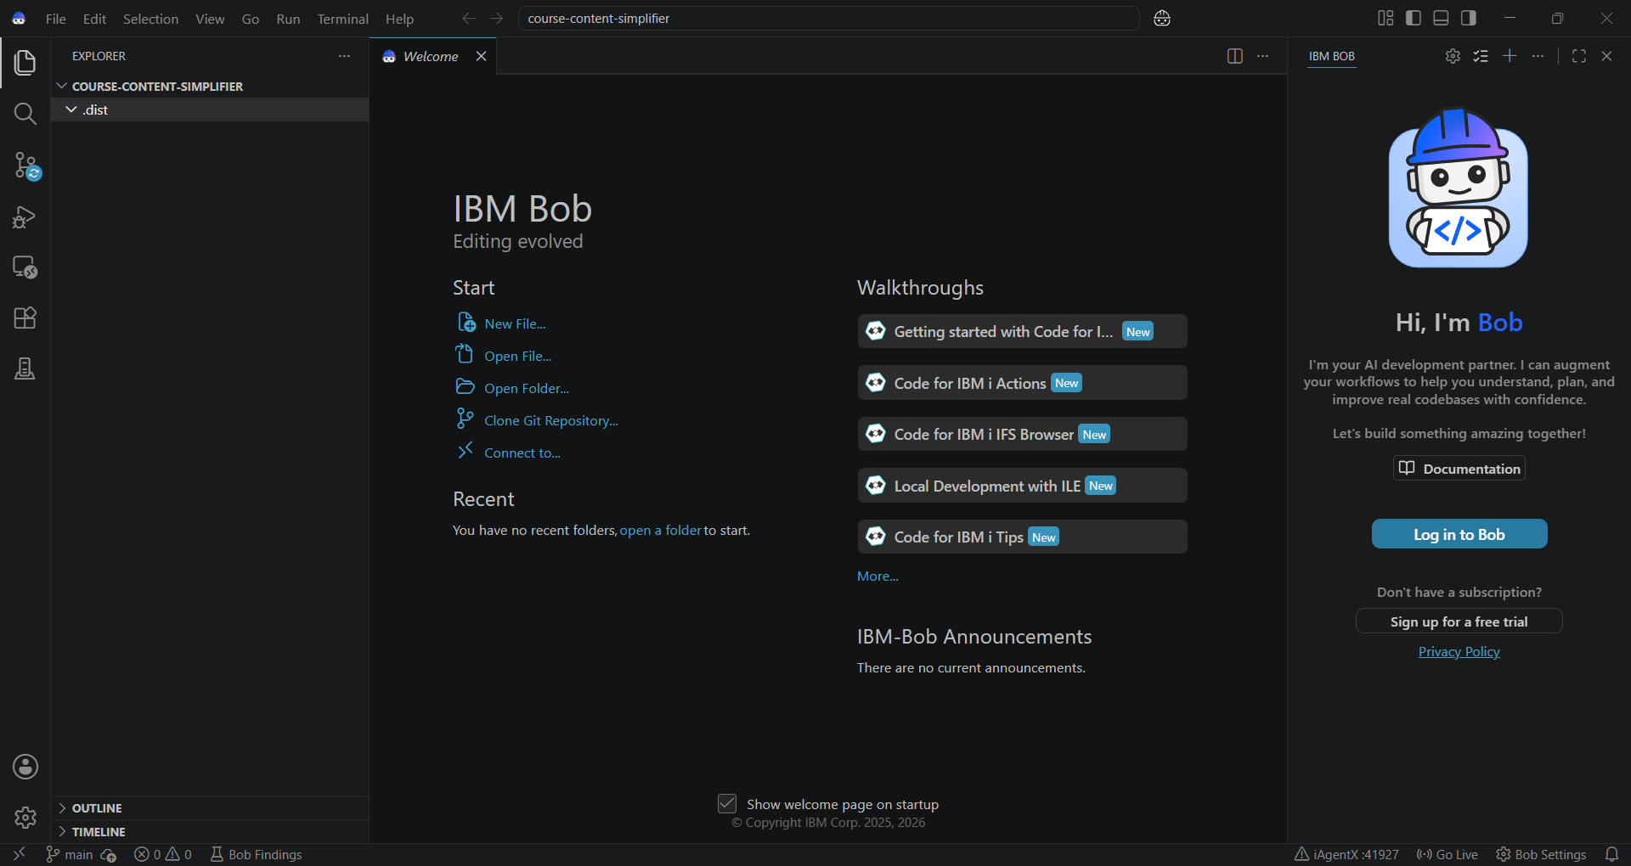
Required Files created using IBM bob -
App.py
Requirements.txt
Style.css
.env
Index.html

Slide 7
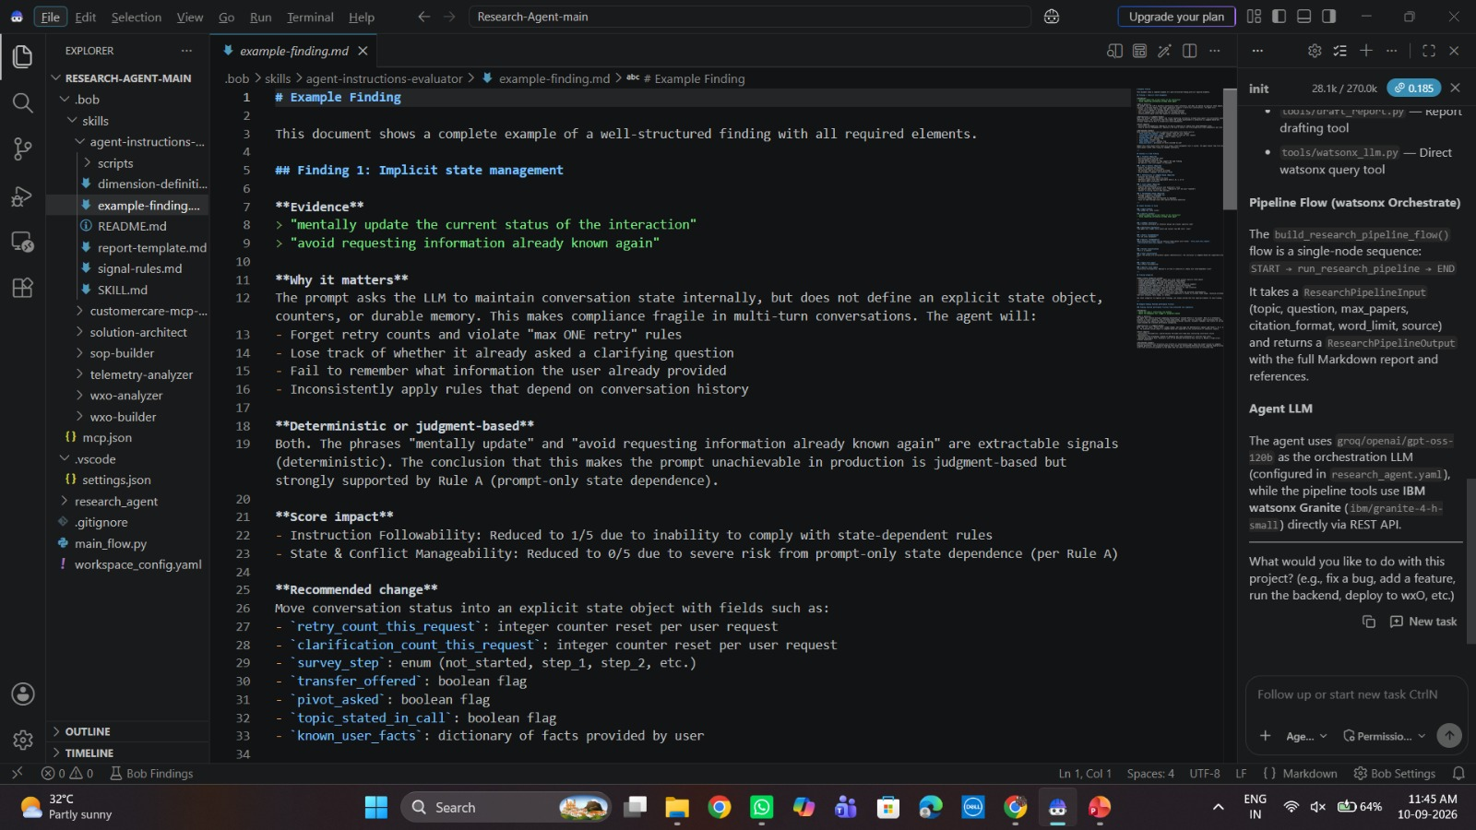
IBM Bob Screenshots:

Slide 8
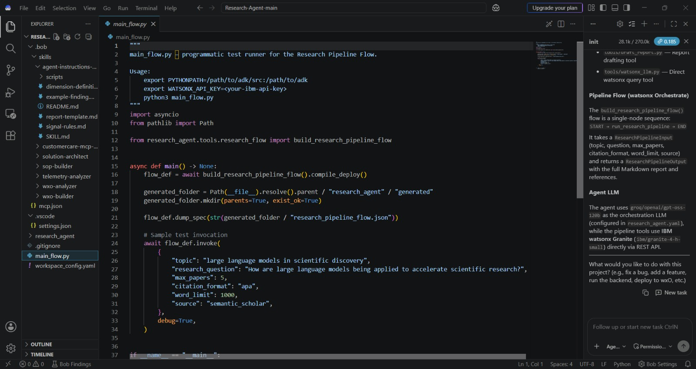

Slide 9
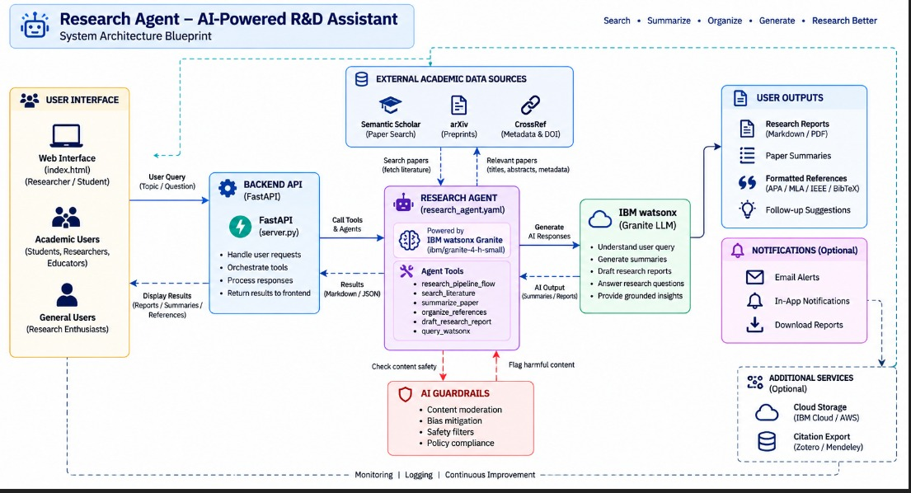
Architecture blueprint for IBM bob:

Slide 10

Role of Agentic AI in the solution
Agentic AI enables the AI Research Agent to function as an intelligent, autonomous research assistant rather than a simple research-search chatbot. Using IBM watsonx.ai and IBM Granite models, it coordinates multiple specialized agents to support researchers throughout the research process.
Each agent performs a specific role—such as discovering relevant research papers, analyzing literature, identifying research gaps, recommending research methodologies, and assisting with research writing—while working collaboratively.
This multi-agent approach ensures efficient research execution, deeper analysis, and relevant results.
Agentic AI also provides context awareness, understanding research details such as the topic, objectives, keywords, methodology, existing studies, and research requirements to generate tailored recommendations. It supports real-time adaptation, continuously refining results based on newly discovered papers, findings, and changes in the research direction.
Additionally, the agents communicate and share information with each other, enabling better research decision-making. For example, the Research Discovery Agent can find relevant papers, while the Literature Analysis Agent summarizes their findings and the Research Gap Agent identifies unexplored areas. The Research Guidance Agent can then suggest suitable research directions based on these gaps.
Overall, Agentic AI makes the system proactive, intelligent, and research-focused, acting as a smart digital research assistant that helps researchers discover studies, analyze literature, identify research gaps, develop new ideas, and improve the overall research process.

Slide 11
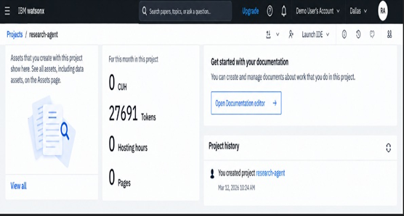
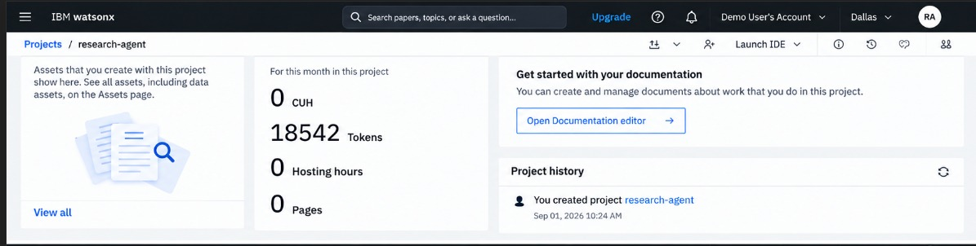
Token Usage
9,149 token are used
Before Prompt
After the Prompt
·
·
·

Slide 12
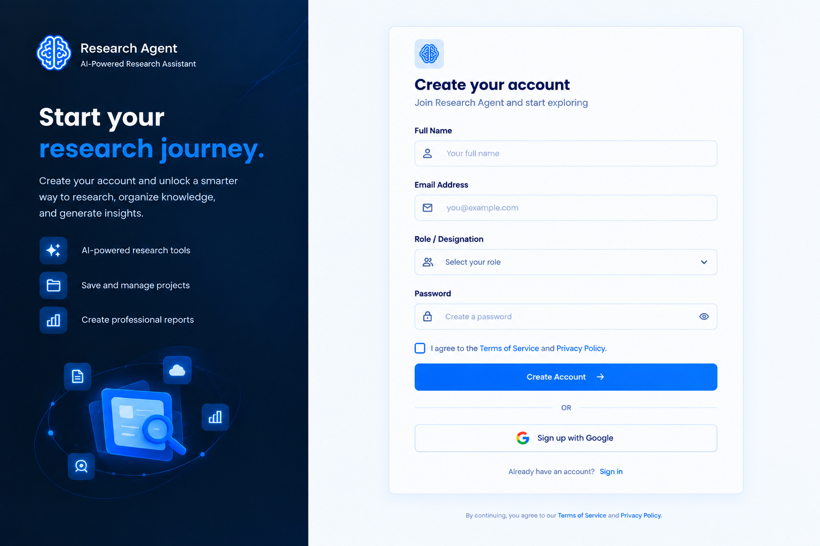
Project Output Screenshot
·
·
·

Slide 13
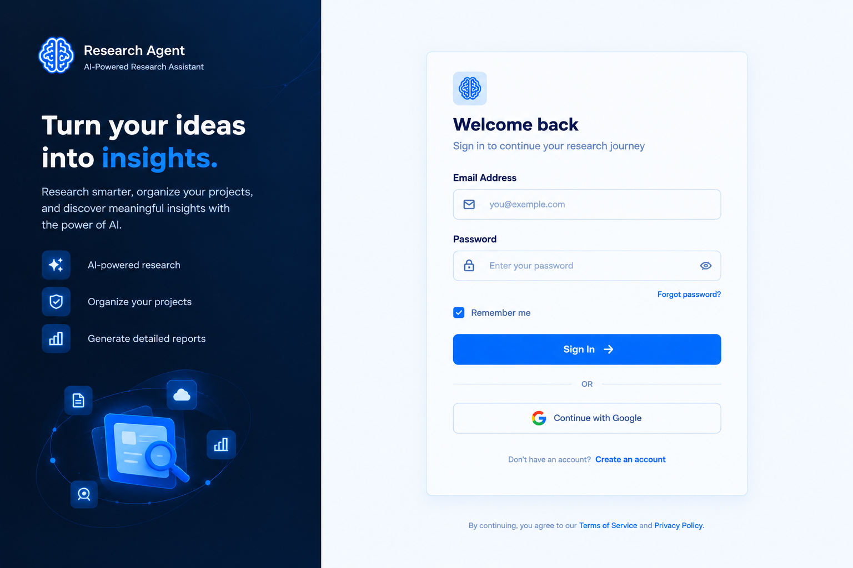
Project Output Screenshot
·
·
·

Slide 14
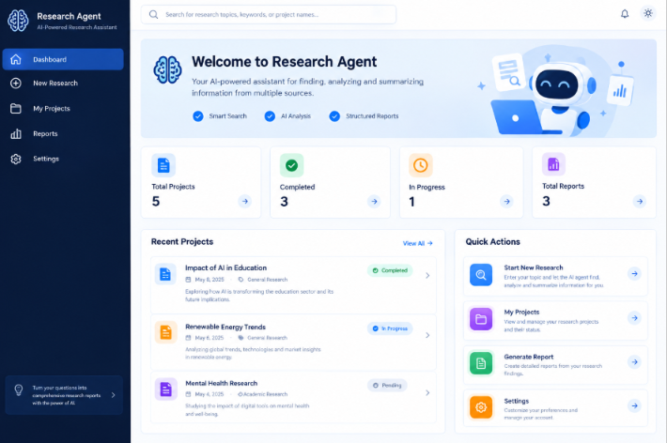
Project Output Screenshot
·
·
·

Slide 15
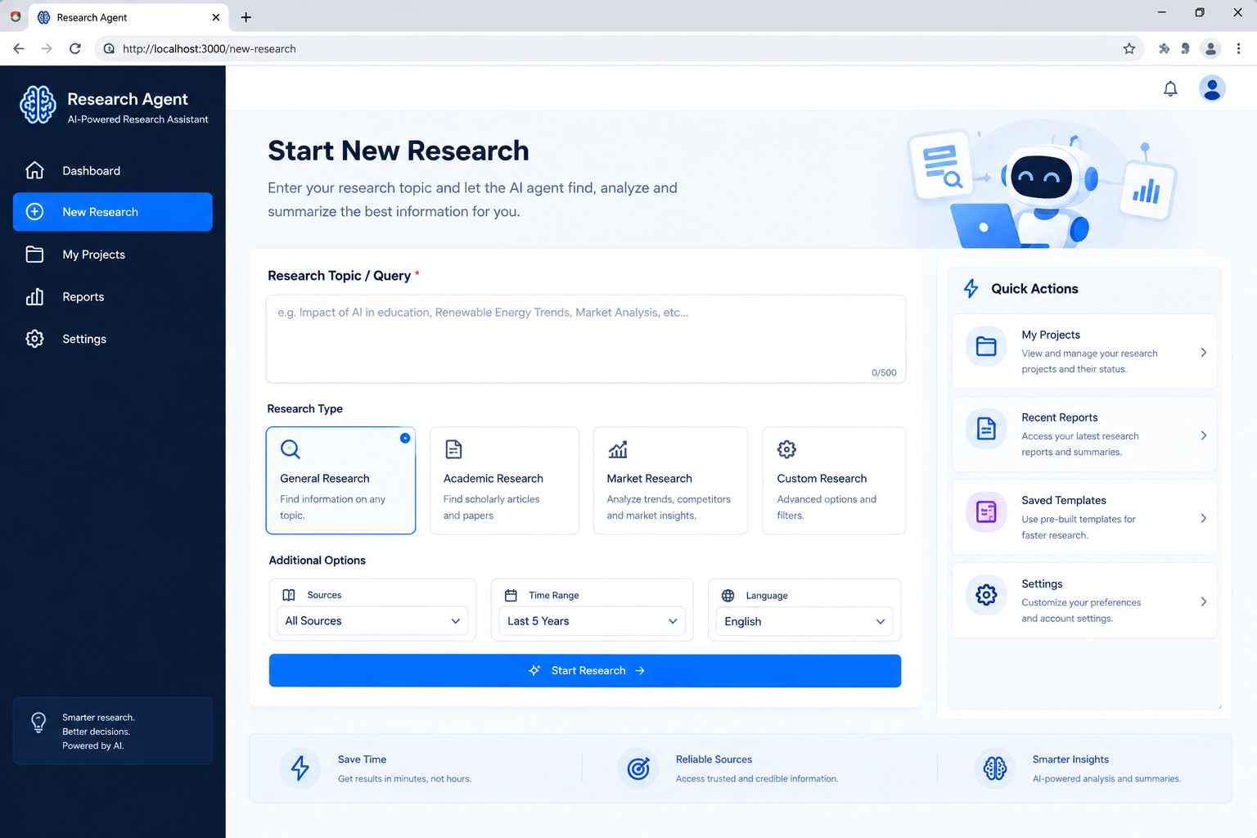
Project Output Screenshot

Slide 16
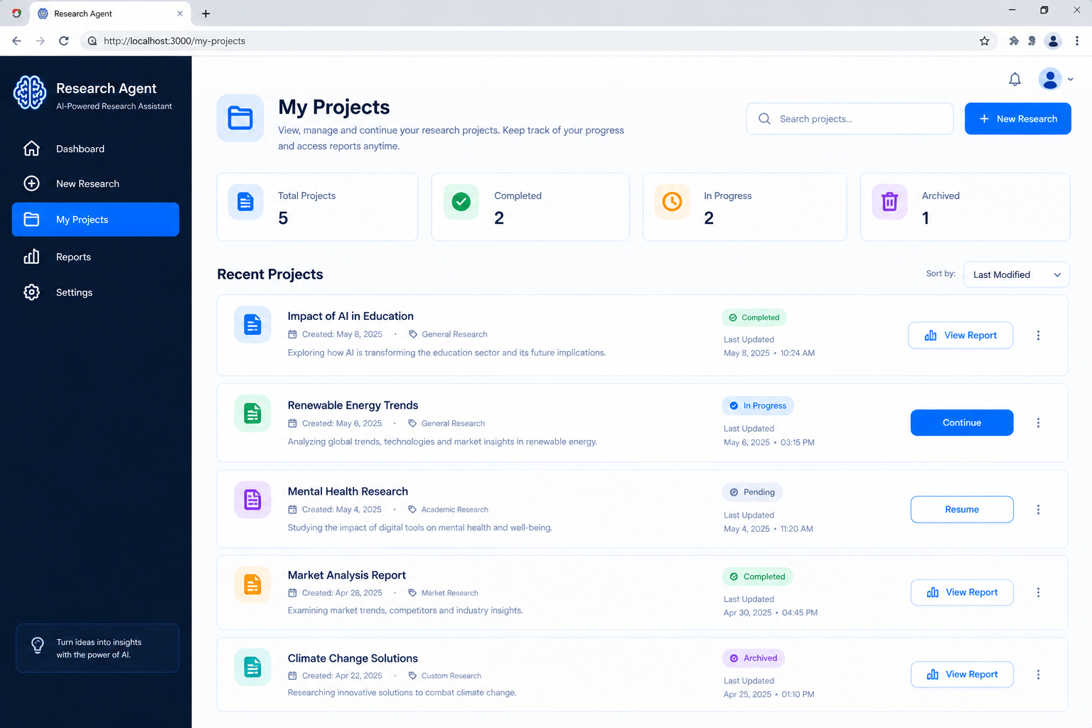
Project Output Screenshot

Slide 17
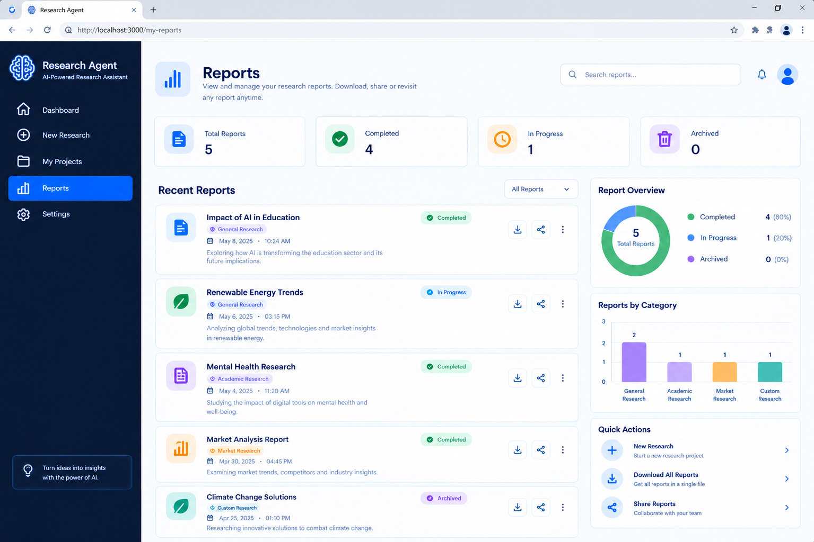
Project Output Screenshot

Slide 18
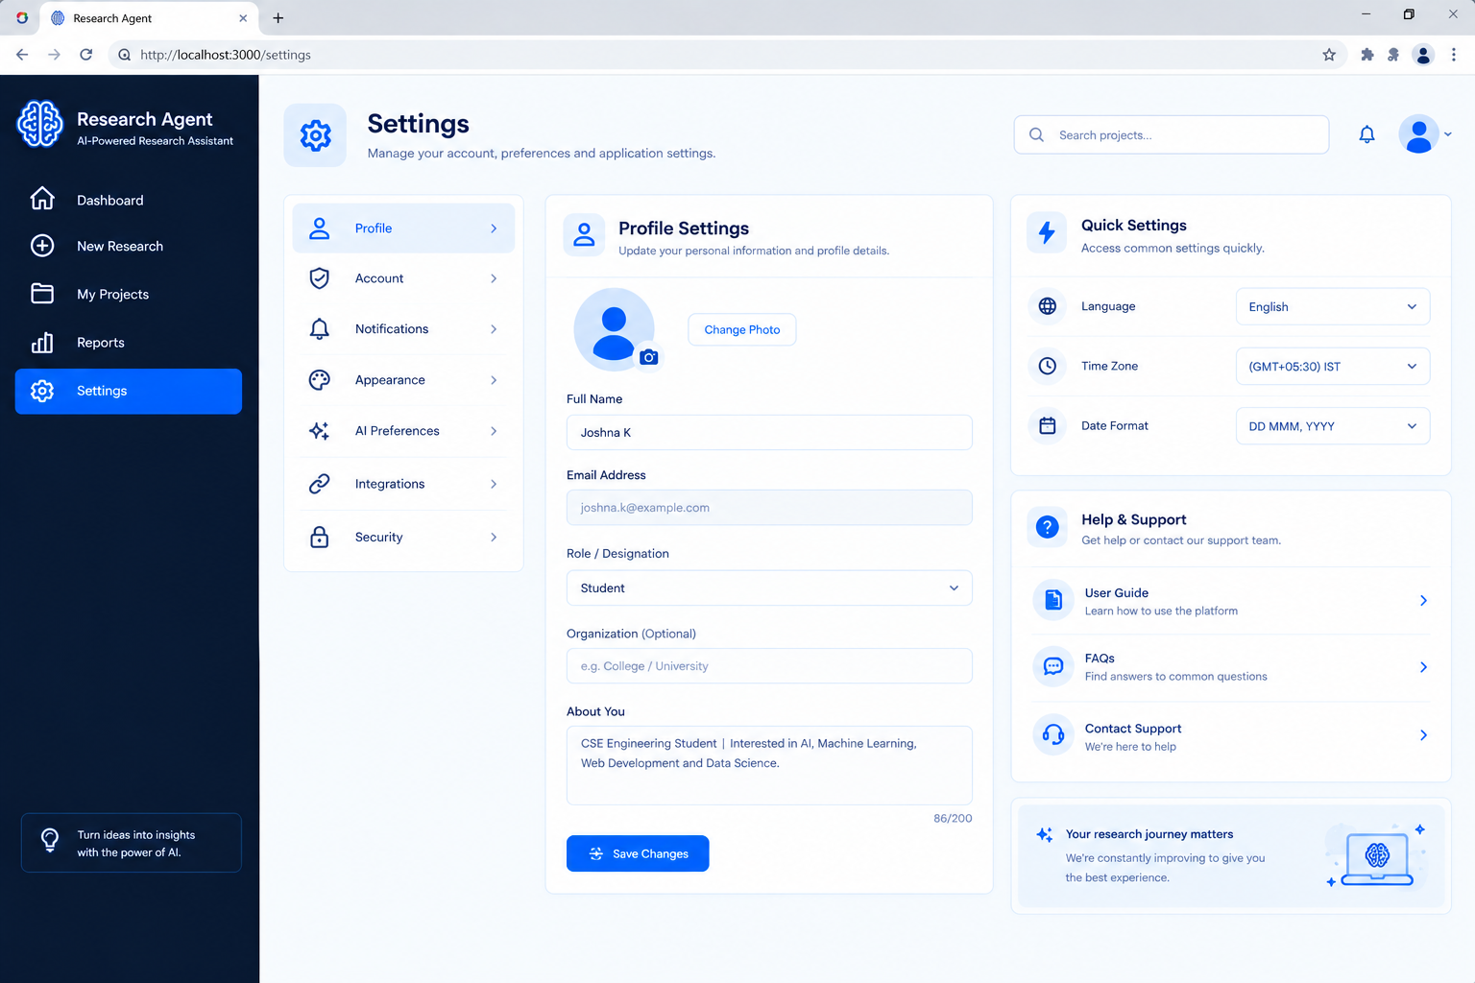
Project Output Screenshot

Slide 19
Novelty and Uniqueness
Key Features of the AI Research Agent
Multi-Agent Intelligence – Multiple specialized agents collaborate for information gathering, analysis, fact-checking, summarization, and report generation.
RAG-Based Accuracy – Retrieves relevant and updated information from trusted research papers, documents, and knowledge sources to provide reliable answers.
Personalized Research – Adapts research results based on the user’s topic, interests, research goals, and preferred level of detail.
Real-Time Adaptation – Continuously updates the research process based on user feedback, new information, and changing research requirements.
Research Gap Analysis – Identifies missing information, research gaps, trends, and unexplored areas related to the selected topic.
Multi-Modal Support – Supports text, documents, images, and other research inputs for better information analysis.
Automated Report Generation – Converts collected information into structured summaries, comparisons, findings, and research reports.
IBM Technology – Uses IBM watsonx.ai and IBM Granite models to provide reliable, governed, and intelligent AI-powered research.
Overall, the system acts as a smart, autonomous, and personalized research assistant that helps users discover, analyze, validate, and organize information efficiently.
The proposed AI Research Agent combines Agentic AI, RAG, and personalization to provide intelligent and efficient research support.

Slide 20
Git Hub Link
· Please create public github repository (Enable Add README button while creating repository) with format –
Please test and Paste the working Github URL –
https://github.com/smmohan07/my-ibm-bob-project.git
1) All Agent relevant files of IBM Cloud , 2) yourproblemstatement.pdf file 3) your projectpresntation.pptx file 4)any other files
·
·
·

Slide 21
Future Scope
For your Research Agent project, you can use the same format like this:
1. Integration with Academic & Online Research Platforms – The system can be integrated with academic databases, research repositories, and online information sources to access updated research papers, articles, and relevant information, helping users obtain more accurate and reliable research results.
2. AI-Powered Voice Assistant & Multilingual Support – Adding voice-based interaction and support for multiple languages can make the Research Agent easier to use for students, researchers, and users who prefer speaking instead of typing, improving accessibility and usability.
3. Smart Research & Knowledge Tracking – The system can continuously track users' research topics, saved sources, notes, and previous research activities to provide personalized recommendations, relevant information, and improved research assistance.
4. Automated Citation & Reference Management – Future versions can automatically identify sources and generate citations and references in formats such as APA, MLA, and IEEE, reducing the effort required to prepare properly formatted research reports.
5. AI-Based Research Report Generation – The system can generate structured research reports by combining information from multiple sources, including summaries, key findings, comparisons, and conclusions, helping users complete research tasks more efficiently.
6. Personalized Research Recommendations – The system can analyze a user's research interests and previous activities to recommend relevant papers, articles, topics, and related research areas, enabling users to discover useful information more easily.
·
·
·

Slide 22
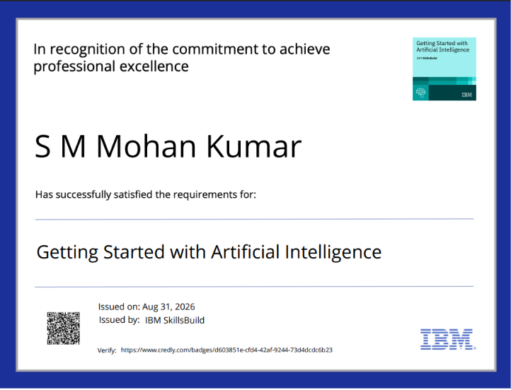
Certificates Earned:

Slide 23
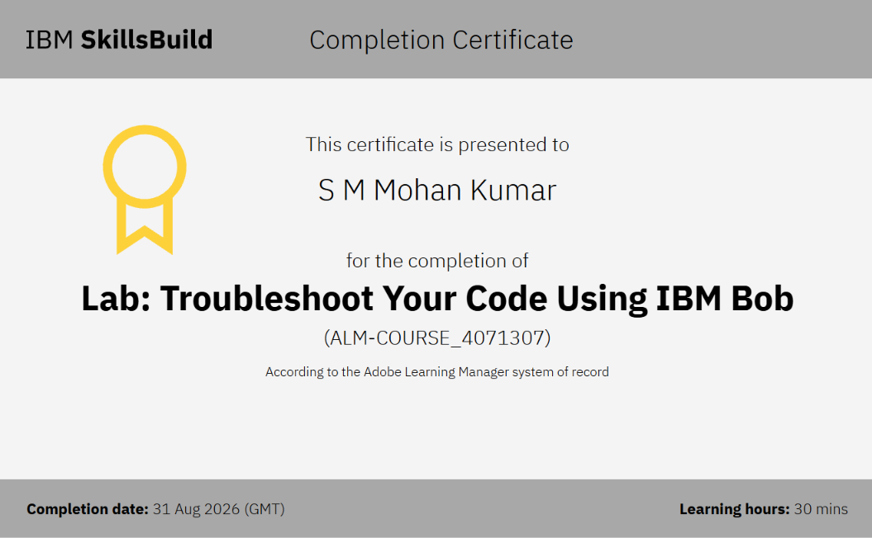
Certificates Earned:​

Slide 24


