Slide 1
FINAL PROJECT REPORT
Project Team 10

Slide 2
Introduction, Targeted Audience, and Description of Data Set.
In this report we cover the analysis of our findings after collection of the data set from the google employees in different areas. Mainly we focused on the satisfaction of google employees, benefits provided by google as a company, cultural environment of google and growth and opportunities provided by google to their employees. This report can highlight the key area for employers to improve employees satisfaction.
The targeted audience of our data set is google employee who is currently working. This dataset of Google employees consists of their reviews and these reviews are based on many aspects such as “work-life balance”, “cultural values”, “career opportunities” and “benefits as employees”. The data is collected across different locations and job categories.
We collected the Google employee review data and it’s total count is 4625 with 17 different columns. We collected information such as workplace location, title, employee type, and response date of employee, brief summary of the work at Google, difficulties faced by employees and employee feedback about employers in rating measures and links to their work profiles.

Slide 3
Fields in Data Set & Sources of Data Set
Many fields includes in it such as Management-to-consultation, Work-Balance-Star, Overall-Rating, Low-Benefit-Star, Date (from 2008-2018), Culture-Value-Star, Location, Employee Type, Job Title, etc. Summary, Different fields rating, Disadvantages, Links of profiles (which are reviewed by employees about the company).
Data set taken from the source website such as kaggle.com and Glassdoor.com.

Slide 4
Process of Data Analysis
Step # 1: Cleaning data extract valuable data from raw data set First we clean raw data sets after that we have to find missing value data set then we make zero missing value data sets. The dataset is imported from the local device or host system. After importing the dataset, then confirmed all classified variables were assigned data type. Downloaded the data Google employee review from the assignment module and looked at the data field and data sets.
Step # 2: Clarify data for Analysis
After generating our data set to excel we clarify data for analysis create parameters for generated fields and create different charts to demonstrate the result of different parameters of google.
Step # 3: Conclude results and explanation from data set
In last step we analysis results and charts created from data set we collected and explain it.

Slide 5
Analysis
We conclude different type of analysis such as descriptive analysis, prescriptive analysis and predictive analysis of data set. In descriptive analysis we show our findings through different bar charts of field data of google employee, in prescriptive data we share some suggestions and recommendations for google employers based on our findings through data set and in last predictive data, we predict some predictive level of google employee in next years on the basis of our data set.

Slide 6
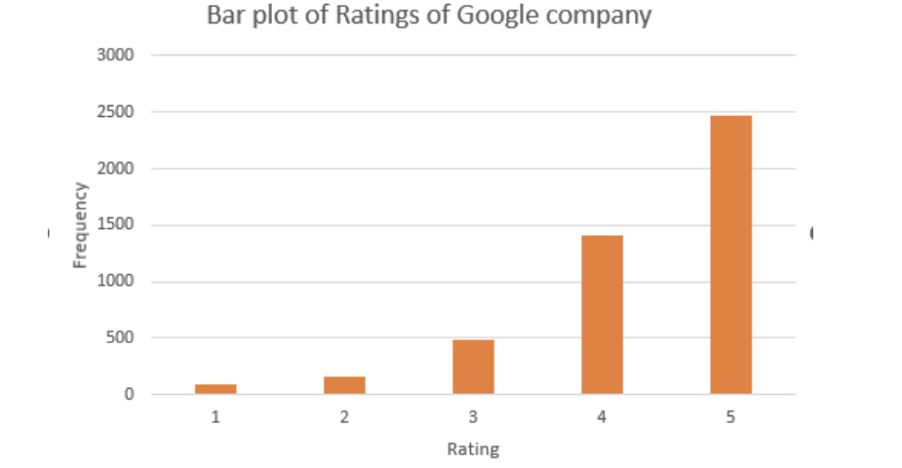
Descriptive Analysis
Descriptive analysis of bar charts for evaluating the different areas of Google employees data sets
Chart # 1: Bar plot of ratings of Google Company
Explanation The bar plot indicates that ratings of five appeared most frequently. As a result of its high ranking and frequent participation, Google can be considered the best firm. We must now ascertain the cause of these excellent ratings. In order to compare the different Employee categories, we would therefore develop a clustered bar plot.

Slide 7
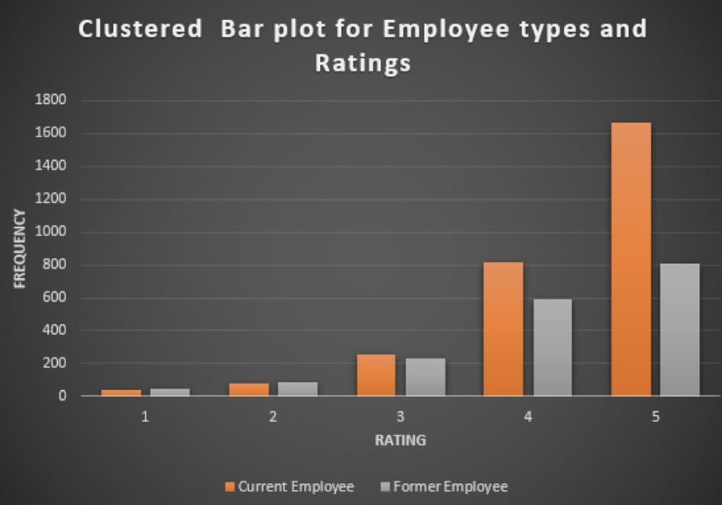
Chart2: Clustered bar plot for employees types and ratings.
Explanation The clustered bar graph showed that the present Employer was mentioned frequently. Therefore, we can conclude that present employees are the ones that rate Google Company highly the most frequently. Good employer branding exists for Google. Potential employees view Google as a top-tier employer despite reservations well about firm's size and influence. The business is renowned for its top-notch benefits and perks and for its dedication to the growth and development of the employees. Google is also seen as a business that constantly innovates and modifies the rules of the game.

Slide 8
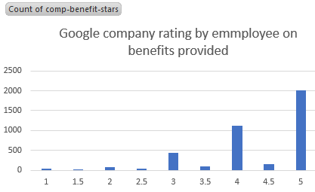
Chart # 3: Bar chart of Google Company rating by employee on benefit provided by company.

Slide 9
Explanation These chart shows the rating on benefits and perks provided by google to its employee. The data in charts shows 2000 employee give 5 rate. Out of 4625 employee 2000 employee give 5 rating that show huge number of employee is satisfied by the benefits and perks. 250 Employee give 4.5 rate. 1200 employee give 4 rate. 100 employee give 3.5 rate.400 employee give 3 rate. Most google employee is satisfied with the benefits as per the data. These are some awesome benefit that google provide to its employee we discuss some benefits provided by google to their employee’s.
Medical benefits Google provides health insurance to its employees. For themselves, their family member, and any dependents they may have, Google employees have the opportunity to create personalized comprehensive medical coverage.
Mental health the mental health of Google's employees is important to the company. Google offer employee assistances program that focused on mental health of employee. Company also provide access to mental health applications to support employees struggling with their psychological health.
Maternity leave People are legally entitled to time off when they give birth to a child. Google ensures that both parents receive time off at home before going back to work. Google offers parents a 6-week paternity leave to male and 18-week paternity leave to female employee.

Slide 10
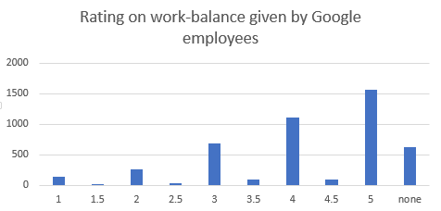
Chart # 4: Bar chart of Google Company rating by employees work life balance.
Explanation This bar chart reflects the work life benefits ratings of google employees. Which rate mostly high rating that shows google provide great work life balance to their employees. If you notice that our data set consist of 4625 employees 1500 employees gives 5 rating which shows good efforts by google employers to create such work life balance for employees. More over almost 1200 employees rate 4 out of 5 and 700 employees rate 3 out of 5 which is good numbers for any company for the satisfaction of their employees.

Slide 11
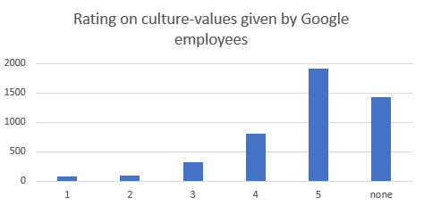
Chart # 5: Bar chart of Google Company rating by employees on cultural value
Explanation this bar chart reflects the cultural values ratings of google employees. Which rate mostly high rating that shows google provide cultural values to their employees. If you notice that our data set consist of 4625 employees 1900 employees gives 5 rating. This is statically proof that google create such great environment for their employees in cultural values and environment which motivate their employees. We also finds almost 900 employees rate 4 out of 5 and 350 employees rate 3 out of 5 which shows mix rating this is also some indications for google employers that they have some areas to create more better cultural environment in company but this number is very less than numbers of satisfied employees on cultural value provide by google.

Slide 12
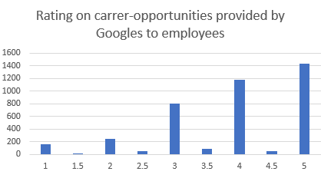
Chart # 6: Bar chart of Google Company rating by employees on career opportunities.
Explanation this bar chart reflects the career opportunities provide to their employees ratings of google employees. Which rate 5 by 1425 employees that shows google prioritize the career growth to their employees. Overall rating show mix rating toward the career opportunities provided by Google employers to their employees just like 180 employees rate 1 out of 5, 230 employees rate 2 out of 5, 800 employee rates 3 out of 5 this is very mix rating which explain that google employers can do more work on career growth of their employees.

Slide 13
Perspective Analysis
There are some suggestions and recommendation for google employers on improvement areas under this overall analysis we conclude its very important for employers to understand that how employees feel or motivated If we look at ratings, reviews, and data from of the best places to work, it appears and we can say with certainty that Google employees are intrinsically motivated in general because this motivation can be very subjective as well. However, if we look at group data set as mentioned about the healthcare benefits for employees, are some of the things which prevent health care people from having the same satisfaction as Google employees? In contrast to most healthcare facilities, Google rewards efforts more often than it does.so they have to focus more to good health care facilities.

Slide 14
Predictive Analysis
The predictive analysis predict that google grow more in future on the basis of our analysis because
Google staff members should always take into Google is a terrific place to work since innovation and creativity are the fundamental components of any company that both customers and employees find appealing. Employees in the best places to work frequently express feeling engaged in their work and a high level of trust for their employers. Offering extensive vacation time is another tactic that Google employees frequently use. On Pay Scale's employee survey, US Google employees gave the corporation good grades in a number of categories, including pay, job satisfaction, and job meaning. Flexibility, mentoring, meaningful job descriptions, competitive compensation, and telecommuting are some more important policies and practices that make Google a wonderful place to work.

Slide 15
Conclusion
This analysis completed on the basis of data available in the internet and its report is helpful for the Google employers to increase the workplace standards. According to our analysis, Google is a wonderful place to work, but there are some areas where improvements can be done.

