Slide 1







Project 4
By Nieveathan, Mushfiq Rehman, Zayan Mohammed ,Habib Rehman

Slide 2
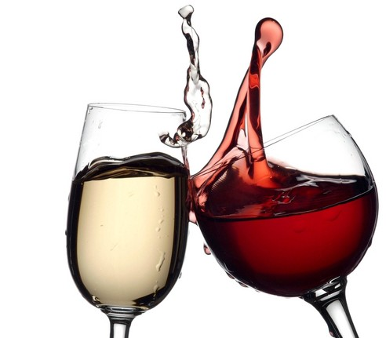


Introduction
Challenge: Classifying Red Wine into distinct categories of quality, based on a combination of physiochemical inputs and sensory output variables, leveraging machine learning and other technologies.
Dataset: https://www.kaggle.com/datasets/uciml/red-wine-quality-cortez-et-al-2009/code

Slide 3
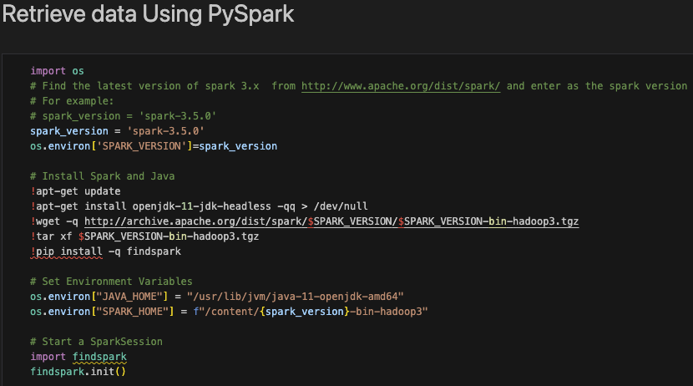

Importing / Cleaning the data
Imported the Data set into google colab using PySpark and utilized the flexibility of Pandas to execute SQL queries on the Data set.
We standardized the dataset, ensuring consistency and accuracy in our subsequent steps.

Slide 4



Machine Learning
Logistic Regression Classifier with the default lbfgs solver
Logistic Regression Classifier with the liblinear solver
Logistic Regression Classifier with the default lbfgs solver and integrated RandomOverSampler
Random Forest Classifier
Support Vector Classifier

Slide 5
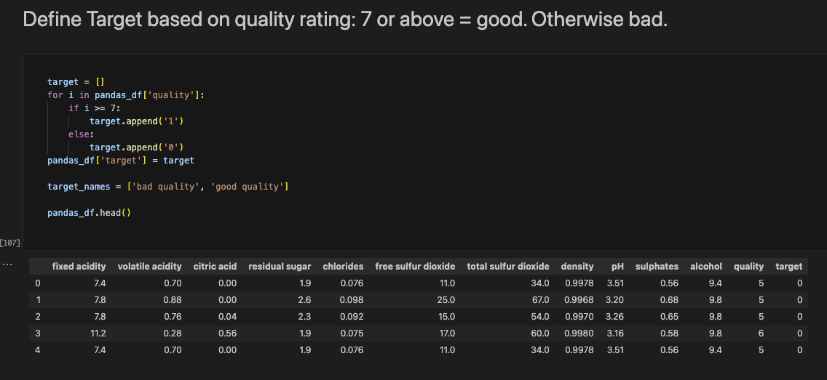
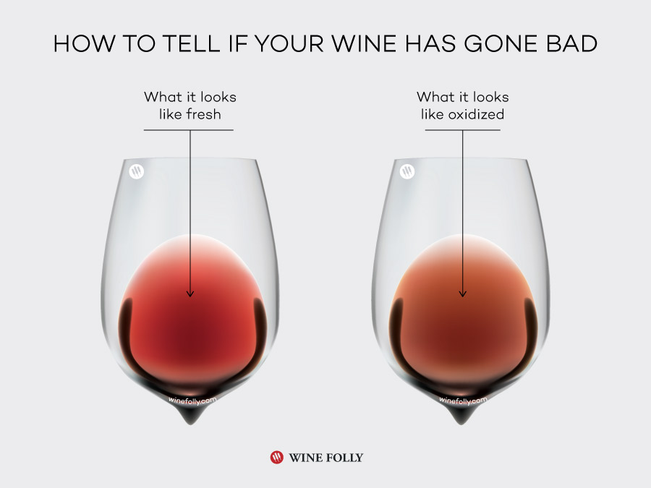
Good or Bad ?

Slide 6
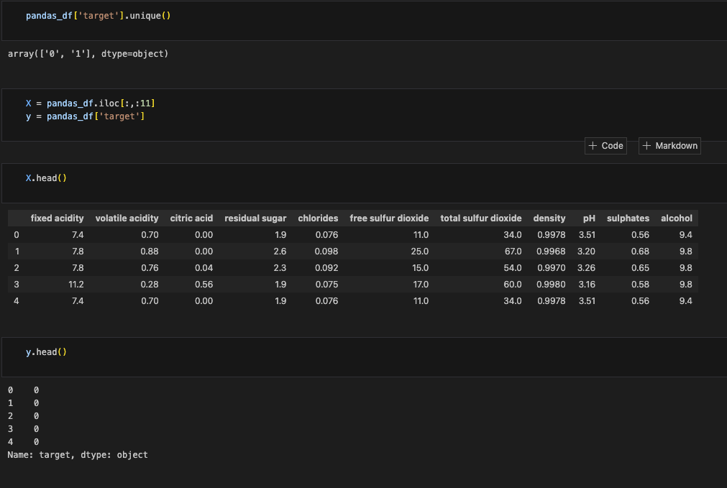

Pandas Data Frame

Slide 7
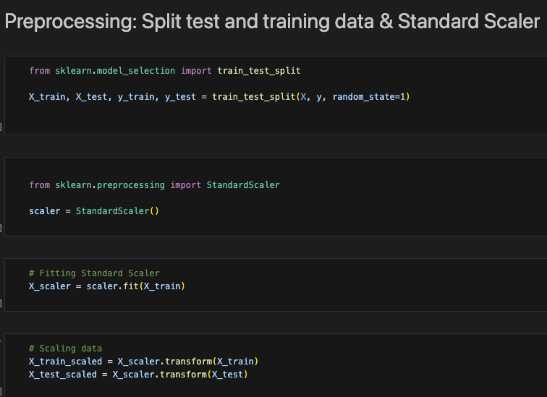
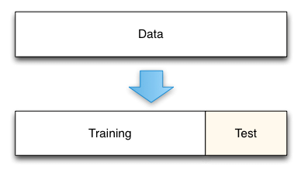

Slide 8
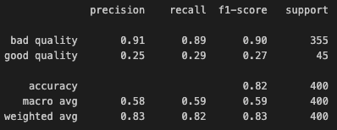
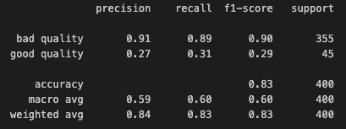
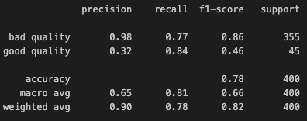
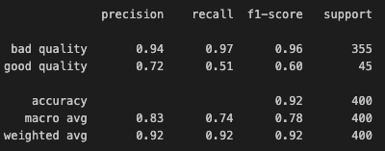
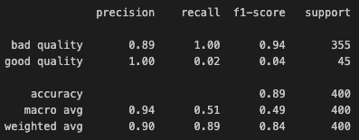
Logistic Regression `solver='lbfgs'`
Logistic Regression `solver='liblinear'`
Logistic Regression `RandomOverSampler`
Random forest
SVM

Slide 9
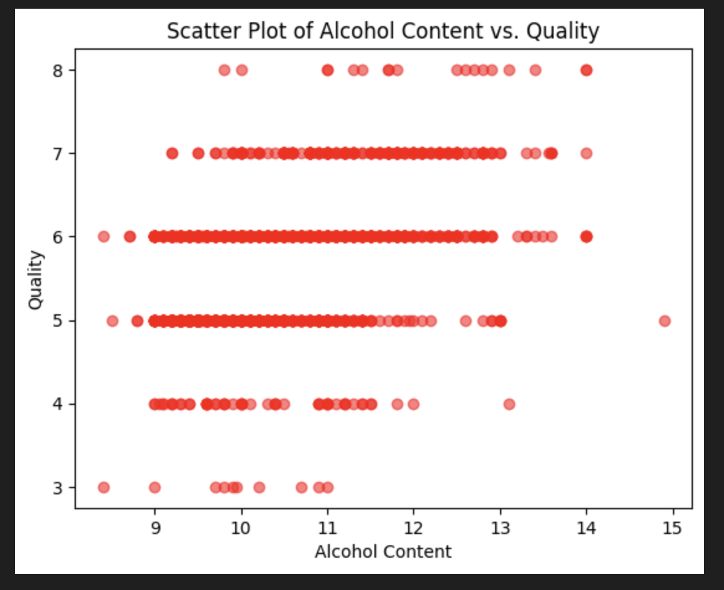
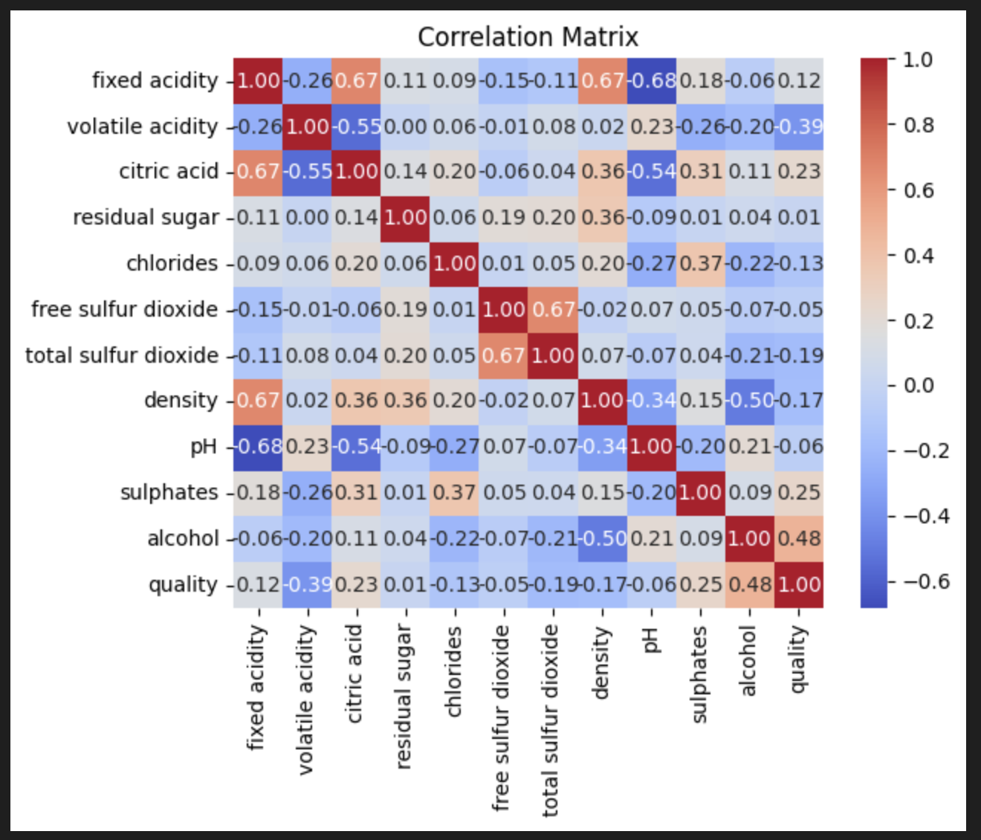

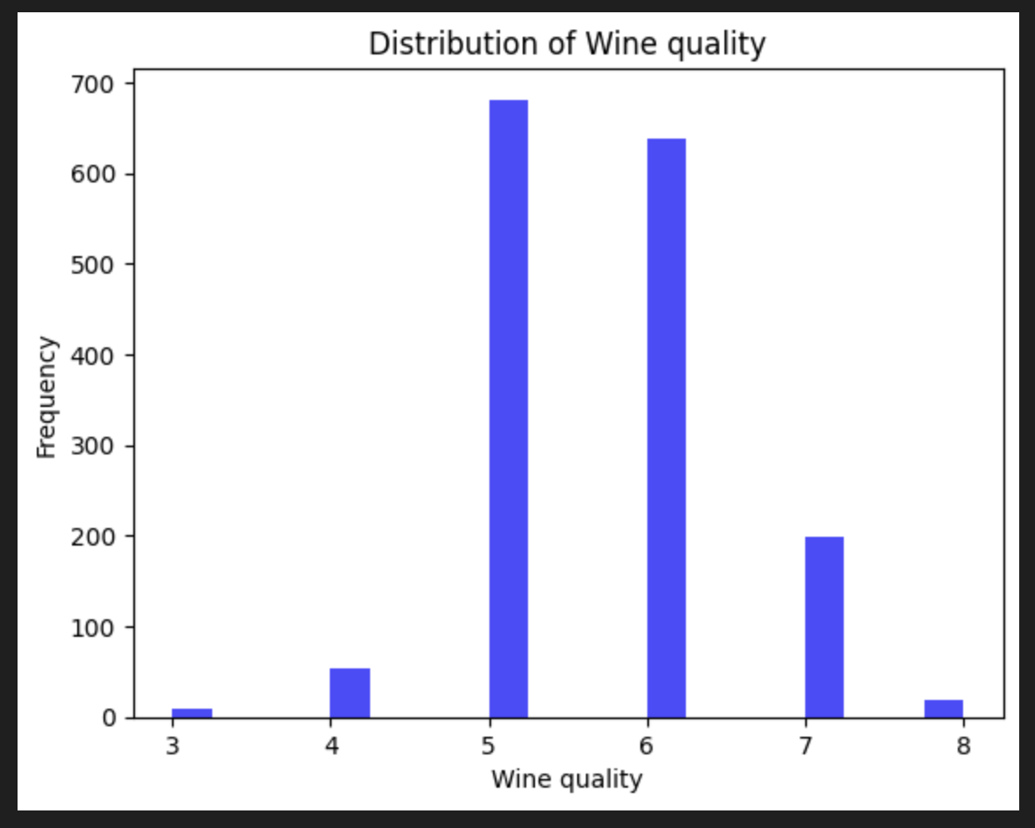
Visualizations

Slide 10
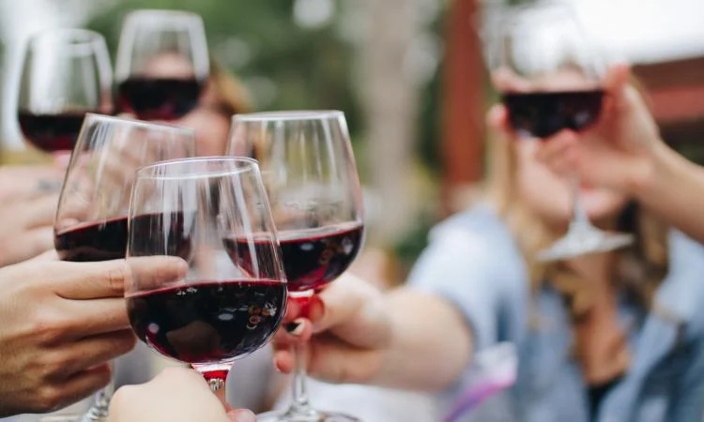


Conclusion

Slide 11


