Slide 1



Broadsoft Consulting Company
Weather forecasting
for various usecases
Presentation by the Data Team
23rd January, 2026
Notes:
We’re the Data Team from Broadsoft Consulting, and today we’ll be presenting a temperature forecasting project designed to support energy consumption estimation and long-term planning

Slide 2

Broadsoft Consulting Company
Table of Contents
Team Slide
Problem
Solution
Data Source
Insights from Data
Data Engineering
Models
Evaluation
Forecast
Value
Notes:
the problem we’re addressing
our data and modeling approach
how we evaluated performance
and most importantly, why this forecast has real value, even years into the future.

Slide 3
Broadsoft Consulting Company
Team contribution
Ms Binder
Ms Salchegger
Ms Kern
Preprocessing
Baseline Models
Statistical Models
Final doc file
ML-Models
Final best models
Visualizations
Slides
Github repo setup
Helper functions
Neural Models
Slides

Slide 4
Broadsoft Consulting Company
Problem
Providing temperature prediction for energy consumption estimate
Company Overview
Showcase current method used and current success
Purpose of the Report
Notes:
Energy demand is directly influenced by temperature — heating, cooling, and infrastructure planning all depend on it.
Current forecasting methods are often:
short-term focused
expensive to run
or difficult to adapt to localized conditions.
Our challenge was to create a robust temperature prediction system that:
works with historical daily data
captures seasonality and long-term trends
and provides accuracy that is good enough to support real decisions, not just theoretical benchmarks

Slide 5
Broadsoft Consulting Company
Solution
Best model has a MAE of 3 degrees over a span of 5 years prediction
Good results
Able to look at typical weather behaviour even years in advance
Reliable delivery
Notes:
Our solution is a data-driven temperature forecasting pipeline.
The final model achieves a mean absolute error of about 3°C, evaluated over a five-year prediction span.

Slide 6
Broadsoft Consulting Company
Data Source
https://dev.meteostat.net/bulk/daily.html https://dev.meteostat.net/data
Website
Updates
daily
Format
CSV format from the get-go

Slide 7

Broadsoft Consulting Company
Data Insights
Location
8 Stations in Michigan
Start: January 1st 1980 End: November 30th 2025
Time Span
Value range
From -25.5°C to 29.7°C

Slide 8
Broadsoft Consulting Company
Data Engineering
observations from nearby stations to a single daily time series
Aggregation
Removal
of unusable variables
Reconstructed
average temperature using min/max values

Slide 9
Broadsoft Consulting Company
Model Summary
Baseline
Statistical
ML
Neural
Naïve
Historic Average
Seasonal Naïve
Random Walk with Drift
Structural (local trend)
Simple Exponential Smoothing (SES)
Holt Linear Trend
Holt-Winters Seasonal
Autoregressive (AR)
Moving Average (MA)
ARIMA
Linear
Ridge
Huber
Tweedie
KNN
Radius Neighbours
Decision Tree
Random Forest
HistGB
LightGBM
XGBoost [+ Random Forest]
Support Vector Regression
MLP Regressor
LSTM
NBEATS
NHITS
GRU
RNN

Slide 10
Broadsoft Consulting Company
Model Evaluations
Baseline
Statistical
ML
Neural
Strong Seasonal naïve
Well captured seasonality
Serves as a competitive lower bound
Improvement over baselines
Struggled with long-term variability
R² often negative or near-zero
Better accuracy
captures nonlinear relationships
More stable error metrics across validation and test sets
Best overall performance on test data
Captures both, seasonality and complex temporal patterns

Slide 11
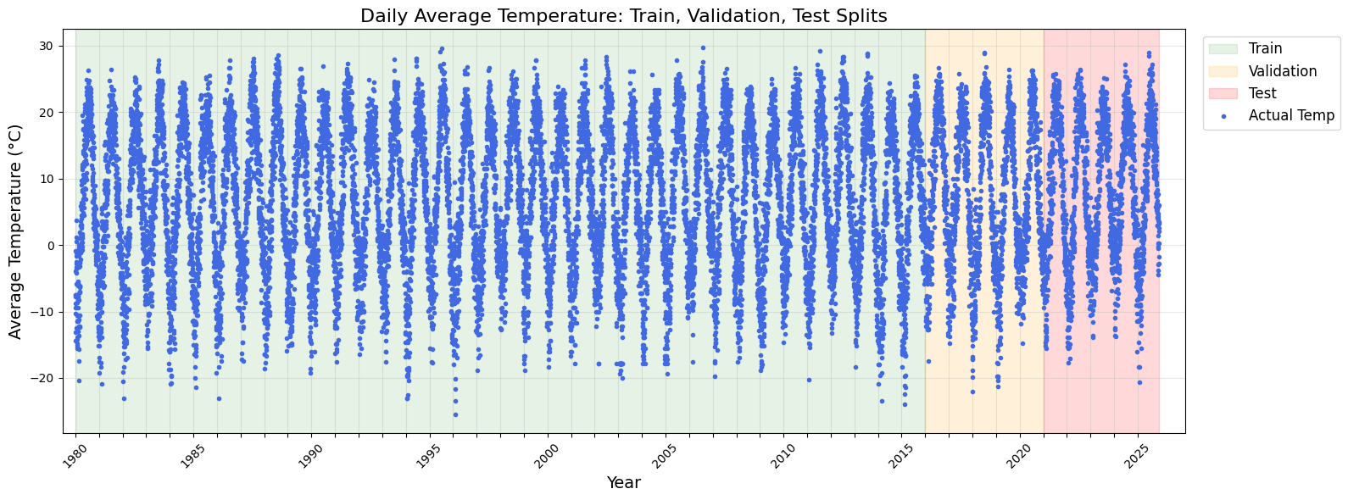
Raw data
Broadsoft Consulting Company

Slide 12
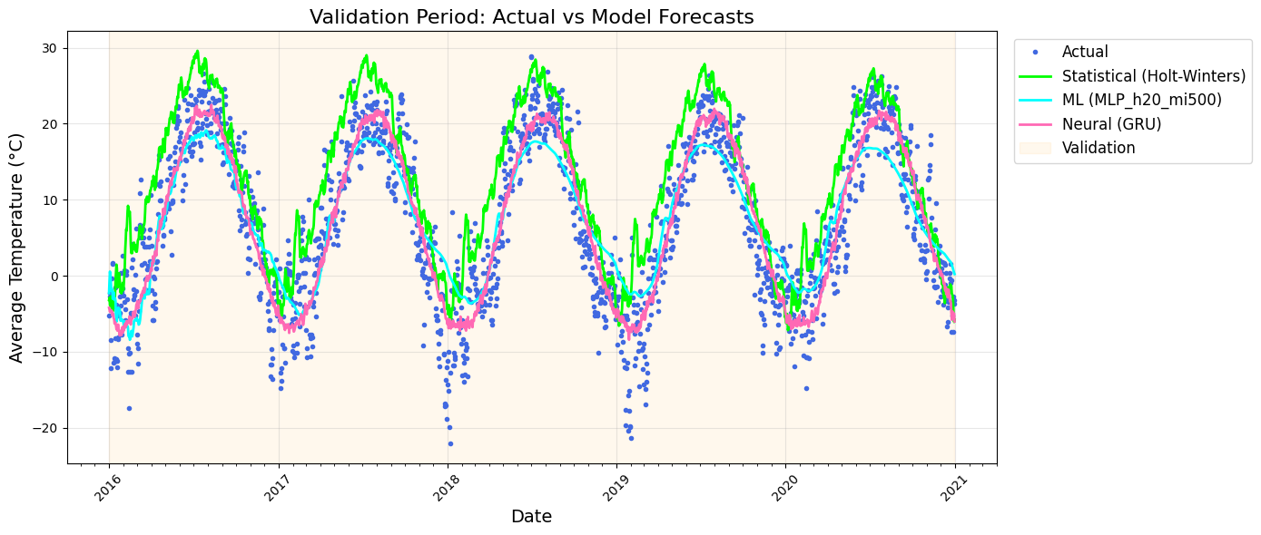
Val
Broadsoft Consulting Company
Family | MAE
Baseline | 5.1999
Statistical | 8.5890
ML | 4.2710
Neural | 3.6032

Slide 13
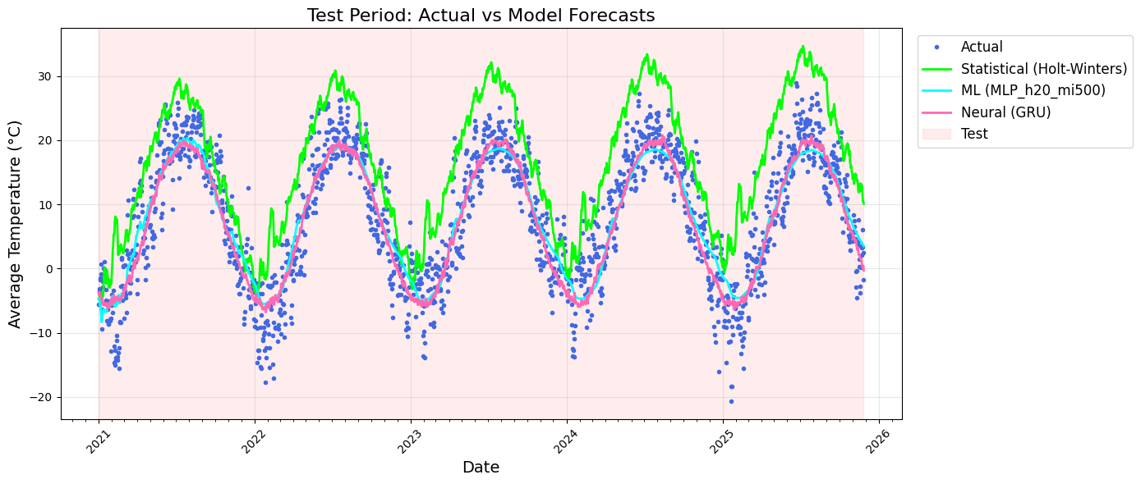
Test
Broadsoft Consulting Company
Family | MAE
Baseline | 4.8010
Statistical | 12.4058
ML | 3.9845
Neural | 3.5033

Slide 14
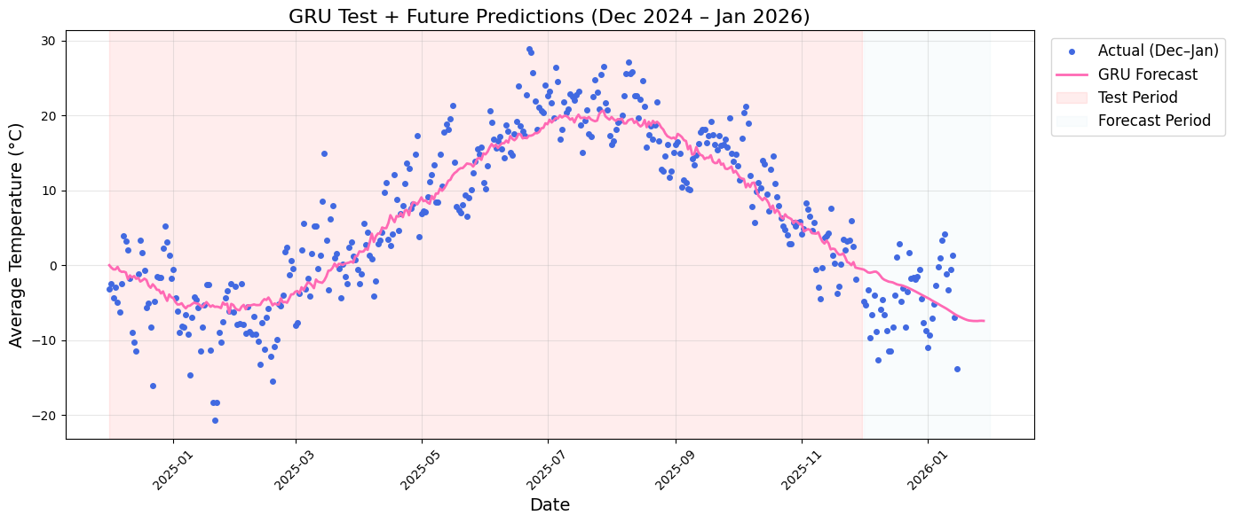
Forecast
Broadsoft Consulting Company

Slide 15

Broadsoft Consulting Company
Value
Case 1
More reliable energy prediction
Case 2
Potential B2C use case
Notes:
This model enables more reliable energy demand estimation, especially for long-term planning.
Potential applications include:
energy load forecasting
infrastructure stress planning
and even consumer-facing weather intelligence tools
The framework is also designed to improve continuously as new data becomes available.

Slide 16
Thank You
We’re looking forward to collaborating with you!
Broadsoft Consulting Company
https://github.com/smn-krn/TIS3IL-WS25-Project/tree/main

