Slide 1
Performance Evaluation and Applications
Project D
AA. 2023-2024
Simone Di Ienno
10938038

Slide 2
Scope
The aim of the project is to find the optimal configuration (i.e. best throughput) by testing different configuration in terms of number of episodes being produced, and number of units being used considering a target throughput and production time less or equal than 60 days. The production can afford two other units to work either on audio, video or VFX.
Firstly, I tried on Matlab different distributions for audio, video, vfx and compositing stages to find the best fitting. *For the Story writing and Shooting stages I considered the given Erlang distributions.

Slide 3
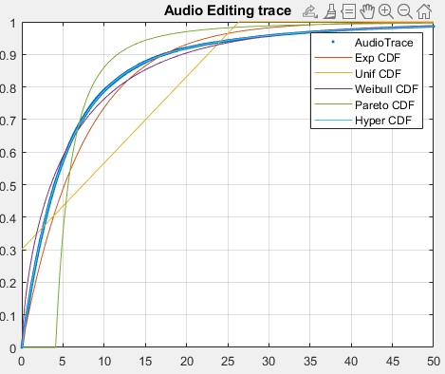
Fitting Audio Editing Trace
Parameters (DISP from Matlab) of the distributions AUDIO EDITING:
PARAMETERS HYPEREXP AUDIO EDITING:
0.0542 0.2165 0.2080
PARAMETERS EXP AUDIO EDITING:
0.1334
PARAMETERS WEIBULL AUDIO EDITING:
5.9513 0.7039
PARAMETERS PARETO AUDIO EDITING:
2.2139 4.1090
PARAMETERS UNIFORM AUDIO EDITING:
-11.3686 26.3567
* Erlang not suitable

Slide 4
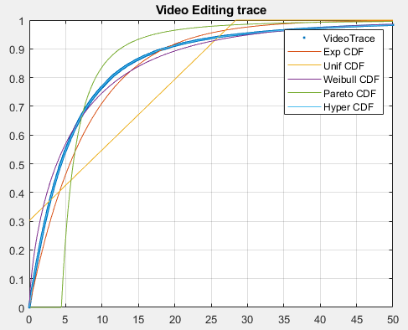
Fitting Video Editing Trace
Parameters (DISP from Matlab) of the distributions VIDEO EDITING:
PARAMETERS HYPEREXP VIDEO EDITING:
0.0493 0.1964 0.1944
PARAMETERS EXP VIDEO EDITING:
0.1243
PARAMETERS WEIBULL VIDEO EDITING:
6.3692 0.7013
PARAMETERS PARETO VIDEO EDITING:
2.2123 4.4100
PARAMETERS UNIFORM VIDEO EDITING:
-12.2929 28.3884
* Erlang not suitable

Slide 5
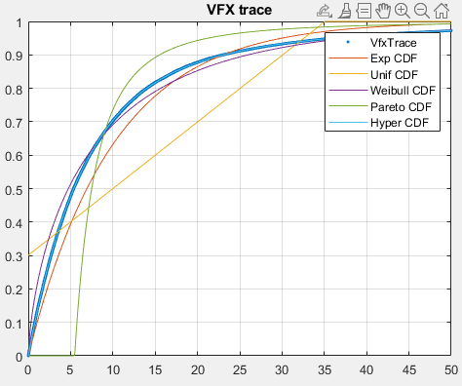
Fitting VFX Trace
Parameters (DISP from Matlab) of the distributions VFX:
PARAMETERS HYPEREXP VFX:
0.0406 0.1602 0.2042
PARAMETERS EXP VFX:
0.1000
PARAMETERS WEIBULL VFX:
7.9604 0.7058
PARAMETERS PARETO VFX:
2.2151 5.4844
PARAMETERS UNIFORM VFX:
-15.0873 35.0829
* Erlang not suitable

Slide 6
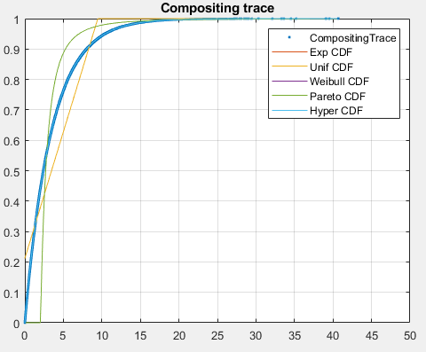
Fitting Compositing Trace
Parameters (DISP from Matlab) of the distributions COMPOSITING:
PARAMETERS HYPEREXP COMPOSITING:
0.2881 4.9851 0.9984
PARAMETERS EXP COMPOSITING:
0.2886
PARAMETERS WEIBULL COMPOSITING:
3.4646 0.9993
PARAMETERS PARETO COMPOSITING:
2.4137 2.0298
PARAMETERS UNIFORM COMPOSITING:
-2.5409 9.4720
* Erlang not suitable

Slide 7
Distribution Parameters
The distribution which fits better the samples is the HyperExponential for all the stages:
Audio editing → lambda1 = 0.054226907827379,
lambda2 = 0.216503199437902, p1 = 0.208010070660864
Video editing → lambda1 = 0.049271322004497,
lambda2 = 0.196379739222654, p1 = 0.194408203608659
VFX → lambda1 = 0.040597712741720,
lambda2 = 0.160212116919602, p1 = 0.204243742616619
Compositing → lambda1 = 0.288123500939979,
lambda2 = 4.985082669381305, p1 = 0.998407144503040

Slide 8
Model - JMT
Then I decided to model the problem as a Queuing Network defined through queuing stations. I considered it as an OPEN, single class model with a deterministic arrival rate.
Open model, because I think there is no dependence among jobs within the system. In addition, focusing on an open model, I can calculate a more accurate average value of N obtaining the best throughput respecting the max production time value.
I used JMT with JSimGraph in order to design this model.

Slide 9
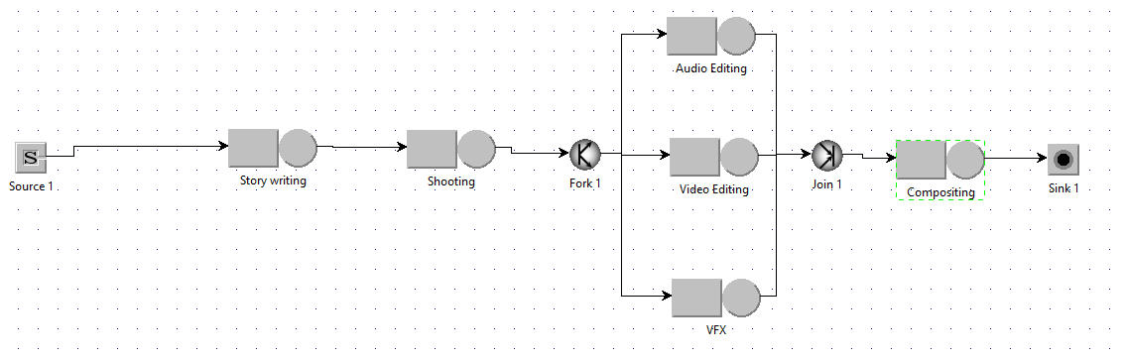
Model - JMT
Steps of the design of the model on JSimGraph:
Add all the required nodes and components of the model;

Slide 10
Model - JMT
Define an open class, setting as Reference Station the Source.
Set deterministic distribution with also the mean value.
Set the necessary parameters in all the queues, in particular the ones of the chosen
distributions for each stage:

Slide 11
Model - JMT
For all stages:
- Queue policy: FCFS and infinite capacity
- Service time distribution according to the fitting (and Erlang for story writing and shooting stages)
- Routing selection: random

Slide 12
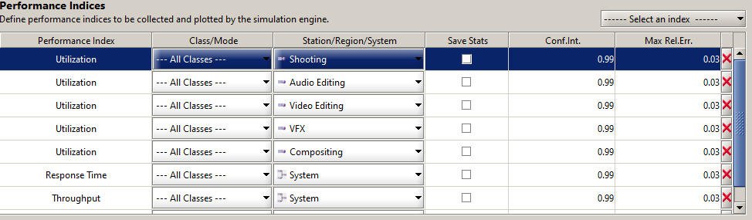
Model - JMT
Define the performance indices to be collected and plotted by the simulation engine:
System Response Time
System Throughput
Utilization of each stage

Slide 13
Results: 1 Audio, 1 Video and 1 VFX (not final result)
I performed the analysis considering 1 unit for audio, 1 for video editing and 1 for VFX. These are the results (by setting a deterministic distribution with mean value = 14 (obtaining the best throughput within 60 days)):
Average N = 4.1551 Average System Throughput = 0.0714
Average System Response time = 58.1258
Utilizations:
Audio = 0.5347, Video = 0.5849, VFX = 0.7070 So, with this configuration, bottlenecks are VFX and Video Editing => I decided to bring directly results with 2 servers for these stations without showing results for intermediate configurations (example: 1 audio 1 video 2 vfx), because by using the fork-join and being stations in parallel, the audio and video editing utilizations will be the same (w.r.t 1-1-1 configuration) considering the same arrival rate. So I added 1 unit for Video Editing and 1 for VFX.

Slide 14
Results: 1 Audio, 2 Video and 2 VFX (final result)
Finally, I performed the analysis considering 1 unit for audio, 2 for video editing and 2 for VFX. These are the results (by setting a deterministic distribution with mean value = 9.3):
System Response Time (R): 57.1441
System Throughput (X): 0.1075
Number of Customers (N): 6.1337
So, considering a response time <= 60 days we can have about N = 6.1337 with a mean throughput (i.e. best throughput) value = 0.1075 (about 1 episode every 9.3 days) I discovered that this is the configuration (2 units for video editing and 2 for vfx) to obtain the best throughput considering a production time <= 60 days.

