Slide 1

Performance Evaluation and Applications
Project D
AA. 2023-2024
Simone Di Ienno
10938038

Slide 2
Presentation
Performance of a Video production company:
The production of an episode of a series can be considered as the execution of six stages and three of them (audio, video and vfx) can be done in parallel). I have used a closed model to represent the Video production in which N is the number of episodes.

Slide 3
Scope
The aim of the project is to find the optimal configuration (i.e. best throughput) by testing different configuration in terms of number of episodes being produced, and number of units being used considering a target throughput and production time less or equal than 60 days. The production can afford two other units to work either on audio, video or VFX. Several episodes can be produced at the same time.
Firstly, I tried on Matlab different distributions for audio, video, vfx and compositing stages to find the best fitting. *For the Story writnig and Shooting stages I considered the given Erlang distributions.

Slide 4
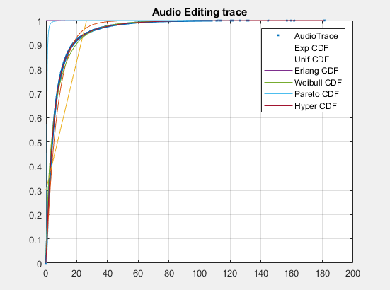
Fitting Audio Editing Trace
Parameters (DISP from matlab) of the distributions AUDIO EDITING:
PARAMETERS HYPEREXP AUDIO EDITING:
0.0542 0.2165 0.2080
PARAMETERS EXP AUDIO EDITING:
0.1334
PARAMETERS WEIBULL AUDIO EDITING:
5.9513 0.7039
PARAMETERS PARETO AUDIO EDITING:
2.2139 4.1090
PARAMETERS UNIFORM AUDIO EDITING:
-11.3686 26.3567

Slide 5
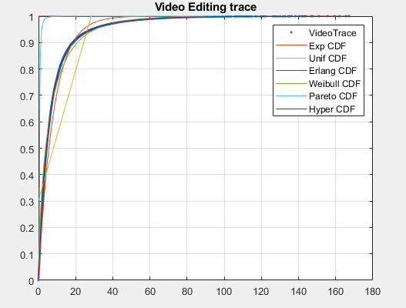
Fitting Video Editing Trace
Parameters (DISP from matlab) of the distributions VIDEO EDITING:
PARAMETERS HYPEREXP VIDEO EDITING:
0.0493 0.1964 0.1944
PARAMETERS EXP VIDEO EDITING:
0.1243
PARAMETERS WEIBULL VIDEO EDITING:
6.3692 0.7013
PARAMETERS PARETO VIDEO EDITING:
2.2123 4.4100
PARAMETERS UNIFORM VIDEO EDITING:
-12.2929 28.3884

Slide 6
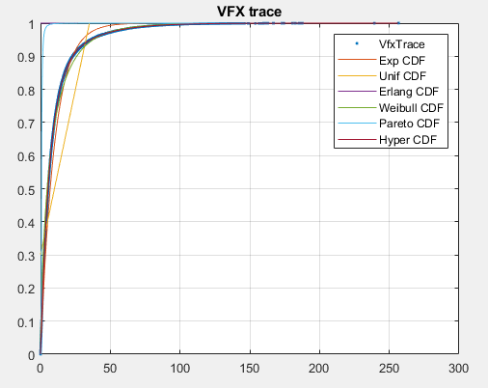
Fitting VFX Trace
Parameters (DISP from matlab) of the distributions VFX:
PARAMETERS HYPEREXP VFX:
0.0406 0.1602 0.2042
PARAMETERS EXP VFX:
0.1000
PARAMETERS WEIBULL VFX:
7.9604 0.7058
PARAMETERS PARETO VFX:
2.2151 5.4844
PARAMETERS UNIFORM VFX:
-15.0873 35.0829

Slide 7
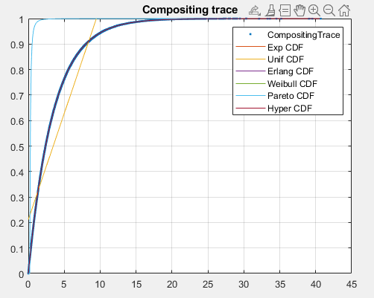
Fitting Compositing Trace
Parameters (DISP from matlab) of the distributions COMPOSITING:
PARAMETERS HYPEREXP COMPOSITING:
0.2881 4.9851 0.9984
PARAMETERS EXP COMPOSITING:
0.2886
PARAMETERS WEIBULL COMPOSITING:
3.4646 0.9993
PARAMETERS PARETO COMPOSITING:
2.4137 2.0298
PARAMETERS UNIFORM COMPOSITING:
-2.5409 9.4720

Slide 8
Distribution Parameters
The distribution which fits better the samples is the HyperExponential for all the stages:
Audio editing → lambda1 = 0.054226907827379,
lambda2 = 0.216503199437902, p1 = 0.208010070660864
Video editing → lambda1 = 0.049271322004497,
lambda2 = 0.196379739222654, p1 = 0.194408203608659
VFX → lambda1 = 0.040597712741720,
lambda2 = 0.160212116919602, p1 = 0.204243742616619
Compositing → lambda1 = 0.288123500939979,
lambda2 = 4.985082669381305, p1 = 0.998407144503040

Slide 9
Model - JMT
Then I decided to model the problem as a Queuing Network defined through queuing
stations. I considered it as a closed, single class model and N which represents the number of episodes.
I used JMT with JSimGraph in order to design this model.

Slide 10
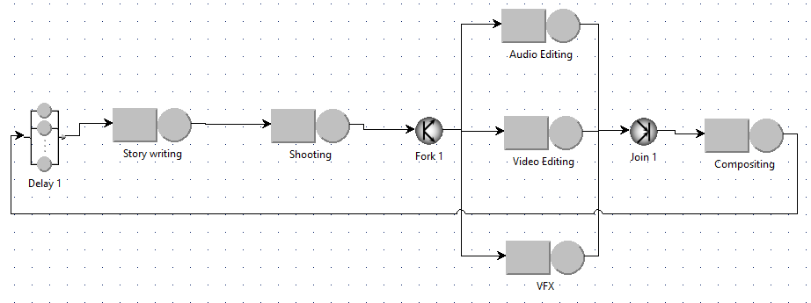
Model - JMT
Steps of the design of the model on JSimGraph:
Add all the required nodes and components of the model;
Set the zero service time as a strategy in the Delay 1 station;

Slide 11
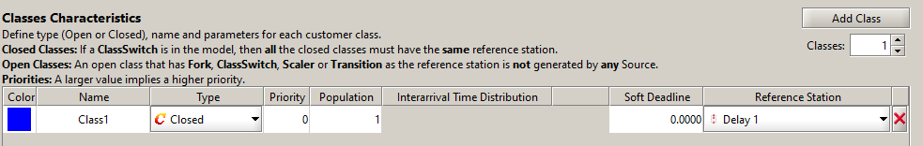
Model - JMT
Set N from 1 to 50 with step = 50 for the What-If analysis.
Define a closed class, setting as Reference Station the Delay 1 station:
Set the necessary parameters in all the queues, in particular the ones of the chosen
distributions for each stage:

Slide 12
Model - JMT
For all the stages:
- Queue policy: FCFS and infinite capacity
- Service time distribution according to the fitting (and Erlang for story writing and shooting stages)
- Routing selection: random

Slide 13
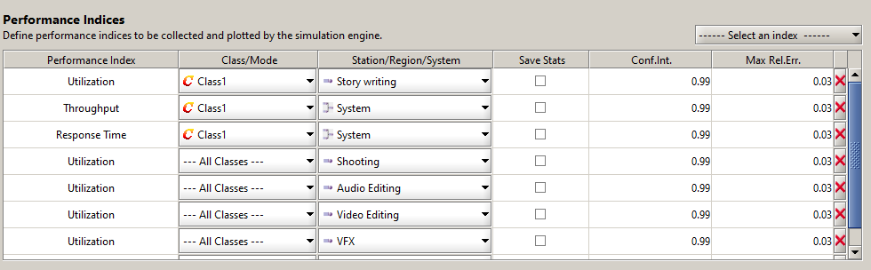
Model - JMT
Define the performance indices to be collected and plotted by the simulation engine:
System Response Time
System Throughput
Utilization of each stage

Slide 14
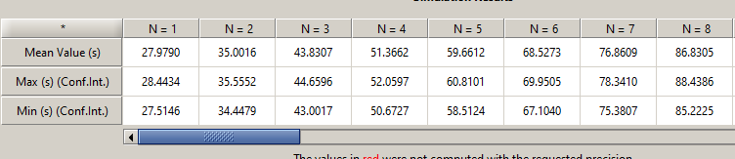
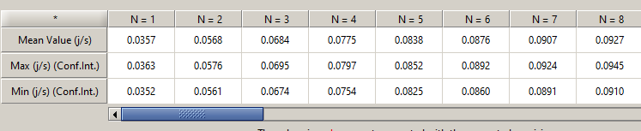
Results: 1 Audio, 1 Video and 1 VFX (not final result)
Finally, I performed the What-If analysis based on N and considering 1 unit for audio and video editing and VFX. These are the results:
System Response Time (Production time):
System Throughput:
So, considering a production time <= 60 days we can have N = 5 (number of episodes) with a mean throughput value = 0.0838 However, with this configuration the VFX stage has the higher utilization; so I added 1 unit for this station.

Slide 15
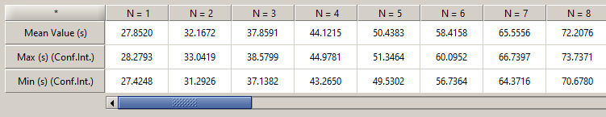

Results: 1 Audio, 1 Video and 2 VFX (not final result)
Now I performed the What-If analysis based on N and considering 1 unit for audio and video editing and 2 VFX (selecting 2 servers in the configuration). These are the results:
System Response Time (Production time):
System Throughput:
So, considering a production time <= 60 days we can have N = 6 (number of episodes) with a mean throughput value = 0.1031 (the throughput has increased) However, with this configuration the Video Editing stage has the higher utilization; so I added 1 unit for this station.

Slide 16
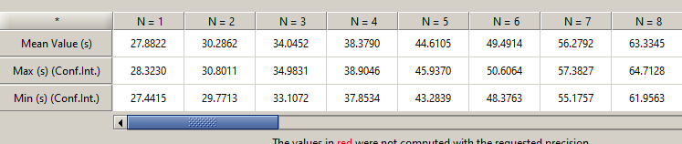
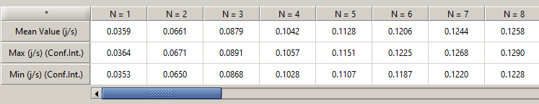
Results: 1 Audio, 2 Video and 2 VFX (final result)
Now I performed the What-If analysis based on N and considering 1 unit for audio, 2 video editing and 2 VFX (selecting 2 servers in the configuration). These are the results:
System Response Time (Production time):
System Throughput:
So, considering a production time <= 60 days we can have N = 7 (number of episodes) with a mean throughput value = 0.1244 (the throughput has increased) I discovered that this is the configuration (2 units for video editing and 2 for vfx) to obtain the best throughput considering a production time <= 60 days. Also the target throughput is guaranteed.

