Slide 1

Using GitHub

Slide 2
Why?
Reuse and Sharing of Knowledge
Many educators around the world teach similar courses. An open source collaboration platform allows fellow educators and students access to infinite resources.
Keeping up to date
Github provides the ability to “follow” a user to receive notifications of their Github activity. You can also “watch” a project to receive notifications when the project is updated.
Industry Relevance
GitHub can also be used as a portfolio showcasing your work. It is common for employers to evaluate candidates based on their existing projects and activity on GitHub. [A GitHub account is a résumé.]

Slide 3
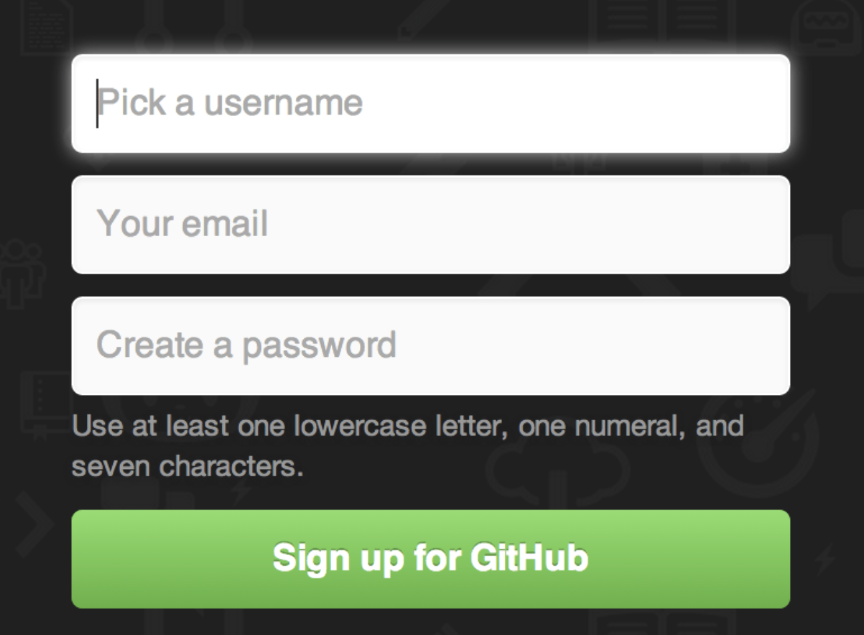
Sign up
GitHub is free for small, public, projects.
The first thing you need to do is set up a free user account. Simply visit https://github.com, choose a user name that isn’t already taken, provide an email address and a password, and click the big green “Sign up for GitHub” button.

Slide 4
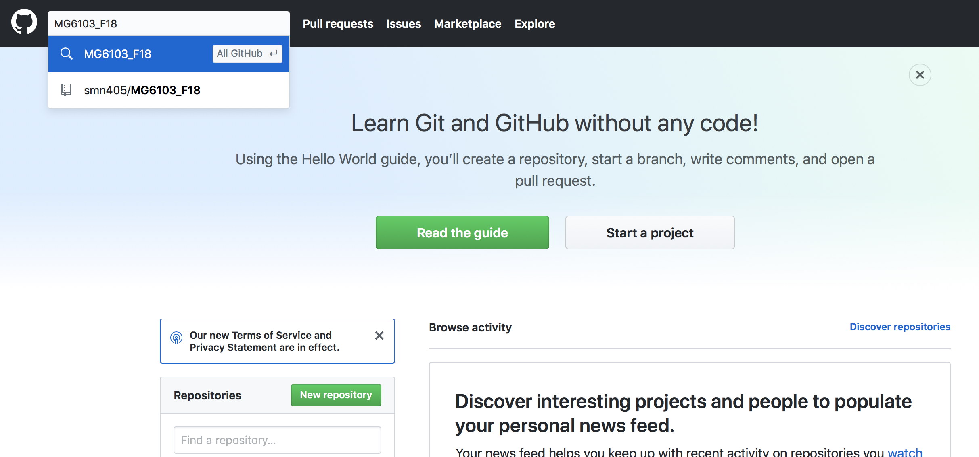
Finding our repository
Once you’ve signed in to GitHub, you can find a repository by using the search box.
Enter MG6103_F18 into the search box and hit enter

Slide 5
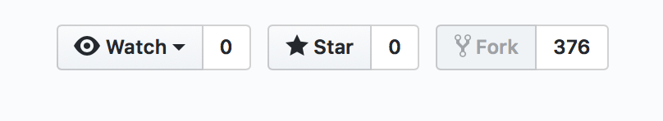
Forking a Repository
A fork is a copy of a repository
Forking creates a new repository in your account that is the clone of another repository. You can then work on your copy of the repository and push changes to your copy
GitHub allows your changes to be sent to the original repository using a “pull request”
More details on forking can be found in the GitHub Help
https://help.github.com/articles/fork-a-repo

Slide 6
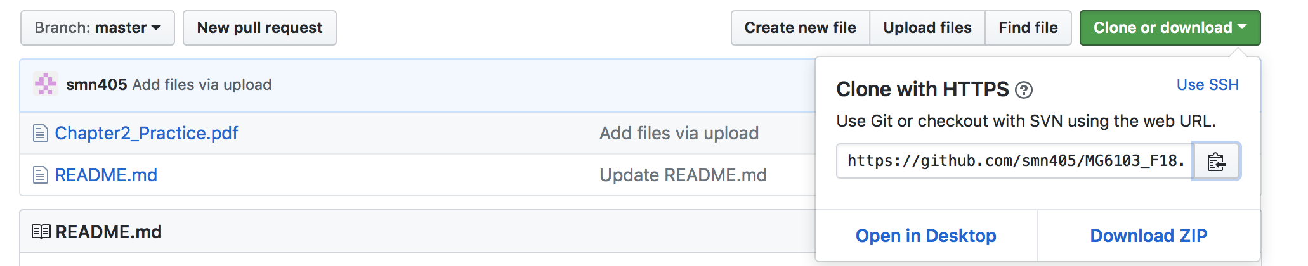
Clone or Download options
Students with some Git experience can simply clone the repository by typing: git clone https://github.com/smn405/MG6103_F18.git Github also allows users to download the repository content as a ZIP file.

Slide 7
References:
Pro Git by Scott Chacon, Apress, 2009: Github Account setup
GitHub Help: Help
Remember: Learning to use Github is easy, and intuitive. If you're new to it you’re more than likely to use encounter it again in future academic/industry situations.
You’re all set….Happy Github-ing !!

