Slide 1
CS-773 Project Microarchitecture interactions in multicore systems
Sumon Nath Profetcher(#7) sumon@cse.iitb.ac.in

Slide 2
Background
Cache Management techniques
Cache Prefetcher
Interaction

Slide 3
Previous ideas
Prefetch aware cache management [MICRO 2011]
Targets replacement policy only
Kill the PC - KPC [ASPLOS 2017]
Not flexible
Harmony³
Targets replacement policy only

Slide 4
Idea
Fine grained approach: identify interactions
Dynamically tune replacement policy & prefetcher
Across the cache hierarchy
Flexible: works with any prefetcher & replacement policy

Slide 5
Interactions
Dead block : not reused in future
A
B
C
D
…
X
Useful block : reused in future
Positive Interaction
Cache
Notes:
Explain the interaction part with example

Slide 6
Interactions
Useful
Dead
Positive:
Evicts
X
Y
Dead
Useful
2. Negative:
X
Evicts
Y
Useful
Useful
Dead
Dead
3. Neutral:
X
Evicts
Y
X
Evicts
Y

Slide 7
Where does prefetcher comes in?
Prefetch
Evicts
Demand
Demand
Evicts
Prefetch
Why?
Prefetch
Evicts
Prefetch
Demand
Evicts
Demand
Takeaway: Consider interactions with at-least one prefetch

Slide 8
Goal
Capture interaction b/w cache management techniques & cache prefetchers
At least one prefetch block in an interaction
Captures
Prefetching decisions
Evictions
Captures
Cache management decision

Slide 9
Ways to identify interactions
Problem: correctly identify blocks to be useful/dead
Techniques used:
Predictor based
Future access based
Notes:
Add the predictor part & say why it does not work

Slide 10
Predictor based
Dead block predictor
8-bit global hysteresis counter
Increments counter when block is evicted with no reuse
Decrements counter on cache hits
Predicts block is dead when counter saturates
Notes:
Add the predictor part & say why it does not work

Slide 11
Predictor results - LLC
Prefetcher: IPCP
Management technique: Hawkeye
High percentage (80%) neutral interaction
Notes:
Add the predictor part & say why it does not work

Slide 12
Predictor results - LLC
Prefetcher: SPP
Management technique: SHiP++
High percentage (60%) neutral interaction
Notes:
Add the predictor part & say why it does not work

Slide 13
Pros & cons
Simple to implement
Dynamically adapts to changing program behavior
Course grained
High number of neutral interactions
Notes:
Add the predictor part & say why it does not work

Slide 14
Future access based
Table which stores the evictions as well as all cache accesses.
Eviction/Access | Incoming Line | Type | Evicted Line | Type
Notes:
Explain this properly with animation

Slide 15
Future access based
Table which stores the evictions as well as all cache accesses.
Eviction/Access | Incoming Line | Type | Evicted Line | Type
Eviction | X | Prefetch | Y | Demand
Notes:
Explain this properly with animation

Slide 16
Future access based
Table which stores the evictions as well as all cache accesses.
Eviction/Access | Incoming Line | Type | Evicted Line | Type
Eviction | X | Prefetch | Y | Demand
Access | Y
Notes:
Explain this properly with animation

Slide 17
Future access based
Table which stores the evictions as well as all cache accesses.
Eviction/Access | Incoming Line | Type | Evicted Line | Type
Eviction | X | Prefetch | Y | Demand
Access | Y
Access | Y
Notes:
Explain this properly with animation

Slide 18
Future access based
Table which stores the evictions as well as all cache accesses.
Eviction/Access | Incoming Line | Type | Evicted Line | Type
Eviction | X | Prefetch | Y | Demand
Access | Y
Access | Y
Eviction | Z | Demand | W | Prefetch
Negative interaction
- 0 hits
- 2 hits
Notes:
Explain this properly with animation

Slide 19
True interactions at LLC
Prefetcher: IPCP
Management technique: Hawkeye
High percentage (87%) negative interaction
Notes:
Add the predictor part & say why it does not work

Slide 20
True interactions at LLC
Prefetcher: SPP
Management technique: SHiP++
High percentage (63%) negative interaction
Notes:
Add the predictor part & say why it does not work

Slide 21
Breakdown of neg interactions
Prefetcher: IPCP
Management technique: Hawkeye
Almost 99% neg interaction are due to useless evicting useless blocks
Notes:
Add the predictor part & say why it does not work

Slide 22
Breakdown of neg interactions
Prefetcher: SPP
Management technique: SHiP++
Almost 98% neg interaction are due to useless evicting useless blocks
Notes:
Add the predictor part & say why it does not work

Slide 23
Ideal performance improvement
What if all negative interactions are eliminated?
Upper bound performance improvement

Slide 24
Methodology
Mathematical model
Additional penalty introduced by negative interactions
Remove penalty to find perf. improvement

Slide 25
Additional penalty
Negative interaction introduce additional penalty for every DRAM access = P
# DRAM access = # of LLC misses
$Additional penalty due to the negative interations per LLC miss$ (P)
$=$ $avg miss latency with prefetcher − avg miss latency without prefetche$r
Problem: Multiple LLC misses processed simultaneously
Notes:
Explain this properly

Slide 26
Out-of-order CPU
MSHR
100 cycles
LOAD A
110 cycles
LOAD B
120 cycles
LOAD C
130 cycles
LOAD D
Average miss latency = (100 + 110 + 120 + 130) /4 = 115 cycles
Amortized miss latency over the instruction window = 115 / 4 = 29 cycles
MSHR occupancy
Notes:
Explain this properly

Slide 27
Additional penalty - Fixed
Negative interaction introduce additional penalty for every DRAM access
# DRAM access = # of LLC misses
$Additional penalty due to the negative interations per LLC miss$ (P)
$=$ $avg miss latency with prefetcher − avg miss latency without prefetche$r
$P=$ $\frac{avg miss latency with prefetcher − avg miss latency without prefetcher}{avg MSHR occupancy}$
Notes:
Explain this properly

Slide 28
CPU cycles saved
Let fraction of LLC misses suffering from penalty be F
$$F=number of llc misses × frac. Negative interactions$$
$$CPU cycles saved=\text{F} ×\text{P}$$
Notes:
Explain this properly

Slide 29
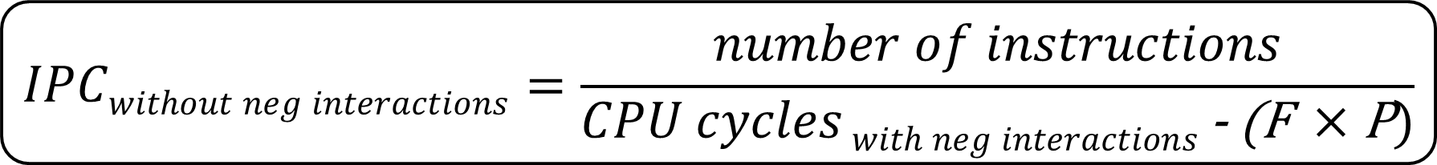
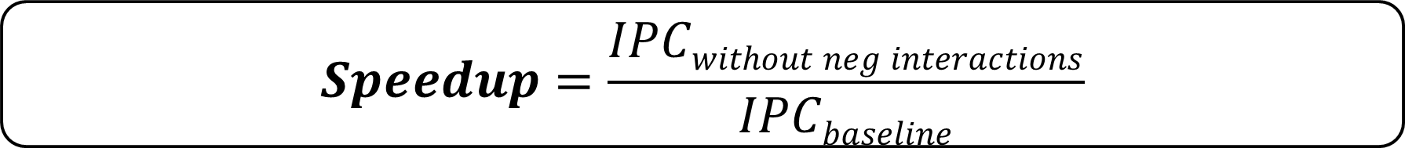
Performance improvement
$$IPCwithout neg interactions=\frac{number of instructions}{CPU cycles with neg interactions \text{- }\text{(}\text{F} ×\text{P})}$$
$$Speedup=\frac{IPCwithout neg interactions}{IPCbaseline}$$
Notes:
Explain this properly

Slide 30
Multicore systems
Servers – Multicore system
32 cores
DRAM BW per channel – 6400 MT/s
4 available channels
1 channel for 8 cores
On average per core DRAM BW
– 800 MT/s

Slide 31
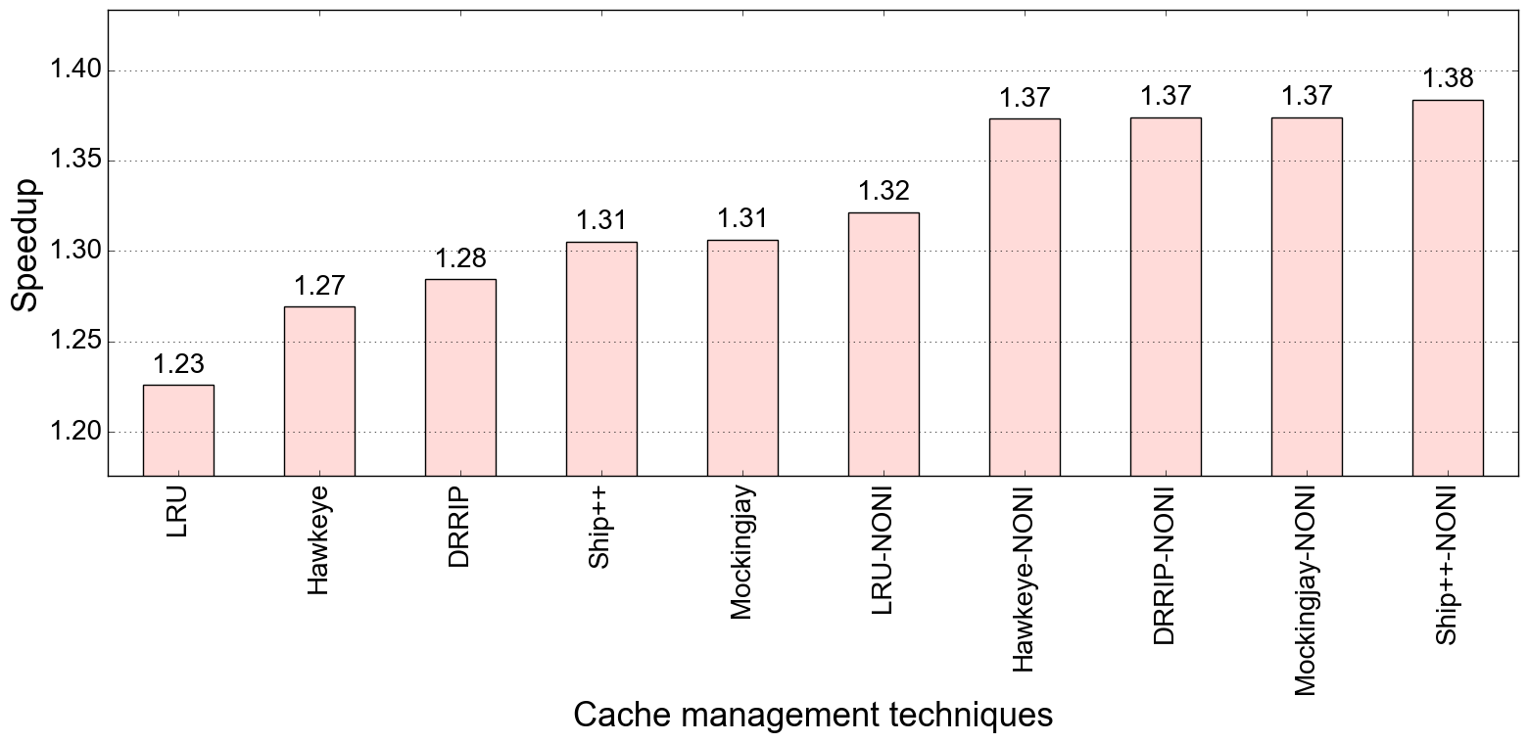
Performance improvement : IPCP (low DRAM Bandwidth, baseline: LRU, no pref)
NONI: no negative interactions
Bench: SPEC 2017
Spread of the plot is ~15%

Slide 32
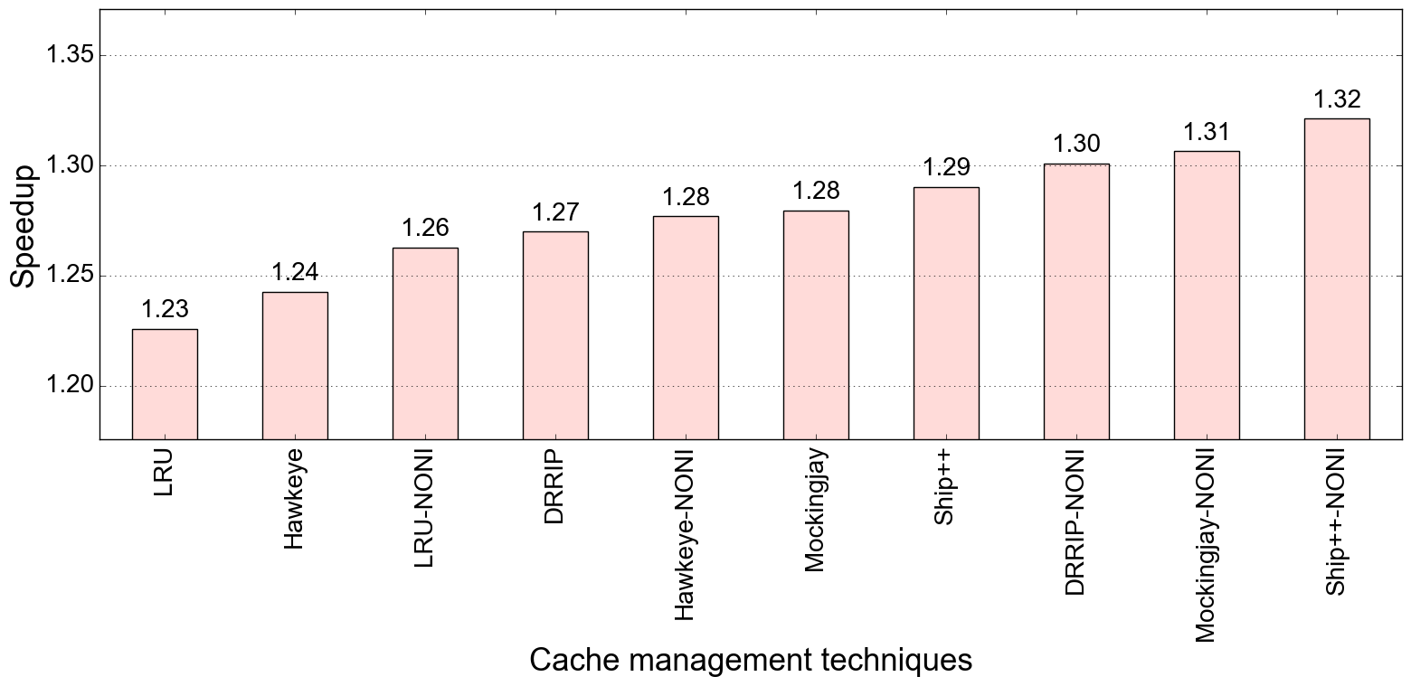
Performance improvement : SPP (low DRAM BW , baseline: LRU, no pref)
Bench: SPEC 2017
Spread of the plot is ~9%

Slide 33
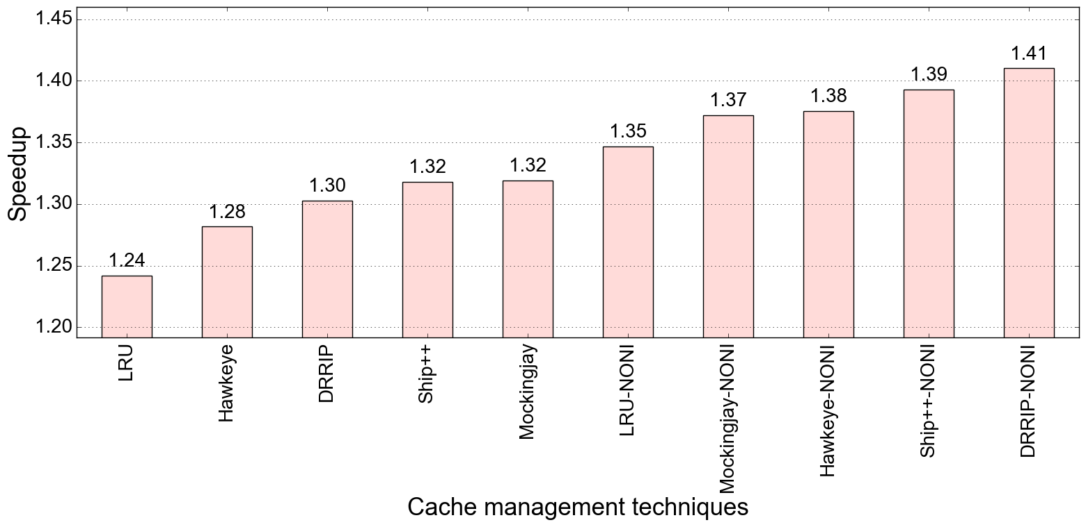
Performance improvement : IP-stride & Next-line (low DRAM BW , baseline: LRU, no pref)
Bench: SPEC 2017
Spread of the plot is ~17%

Slide 34
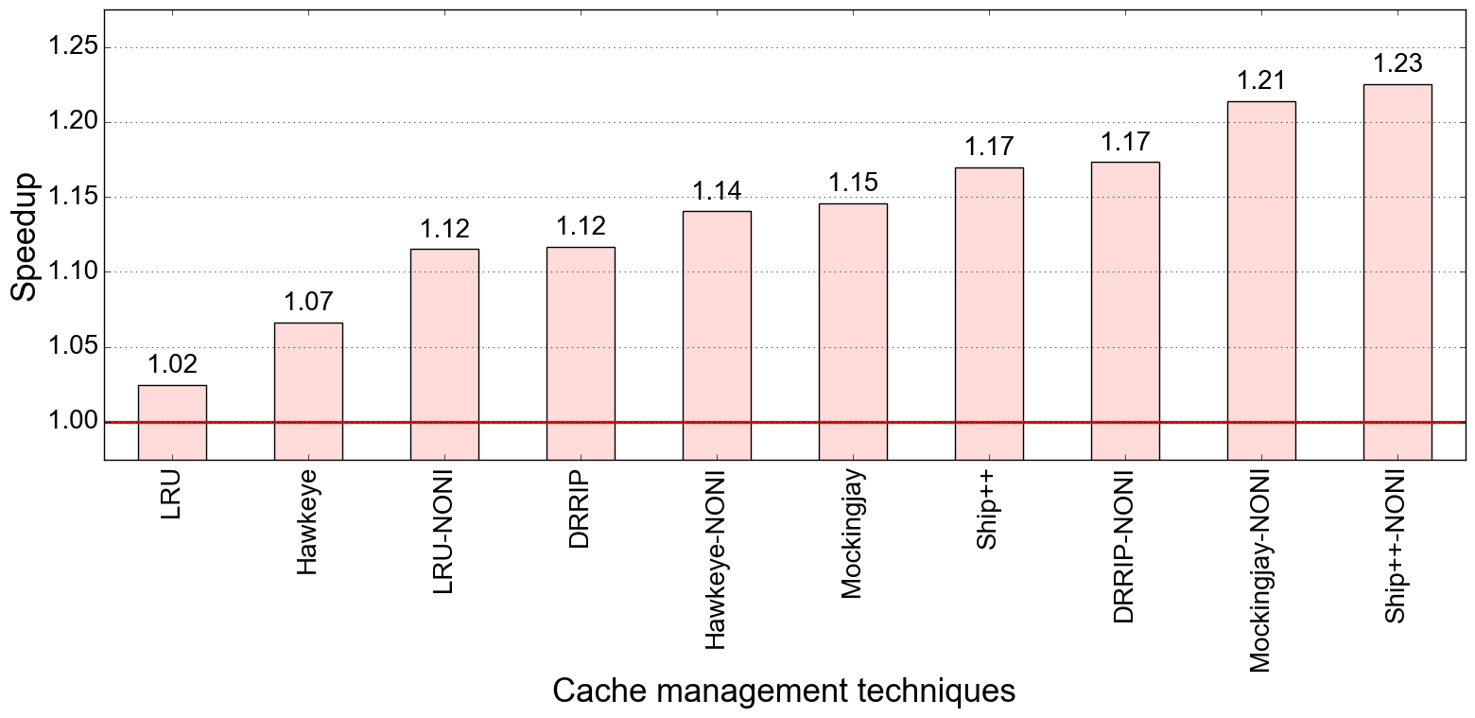
Performance improvement : IPCP (low DRAM Bandwidth, baseline: LRU, no pref)
Bench: GAP
Spread of the plot is ~21%

Slide 35
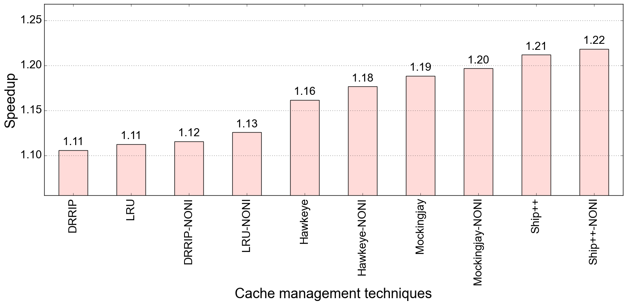
Performance improvement : SPP (low DRAM BW , baseline: LRU, no pref)
Bench: GAP
Spread of the plot is ~11%

Slide 36
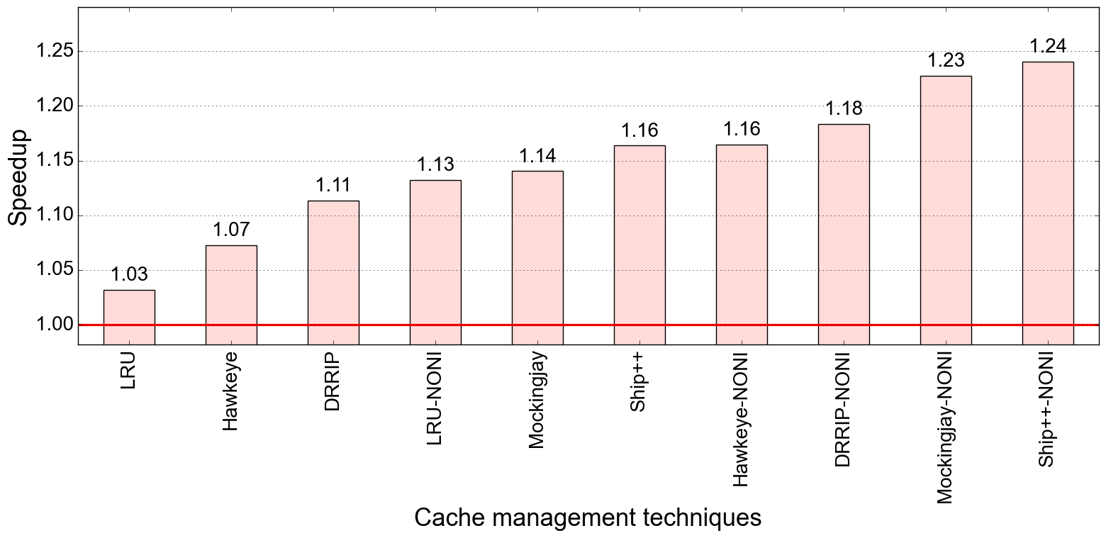
Performance improvement : IP-stride & Next-line (low DRAM BW , baseline: LRU, no pref)
Bench: GAP
Spread of the plot is ~21%

Slide 37
Conclusion
Overall high performance improvement for the ideal case
Will be exploring various ideas and techniques to minimize the negative interactions

Slide 38
Github link
https://github.com/smn98/Champsim-RnD

Slide 39
Thank You

