Slide 1
CS-773 Project checkpoint 2 Microarchitecture interactions
Sumon Nath Profetcher(#7) sumon@cse.iitb.ac.in

Slide 2
Background
Cache Replacement policy
Cache Prefetcher
Interaction

Slide 3
Previous ideas
Prefetch aware cache management(PACMan¹)
Targets replacement policy only
Kill the PC(KPC²)
Not flexible
Harmony³
Targets replacement policy only
[1] Jain, Akanksha, and Calvin Lin. "Rethinking belady's algorithm to accommodate prefetching." In 2018 ACM/IEEE 45th Annual International Symposium on Computer Architecture (ISCA), pp. 110-123. IEEE, 2018.
[2] Kim, Jinchun, Elvira Teran, Paul V. Gratz, Daniel A. Jiménez, Seth H. Pugsley, and Chris Wilkerson. "Kill the program counter: Reconstructing program behavior in the processor cache hierarchy." ACM SIGPLAN Notices 52, no. 4 (2017): 737-749.
[3] Wu, Carole-Jean, Aamer Jaleel, Margaret Martonosi, Simon C. Steely Jr, and Joel Emer. "PACMan: prefetch-aware cache management for high performance caching." In Proceedings of the 44th Annual IEEE/ACM International Symposium on Microarchitecture, pp. 442-453. 2011.

Slide 4
Proposed idea
Fine grained approach: identify interactions
Dynamically tune replacement policy & prefetcher
Across the cache hierarchy
Flexible: works with any prefetcher & replacement policy

Slide 5
Interactions- cache eviction
Positive interaction
Useful block evicts useless block
Negative interaction
Useless block evicts useful block
*Useless prefetch block evicts useless block
Neutral interaction
other cases

Slide 6
Ways to identify interactions
Predictor based ~ not precise
Future access based ~ precise

Slide 7
Identification of interactios
Table which stores the interaction as well as all cache accesses.
Is_eviction | Line_1 | Type_1 | Line_2 | Type
1 | A(evicts) | P | X(evicted) | C
0 | X(access)
0 | X(access)
1 | Y(evicts) | C | Z(evicted) | P
At the end of epoch
Parse table to record interaction

Slide 8
Interactions distribution
Prefetcher used at L1, L2 : IPCP
Replacement policy used at LLC: LRU
Negative interactions: ~80%

Slide 9
Breakdown of negative interactions
98% : Useless Prefetch blocks evicting useless blocks
Inaccurate prefetches

Slide 10
Checkpoint - 1

Slide 11
Ideal performance improvement
What if all negative interactions are eliminated?
Upper bound performance improvement

Slide 12
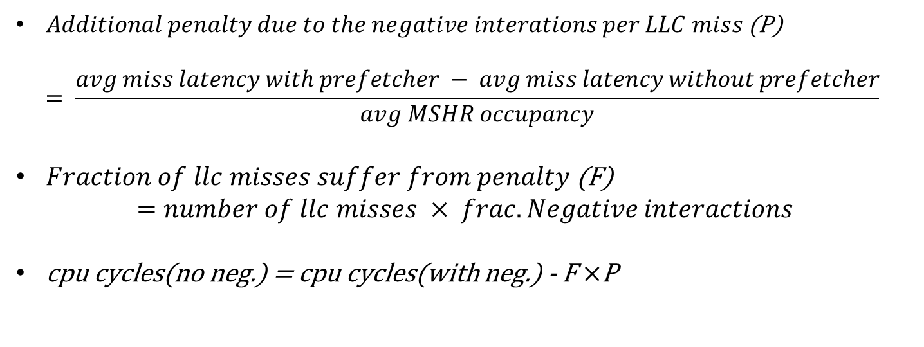
Methodology
$Additional penalty due to the negative interations per LLC miss$ (P)
$$= \frac{avg miss latency with prefetcher − avg miss latency without prefetcher}{avg MSHR occupancy}$$
$Fraction of llc misses suffer from penalty$(F)
$$=number of llc misses × frac. Negative interactions$$
cpu cycles(no neg.) = cpu cycles(with neg.) - F $×$P

Slide 13
Performance improvement
Baseline: IPCP prefetcher
0.8% speedup with no negative interaction at LLC

Slide 14
Performance improvement
Baseline: No prefetcher
IPCP: 30%
IPCP(no neg) : 31%
Ideal L1D : 62%

Slide 15
Low DRAM bandwidth
Servers – Multicore system
32 cores
DRAM BW per channel – 6400 MT/s
4 available channels
1 channel for 8 cores
On average per core DRAM BW
– 800 MT/s

Slide 16
Performance improvement(low DRAM BW)
Baseline: IPCP prefetcher
5.2% speedup with no negative interaction at LLC

Slide 17
Performance improvement(low DRAM BW)
IPCP(with neg): 20%
IPCP(no neg) : 26%
Ideal L1D: 78%
Baseline: No prefetcher

Slide 18
Checkpoint - 2

Slide 19
Work done
Automated all experiments for different prefetcher and replacement policy combinations
Written scripts to generate plots

Slide 20
Experiment results
Following graph shows the performance improvement for a fixed prefetcher with varying replacement policies with/without negative interaction compared to an LRU baseline with no prefetching

Slide 21
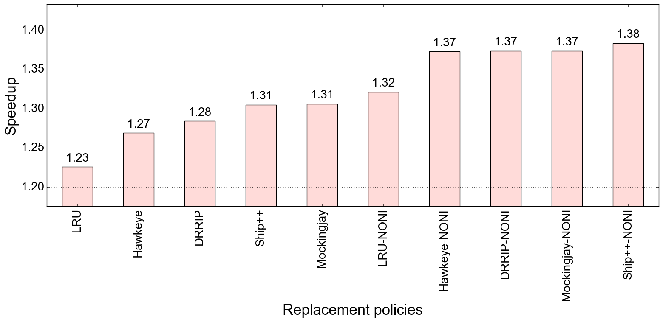
Performance improvement : IPCP (low DRAM BW, baseline: LRU, no pref)
NONI: no negative interactions
Bench: SPEC 2017
Spread of the plot is ~15%

Slide 22
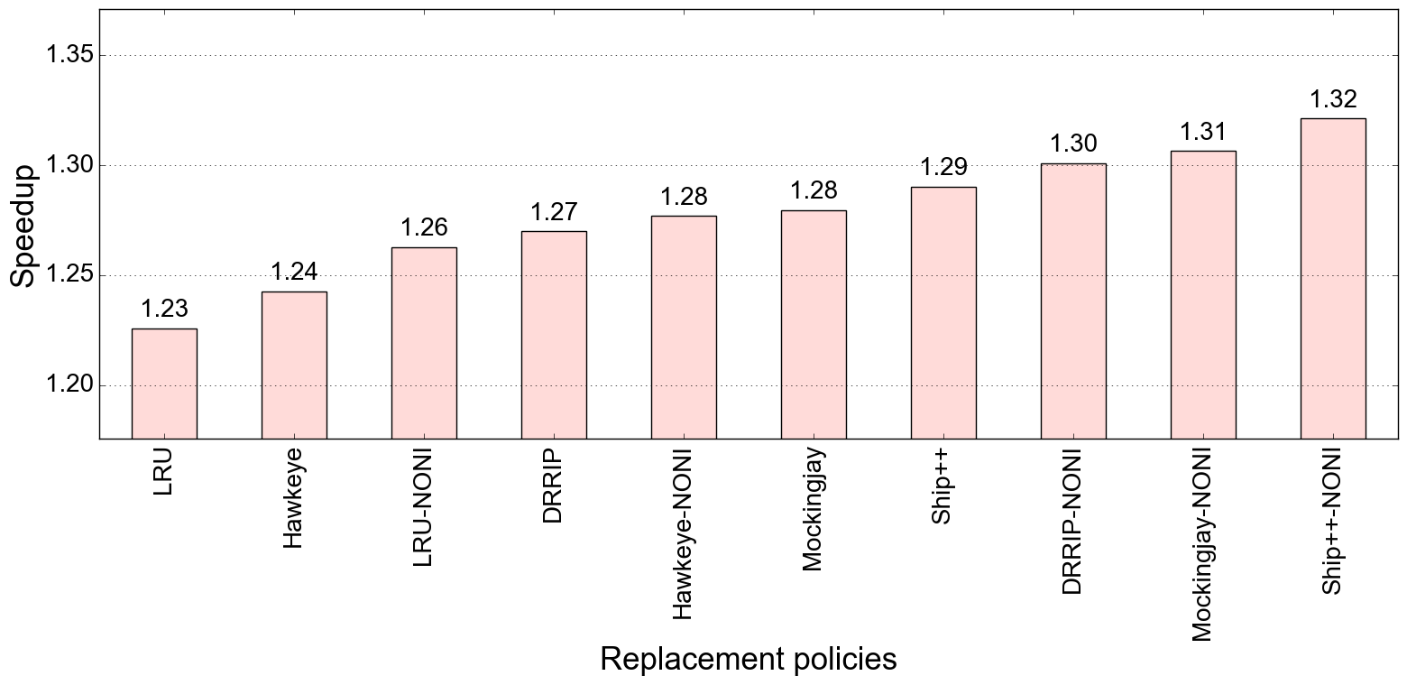
Performance improvement : SPP (low DRAM BW , baseline: LRU, no pref)
Bench: SPEC 2017
Spread of the plot is ~9%

Slide 23
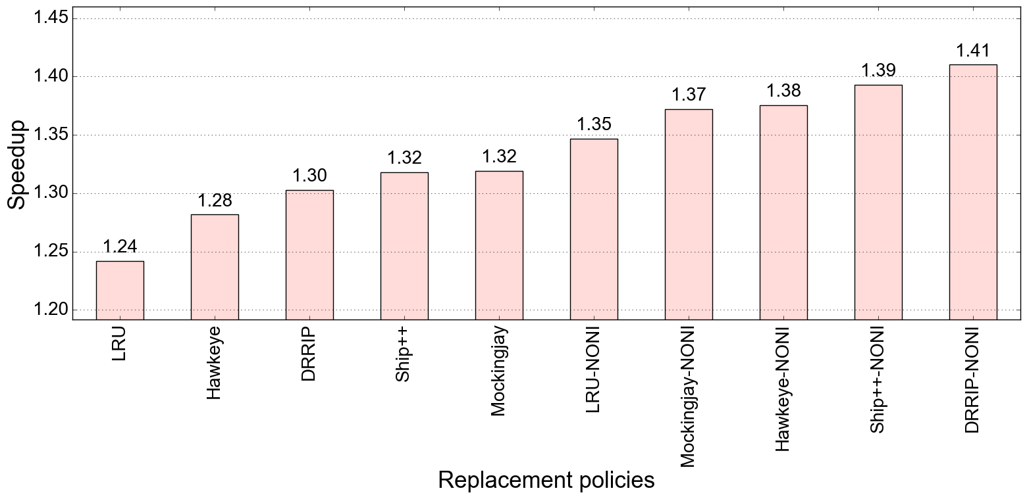
Performance improvement : IP-stride & Next-line (low DRAM BW , baseline: LRU, no pref)
Bench: SPEC 2017
Spread of the plot is ~17%

Slide 24
Experiment results
Following graph shows the performance improvement for a fixed replacement policy with varying prefetchers with/without negative interaction compared to an LRU baseline with no prefetching

Slide 25
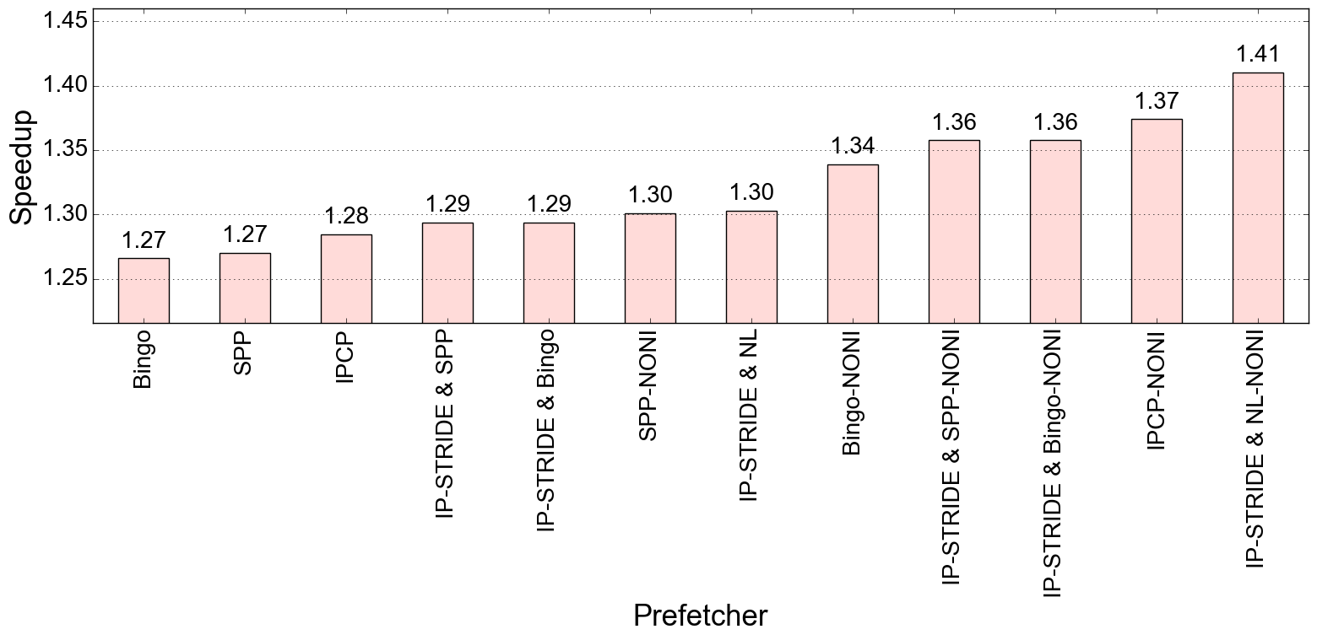
Performance improvement : DRRIP (low DRAM BW, baseline: LRU, no pref)
Bench: SPEC 2017
Spread of the plot is ~14%

Slide 26
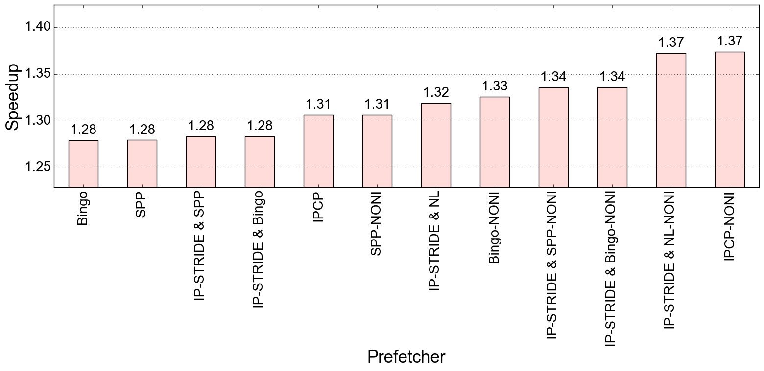
Performance improvement : Mockingjay (low DRAM BW , baseline: LRU, no pref)
Bench: SPEC 2017
Spread of the plot is ~9%

Slide 27
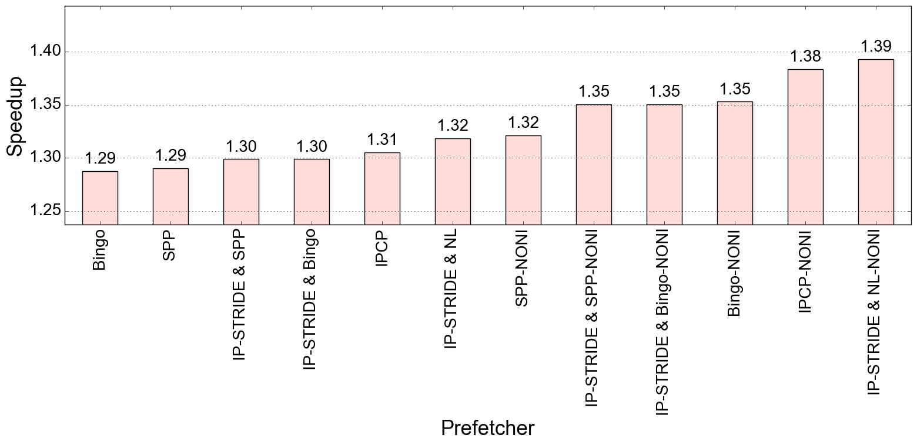
Performance improvement : Ship++ (low DRAM BW , baseline: LRU, no pref)
Bench: SPEC 2017
Spread of the plot is ~10%

Slide 28
Conclusion
Overall we get a high performance improvement for the ideal case when negative interactions are eliminated.
We will be exploring various ideas and techniques to minimize the negative interactions and improve performance.

Slide 29
Github link
https://github.com/smn98/Champsim-RnD

Slide 30
Thank You

