Slide 1
CASPER @ IIT Bombay
Discussion
Week of July 4, 2022
Sumon sumon@cse.iitb.ac.in

Slide 2
Interaction per cache set (Single core)
Benchmark: 602.gcc_s-2226B
Prefetcher: IP-stride & Next-line
Management technique: Mockingjay

Slide 3
Interaction per cache set (Single core)
Benchmark: 605.mcf_s-1554B
Prefetcher: IP-stride & Bingo
Management technique : Ship++

Slide 4
Interaction per cache set (Single core)
Benchmark: 607.cactuBSSN_s-3477B
Prefetcher: Bingo
Management technique : DRRIP

Slide 5
Interaction per cache set (Single core)
Benchmark: 619.lbm_s-2677B
Prefetcher: IPCP
Management technique : LRU

Slide 6
Interaction per cache set (Single core)
Benchmark: 623.xalancbmk_s-10B
Prefetcher: SPP
Management technique : Mockingjay

Slide 7
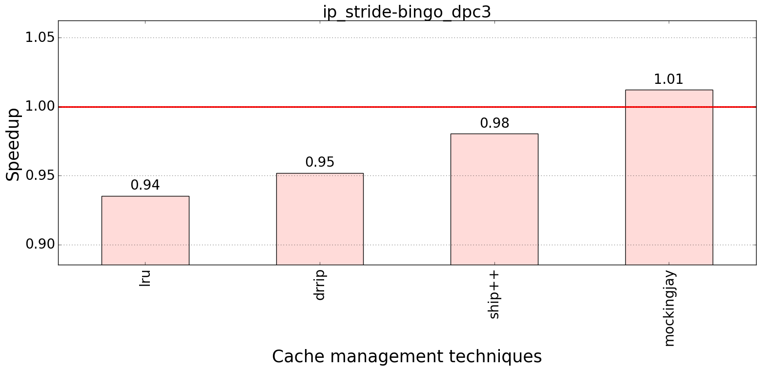
Performance improvement : IP-stride & Bingo (heterogenous mixes - 8 core)
Bench: SPEC 2017
Baseline:
No prefetcher
LRU

Slide 8
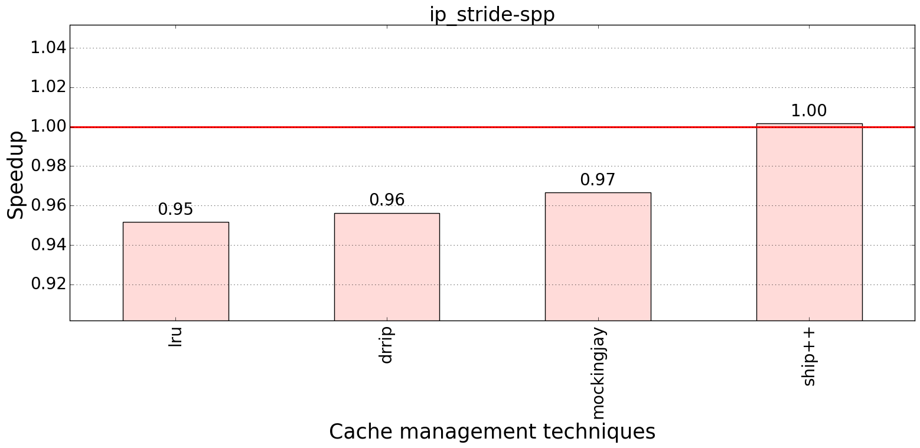
Performance improvement : IP-stride & SPP (heterogenous mixes - 8 core)
Bench: SPEC 2017
Baseline:
No prefetcher
LRU

Slide 9
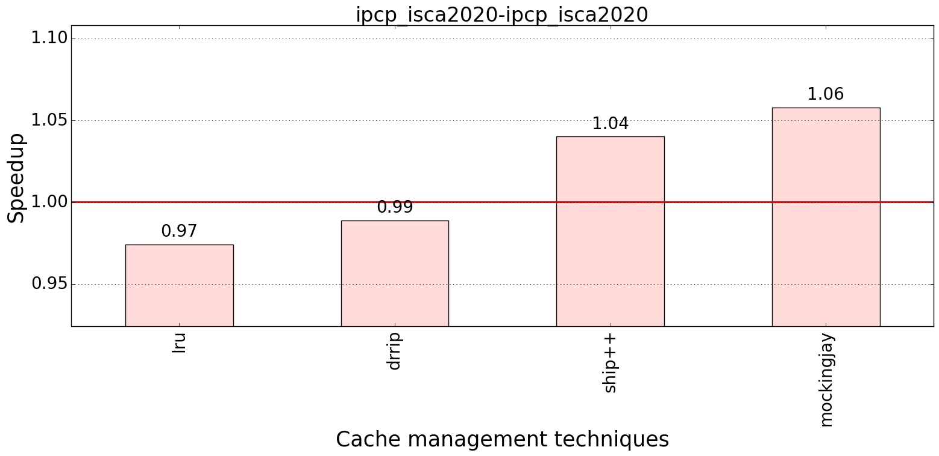
Performance improvement : IPCP (heterogenous mixes - 8 core)
Bench: SPEC 2017
Baseline:
No prefetcher
LRU

Slide 10
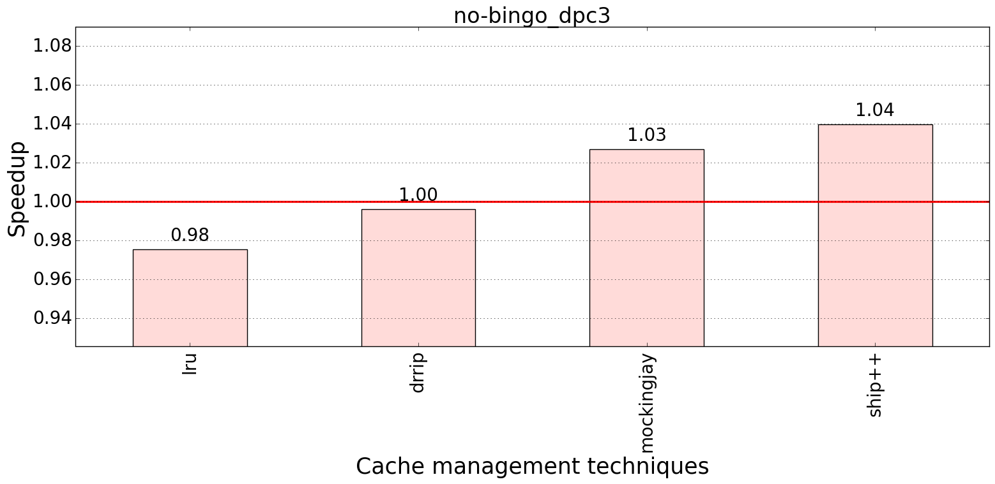
Performance improvement : Bingo (heterogenous mixes - 8 core)
Bench: SPEC 2017
Baseline:
No prefetcher
LRU

Slide 11
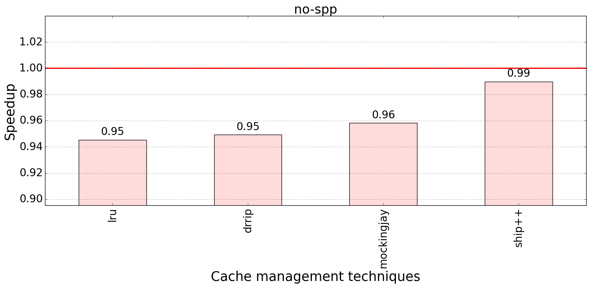
Performance improvement : SPP (heterogenous mixes - 8 core)
Bench: SPEC 2017
Baseline:
No prefetcher
LRU

Slide 12
CASPER @ IIT Bombay
Discussion
Week of June 2, 2022
Sumon sumon@cse.iitb.ac.in

Slide 13
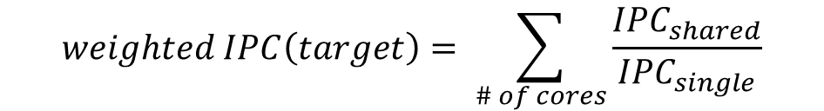
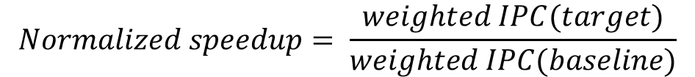
Multicore: Normalized speedup
Shared environment (multicore)
$$weighted IPC\left(target\right)= \sum_{\# of cores}{\frac{{IPC}_{shared}}{{IPC}_{single}}}$$
Isolated environment
Same for baseline, weighted IPC(baseline)
$$Normalized speedup= \frac{weighted IPC(target)}{weighted IPC(baseline)}$$

Slide 14
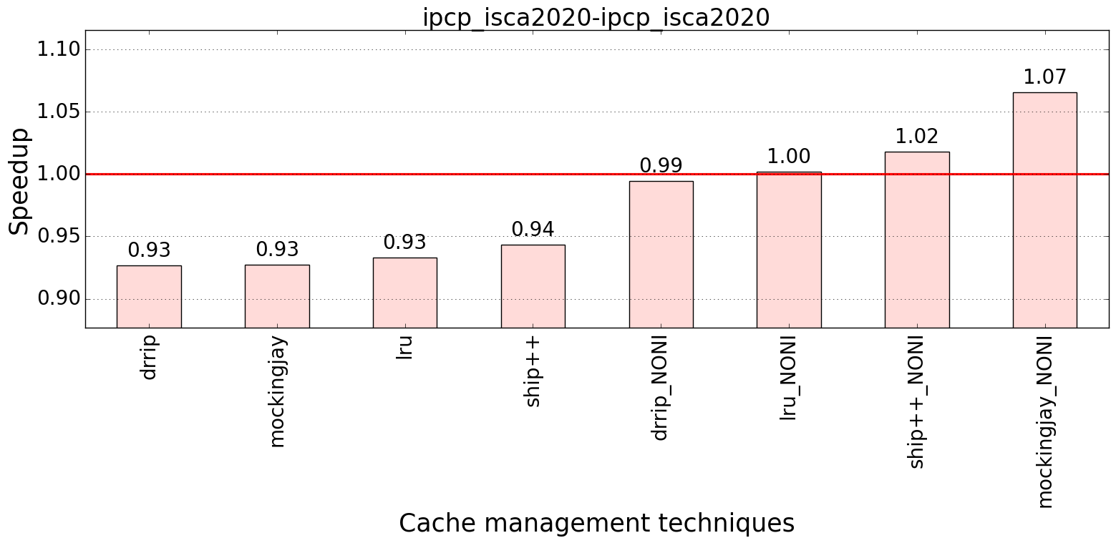
Performance improvement : IPCP
Bench: SPEC 2017
Baseline:
No prefetcher
LRU

Slide 15
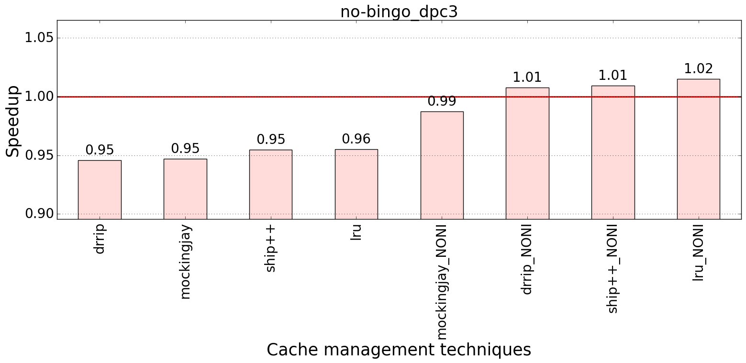
Performance improvement : Bingo
Bench: SPEC 2017
Baseline:
No prefetcher
LRU

Slide 16
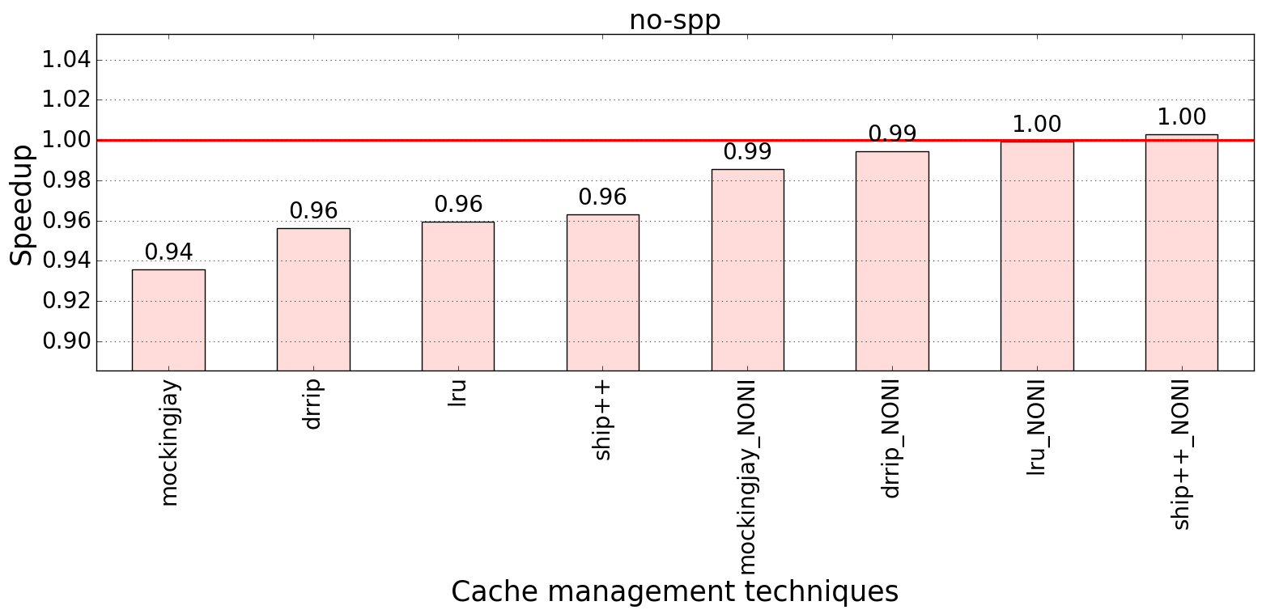
Performance improvement : SPP
Bench: SPEC 2017
Baseline:
No prefetcher
LRU

Slide 17
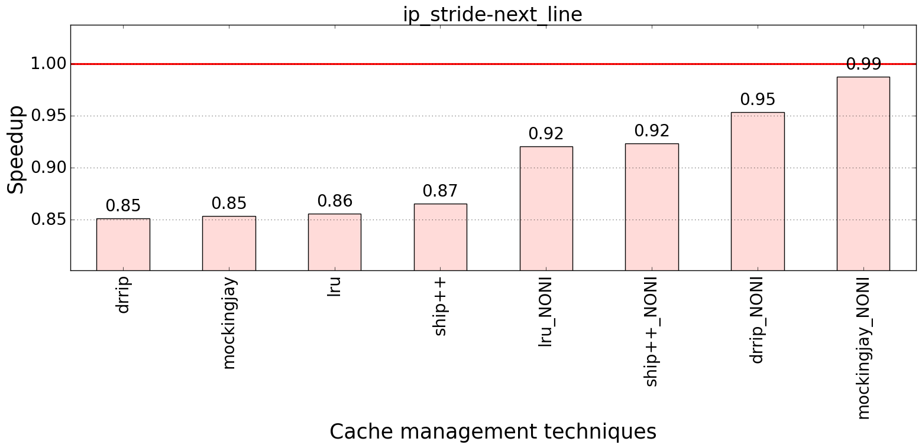
Performance improvement : IP-stride & Next-line
Bench: SPEC 2017
Baseline:
No prefetcher
LRU

Slide 18
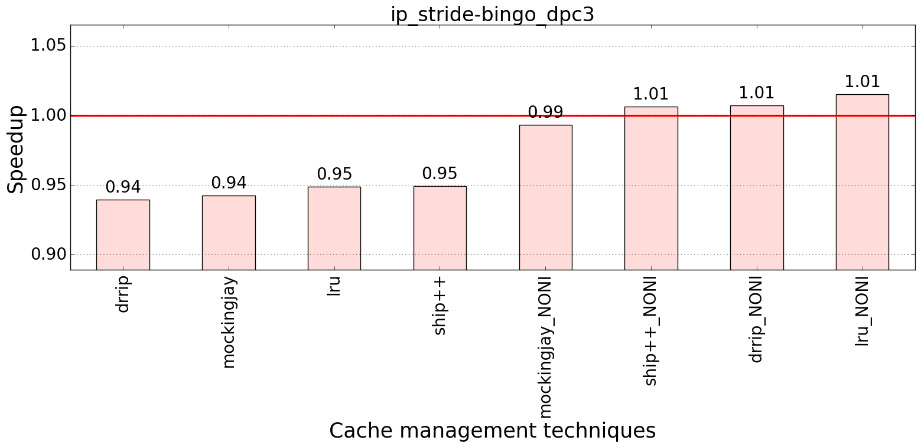
Performance improvement : IP-stride & Bingo
Bench: SPEC 2017
Baseline:
No prefetcher
LRU

