Slide 1
CS305: Computer Architecture
Tutorial-I
https://www.cse.iitb.ac.in/~biswa/courses/CS305/main.html

Slide 2
Problem-1
Consider the unpipelined processor that has a 1 ns clock cycle and that it uses 4 cycles for ALU operations and branches and 5 cycles for memory operations. Assume that the relative frequencies of these operations are 40%, 20%, and 40%, respectively. Suppose that pipelining the processor adds 0.2 ns of overhead to the clock. Ignoring any latency impact, how much speedup in the instruction execution rate will we gain from a pipeline?

Slide 3
Solution
The average instruction rate (execution time) on the unpipelined processor =
Clock cycle X Average CPI
= 1 ns X [(40% + 20%)X 4 + 40% X 5]
= 1 ns X 4.4 = 4.4 ns

Slide 4
Solution Contd.
In the pipelined processor,
Clock cycle time = 1ns + 0.2ns latch overhead = 1.2ns
Speedup = 4.4/1.2 = 3.66 times
tips: The question does not mention #pipeline stages. If you think deep, it does not matter because after a while one instruction will be done in one cycle, so speedup is just the ratio of cycle time

Slide 5
Problem-2
Consider a 4-stage pipelined CPU with the following details in terms of #cycles: I1 to I4 are four instructions
 | Stage-1 | Stage-2 | Stage-3 | Stage-4
I1 | 2 | 1 | 1 | 1
I2 | 1 | 3 | 2 | 2
I3 | 2 | 1 | 1 | 3
I4 | 1 | 2 | 2 | 2
How many cycles will it take to execute (i) I1 to I4 once (ii) I1 to I4 twice

Slide 6
Try it on your own for two iterations (I1 to I4 twice)
The answer will be 23

Slide 7
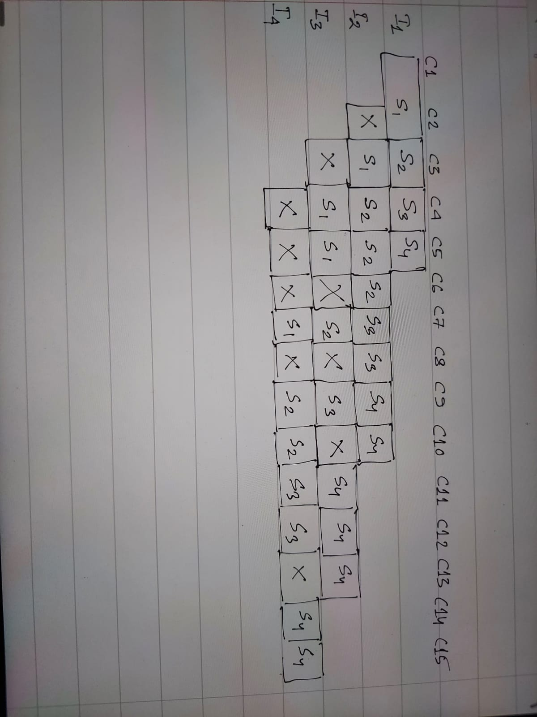
Solution (Make sure no two instructions use the same stage at the same time)

Slide 8
Problem 3
Consider a datacenter processor running at 100% utilization at 100 W, 50% of the power is attributed to leakage. What is the total power dissipation when the processor is running at 25% utilization?
Total power =
dynamic power + leakage power
50W x 25% + 50W = 62.5W

Slide 9
Problem 4
Your laptop has an IPC that is 30% worse than your friend’s laptop. It has a clock speed that is 40% higher than friend’s laptop. If the ISA and the compiler used are the same, what is the speedup with your laptop compared to your friend’s laptop?

Slide 10
Solution
Speed up = Your laptop’s performance
----------------------------------
Your friend’s laptop’s performance
Execution time = cycle time X CPI X #Instructions
Performance = 1/execution time
= clock speed X IPC/instructions

Slide 11
Solution Contd.
Speedup = Yours (clock speed X IPC)
-------------------------------------------
Your Friend’s (clock speed X IPC)
= 1.4 X 0.7
= 0.98

