Slide 1
CS305: Computer Architecture
Tutorial - IV
https://www.cse.iitb.ac.in/~biswa/courses/CS305/main.html

Slide 2
Problem-1
An architect is designing the prefetch engine for his machine. He first runs two applications A and B on the machine, with a stride prefetcher.
Application A:
uint8_t a[1000];
sum = 0;
for (i = 0; i < 1000; i += 4)
{
sum += a[i];
}
Application B:
uint8_t a[1000];
sum = 0;
for (i = 1; i < 1000; i *= 4)
{
sum += a[i];
}
i and sum are in registers, while the array a is in memory. A cache block is 4 bytes in size.
What is the prefetch accuracy and coverage for applications A and B using a stride prefetcher. This stride prefetcher detects the stride between two consecutive memory accesses and prefetches the cache block at this stride distance from the currently accessed block.

Slide 3
Solution
Application A’s prefetch accuracy is 248/249 and coverage is 248/250.
Application A accesses a[0], a[4], a[8], ... a[996]. It has 1000/4 = 250 accesses to memory. The first two accesses to a[0] and a[4] are misses. After observing these two accesses, the prefetcher learns that the stride is 4 and starts prefetching a[8], a[12], a[16] and so on until a[1000] (on the access to a[996], a[1000] is prefetched; however, it is not used). In all, 249 cache blocks are prefetched, while only 248 are used.
Application B’s prefetch accuracy is 0 and coverage is 0.
Application B accesses a[1], a[4], a[16], a[64] and a[256]. It has five accesses to memory. However, there isn’t a constant stride between these accesses, as the array index is multiplied by 4, rather than being incremented/decremented by a constant stride. Hence, the stride prefetcher cannot prefetch any of the accessed cache blocks and the prefetch accuracy and coverage are both 0.

Slide 4
Problem-2
The following table shows two processors and their read/write operations on two different words of a cache block X (initially X[0] = X[1] = 0).
List the possible values of the given cache block for a correct cache coherence protocol implementation. List at least one more possible value of the block if the protocol doesn't ensure cache coherency.
 | P1 | P2
a. | X[0] ++; X[1] = 4; | X[0] = 2; X[1] ++;
b. | X[0] ++; X[1] += 3; | X[0] = 5; X[1] =2;

Slide 5
Solution
a. Coherent : [2, 4], [3, 4], [2, 5], [3, 5]
Non-coherent: [1, 1]
b. Coherent : [5, 5], [6, 5], [5, 2], [6, 2]
Non-coherent: [1, 2]

Slide 6
Problem-3
A machine with a 4 GB DRAM main memory system has 4 channels, 1 rank per channel and 4 banks per rank. The cache block size is 64 bytes.
You are given the following byte addresses and the channel and bank to which they are mapped:
Byte: 0x0000 ⇒ Channel 0, Bank 0
Byte: 0x0100 ⇒ Channel 0, Bank 0
Byte: 0x0200 ⇒ Channel 0, Bank 0
Byte: 0x0400 ⇒ Channel 1, Bank 0
Byte: 0x0800 ⇒ Channel 2, Bank 0
Byte: 0x0C00 ⇒ Channel 3, Bank 0
Byte: 0x1000 ⇒ Channel 0, Bank 1
Byte: 0x2000 ⇒ Channel 0, Bank 2
Byte: 0x3000 ⇒ Channel 0, Bank 3
Determine which bits of the address are used for each of the following address components. Assume row bits are higher order than column bits:
• Byte on bus Addr [ 2 : 0 ]
• Channel bits (channel bits are contiguous) Addr [ : ]
• Bank bits (bank bits are contiguous) Addr [ : ]
• Column bits (column bits are contiguous) Addr [ : ]
• Row bits (row bits are contiguous) Addr [ : ]

Slide 7
Solution
• Byte on bus Addr [ 2 : 0 ]
• Channel bits (channel bits are contiguous) Addr [ 11 : 10 ]
• Bank bits (bank bits are contiguous) Addr [ 13 : 12 ]
• Column bits (column bits are contiguous) Addr [ 9 : 3 ]
• Row bits (row bits are contiguous) Addr [ 31 : 14 ]

Slide 8
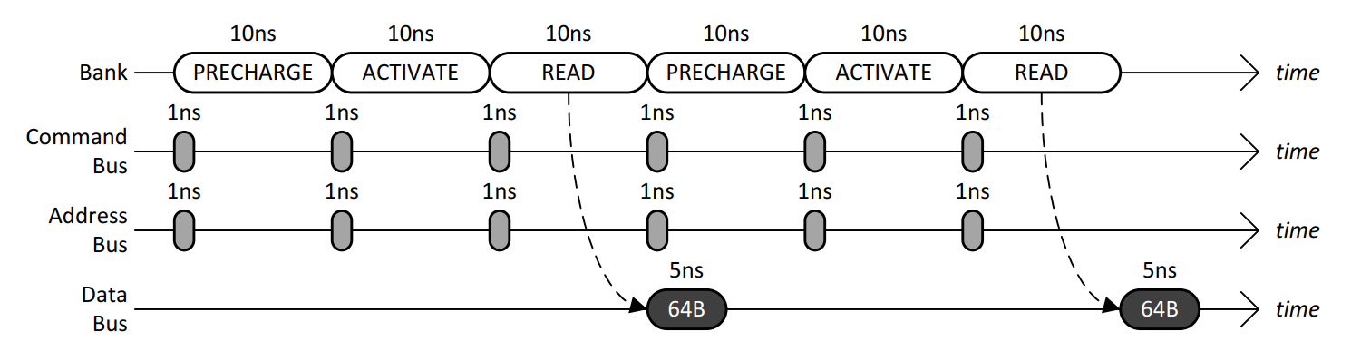
Problem-4
The following timing diagram shows the operation of a single DRAM channel and a single DRAM bank for two back-to-back reads that conflict in the row-buffer. Immediately after the bank has been busy for 10ns with a READ, data starts to be transferred over the data bus for 5ns.
(a) Given a long sequence of back-to-back reads that always conflict in the row-buffer, what is the data throughput of the main memory system?
(b) To increase the data throughput, the main memory designer is considering adding more DRAM banks to the single DRAM channel. Given a long sequence of back-to-back reads to all banks that always conflict in the row-buffers, what is the minimum number of banks that is required to achieve the maximum data throughput of the main memory system?

Slide 9
Solution
(a) 64B/30ns = 32B/15ns = 32GB/15s = 2.13GB/s
(b) 30ns/5ns = 6

Slide 10
Problem-5
Consider a typical disk that rotates at 15000 rotations per minute (RPM) and has a transfer rate of 50×10⁶ bytes/sec. If the average seek time of the disk is twice the average rotational delay and the controller's transfer time is 10 times the disk transfer time, find the average time (in milliseconds) to read or write a 512-byte sector of the disk.

Slide 11
Solution
Average time to read/write = Avg. seek time + Avg. rotational delay + Transfer time
Rotational delay =60/15000 s = 4 ms
Avg. rotational delay =(1/2) x 4 = 2 ms
Avg. seek time =2 × 2 ms = 4 ms
Disk transfer time =512 / 50 x 10⁶ = 0.0102 ms
Effective transfer time =10 × disk transfer time = 0.102 ms
So, avg. time to read/write = 4 + 2 + 0.0102 + 0.102 =6.11 ms ≈6.1 ms

Slide 12
Problem-6
The size of the data count register of a DMA controller is 16 bits. The processor needs to transfer a file of 29,154 kilobytes from disk to main memory. The memory is byte addressable. Find the minimum number of times the DMA controller needs to get the control of the system bus from the processor to transfer the file from the disk to main memory .

Slide 13
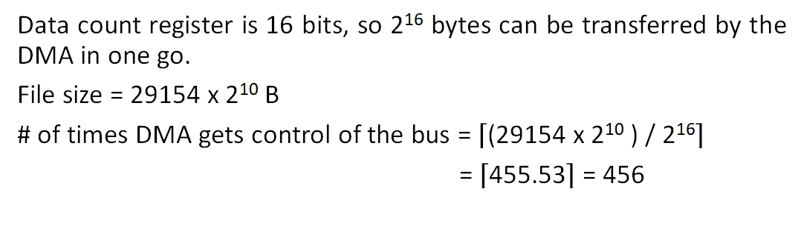
Solution

