Slide 1
CASPER @ IIT Bombay
Discussion
Week of June 2, 2022
Jayati | Sumon jshrivastava@ee.iitr.ac.in | sumon@cse.iitb.ac.in

Slide 2
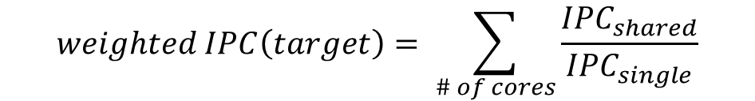
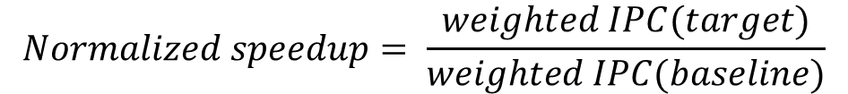
Multicore: Normalized speedup
Shared environment (multicore)
$$weighted IPC\left(target\right)= \sum_{\# of cores}{\frac{{IPC}_{shared}}{{IPC}_{single}}}$$
Isolated environment
Same for baseline, weighted IPC(baseline)
$$Normalized speedup= \frac{weighted IPC(target)}{weighted IPC(baseline)}$$

Slide 3
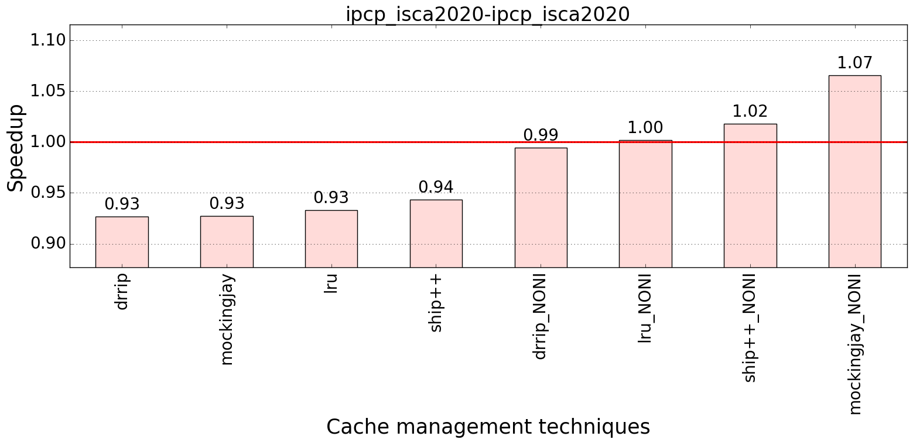
Performance improvement : IPCP
Bench: SPEC 2017
Baseline:
No prefetcher
LRU

Slide 4
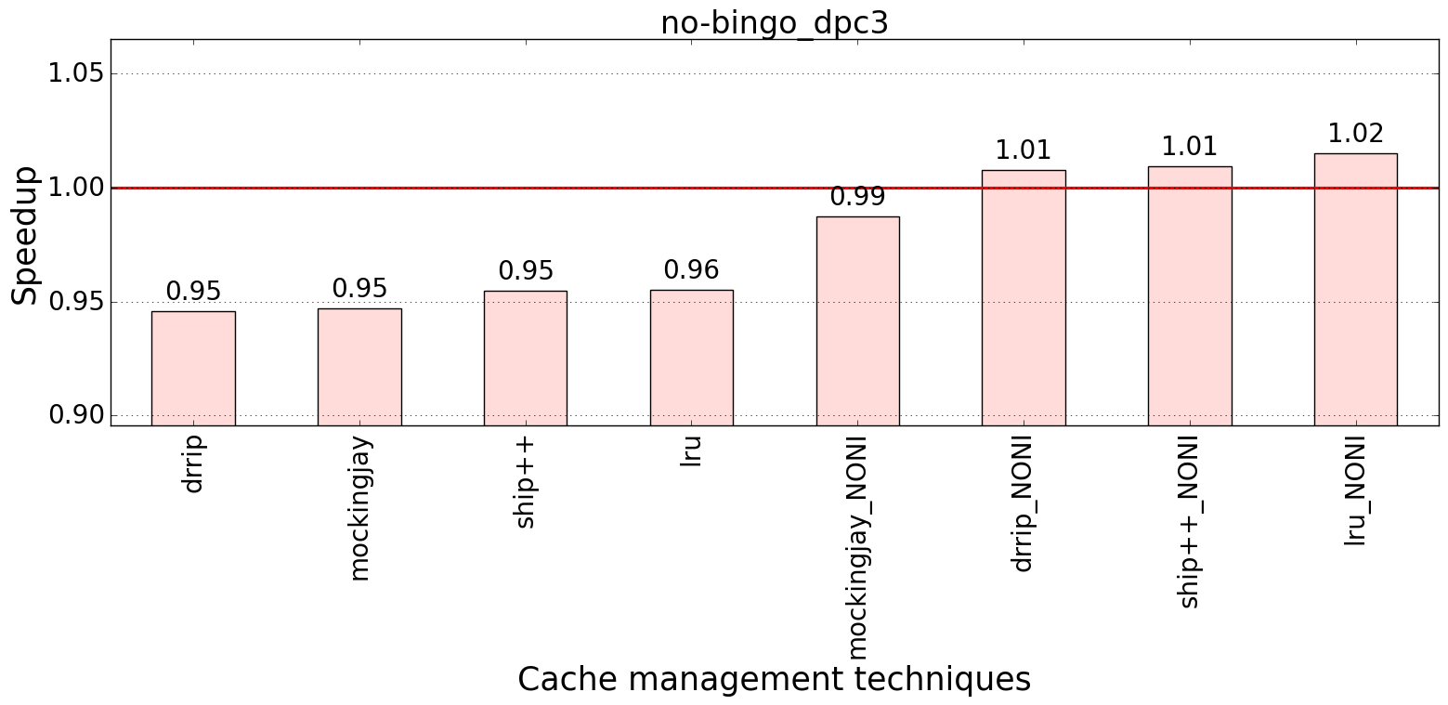
Performance improvement : Bingo
Bench: SPEC 2017
Baseline:
No prefetcher
LRU

Slide 5
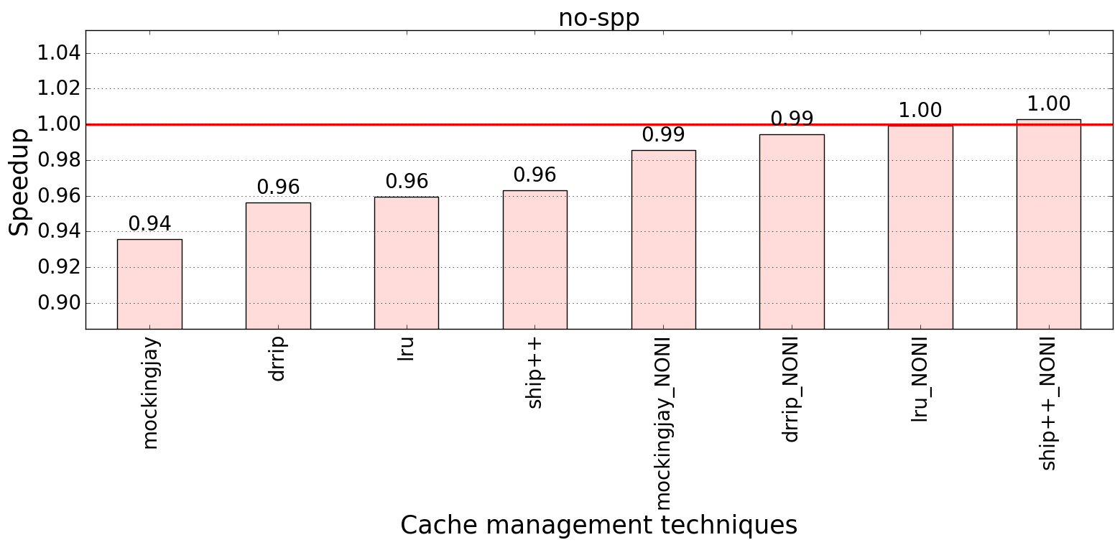
Performance improvement : SPP
Bench: SPEC 2017
Baseline:
No prefetcher
LRU

Slide 6
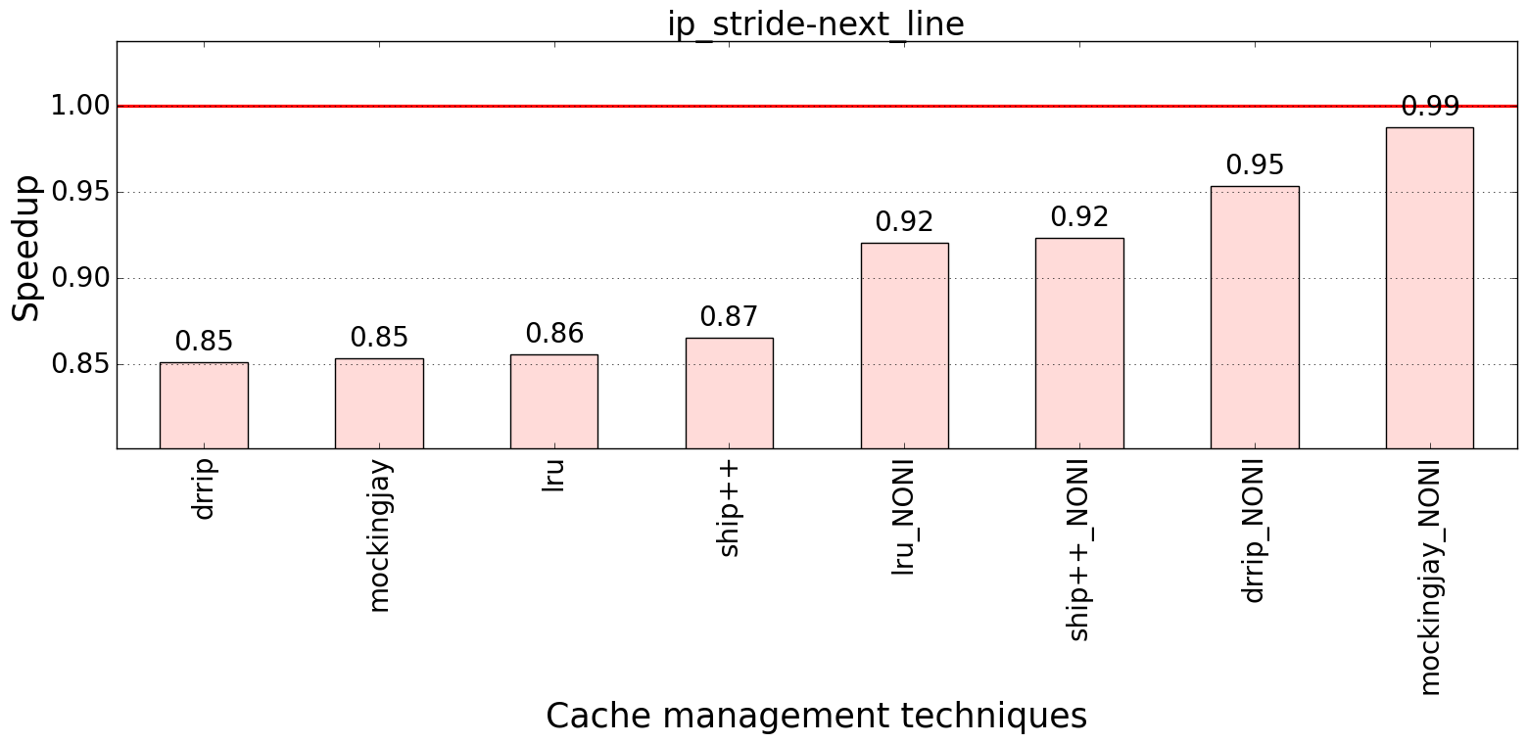
Performance improvement : IP-stride & Next-line
Bench: SPEC 2017
Baseline:
No prefetcher
LRU

Slide 7
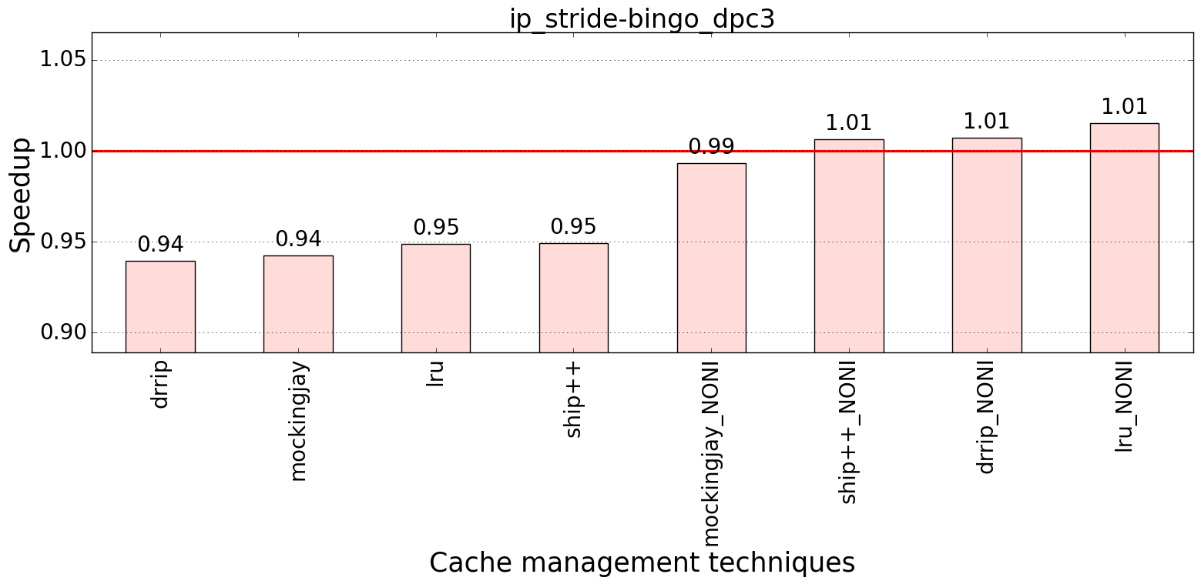
Performance improvement : IP-stride & Bingo
Bench: SPEC 2017
Baseline:
No prefetcher
LRU

