Slide 1
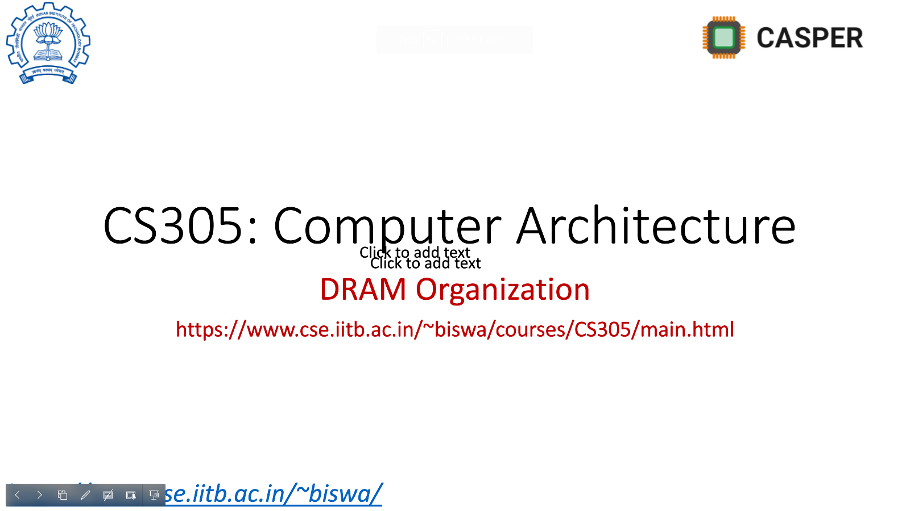
RnD - II Quantifying microarchitecture interactions in multicore systems
Sumon Nath (21q050007) guided by Prof. Biswabandan Panda sumon@cse.iitb.ac.in

Slide 2
Interaction
Cache
Decides which blocks to retain
Decides which blocks to prefetch
Management techniques
Interact
Prefetchers
Communicate

Slide 3




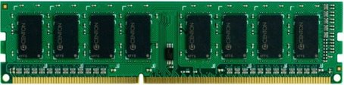
Multi-core scenario
L1
L1
L1
P
L1
P
P
P
L2
L2
L2
L2
Interconnect
DRAM bandwidth remains same
Increased contention
LLC
More pollution & bandwidth demand

Slide 4

Multi-core memory bandwidth
Servers – Multicore system
32 cores, 64MB LLC
DRAM BW per channel – 6400 MT/s
4 available channels
1 channel for 8 cores
On average per core DRAM BW– 800 MT/s
figure taken from intel.com

Slide 5
Problems in the SOTA
Prefetchers private to core
Prefetcher has no knowledge about cache management techniques
Management techniques do not differentiate prefetch & demand requests

Slide 6
Prior work
Prefetch aware cache management - PACMan [MICRO 2011]
Kill the PC - KPC [ASPLOS 2017]
Harmony [ISCA 2018]

Slide 7
PACMan
Modifies RRIP to accommodate prefetching
 | RRIP original | RRIP PACMan
Insertion | 2 or 3 | 3 (distant)
Promotion(hit) | 0 (near-immediate) | No update
Intuition: Deprioritizes all prefetches

Slide 8
Harmony
Redefines Belady’s optimal policy to accommodate prefetching
Belday: Evict block that will be used furthest in the future
DEMAND MIN: Evict block that will be prefetched furthest in the future
Emulates DEMAND MIN on the Hawkeye predictor

Slide 9
Problem: PACMan & Harmony
Coarse grained decisions
Treats all prefetches the same way
No communication from prefetcher end

Slide 10
Kill the PC
Cooperative cache management and prefetching scheme
Uses feedback on prefetch accuracy to determine usefulness of prefetches
Cache management based on dead block prediction
Problem:
Rigid cache management technique
Difficult to integrate with SOTA

Slide 11
Our Idea
Fine grained approach: identify interactions
Dynamically tune LLC management technique & prefetcher
Across the cache hierarchy
Flexible

Slide 12
Interactions definition
Dead block : not reused in future
A
B
C
D
…
X
Useful evicts dead
Useful block : reused in future
Positive Interaction
Cache
Notes:
Explain the interaction part with example

Slide 13
Interactions
Useful
Dead
Positive:
Evicts
X
Y
Dead
Useful
2. Negative:
X
Evicts
Y
Useful
Useful
Dead
Dead
3. Neutral:
X
Evicts
Y
X
Evicts
Y

Slide 14
Where does prefetcher comes in?
Prefetch
Evicts
Demand
Demand
Evicts
Prefetch
Why?
Prefetch
Evicts
Prefetch
Demand
Evicts
Demand
Takeaway: Consider interactions with at-least one prefetch

Slide 15
Goal
Capture interaction b/w cache management techniques & cache prefetchers
At least one prefetch block in an interaction
Captures
Prefetching decisions
Evictions
Captures
Cache management decision

Slide 16
Exception case
Prefetch
Evicts
Demand
/Prefetch
Dead
Dead
Negative interaction
Reason: negative w.r.t to DRAM bandwidth consumption

Slide 17
Ways to identify interactions
Problem: correctly identify blocks to be useful/dead
Techniques used:
Predictor based [ASPLOS ‘17]
Future access based (our idea)
Notes:
Add the predictor part & say why it does not work

Slide 18
Predictor based
Dead block predictor
8-bit global hysteresis counter
Increments counter when block is evicted with no reuse
Decrements counter on cache hits
Predicts block is dead when counter saturates
Notes:
Add the predictor part & say why it does not work

Slide 19
Predictor results - LLC
Prefetcher: IPCP
Management technique: Hawkeye
High percentage (80%) neutral interaction
Notes:
Add the predictor part & say why it does not work

Slide 20
Predictor results - LLC
Prefetcher: SPP
Management technique: SHiP++
High percentage (60%) neutral interaction
Notes:
Add the predictor part & say why it does not work

Slide 21
Pros & cons
Simple to implement
Dynamically adapts to changing program behavior
Coarse grained
High number of neutral interactions
Notes:
Add the predictor part & say why it does not work

Slide 22
Our appraoch: future access based
Table stores the evictions as well as all cache accesses.
Eviction/Access | Incoming Line | Type | Evicted Line | Type

Slide 23
Future access based
Table stores the evictions as well as all cache accesses.
Eviction/Access | Incoming Line | Type | Evicted Line | Type
Eviction | X | Prefetch | Y | Demand
Notes:
Explain this properly with animation

Slide 24
Future access based
Table stores the evictions as well as all cache accesses.
Eviction/Access | Incoming Line | Type | Evicted Line | Type
Eviction | X | Prefetch | Y | Demand
Access | Y
Notes:
Explain this properly with animation

Slide 25
Future access based
Table stores the evictions as well as all cache accesses.
Eviction/Access | Incoming Line | Type | Evicted Line | Type
Eviction | X | Prefetch | Y | Demand
Access | Y
Access | Y
Notes:
Explain this properly with animation

Slide 26
Future access based
Table stores the evictions as well as all cache accesses.
Eviction/Access | Incoming Line | Type | Evicted Line | Type
Eviction | X | Prefetch | Y | Demand
Access | Y
Access | Y
Eviction | Z | Demand | W | Prefetch
Negative interaction
- 0 hits
- 2 hits
Records till an epoch is reached
Notes:
Explain this properly with animation

Slide 27
Interactions at LLC
Prefetcher: IPCP
Management technique: Hawkeye
High percentage (87%) negative interaction
Notes:
Add the predictor part & say why it does not work

Slide 28
Interactions at LLC
Prefetcher: SPP
Management technique: SHiP++
High percentage (63%) negative interaction
Notes:
Add the predictor part & say why it does not work

Slide 29
Breakdown of neg interactions
Prefetcher: IPCP
Management technique: Hawkeye
Almost 99% neg interaction are due to useless evicting useless blocks
Notes:
Add the predictor part & say why it does not work

Slide 30
Breakdown of neg interactions
Prefetcher: SPP
Management technique: SHiP++
Almost 98% neg interaction are due to useless evicting useless blocks
Notes:
Add the predictor part & say why it does not work

Slide 31
Ideal performance improvement
What if all negative interactions are eliminated?
Upper bound performance improvement

Slide 32
Additional penalty
Negative interaction introduce additional penalty for every DRAM access : P
# DRAM access = # of LLC misses
$Additional penalty due to the negative interations per LLC miss$ (P)
$=$ $avg miss latency with prefetcher − avg miss latency without prefetche$r
Problem: Multiple LLC misses processed simultaneously
Notes:
Explain this properly

Slide 33
Out-of-order CPU
MSHR - multiple cache misses served at a time
100 cycles
LOAD A
110 cycles
LOAD B
120 cycles
LOAD C
130 cycles
LOAD D
Average miss latency = (100 + 110 + 120 + 130) /4 = 115 cycles
Amortized miss latency over the instruction window = 115 / 4 = 29 cycles
MSHR occupancy
Notes:
Explain this properly

Slide 34
Additional penalty - Fixed
Negative interaction introduce additional penalty for every DRAM access : P
# DRAM access = # of LLC misses
$Additional penalty due to the negative interations per LLC miss$ (P)
$=$ $avg miss latency with prefetcher − avg miss latency without prefetche$r
$P=$ $\frac{avg miss latency with prefetcher − avg miss latency without prefetcher}{avg MSHR occupancy}$
Notes:
Explain this properly

Slide 35
CPU cycles saved
Let number of LLC misses suffering from penalty be F
$$F=number of llc misses × frac. Negative interactions$$
$$CPU cycles saved=\text{F} ×\text{P}$$
Notes:
Explain this properly

Slide 36
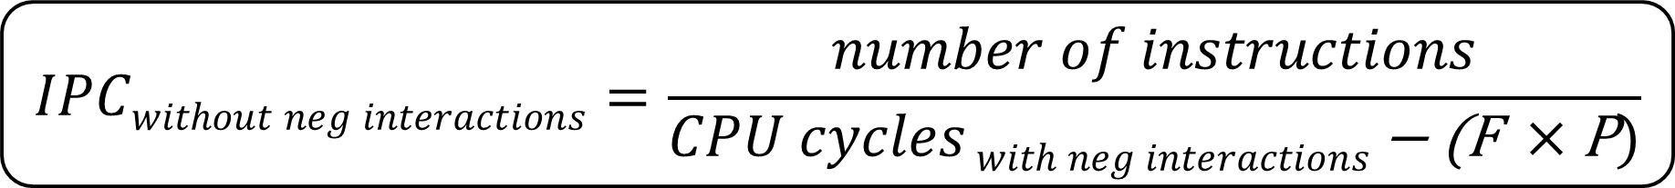

Performance improvement
$$IPCwithout neg interactions=\frac{number of instructions}{CPU cycles with neg interactions \text{− }\text{(}\text{F} ×\text{P})}$$
$$Speedup=\frac{IPCwithout neg interactions}{IPCbaseline}$$
Notes:
Explain this properly

Slide 37
Evaluation setup
Champsim simulator
Workloads: SPEC CPU 2017 and GAP
DRAM bandwidth : 800 MT/s
- Simulates server (multi-core)
Notes:
Explain this properly

Slide 38
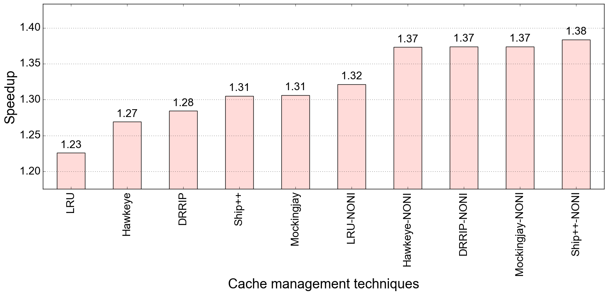
Performance improvement : IPCP (baseline: LRU, no pref)
NONI: no negative interactions
Bench: SPEC 2017
Spread of the plot is ~15%
Notes:
DRAM bandwidth remove

Slide 39
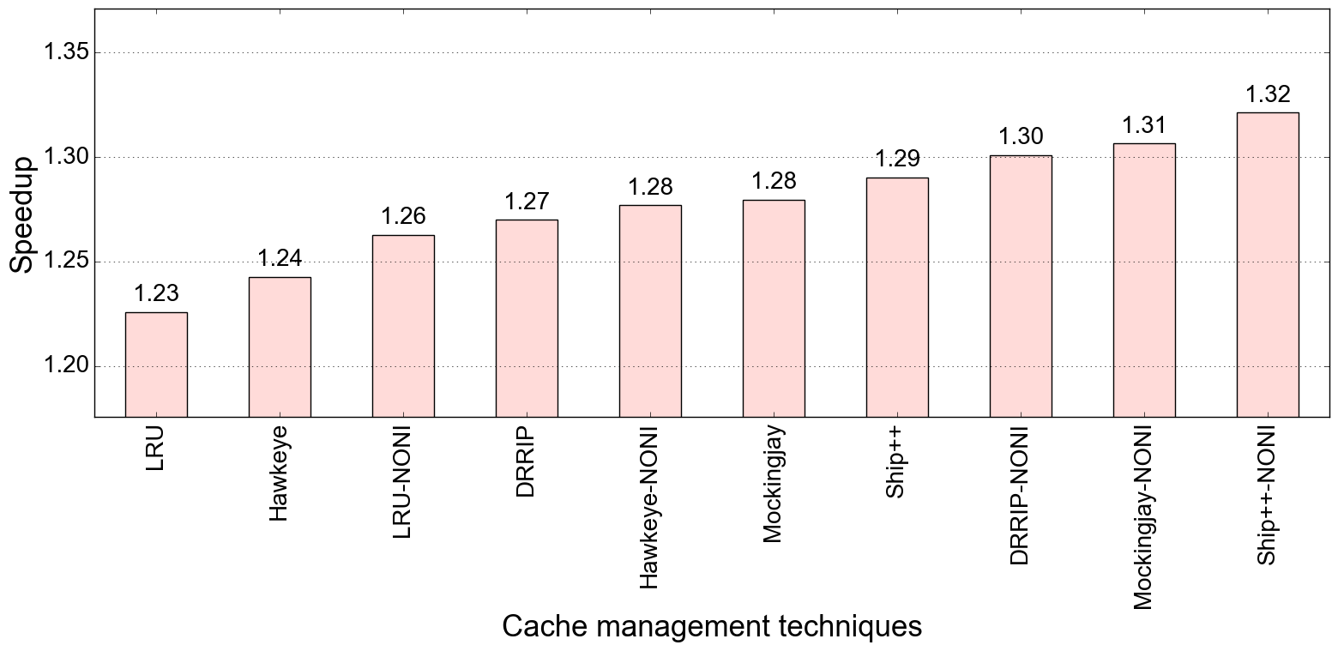
Performance improvement : SPP (baseline: LRU, no pref)
Bench: SPEC 2017
Spread of the plot is ~9%

Slide 40
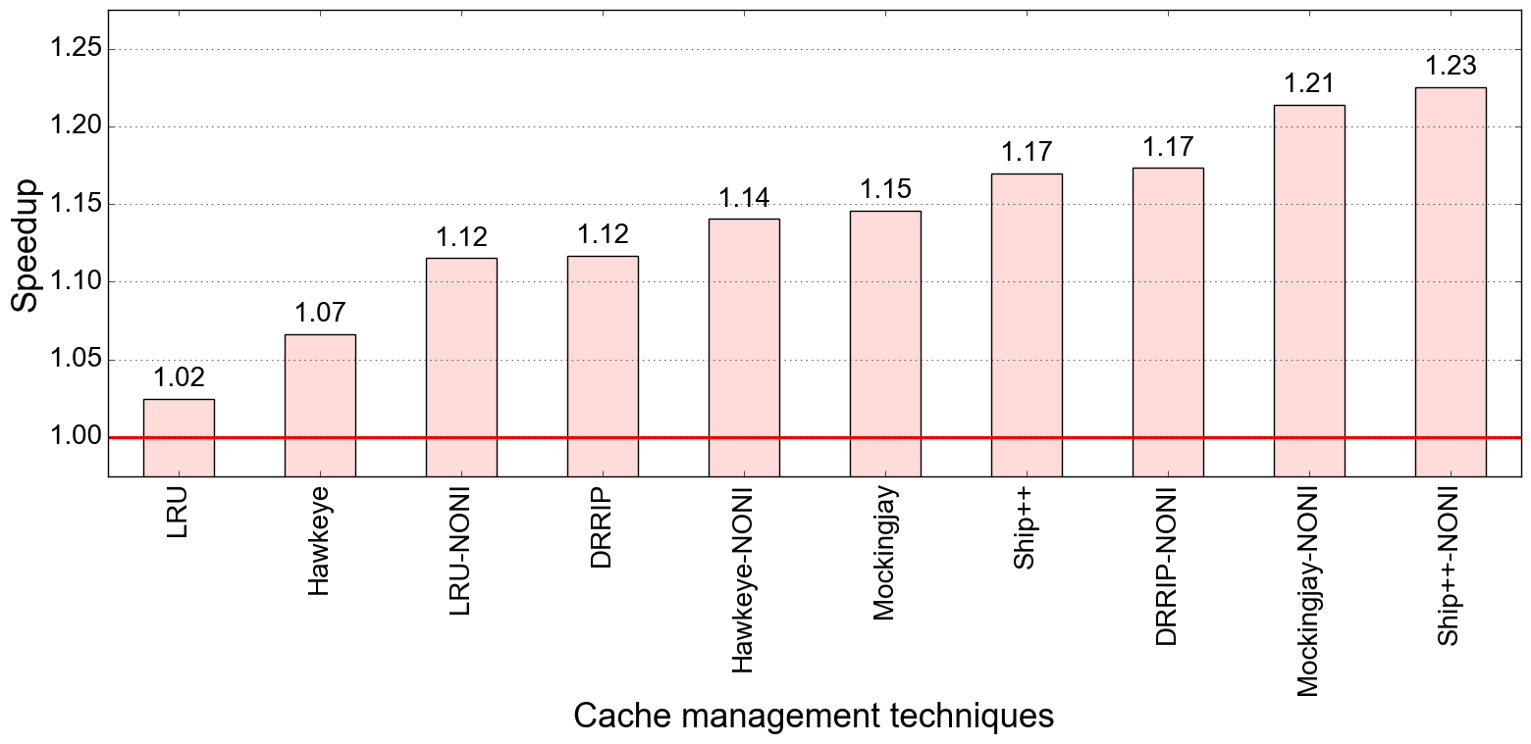
Performance improvement : IPCP (baseline: LRU, no pref)
Bench: GAP
Spread of the plot is ~21%

Slide 41
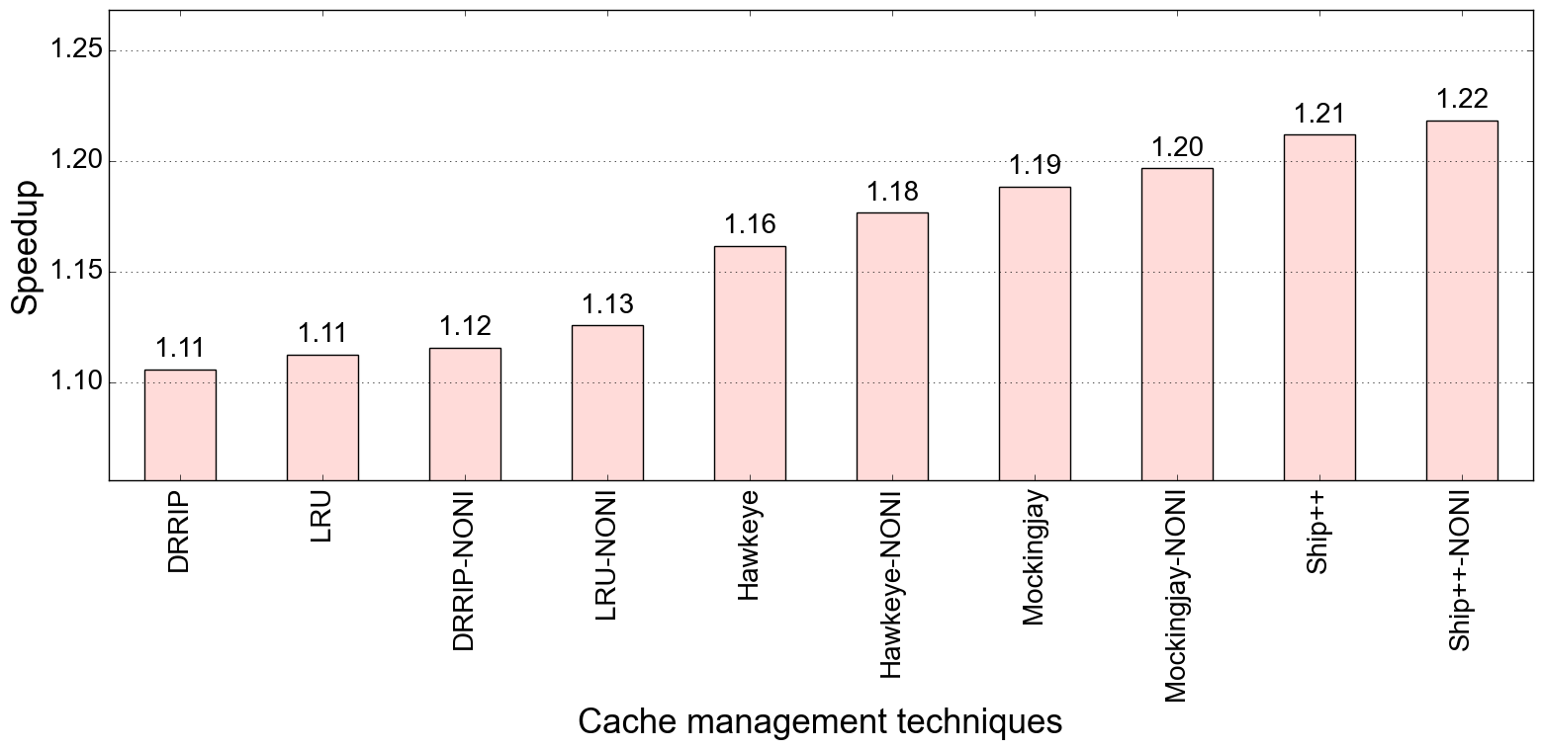
Performance improvement : SPP (baseline: LRU, no pref)
Bench: GAP
Spread of the plot is ~11%

Slide 42
Conclusion & future work
Overall high-performance improvement for the ideal case
Will be exploring various ideas and techniques to minimize the negative interactions keeping performance, energy, and bandwidth in mind

Slide 43
Thank You

