Slide 1
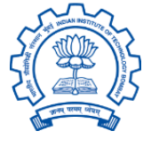
Seminar presentation A study of cache prefetchers & management techniques and how they interact
Sumon Nath(21q050007) guided by Prof. Biswabandan Panda sumon@cse.iitb.ac.in

Slide 2
Outline
Problem
Cache management techniques
Hardware prefetching
Interaction between the two
Conclusion

Slide 3
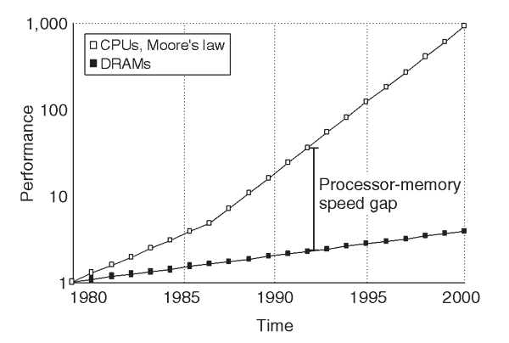
Problem
55% growth rate
10% growth rate

Slide 4

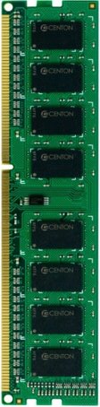
Problem: Memory wall
CORE
DRAM Controller
100’s of cycles

Slide 5
Latency tolerance techniques
Out-of-order execution
Multithreading
Caching
Cache Management techniques
Cache Prefetching

Slide 6
Up next …
Problem
Cache management techniques
Hardware prefetching
Interaction between the two
Conclusion

Slide 7
Cache Management
Ways
High priority
High priority
Low priority
Low priority
A
A
B
B
C
C
D
D
Victim
Victim
Decisions:
Insertion
Promotion - On cache hit
Eviction
Sets
…
Last level cache(LLC)
Notes:
In actual seminar ppt you can add cache contention in the next slide

Slide 8
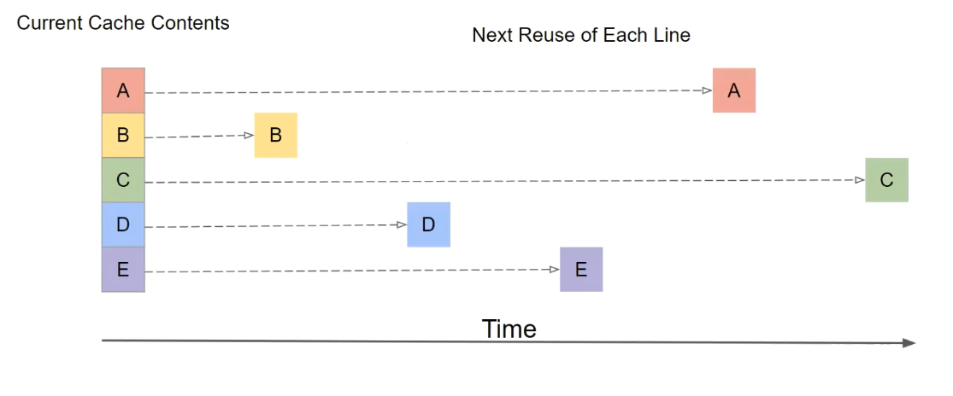
Optimal technique - Belady
Notes:
In actual seminar ppt you can add cache contention in the next slide

Slide 9
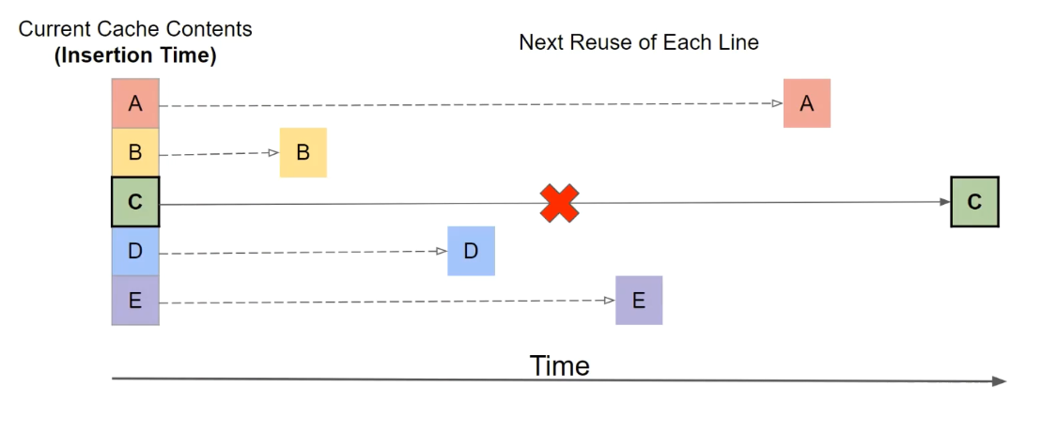
Optimal technique - Belady
Notes:
In actual seminar ppt you can add cache contention in the next slide

Slide 10
LRU
Insert : new block E to MRU
MRU
LRU
Assumption:
new block will be
re-referenced soon
E
A
A
B
C
D
D
Promotion(on hit) : LRU to MRU
Evict: block at LRU position
Works only for cache fitting workloads
MRU
LRU
E
A
A
B
C
D
D

Slide 11
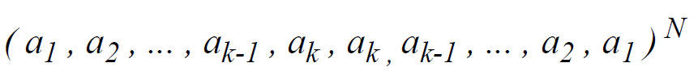
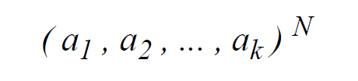
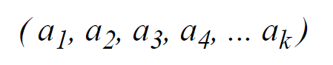
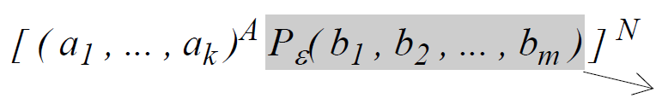
Access patterns
Recency friendly
, k < cache size
Thrashing
, k > cache size
Streaming
, k =∞
Scanning
(Non-temporal data)
Scan
Mix of all

Slide 12
Re-reference interval prediction [ISCA ‘10]
RRP head
RRP tail
A
E
F
G
H
A
B
C
D
D
Reuse
prediction
near-
immediate
(0)
intermediate
(1)
far
(2)
distant
(3)
Insert : new block with RRPV=2/3
Promotion: update RRPV to 0
Eviction: block with RRPV=3
Assumption:
new block will not be
re-referenced soon

Slide 13
RRIP: set-dueling
Scan resistant
Thrash resistant
SRRIP
Insert with RRPV = 2
Preserves accesses with hits
Discards scans quickly
BRRIP
Insert with RRPV=2/3 randomly
Preserves some blocks in a thrashing workload
Set-dueling
mechanism
Selects winning policy
Dynamic-RRIP: dynamically adapts to active workload

Slide 14
Advanced prediction: SHiP
Signature
Updates counter on hits
Predicts RRPV of new blocks with same signature
counter
A
####
Signature history counter table
LLC
Improves RRIP accuracy by correlating blocks with same signature

Slide 15
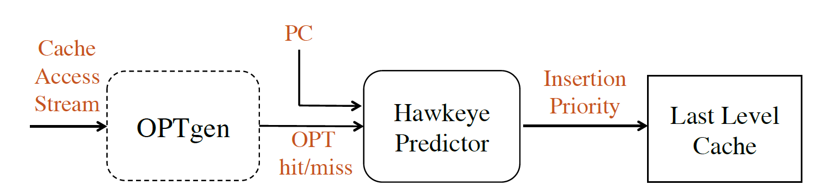
Emulating Belady: Hawkeye
Emulates Belady’s MIN policy
Learns from OPTgen’s decisions
Cache friendly
Prediction
Cache averse
Binary classification

Slide 16
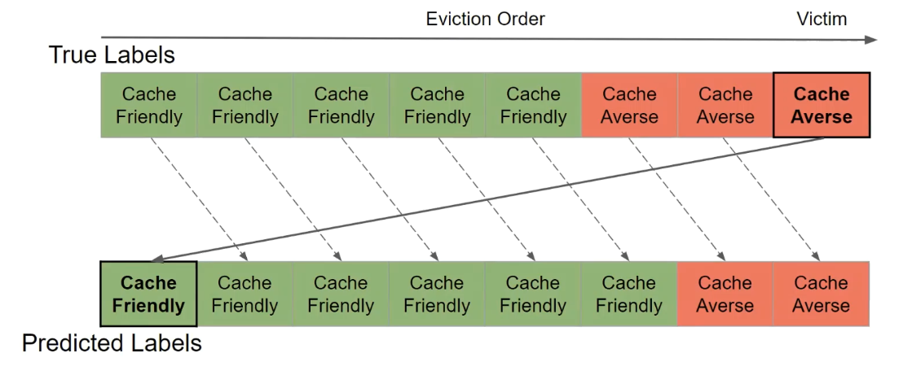
Binary classification
Misprediction-> high impact

Slide 17
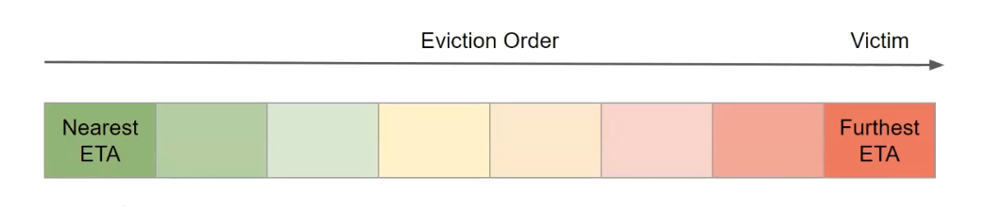
Multiclass classification: Mockingjay

Slide 18
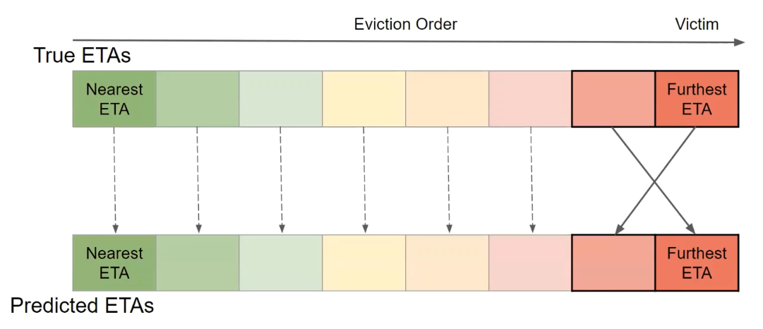
Multiclass classification: Mockingjay
Misprediction-> low impact

Slide 19
Techniques employed
Cache Management techniques
Emulates Belady
Basic
RRIP
LRU
DRRIP
SHiP
Hawkeye
Mockingjay
Increasing complexity
Increasing performance
Notes:
references

Slide 20
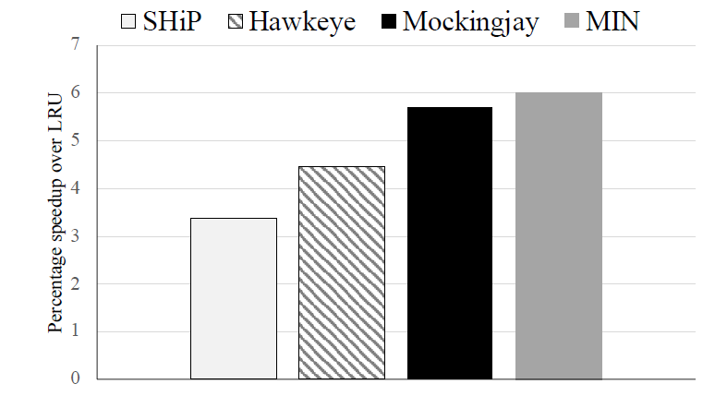
Comparison of techniques
Belady
Mockingjay speedup - 5.5% close to 6% of Belady’s optimal
Notes:
references

Slide 21
Up next …
Problem
Cache management techniques
Hardware prefetching
Interaction between the two
Conclusion

Slide 22
Hardware Prefetching
HIT
X + 3
3
X + 3
5
CORE
Cache
data
4
X + 2
X + 1
X
X + 3
1
Prefetcher
2

Slide 23
Metrics of interest
Accuracy
Used prefetches / total prefetches
Coverage
Misses eliminated by prefetching / total misses
Timeliness
How early/late a prefetch is?
Bandwidth consumption
Cache pollution - unused prefetches

Slide 24
Prefetcher aggressiveness
Prefetch distance: distance of the farthest prefetch from demand access
Prefetch degree: number of prefetches issued
Aggressive prefetcher : high prefetch distance & degree

Slide 25
Prefetcher aggressiveness
Aggressive prefetcher
Higher coverage ☺
Lower accuracy, higher bandwidth & pollution ☹
Lower aggressiveness
Higher accuracy, lower bandwidth & pollution ☺
Lower coverage ☹

Slide 26
Stride patterns
+1, +1, +1,…
+3, +3, +3,…
Constant Stride
+1, +2, +1, +2…
+1, -3, +4, +1, +1, -3, +4, +1…
Complex Stride

Slide 27
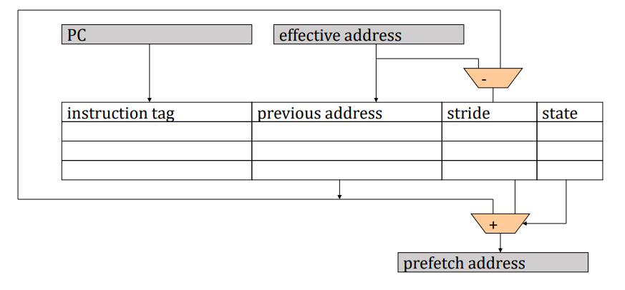
Stride prefetching
Associates Instruction pointer(IP) to a constant stride

Slide 28
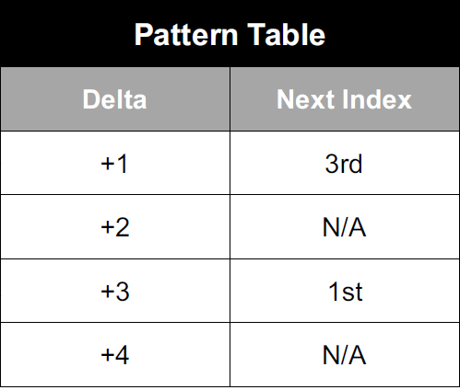
Look-ahead Mechanism
Prefetch
Prefetch
Can handle complex strides

Slide 29
Prefetching techniques
Hardware prefetchers (Non-ML)
Hybrid
IPCP
Stride based
Lookahead based
Best offset based
Region based
IP-stride
VLDP
SPP
BOP
Bingo
SMS

Slide 30
Comparison of prefetchers

Slide 31
Up next …
Problem
Cache management techniques
Hardware prefetching
Interaction between the two
Conclusion

Slide 32
Interaction
Cache
Decides blocks to evict
Decides which blocks to prefetch
Management techniques
Interact
Prefetchers
Communicate

Slide 33
Interaction: papers
Prefetch aware cache management [MICRO 2011]
Modifies RRIP to adapt to prefetching
Kill the PC [ASPLOS 2017]
Co-operative prefetching & caching scheme
Harmony [ISCA 2018]
Modifies Belady’s optimal policy to accommodate prefetching

Slide 34
Conclusion & future work
LLC management techniques are key to performance
And have almost reached optimal performance threshold.
Hardware prefetchers are ubiquitous in modern systems and improves performance by many folds.
Need to study the interaction between the two to further improve performance

Slide 35
Thank You Any Questions

