Slide 1
Kernel Image Processing CUDA
Simone Carlesi
Mat. 7160828
Firenze,

Slide 2
Kernel Image Processing with CUDA
Problem choice
In order to apply CUDA approach, this problem has been choosen due to the fact that
in Kernel Image Processing every pixel is totally indipendant from every other pixel
in the image to be processed; so the problem is highly parallelizable and GPU can be
exploited.

Slide 3
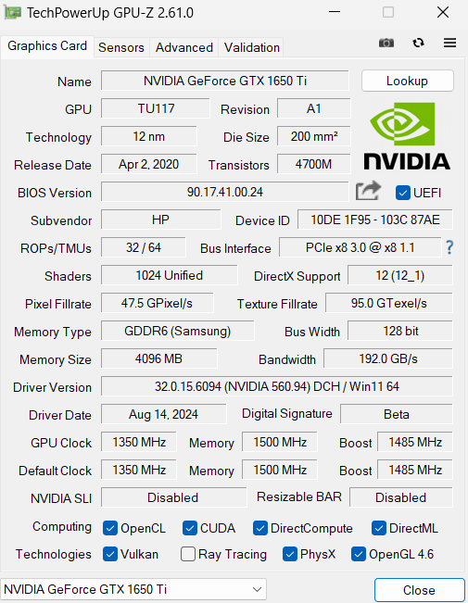
Kernel Image Processing with CUDA
GPU Specs
Below GPU specs are summarized. That is the GPU where the program has been tested on.
As we can see, this GPU (Turing) has a PCIe 3.0 with 8 active lanes for CPU <-> GPU data transfer. The PCIe 3.0 has a teoritical bandwidth of about 1 GB/s per every lane. So, in this case, the total teoritical peak
bandwidth is 1 GB/s * 8 lanes = 8 GB/s
The actual memory type is GDDR6 with a peak teoritical bandwidth of 192 GB/s

Slide 4
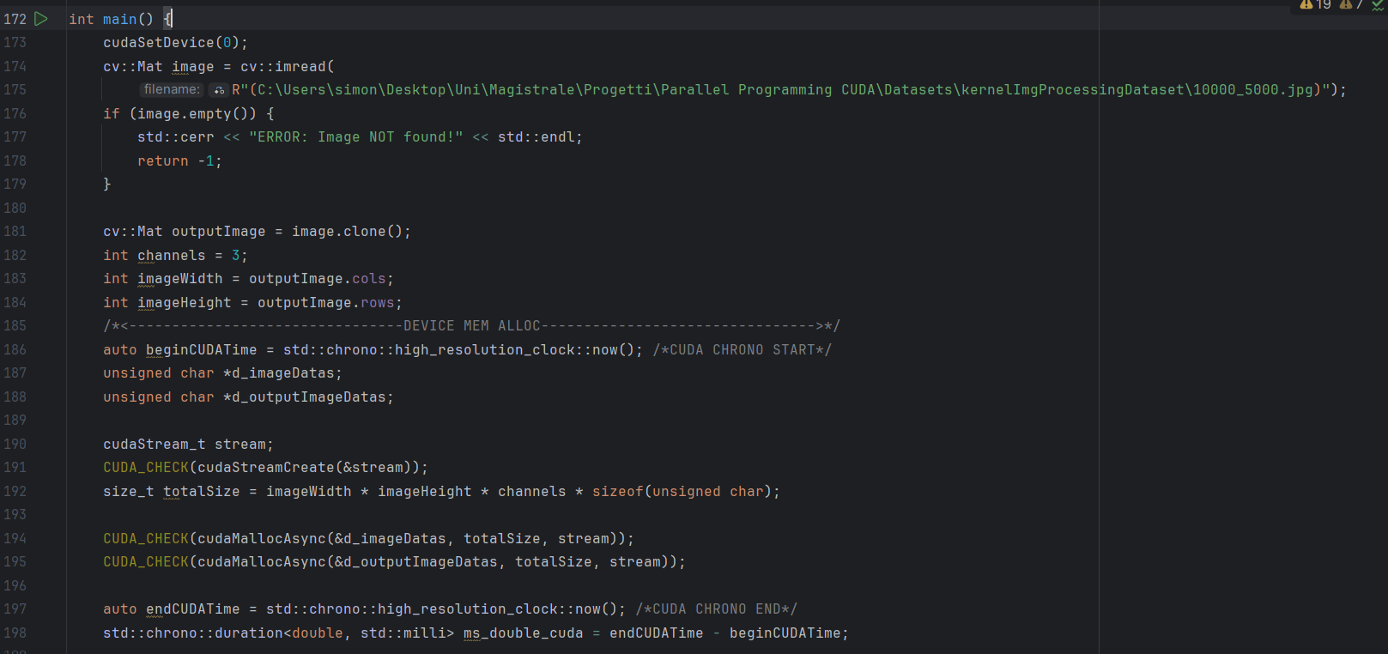
Kernel Image Processing with CUDA
Program explanation
In the very first line of the main method, a cudaSetDevice(0) is called to create CUDA
environment and assign the Nvidia GPU as the device to be used in the program

Slide 5
Kernel Image Processing with CUDA
Program explanation
Than the image to be processed is retreived through the opencv library. After, image width
and height are assigned to the corresponding variables. We want to process also colored
images, so the 3 RGB channels are used.

Slide 6
Kernel Image Processing with CUDA
Program explanation
Datas are arranged as a one - dimensional array containing all the RGB values for every
Pixel in the image in a linear style, i.e. d_imageData[0], d_imageData[1], d_imageData[2]
will contain the R,G,B values for the 0-indexed pixel, and so on. d_outputImageData will be the
device final array containing the updated RGB values for every pixel.

Slide 7
Kernel Image Processing with CUDA
Program explanation
A cuda stream is created in order to perform the async allocation of the memory on the
Device.

Slide 8
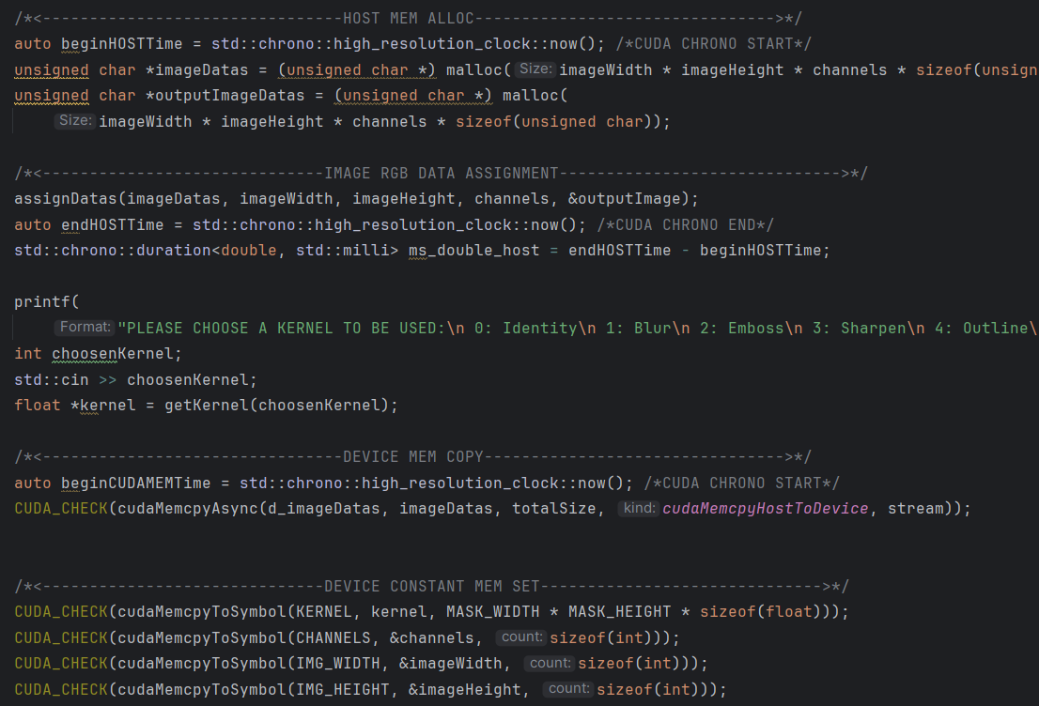
Kernel Image Processing with CUDA
Program explanation
imageDatas and outputImage datas arrays are allocated on host memory and than the
assignDatas method assigns them the right R,G,B values.

Slide 9
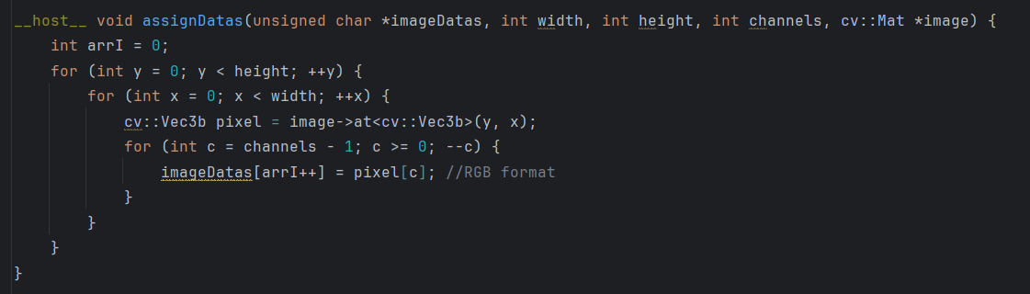
Kernel Image Processing with CUDA
assignDatas()
assignDatas method will convert BGR format in RGB format and assign values to the proper
Array index.

Slide 10
Kernel Image Processing with CUDA
Program explanation
The user is than prompted to choose a kernel for the image processing whose values are than
retreived through the getKernel method.
There is no need to copy datas from HOST to DEVICE in a synchronous way, so this is done
Asynchronously.

Slide 11
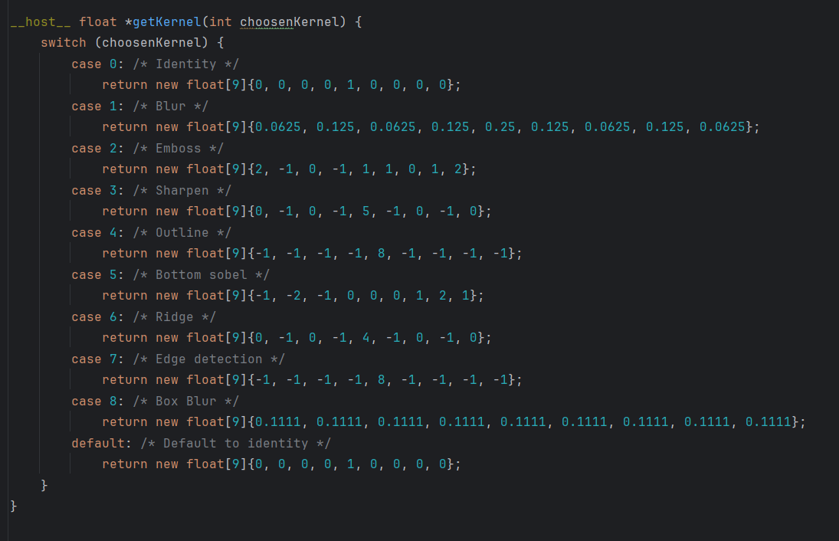
Kernel Image Processing with CUDA
getKernel()
The getKernel method will return the values of the choosen kernel in a one – dimensional array.

Slide 12
Kernel Image Processing with CUDA
Program explanation
Due to the fact that every thread will need to access always the same values for the kernel, channels number, image width and image height, these values are allocated
on the constant memory

Slide 13
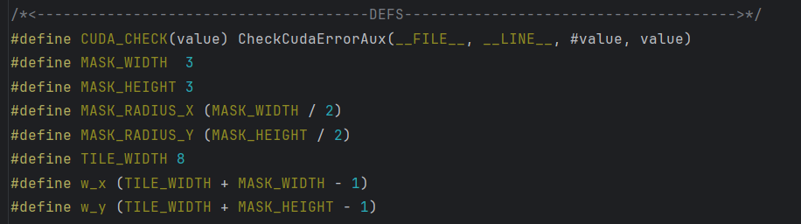
Kernel Image Processing with CUDA
Definitions explanation
In the definitions a 3x3 kernel has been assumed. The TILE_WIDTH value has been set to 8, that means an 8x8 thread block. As we’ll see,
on this GPU, this guarantees a full SM occupancy. An 8x8 thread block means 64 threads per block. As a warp is made up of 32 threads, the thread warp will be full as it’s called. w_x and w_y values refer to the shared tile size taking into account the TILE_WIDTH and the MASK_WIDTH/HEIGHT. In this case, we’ll have both w_x and w_y = 8 + 3 - 1 = 10. That means that every shared memory tile will be 10*10 = 100 RGB values long

Slide 14
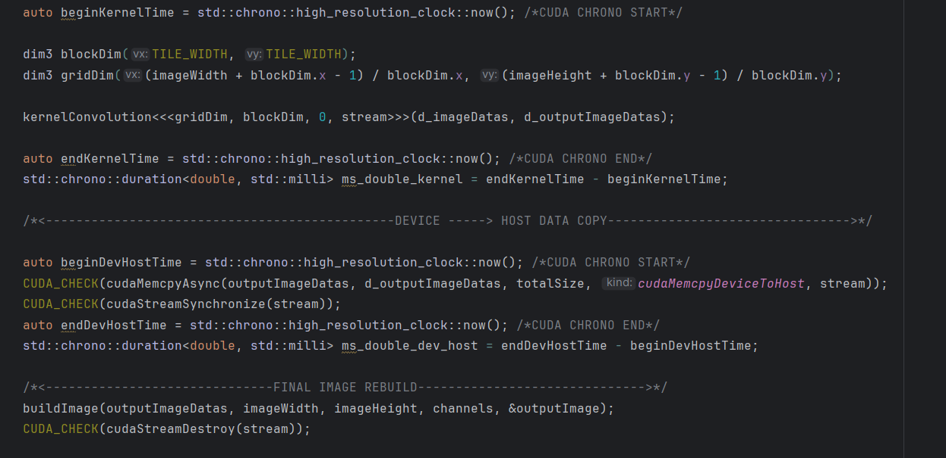
Kernel Image Processing with CUDA
Definitions explanation
The kernelConvolution kernel is called with a 2D (8,8) block dimension = 64 threads/block and a 2D grid whose x, y sizes are calculated according to the image width, height and the x,y block dimensions to guarantee that the full image is covered by a thread.

Slide 15
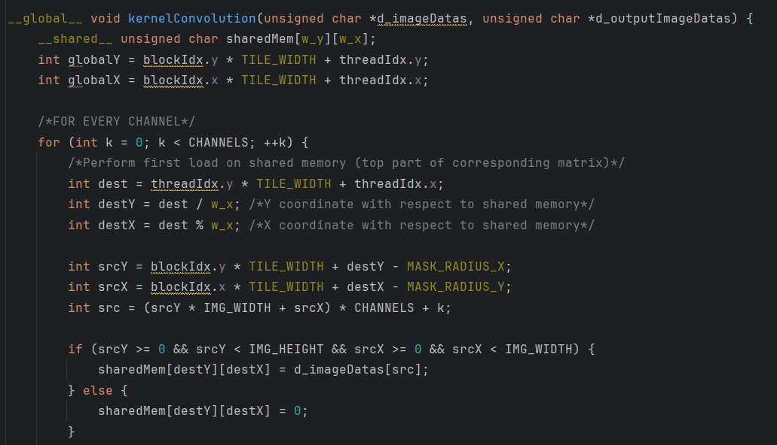
Kernel Image Processing with CUDA
kernelConvolution explanation
The kernelConvolution kernel takes the 2 one – dimensional input and output datas arrays as parameters. At the very beginning of the kernel, a 2D shared memory tile of sizes w_y*w_x is allocated onto the shared memory. In our case, as mentioned before, it will be a 10*10*sizeof(unsigned char) = 100 bytes memory allocation.

Slide 16
Kernel Image Processing with CUDA
kernelConvolution explanation
The use of the shared memory in the case of stencil operations is very useful: in fact, every thread within a block will need some of the values that has been already retreived from the global memory, which is much slower than the shared memory, by its neighbours. We can make threads cooperate between each other making them store their retrived RGB values into the shared memory so that the other threads within the same block can access them without making redoundant accesses to the global memory.

Slide 17
Kernel Image Processing with CUDA
kernelConvolution explanation
The very first part of the kernel concerns the RGB loading into the shared memory. As this is a stencil operation, we’ll need to load also some of the neighbours tiles RGB datas. So we’ll perform a 2-batch loading. The first load will fill the shared memory matrix upper part. Every thread will take one channel per-time into account (that’s the why of the for loop) and will perform the stencil operation. At the end of the loop, the new RGB value will be stored back.

Slide 18
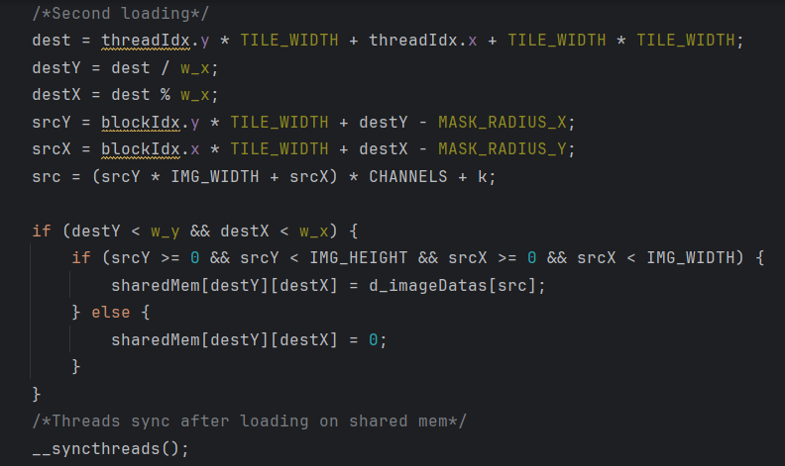
Kernel Image Processing with CUDA
kernelConvolution explanation
As mentioned before, the second part of the loading operation concerns the bottom of the shared memory matrix. At the end of the 2 loadings, we’ll need a __syncthreads() directive in order to be sure that every thread has already performed it’s memory loading and so that all the needed values have been correctly loaded into the shared memory.

Slide 19
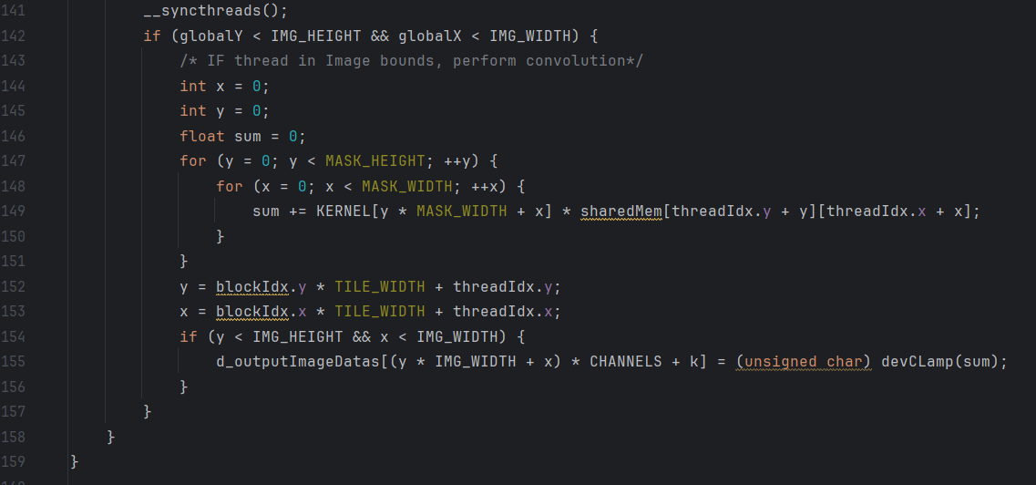
Kernel Image Processing with CUDA
kernelConvolution explanation
Here the kernel convolution of the R,G,B channels is performed. At the end, a store into the outputImageDatas array is performed, taking into account the current k channel. If a RGB value exceeds the valid lower or upper bound, it is clamped to the nearest bound [0,255].

Slide 20
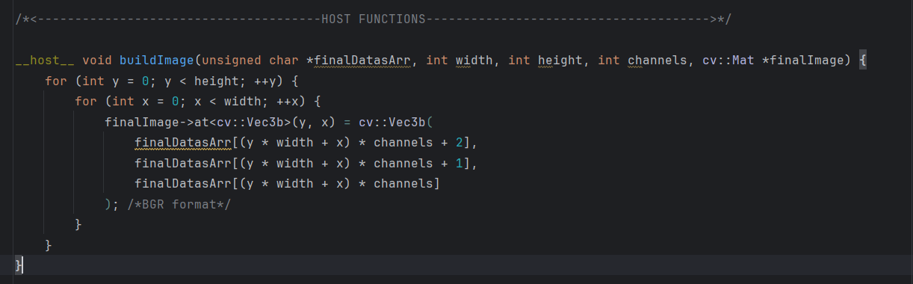
Kernel Image Processing with CUDA
Program explanation
At the end of the process, the new image is built using the opencv library

Slide 21
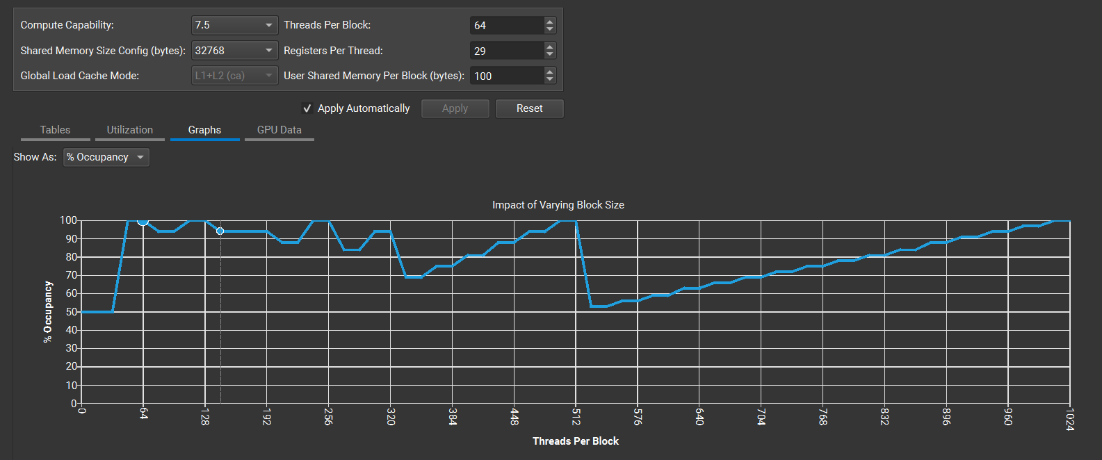
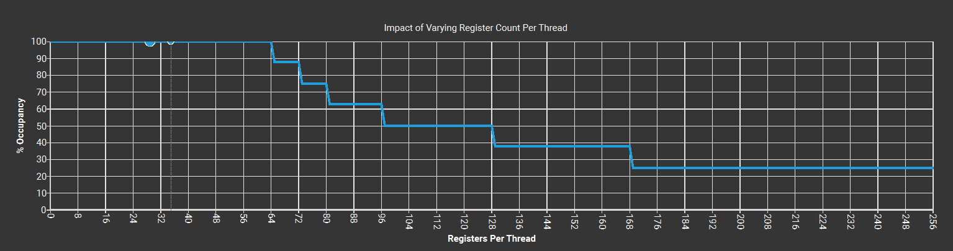
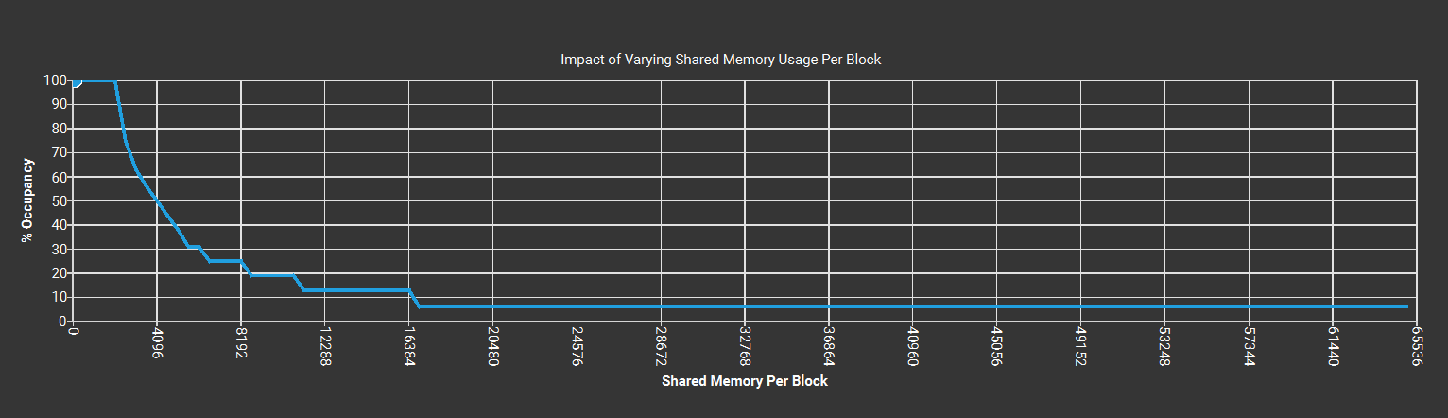
Kernel Image Processing with CUDA
Nsight compute metrics – Occupancy, 8x8 blocks
100% occupancy with 8x8 blocks
100% occupancy with 29 registers/thread
100% occupancy with 100 bytes of shared memory

Slide 22
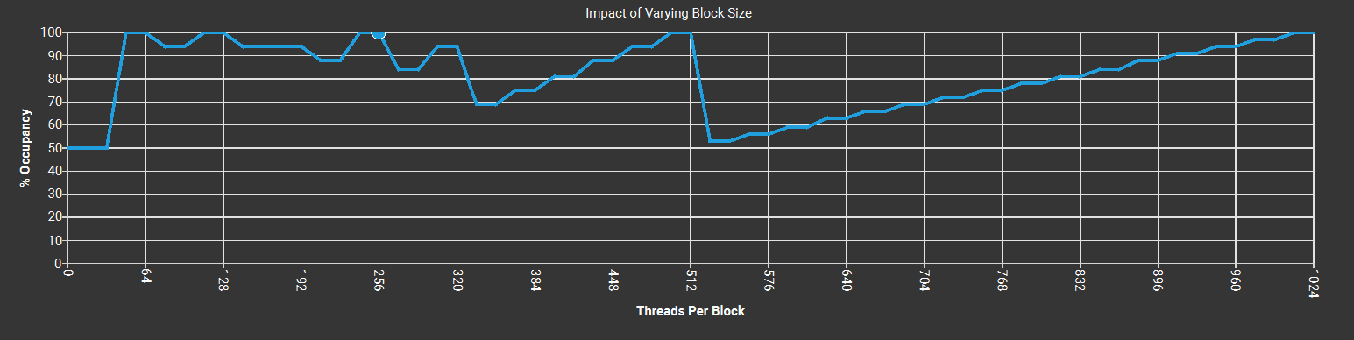
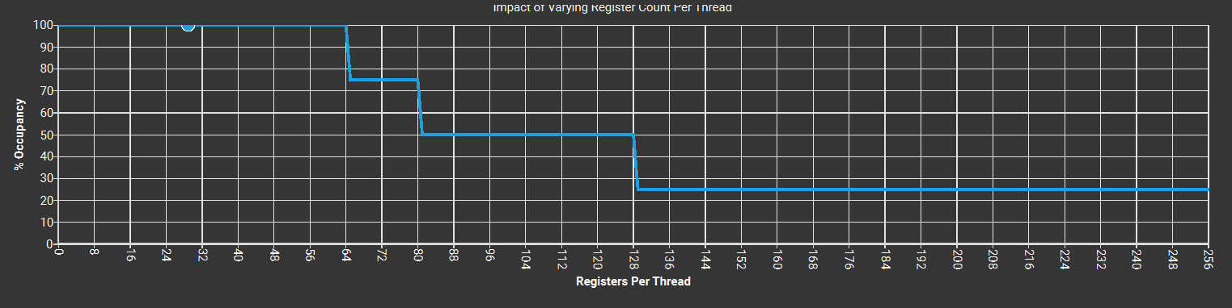
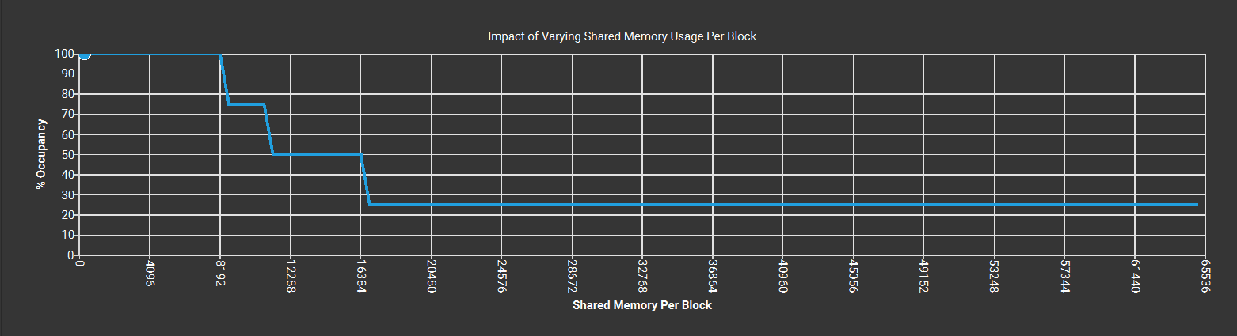
Kernel Image Processing with CUDA
Nsight compute metrics – Occupancy, 16x16 blocks
100% occupancy with 16x16 blocks
100% occupancy with 29 registers/thread
100% occupancy with 324 bytes of shared memory

Slide 23
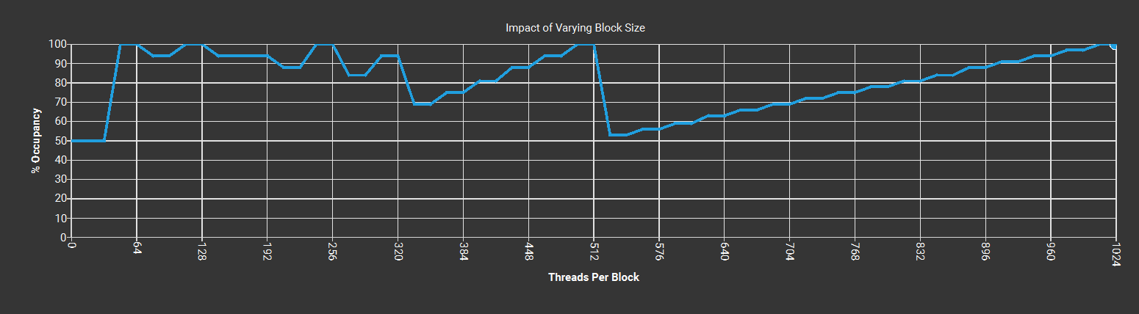
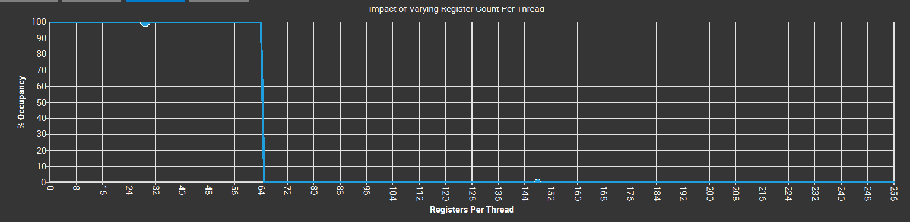
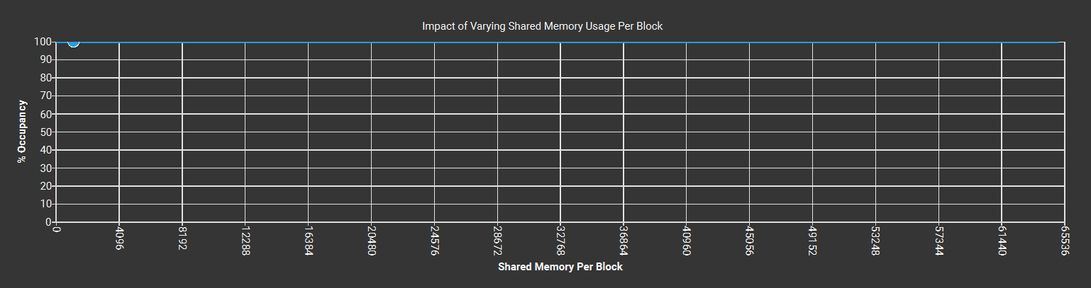
Kernel Image Processing with CUDA
Nsight compute metrics – Occupancy, 32x32 blocks
100% occupancy with 32x32 blocks
100% occupancy with 29 registers/thread
100% occupancy with 1156 bytes of shared memory

Slide 24
Kernel Image Processing with CUDA
Notes
NOTE: As the Nvidia 1650 Ti max blocks number per Multiprocessor is 16 and the max threds number per Multiprocessor is 1024: - An 8x8 block granularity gives 64 threads/block -> 1024/64 = 16 blocks/SM -> full capacity achieved
A 16x16 block granularity gives 256 threads/block -> 1024/256 = 4 blocks/SM
A 32x32 block granularity gives 1024 threads/block -> 1 block/SM

Slide 25
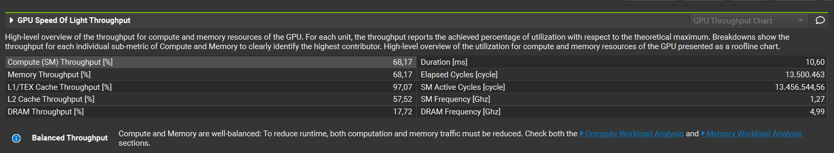
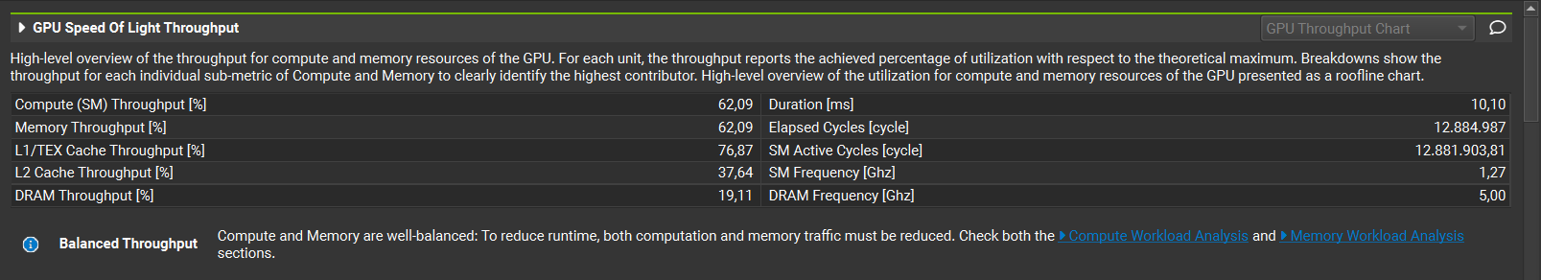
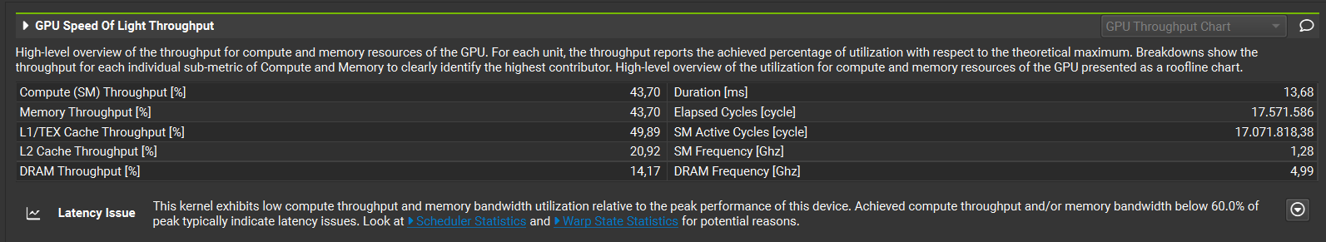
Kernel Image Processing with CUDA
Nsight compute metrics – Compute / Mem throughput
8x8 blocks
16x16 blocks
32x32 blocks

Slide 26
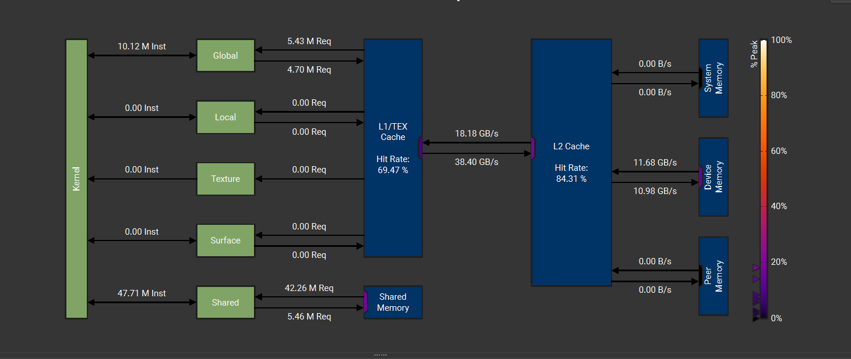
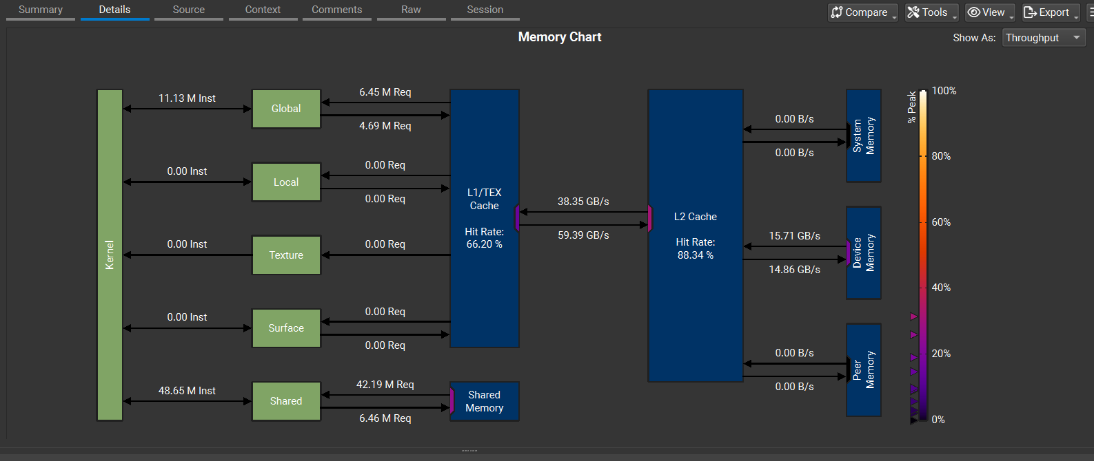
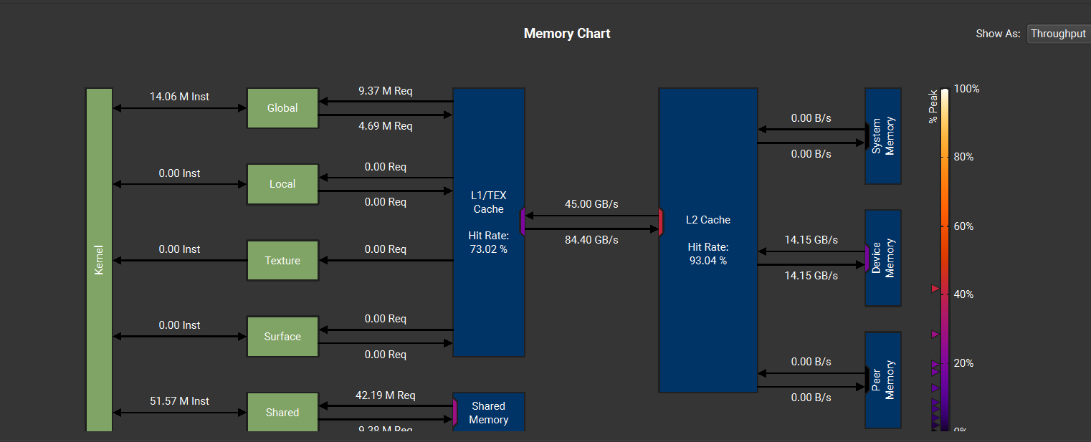
Kernel Image Processing with CUDA
Nsight compute metrics – Memory Throughput
32x32 blocks
16x16 blocks
8x8 blocks

Slide 27
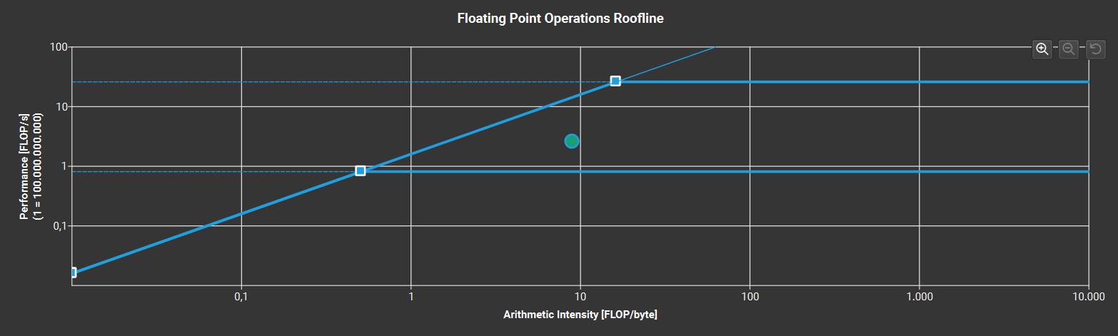
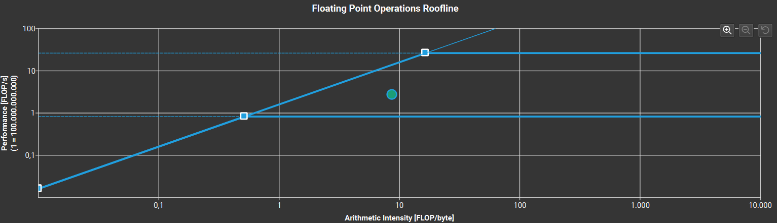
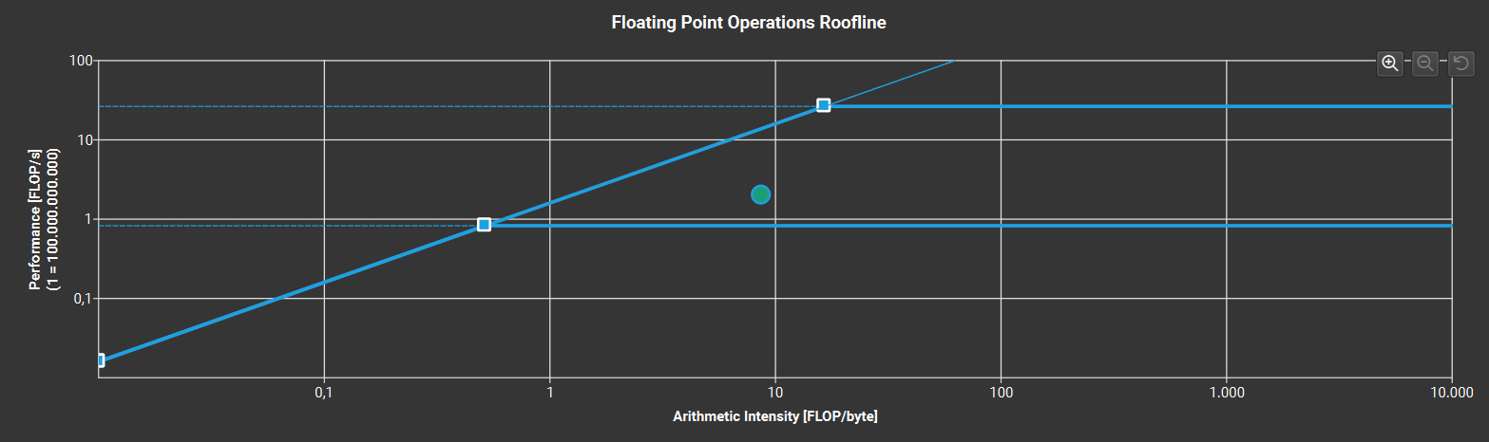
Kernel Image Processing with CUDA
Nsight compute metrics – FLOPS
8x8 blocks
16x16 blocks
32x32 blocks

Slide 28
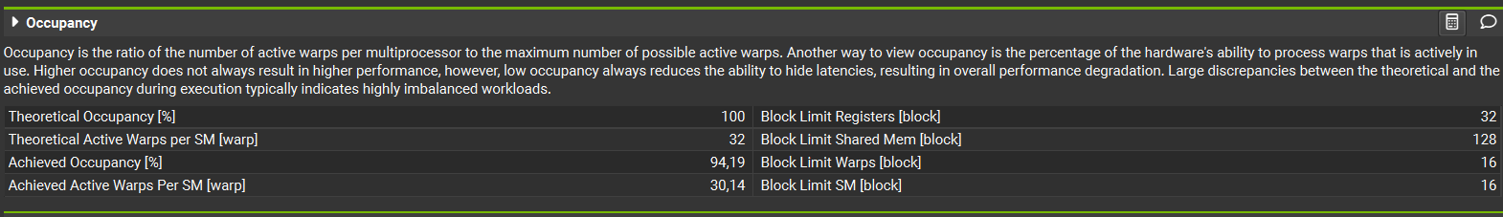
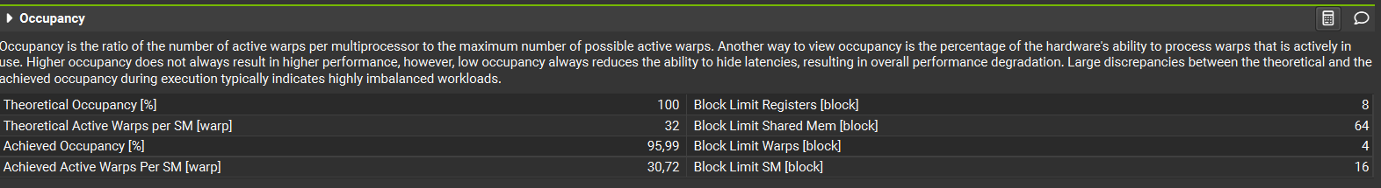
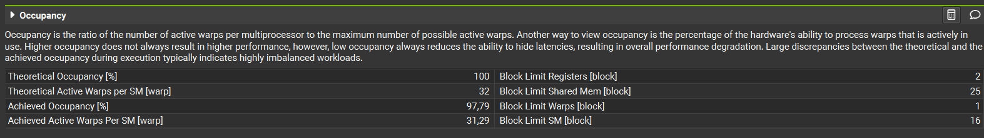
Kernel Image Processing with CUDA
Nsight compute metrics – Achieved Occupancy
8x8 blocks
16x16 blocks
32x32 blocks

Slide 29
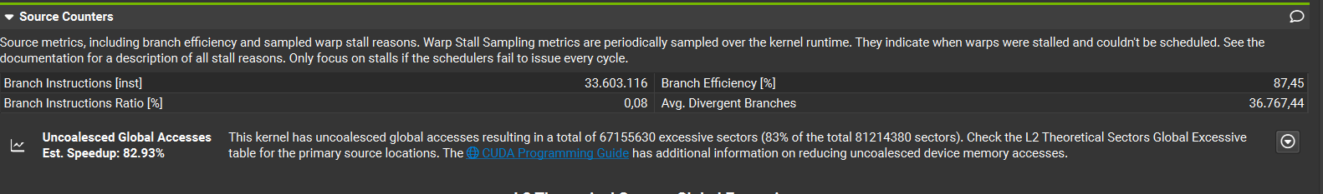
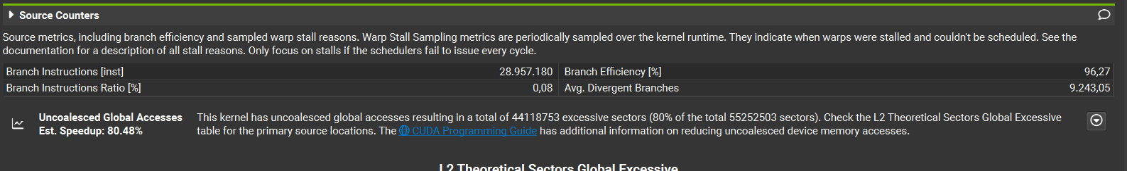
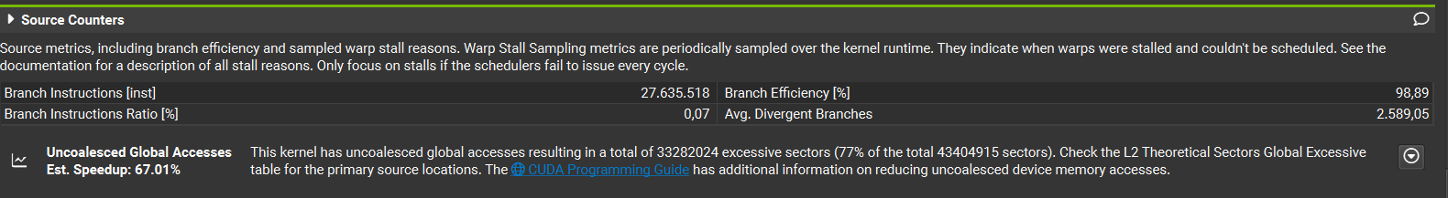
Kernel Image Processing with CUDA
Nsight compute metrics – Coalesced access
8x8 blocks
16x16 blocks
32x32 blocks

Slide 30
Kernel Image Processing with CUDA
Nsight compute metrics – Coalesced access
The previous slide shows that for every configuration the coalesced access to memory is not
that good. For the most, threads access with an uncoaleshed pattern. This behaviour can be
imputable to the stride access to the global memory when RGB pixel values are retrived to be
copied into the shared memory. A further optimization could be reshaping the initial RGB array so
that datas would be linearly stored into it and making threads access memory in a linear way
exploiting the coaleshed access.
When shared memory in accessed too, some uncolashed access are performed by threads, also
due to the fact that neighbours datas are stored into strided positions.

Slide 31
Kernel Image Processing with CUDA
Speedup metrics
The following metrics are tested on a 10000x5000 pixels image and
as the mean of 5 attempts. For all of the attempts, the blur kernel has been used and
8x8 blocks were launched.
SEQUENTIAL PROGRAM TIMING kernelProcessing() ms: 1602
SEQUENTIAL PROGRAM TOTAL TIMING including building/rebuilding image ms: 2206
CUDA PROGRAM TIMING kernelProcessing() ms: 0,09
CUDA PROGRAM TOTAL TIMING including all the overheads and building/rebuilding image ms: 320

Slide 32
Kernel Image Processing with CUDA
Speedup metrics
As we can see, the speedup of the kernel itself is: 1602ms / 0,12ms = 17800x
Of course, one has to take in account the total overhead introduced from CUDA environment initialization, memory allocation, memory copy from host to device and device to host copy back. With this considerations, the speedup is: 2206ms / 320ms = 6.9x This tests are conducted on a single image. A further optimization of this program would be to make use of pinned memory to process a larger amount of datas, maybe more than one
image per time and measuring the speedup. With the use of pinned memory for that case, the allocation costs would be higher, but the memory throughput would be higher too, leading to a greater benefit in transferring back and forth input and output arrays and to a much higher speedup. Another futher optimization could be the use of streams to copy asyncronousely datas and overlap data transfers with kernel processing. In the next slides the implementation.

Slide 33
Kernel Image Processing with CUDA
Variant: streams
A brief summary of the changes made is:
Implementation of streams (in this case 4 streams)
Every stream is responsible to process a determined number of rows of the image i.e. in our case the number of rows will be image height / 4 except of the last stream that will perform less rows in the case image height is not a multiple of 4
The code has been adapted to the use of streams. The kernel has been adapted too.

Slide 34
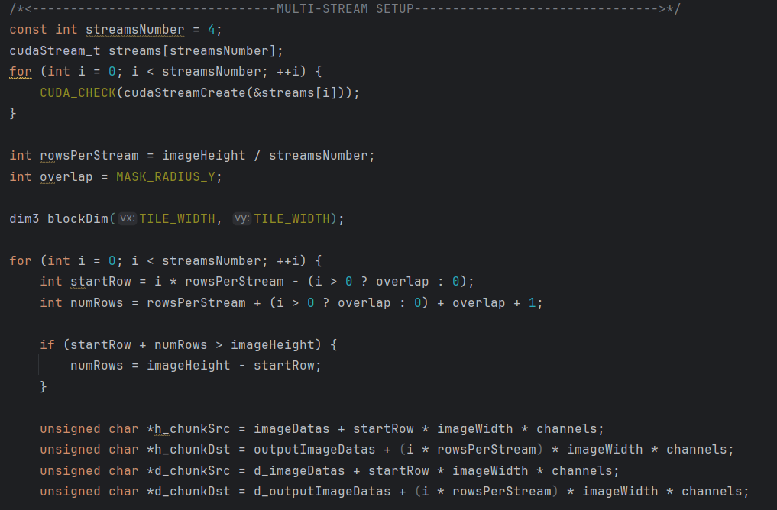
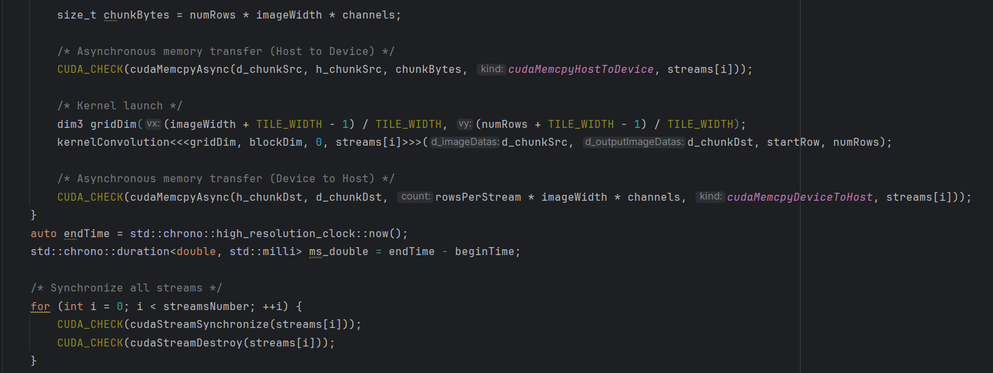
Kernel Image Processing with CUDA
Host code changes

Slide 35
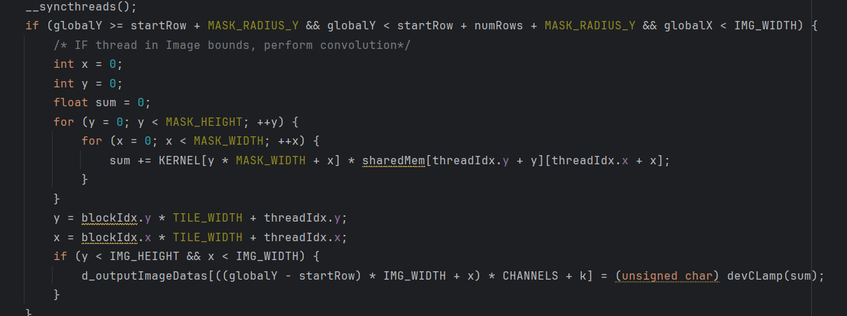
Kernel Image Processing with CUDA
Kernel code changes

Slide 36
Kernel Image Processing with CUDA
Streams: Speedup metrics
With the use of streams, the speedup has not changed so much (and it was lower then the previous version): 360ms as average. Another trial were made using a larger image of 20000x20000 pixels. These are the results. As before, the timing was taken as an average of 5 attempts.
Timing of sequential program: 18680ms
Timing of CUDA program: 2230ms
Timing for building the image: 700ms Speedup: 8.37x
As we see, lot of the time is spent in the initial image building process. So, an optimization could be the parallelization of this step in order to improve
speedup much further.

Slide 37
Kernel Image Processing with CUDA
Conclusions
Kernel Image processing was a good candidate to be implemented through CUDA as it has
a lot of parallelism and, as we saw, can be adapted to make threads cooperate with each
other. The kernel itself demonstrated to be highly performant with respect with the sequential
algorithm. The introduction of CUDA overheads has a very high cost, but its use is of course always convenient.
As the bottlenecks are data transfers between the host and the device, these are for sure a further optimization area. Another 2 variants making use of pinned memory and «thrust» library have been implemented and they’re avaiable on the github repo at the following links:
Pinned memory variant: https://github.com/smncarlesi/ParallelProgCUDA/tree/main/kernelImageProcessingCUDA_PinnedMem
Thrust: https://github.com/smncarlesi/ParallelProgCUDA/tree/main/imageProcessingCUDA_thrust

