Slide 1
Kmeans algorithm with OpenMP
Simone Carlesi
Mat. 7160828
Firenze,

Slide 2
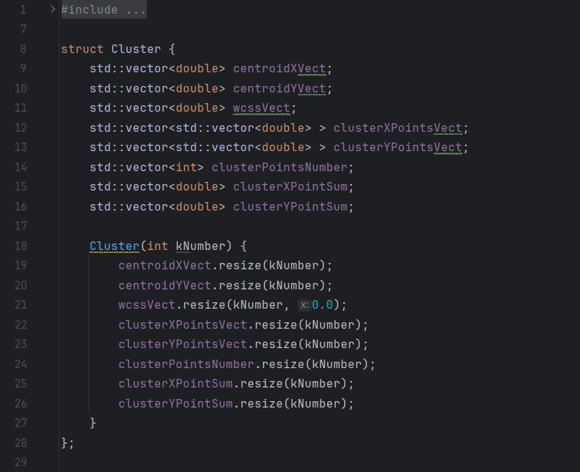
Kmeans algorithm with OpenMP
Choice of structures
For this problem, SoA is better than AoS because points coordinates are more likely to be contiguos in memory due to the fact that coordinates are stored in different vectors. With AoS, points coordinates will not be that contiguos and will lead to more CPU Cache misses. SoA is SIMD friendly.

Slide 3
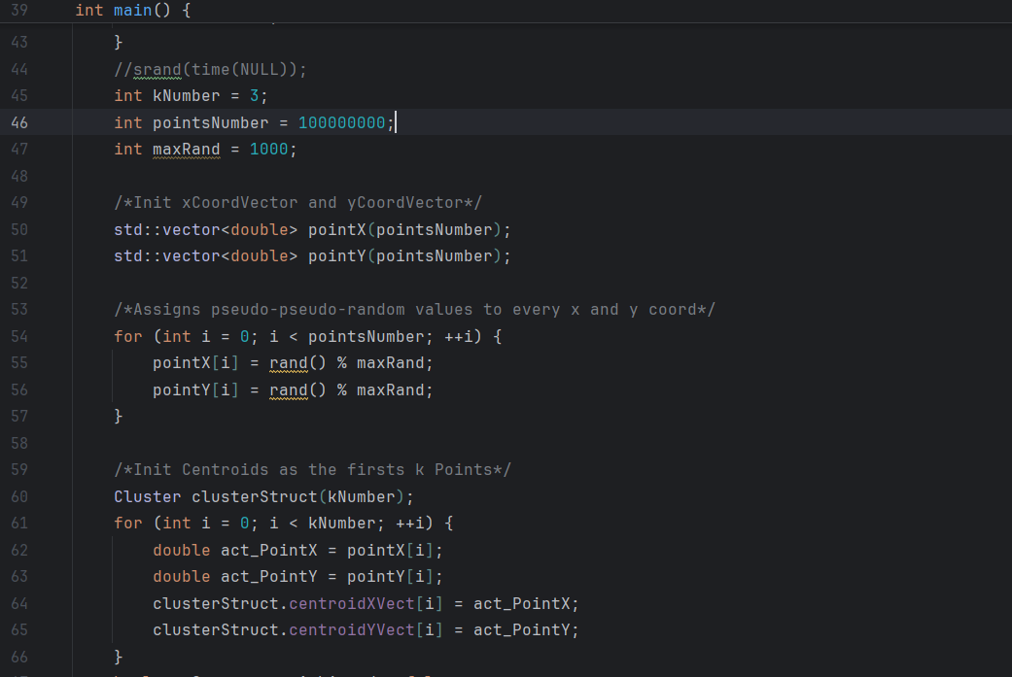
Kmeans algorithm with OpenMP
Initializations
Initialization of 2 vectors for pseudo-pseudo random points coords to be assigned to Clusters; Initialization of a Cluster struct with kNumber Centroids. First k points are choosen as the initial Centroids.

Slide 4
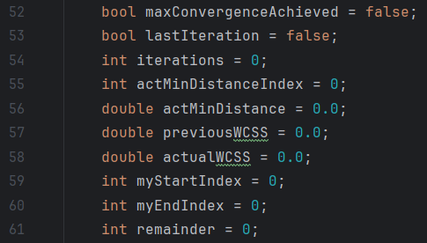
Kmeans algorithm with OpenMP
Initializations
Initialization of other variables that will be useful later.

Slide 5
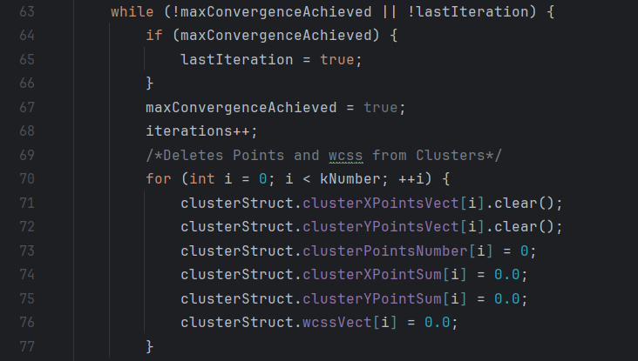
Kmeans algorithm with OpenMP
Conditions check and clearing of Cluster struct
While convergence is not achieved or last iteration has not been yet performed, repeat the process. Clears the whole Cluster struct apart of the Centroids coordinates at every iteration

Slide 6
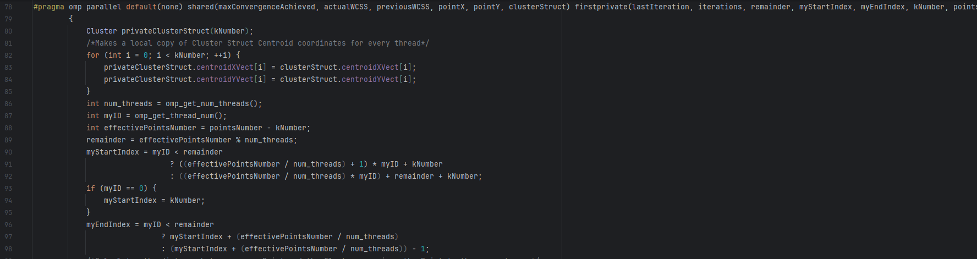
Kmeans algorithm with OpenMP
Shared and firstprivate variables
shared: maxConvergenceAchieved, actualWCSS, previousWCSS, pointX, pointY, clusterStruct
firstprivate:
lastIteration, iterations, remainder, myStartIndex, myEndIndex, kNumber, pointsNumber, actMinDistanceIndex, actMinDistance
Opening of parallel region-> thread fork->Initialization of local Cluster struct for every thread -> copy of the actual Centroids coordinates for every thread

Slide 7
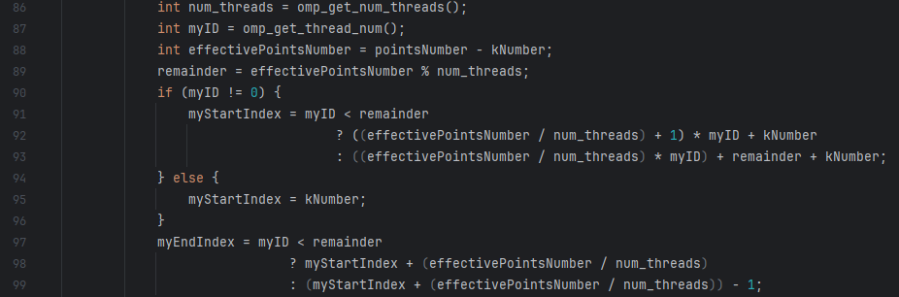
Kmeans algorithm with OpenMP
Work distribution
Manual assignment of indexes for every thread in order to reduce the overhead of an automatic #pragma omp for directive No need for any syncronization because every variable is private to every thread

Slide 8
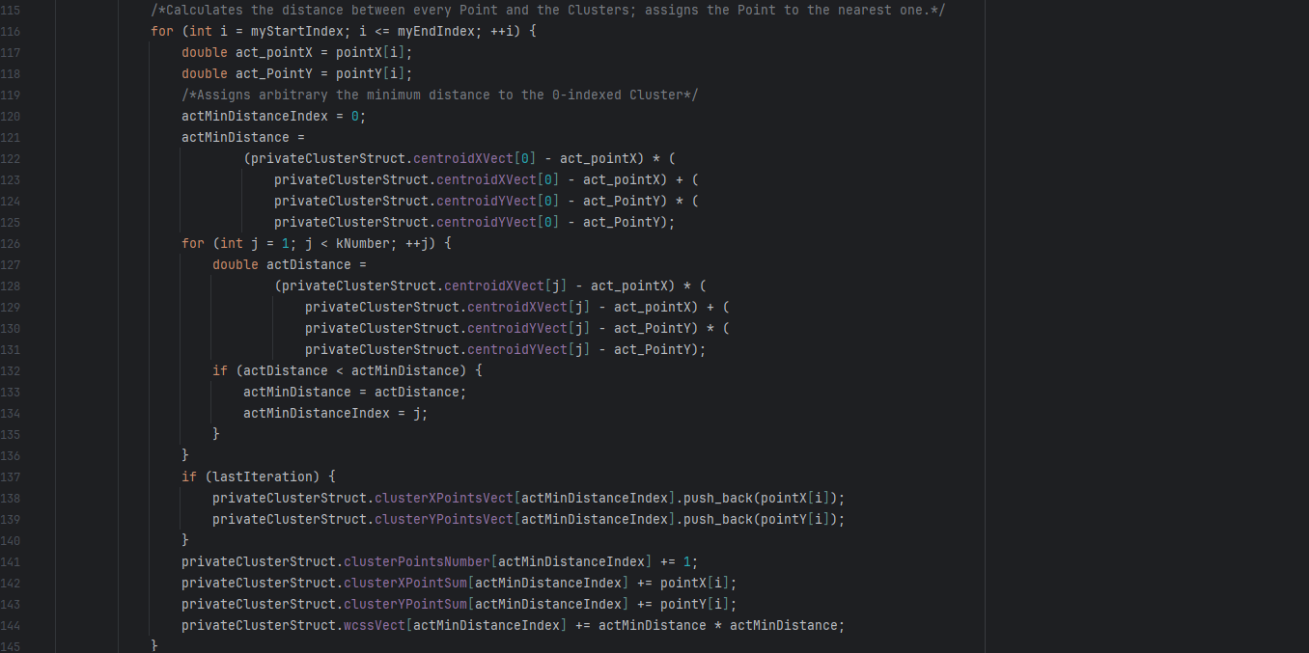
Kmeans algorithm with OpenMP
Initializations and work distribution
Work is distributed among threads. Every thread finds the nearest cluster for every point belonging to its range. When nearest cluster is found, there is no need to push the actual point coordinates into the local struct (more overhead) exept in case this is the last iteration. We only update the partials number of the points, sum of the X,Y coordinates and wcss. There is no need for syncronization because every struct has been privatized and every thread works on a different index of pointX and pointY vectors.

Slide 9
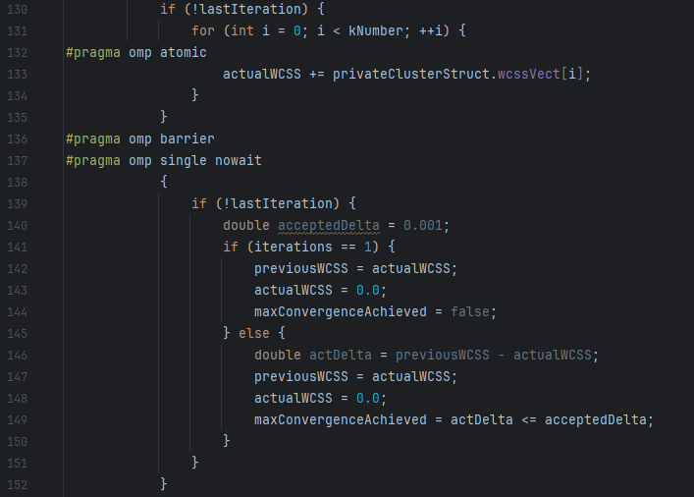
Kmeans algorithm with OpenMP
WCSS update and convergence check
If last iteration has not been yet performed, atomically update the actualWCSS value for every cluster with a reduction on the shared variable and picking partial wcss from every local cluster struct in order to avoid race conditions. A barrier is needed at the end of this process to make sure that every thread has updated the shared wcss to assure that the following calculation is correct.
On the other hand, there is no need to wait for every thread at the end of the single directive so a nowait clause has been put in order to reduce the overhead caused by the waiting time

Slide 10
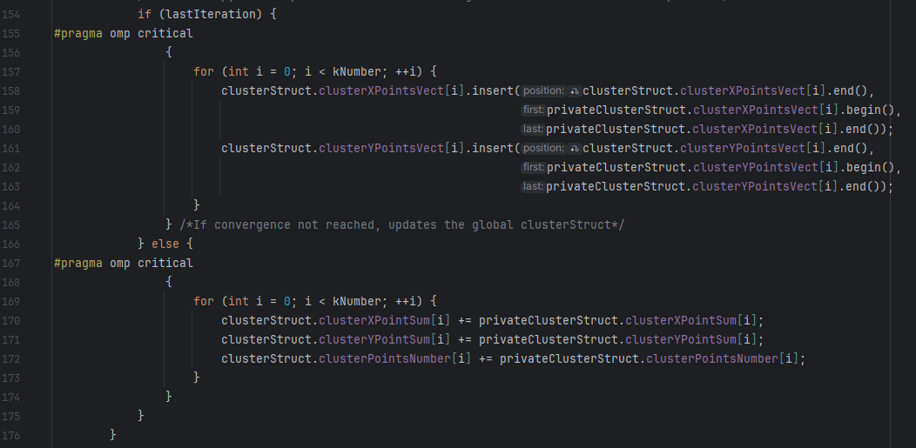
Kmeans algorithm with OpenMP
Shared cluster struct updating
If last iteration has been yet performed, we need to copy all of the points coordinates into the shared cluster struct
Otherwise, there is no need to copy them and we only need to copy all the partial sums of X, Y coordinates and the partial points count into the shared cluster struct, for every cluster. A critical region is needed in order to do these to avoid race conditions on the shared struct.

Slide 11
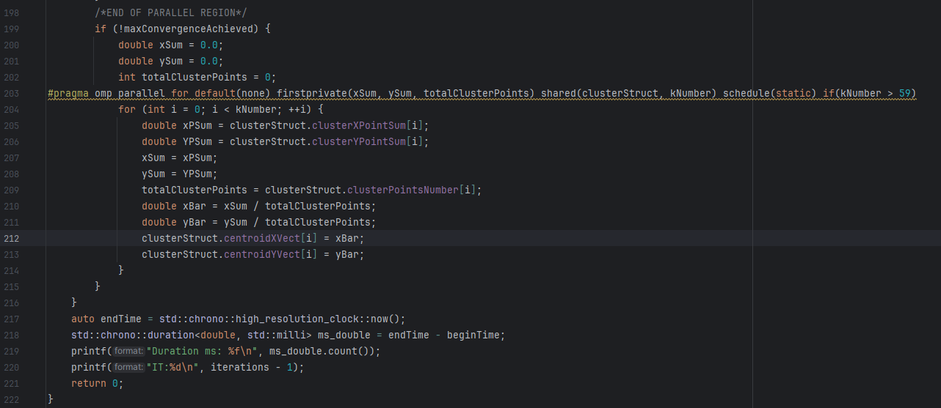
Kmeans algorithm with OpenMP
New centroids coordinates or last iteration performing
End of parallel region and thread join. Check if convergence has been achieved, otherwise new centroids coordinates are calculated and assigned to the shared cluster struct. Parallelization of this loop seemed to be not that beneficial, but not worst of the sequential version too. So an arbitrary large number was left as a condition.

Slide 12
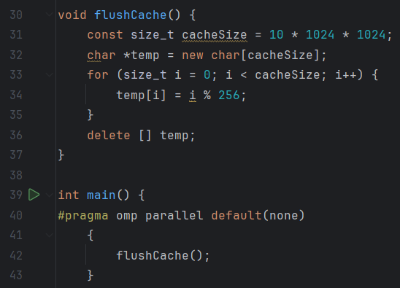
Kmeans algorithm with OpenMP
Speedup
A cache flush is useful to avoid cache warming and alterate the results

Slide 13
Kmeans algorithm with OpenMP
Speedup
Different trials were made, the results are shown in the next slides. The timing values are in ms and were taken as the avarage of 5 attempts, with both serial
and parallel versions.
It was noticed that made no sense to parallelize if the number of points is below 60.000 because the overhead is not worth it. An if clause was added at the very beginning of the parallel region to avoid this.

Slide 14
Kmeans algorithm with OpenMP
Timing values with different points number
DATA | kNumber | Points Number | Seq. Timing (ms) | Par. Timing(ms) | Speedup
1 | 3 | 100 | 0.012 | 0.16 | 0x
2 | 3 | 60.000 | 31 | 30 | 1,03x
3 | 3 | 150.000 | 84 | 57 | 1,47x
4 | 3 | 500.000 | 289 | 132 | 2,19x
5 | 3 | 5.000.000 | 2636 | 665 | 3,96x
6 | 3 | 100.000.000 | 98.470 | 11.073 | 8,89x
7 | 3 | 200.000.000 | 187.929 | 21.215 | 8,86x
8 | 3 | 300.000.000 | 285.320 | 26.126 | 10,92x

Slide 15
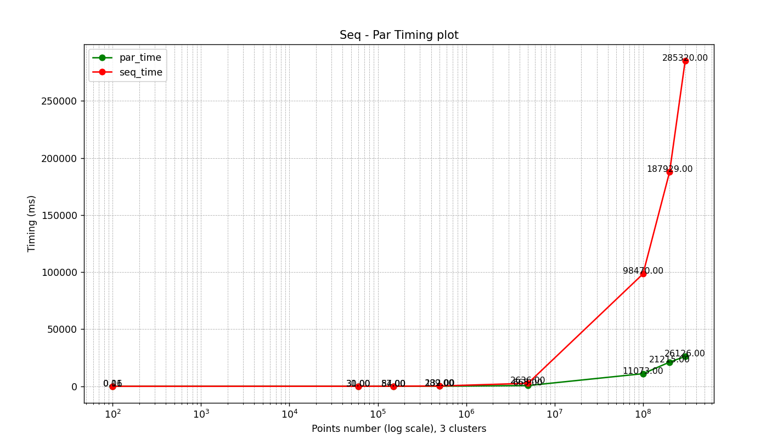
Kmeans algorithm with OpenMP
Comparable timing plot for sequential - parallel version

Slide 16
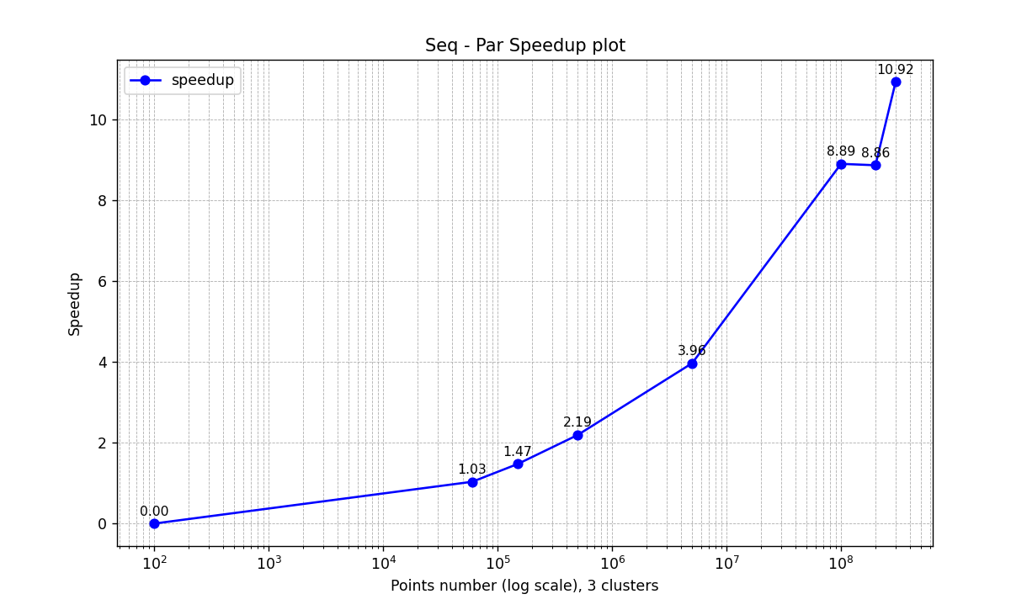
Kmeans algorithm with OpenMP
Speedup plot

Slide 17
Kmeans algorithm with OpenMP
Timing values with different clusters number
DATA | kNumber | Points Number | Seq. Timing (ms) | Par. Timing(ms) | Speedup
1 | 3 | 5.000.000 | 2.213 | 485 | 4,56x
2 | 5 | 5.000.000 | 2.121 | 380 | 5,58x
3 | 9 | 5.000.000 | 12.540 | 1391 | 9,01x
4 | 12 | 5.000.000 | 6.036 | 627 | 9,63x
5 | 15 | 5.000.000 | 7.348 | 852 | 8,62x
6 | 25 | 5.000.000 | 15.223 | 2448 | 6,21x

Slide 18
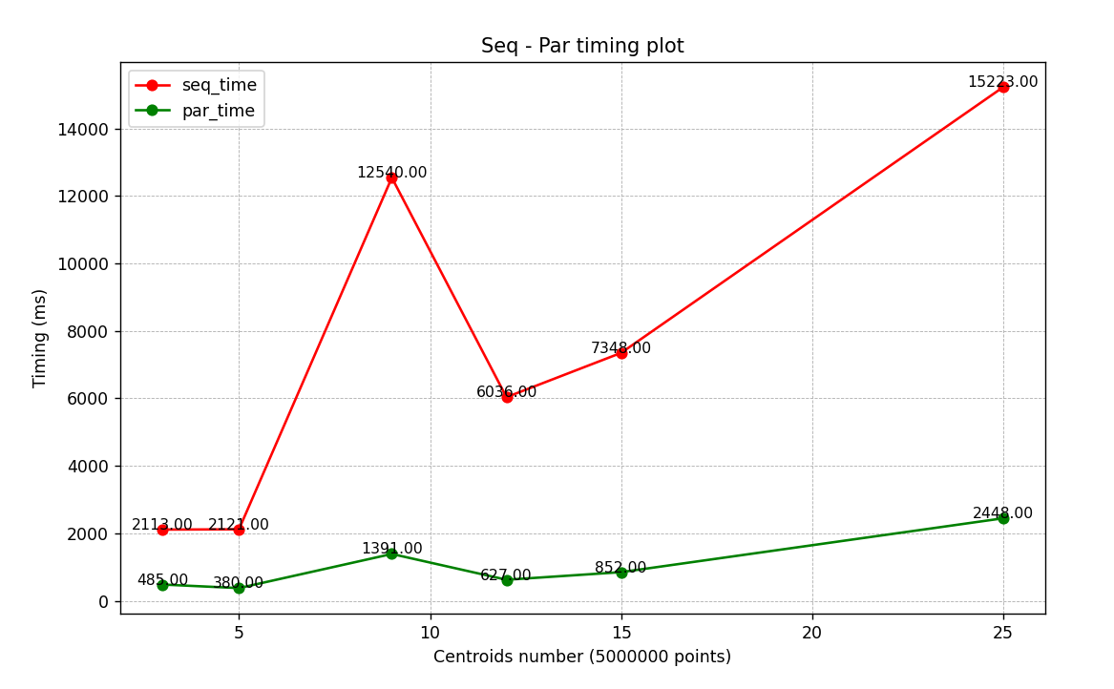
Kmeans algorithm with OpenMP
Comparable timing plot for sequential - parallel version

Slide 19
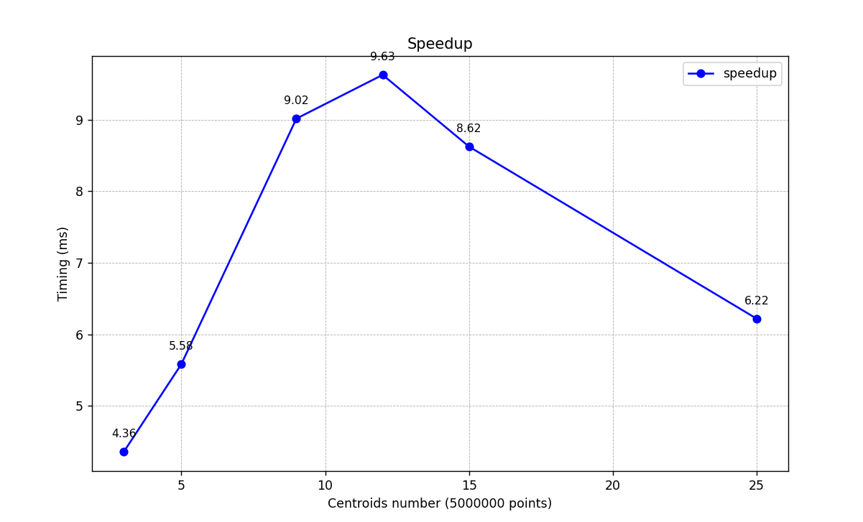
Kmeans algorithm with OpenMP
Speedup plot

Slide 20
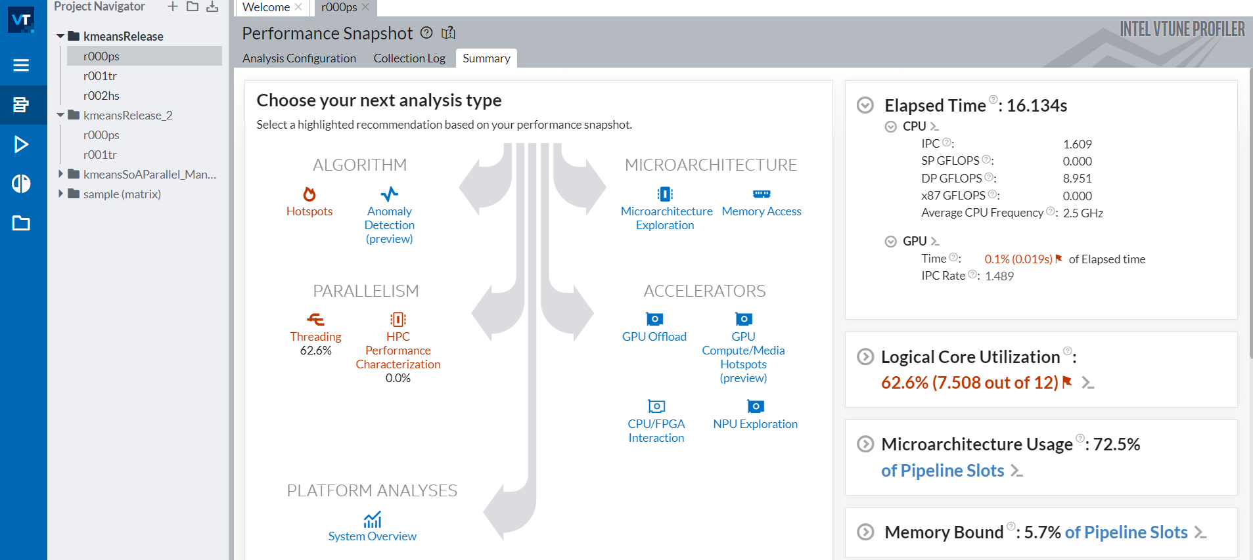
Kmeans algorithm with OpenMP
Intel VTune metrics
Using Intel Vtune profiler, it was found that 62.6% of logical cores were utilized, but this low metric is also due to the fact that the very first part of the algorithm (the random numbers generation) has been written in a sequential style aiming
to reproduce the same experiments every time and not to assign the same point
values to every thread. Moreover, the very last part is, in most cases, sequential too
for the reasons explained before.

Slide 21
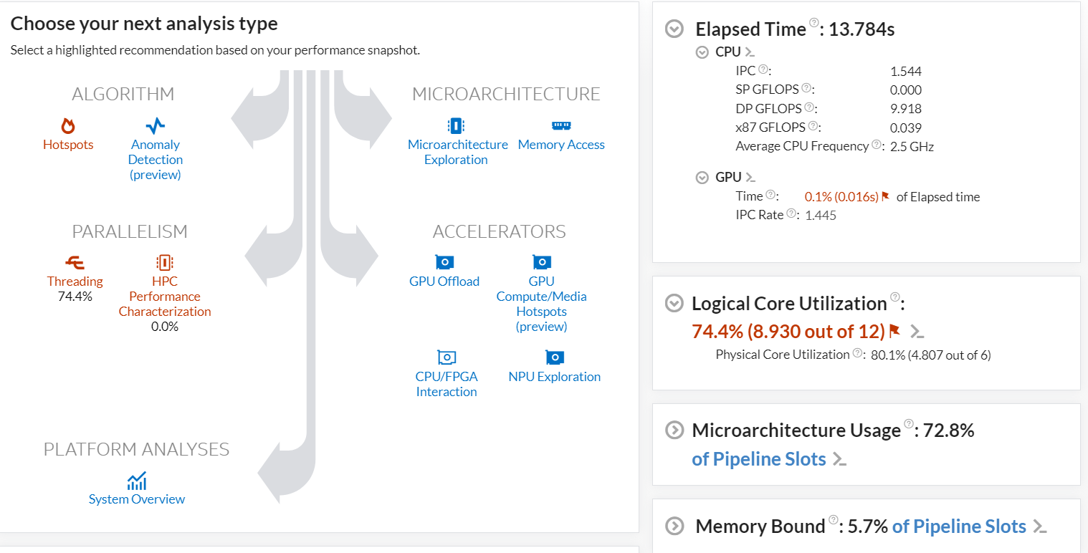
Kmeans algorithm with OpenMP
Intel VTune metrics
An experiment was made adding parallelization also in the very first part of the algorithm
and these were the results. The percentage has risen by an 11.8% leading to a usage of 8.930
out of 12 and a 80.1% of physical core utilization. In a real context, this version would be used
and points would be assigned with a parallel approach.

Slide 22
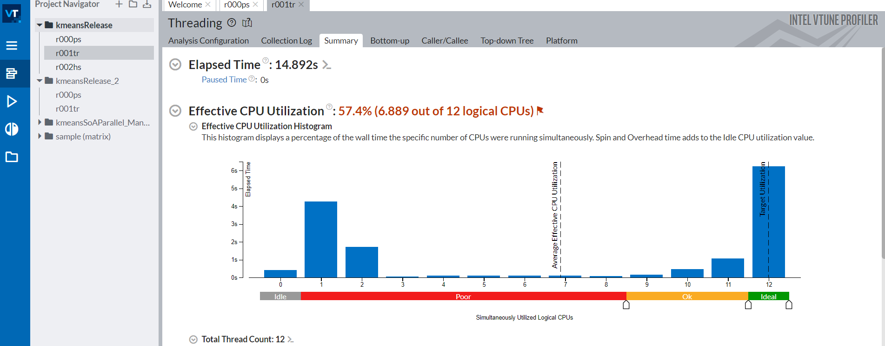
Kmeans algorithm with OpenMP
Intel VTune metrics
The Intel VTune Threading profiling shows an average spent time on 57.4% of the logical CPUs (6.889 out of 12). We can notice that a lot of time is spent on only 1 CPU, and this is also due to the fact explained before (as shown in the next slide). Of course, the critical region and the atomic instructions also play a role in this.

Slide 23
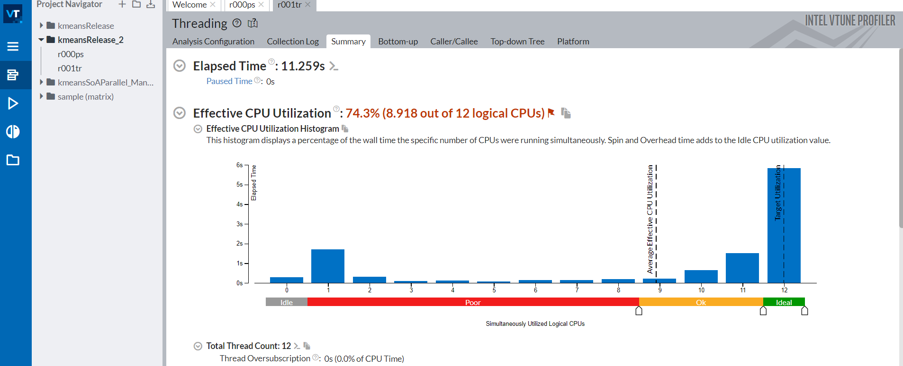
Kmeans algorithm with OpenMP
Intel VTune metrics
On the other hand, with the second version of the code, the results are these. A 74.3% of the logical CPUs were utilized and the time spent on only 1 CPU is much less,
meaning that the previous low metric was much due to the fact we talked about.
The sequentiality accountable to the critical and atomic operations, of course, didn’t disappear, but now the entire program time was spent on 8.918 CPUs as an average.

Slide 24
Kmeans algorithm with OpenMP
Conclusions
The kmeans algorithm was found as a very good problem to be parallelized: it has a lot of
parallelism inside it, with a particoular focus on the cluster assignment phase, where it is embarassingly parallel, as every point is indipendent from every other. The obtained speedup was nice and has a room of improvement, maybe implementing a 3D version in which the parallelization would have much effect.
CUDA would be a good candidate for parallelizing this problem too for the reasons explained before.

Slide 25
Kmeans algorithm with OpenMP
Specifics
OS: Windows 11 23H2 CPU: Intel(R) Core(TM) i7-10750H CPU @ 2.60GHz 2.59 GHz x64 Number of Physical Cores: 6 (with hyperthreading)
Number of threads: 12

