Slide 1
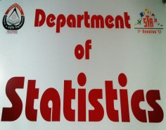

Association Between Type of Delivery and Childhood Disease: Evidence from Multiple Indicator Cluster Survey, Bangladesh
Jenifar Jahan¹
Mohammad Nayeem Hasan¹
Sumyea Jahan¹
Muhammad AB Chowdhury²
Md. Jamal Uddin^{1,3}
Department of Statistics, Shahjalal University of Science & Technology, Bangladesh
Department of Emergency Medicine, University of Florida, USA
Section of Biostatistics, Department of Public Health, University of Copenhagen, Denmark

Slide 2
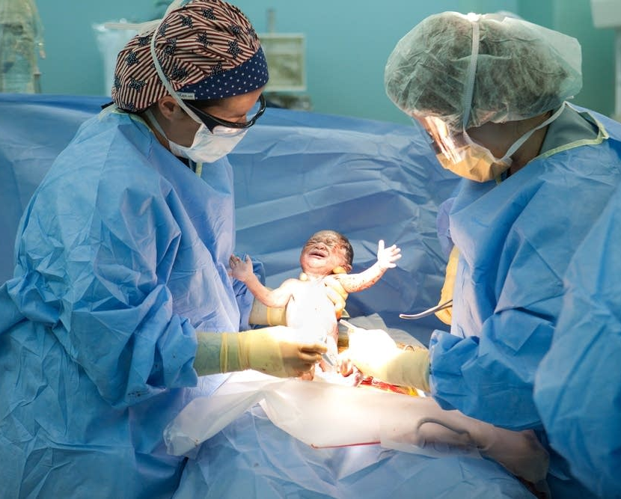



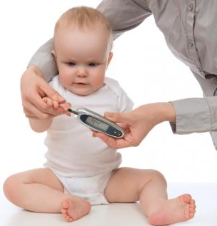
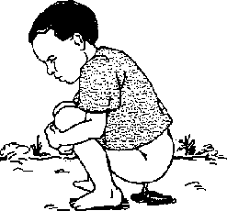

Background
A caesarean section (C-section) is a surgical procedure, performed when a vaginal delivery would put the baby or mother at risk
Women experiencing C-section delivery have a risk of major morbidity
e.g., cardiac arrest, hysterectomy, puerperal infection, wound hematoma are some complications to women

Slide 3
Objective
To inspect the association between C-section delivery and infantile disease (e.g. cough, diarrhoea, difficulty in breathing)

Slide 4
Methodology (Study Design)
Multiple indicator cluster survey (MICS), data 2012-13
Based on a sample of 51,895 households (43,474 rural, 8,421 urban) interviewed with response rate 98.5%
Provides a comprehensive picture of children and women in the seven divisions of our country
Women were aged between 15-49 years
Overall 19.1% women had delivery by C-section

Slide 5
Continued…
7,921 children were under 2 years of age
Information of the mode of delivery (C-section vs. normal) was available for 2,138 children
Among them, 62.1% were born by C-section delivery & 37.9% were delivered normally

Slide 6
Methodology (Statistical analysis)
We examined two outcome variables of interest, using Poisson regression analysis & Logistic regression analysis
Firstly, we count all disease for Poisson regression analysis
Then, we count higher disease and lower disease by their median point for Logistic regression analysis

Slide 7
Methodology (Statistical analysis)
Poisson regression analysis (as the outcome is count)
Logistic regression analysis (outcome binary, where 0 means lower disease[<3] and 1 means higher disease[ ≥3 ] )
Crude model:
Disease (count) ~ C-section
Adjusted model:
Disease(count) ~ C-section + Religion + Breastfed + Sex (child) + Education (mothers) + Child Age (in months) + BMI (mothers)+ Wealth Index
C-section: caesarean section

Slide 8
Bar chart for disease (Poisson outcome)

Slide 9
Bar chart for disease (Logistic outcome)

Slide 10
Result
Poisson regression analysis between disease (count) and C-section
Crude Model (only C-section variable in the model)
 | Relative Risk | 95% CI | P-value
C-section (Yes vs No) | 1.06 | 1.00 – 1.11 | 0.03
Adjusted Model (C-section & other covariates in the model)
 | Relative Risk | 95% CI | P-value
C-section (Yes Vs No) | 1.03 | 0.99 – 1.08 | 0.14
The Poisson regression analysis showed that the relative risk for the C-section was 1.06 (Crude) & 1.03 (Adjusted), indicates that children were born in C-section compare to the normal delivery are at increased risk for developing childhood disease. However, the association was not significant in the adjusted model.
CI: Confidence Interval

Slide 11
Adjusted Poisson model
Source | Chi-Square | Pr > ChiSq
C-Section | 2.22 | 0.14
religion | 0.30 | 0.59
Breastfed | 2.83 | 0.09
Sex | 1.00 | 0.32
Mothers Education | 0.01 | 0.92
Child Age | 1.23 | 0.27
BMI Category | 0.22 | 0.64
Wealth Index | 6.39 | 0.01

Slide 12
Result
Logistic regression analysis between disease (binary) and C-section
Crude Model (only C-section variable in the model)
 | Odds Ratio | 95% CI | P-value
C-section (Yes vs No) | 1.18 | 0.93 – 1.50 | 0.18
Adjusted Model (C-section & other covariates in the model)
 | Odds Ratio | 95% CI | P-value
C-section (Yes Vs NO) | 1.10 | 0.86 – 1.41 | 0.44
The crude and adjusted logistic regression analyses showed that the odds ratios for the C-section were 1.18 and 1.10 times higher than the odds ratio for the normal delivery, respectively, though the association was not statistically significant at 5% level.
CI: Confidence Interval

Slide 13
Adjusted Logistic Model
Source | Chi-Square | Pr > ChiSq
C-Section | 0.60 | 0.44
religion | 0.21 | 0.65
Breastfed | 1.11 | 0.29
Sex | 0.00 | 0.98
Mothers Education | 0.83 | 0.36
Child Age | 0.00 | 0.96
BMI Category | 0.00 | 0.96
Wealth Index | 9.91 | 0.01

Slide 14
Key findings
Both Poisson and logistic regression showed that children were born in C-section compare to the normal delivery are at increased risk for developing childhood disease (children less than 2 years of age).
However, based on our data the association was not statistically significant in the adjusted model at 5% level of significance.
This may due to i) small size ii) did not available proper information of the delivery and iii) many missing observations

Slide 15
Limitation of our data
There is a lack of information about C-section babies in MICS data
Number of children under the age of 2 years was not enough
Information about child disease like Asthma, type 1 diabetes, Crohn's disease, allergic diseases, immune deficiencies leukemia, were not available
Information about Food habit of children also wasn’t given enough
Insufficient information was available about mothers health

Slide 16
Conclusion
Although we did not identify the significant association between C-section and childhood disease, we recommend to parents, doctors to try normal delivery first unless a medical emergency threatens the life of the mother or the child.

Slide 17



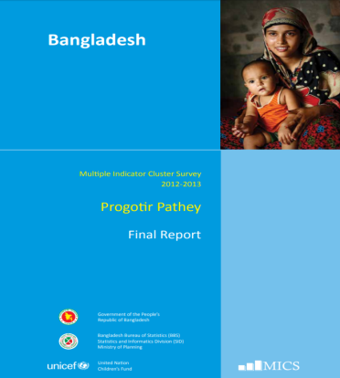


Acknowledgement

Slide 18


