Slide 1
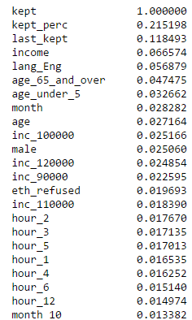
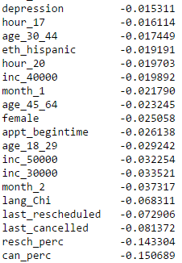
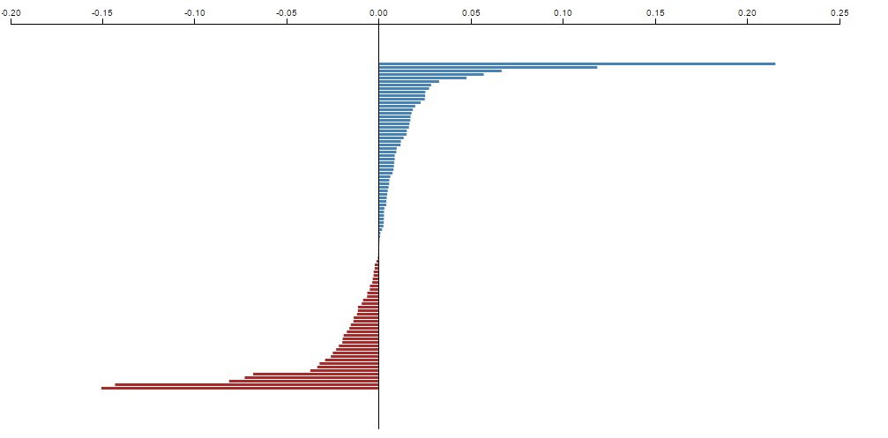
Appointment Cancellation Predictions
~72% accuracy predicting appointment being cancelled.
Features: previous appointment kept, cancelled, rescheduled. Zip avg per capita income. Basic Demographics. Time/Day of appointment. Depression diagnosis.
Other ideas: Distance to appointment, weather, diagnosis/procedures, Reason for appointment, # of appointments, days until previous appointment.
Positive Correlation
Negative Correlation
1.00= 100% Chance of keeping appointment
0.00= No relation with keeping appointment
-1.00=100% Chance of cancelling appointment

Slide 2
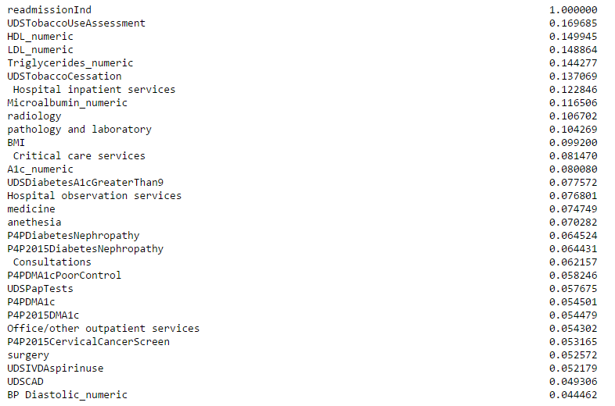
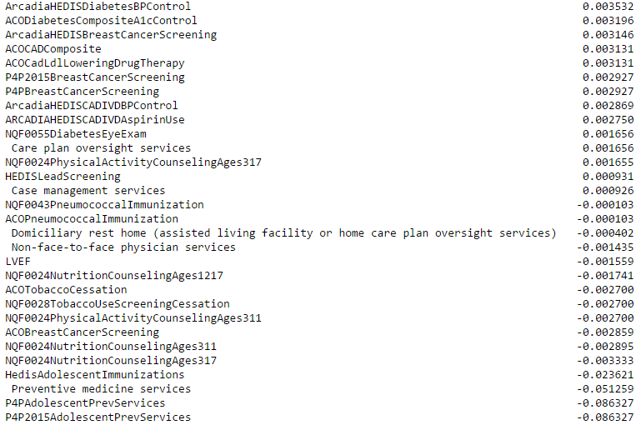
30 Day ER Readmission Model
2015. ~100,000 persons
~80% accuracy predicting person of having a readmission.
Features: Person in Measure Numerator, Single Patient Report 1 or 0 indicator and a few values(HDL,LDL), CPT grouping of events from previous year. No demographics, non-measure diagnosis
Positive Correlation
Negative Correlation
1.00= 100% Chance of readmission.
0.00= No relation on readmission
-1.00=100% Chance of no readmission

Slide 3
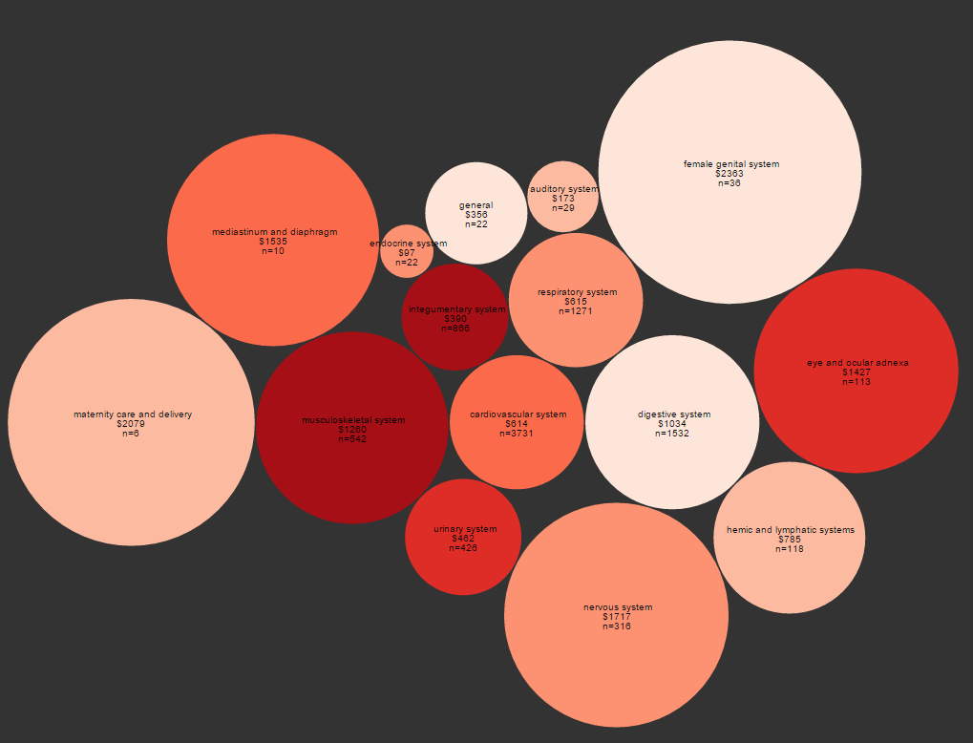
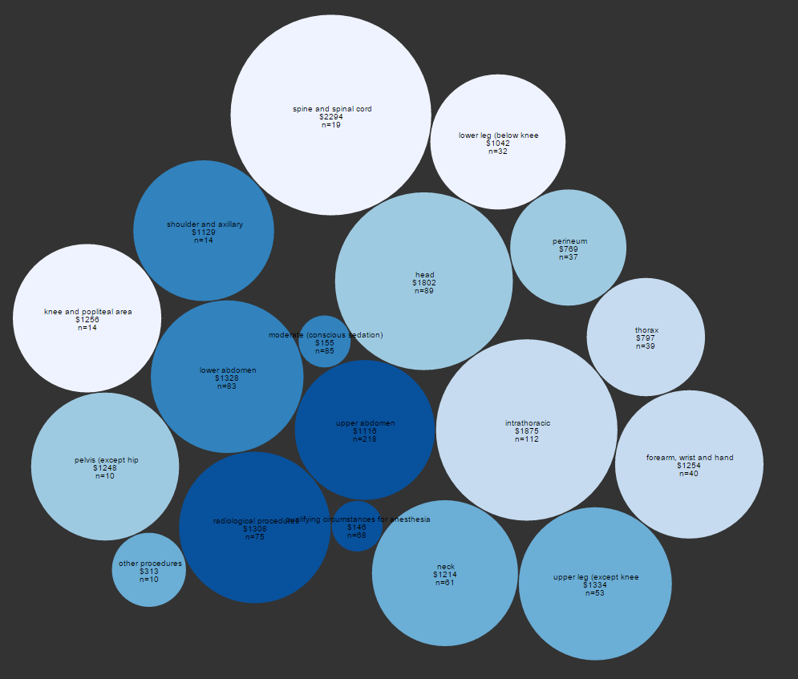

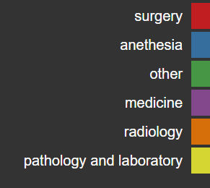
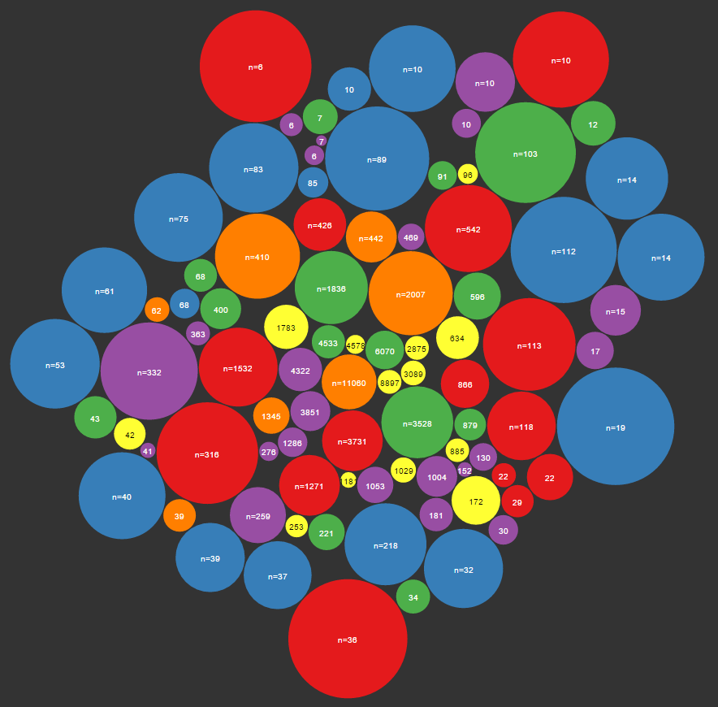
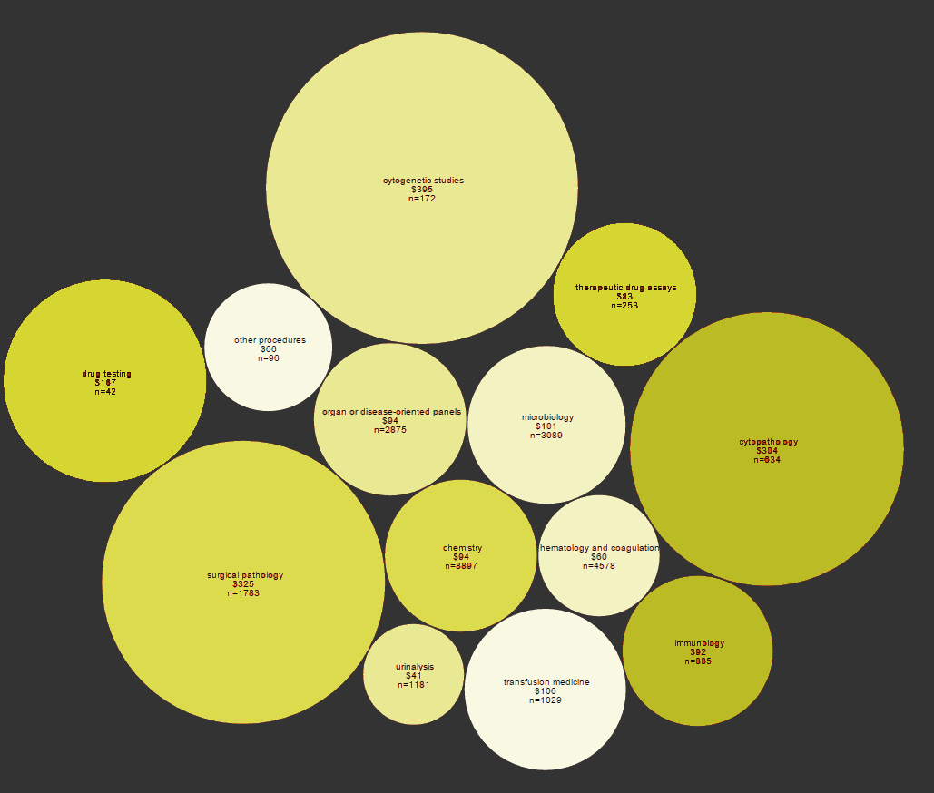
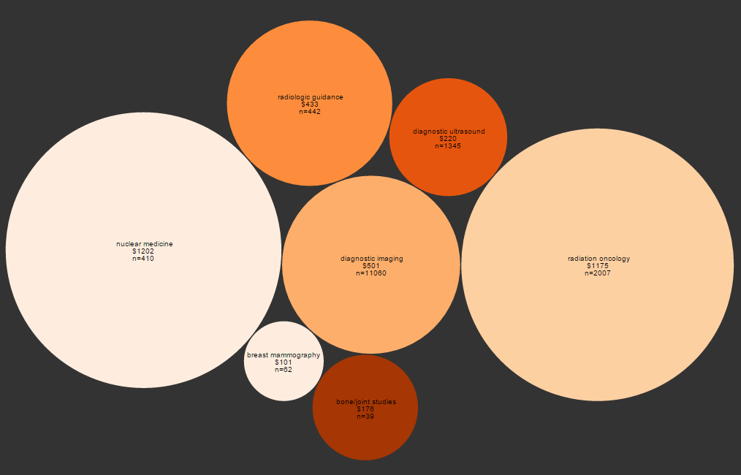
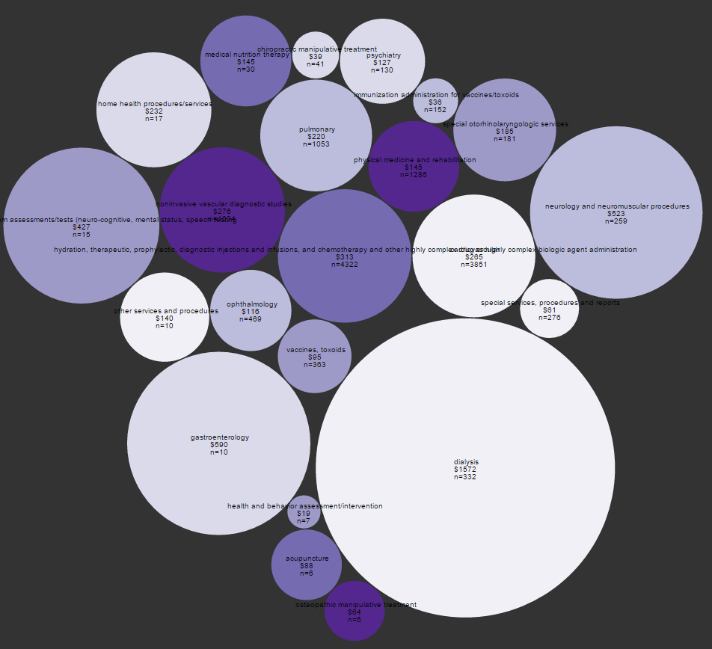
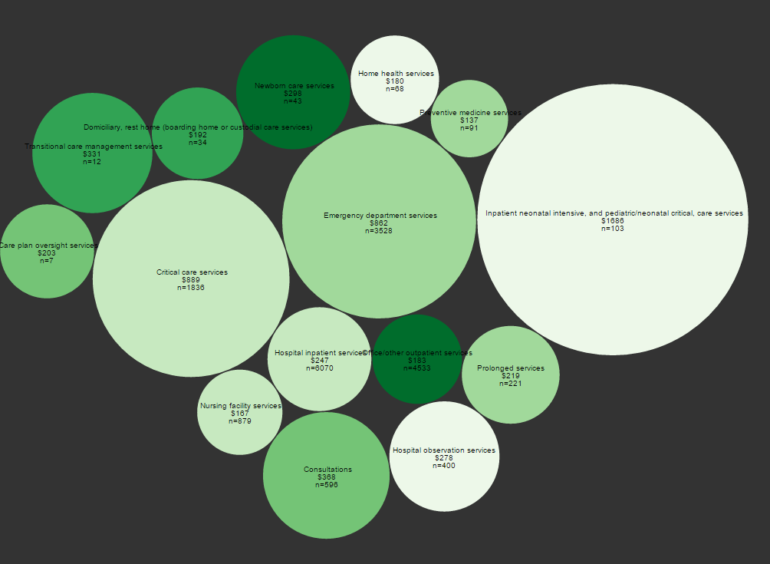
Procedure Cost and Occurrence Rate
Final 3 Months of Life
Anesthesia
Surgery
Overall
Combined
The closer to center the more frequently it occurs, numbers on bubble represents times occurred, size corresponds to cost.
Radiology
Pathology & Laboratory
Medicine
Other

Slide 4
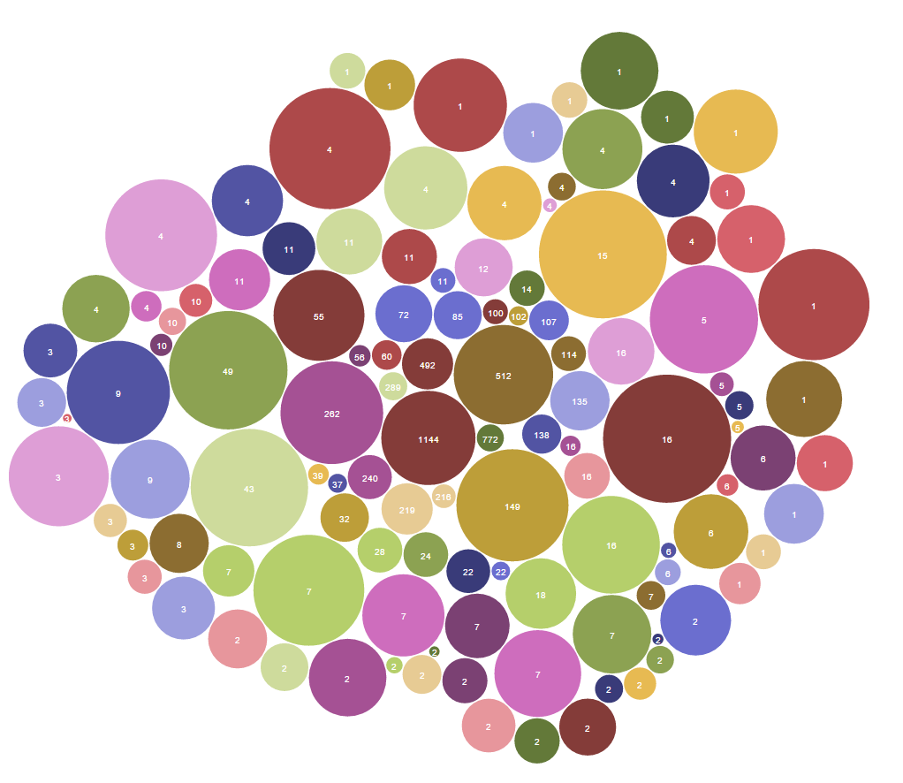
Procedure by Cost and Occurrence Final Week of Life
The closer to center the more frequently it occurs, numbers on bubble represents times occurred, size corresponds to cost, legend for procedure not shown below

Slide 5
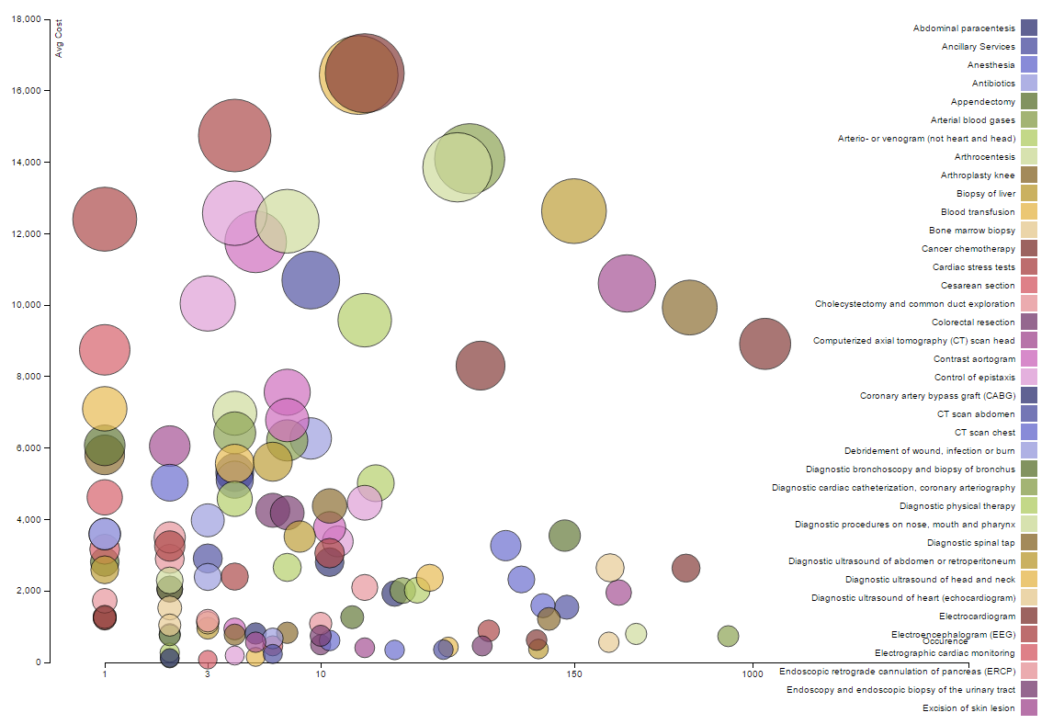
Procedure by Cost and Occurrence Final Week of Life

Slide 6
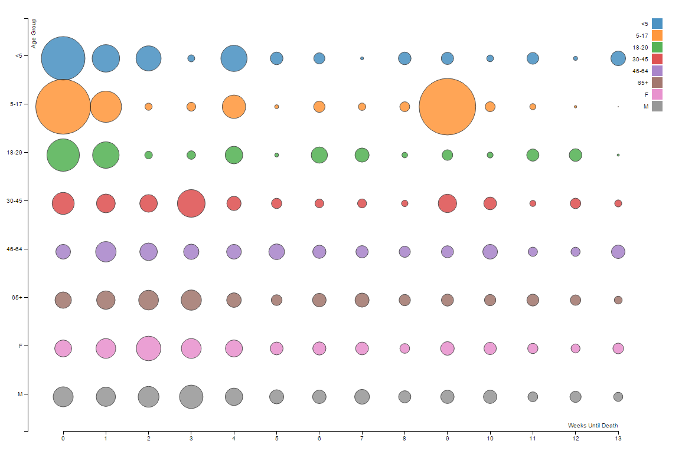
Avg Cost by Week by Groups
(size corresponds to cost)

