Slide 1
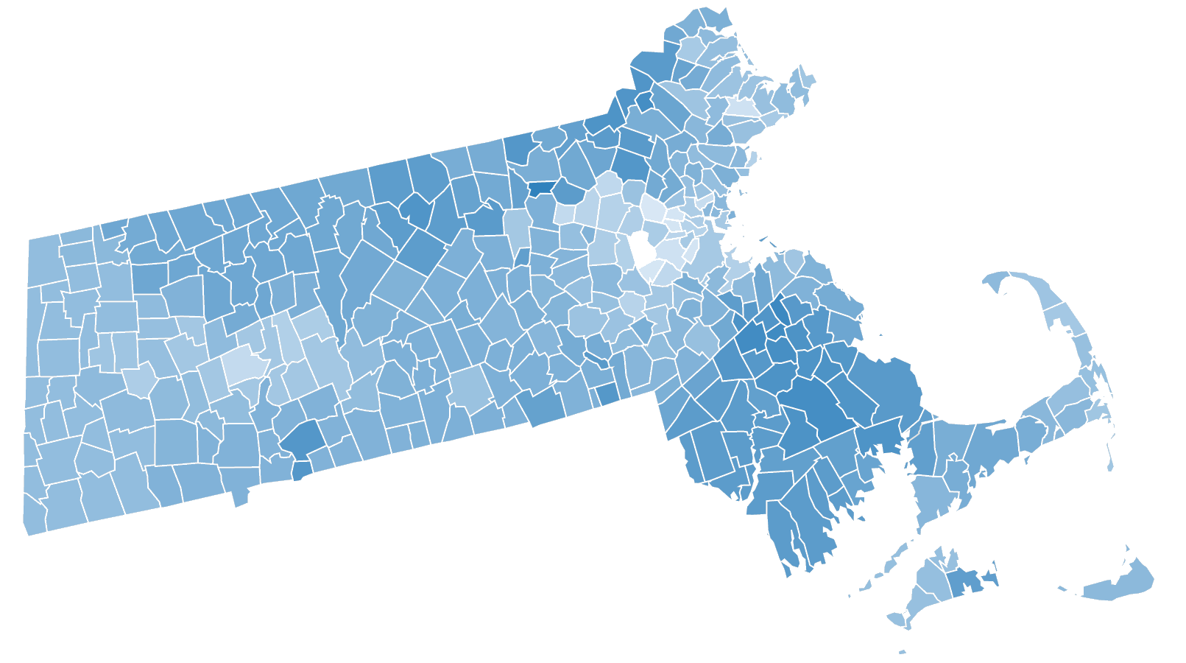
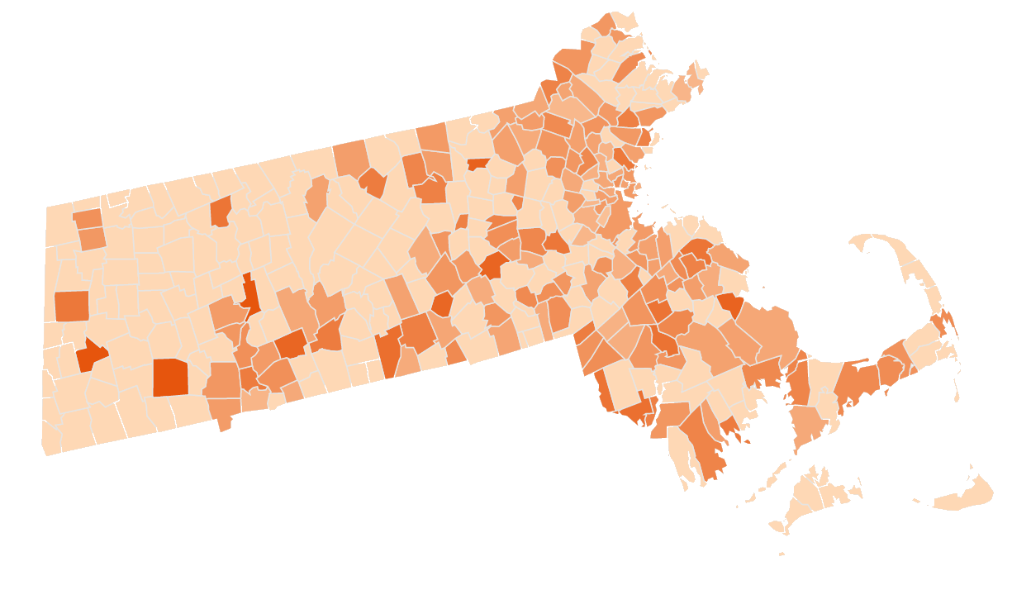
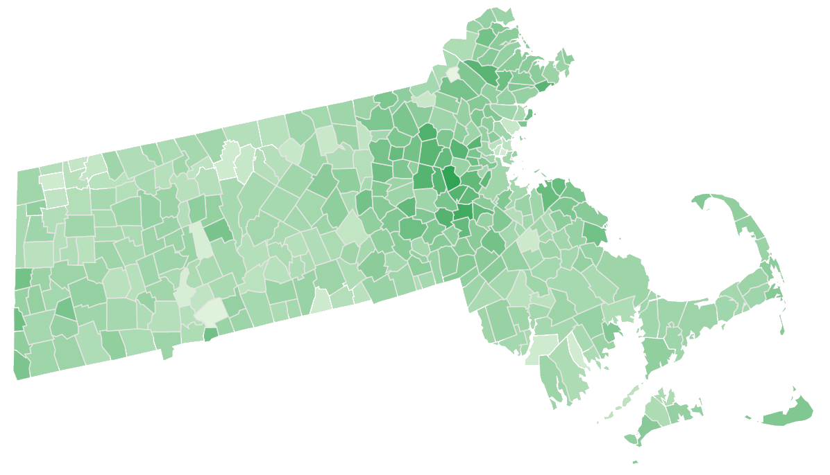









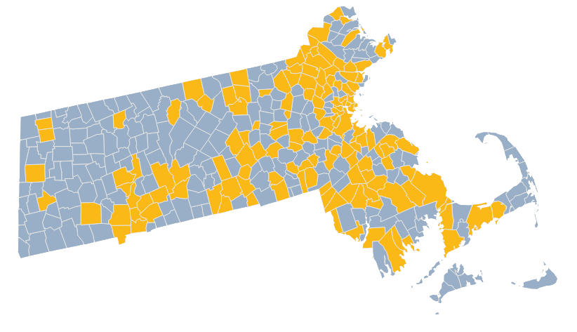
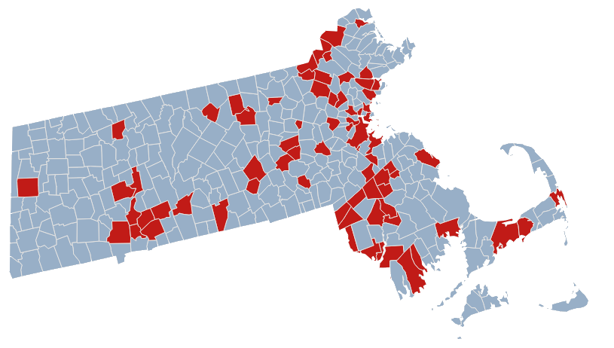
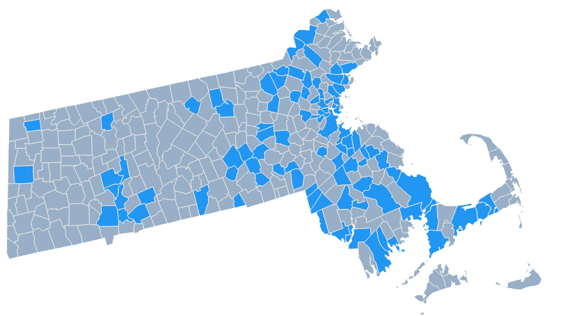
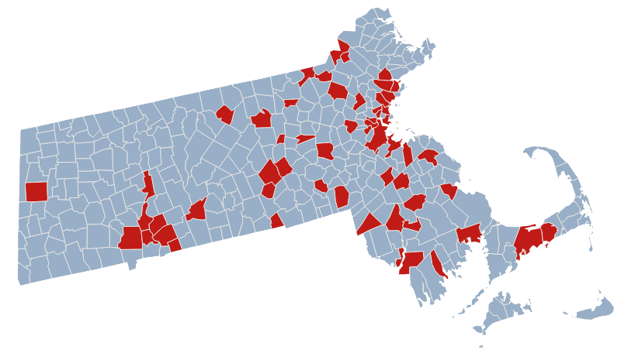
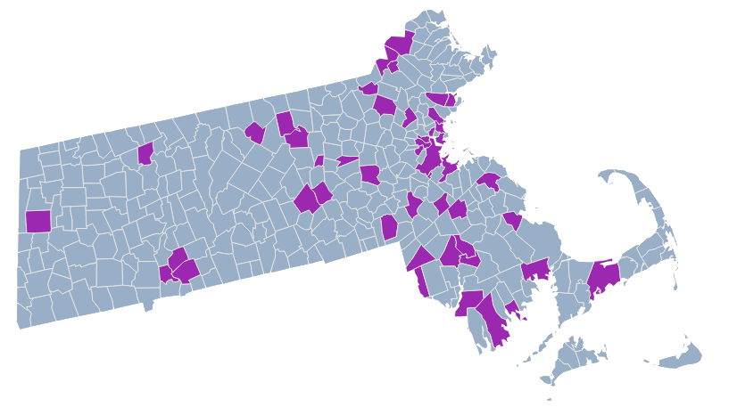
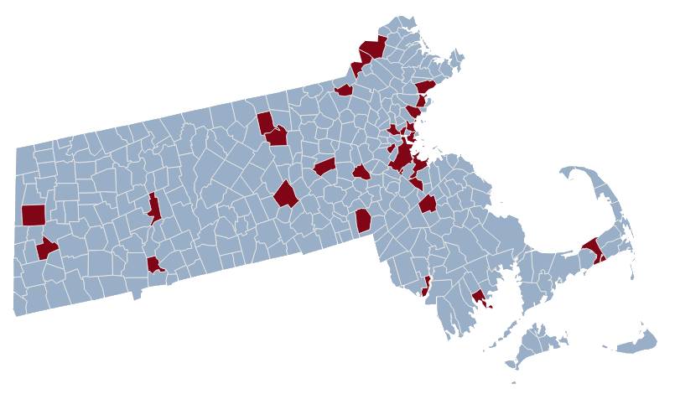
FAST FOOD, OBESITY AND INCOME
AN ANALYSIS OF MASSACHUSETTS
OBESITY
FAST FOOD
INCOME
HIGH %
LOW %
HIGH %
LOW %
HIGH %
LOW %
FAST FOOD PER CAPITA VS OBESITY
INCOME PER CAPITA VS OBESITY
FAST FOOD PER CAPITA VS INCOME PER CAPITA
1.5
1.5
100k
1.0
1.0
80k
.5
.5
60k
Fast Food per Capita
Income per Capita
Fast Food per Capita
.25
40k
.25
20k
0
.15
.2
.25
.3
0
20K
40K
60K
80K
% Obesity
.15
.2
.25
.3
Income per Capita
% Obesity

Slide 2
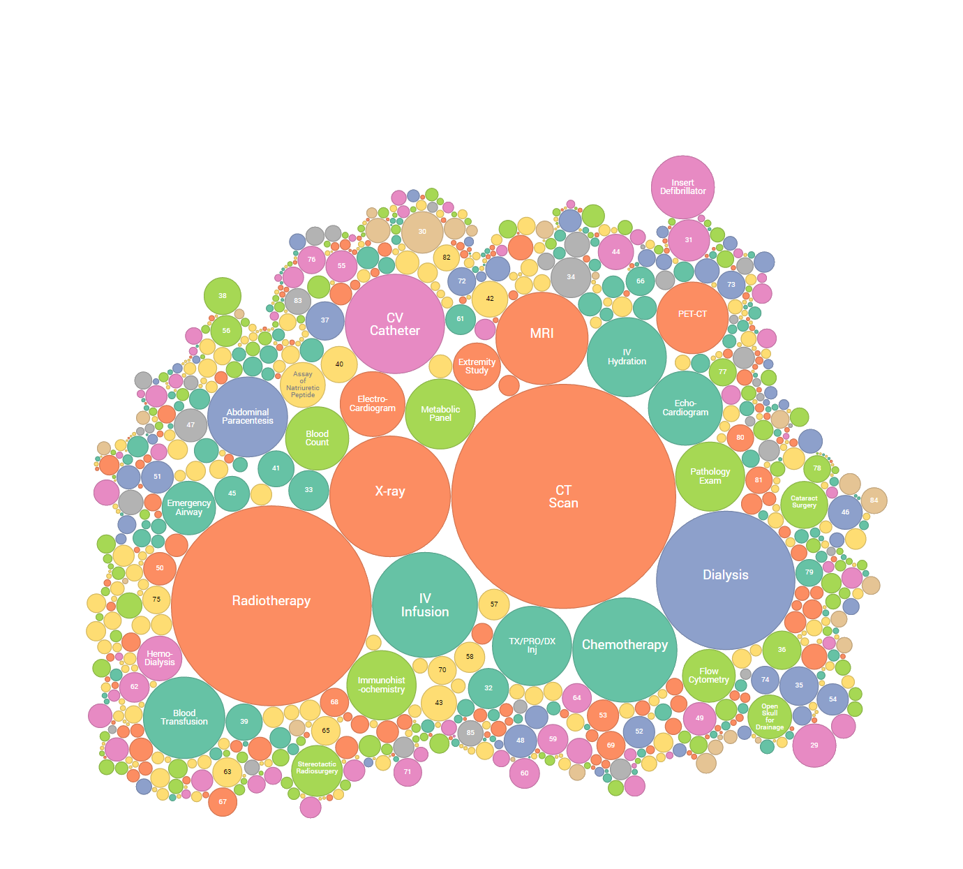
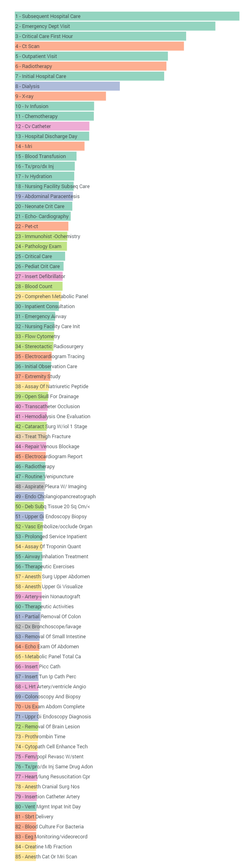

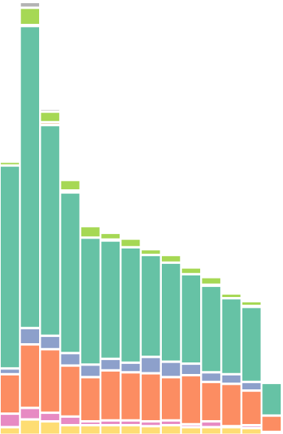
END OF LIFE
DETAIL
Costs, Procedures, Frequency
LEGEND
$447
$357
$260
$254
$208
$204
$198
$84
$74
$56
$55
$49
$49
$43
$34
$32
$31
$31
$30
$29
$28
$25
$24
$24
$22
$21
$20
$19
$17
$17
$14
$14
$14
$14
$13
$12
$12
$11
$10
$10
$10
$9
$9
$9
$9
$9
$8
$8
$8
$8
$8
$7
$7
$7
$7
$7
$7
$6
$6
$6
$6
$6
$5
$5
$5
$5
$5
$5
$5
$5
$5
$5
$5
$5
$5
$5
$5
$4
$4
$4
$4
$4
$4
$4
COST BY PROCEDURE
All cost are average cost per person in the overall population
Evaluation and Therapeutic Procedure
Anesthesia, Labs and Medication Supplies
Diagnostic Procedure
Cardiovascular System Procedure
Musculoskeletal System Procedure
Respiratory System Procedure
Digestive System Procedure
Other
Higher Occurrence
Closer to Center
COST BY WEEK
UNTIL DEATH
$450
$300
$150
1 2 3 4 5 6 7 8 9 10 11 12 13
$100 Per Person

Slide 3
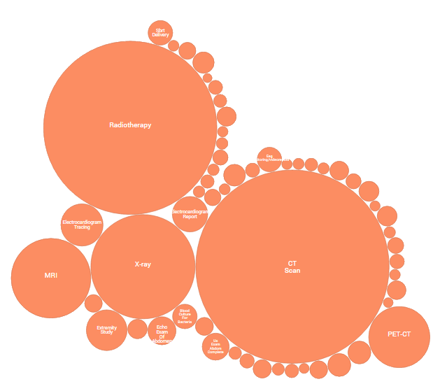
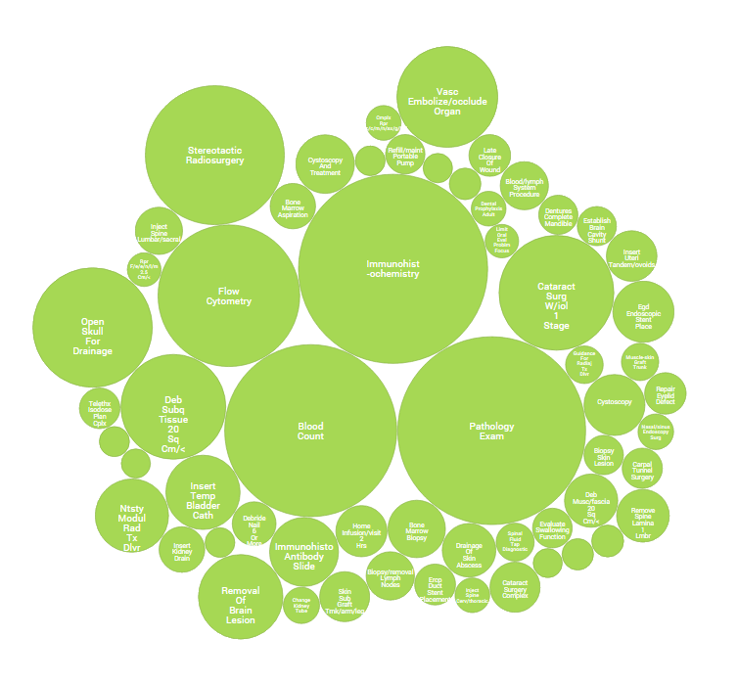
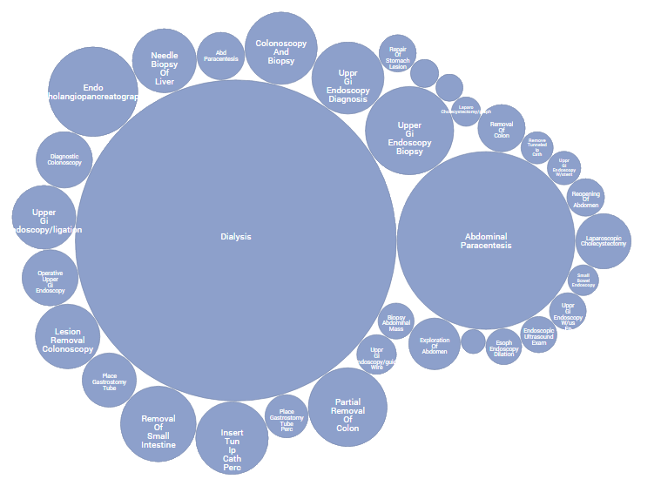
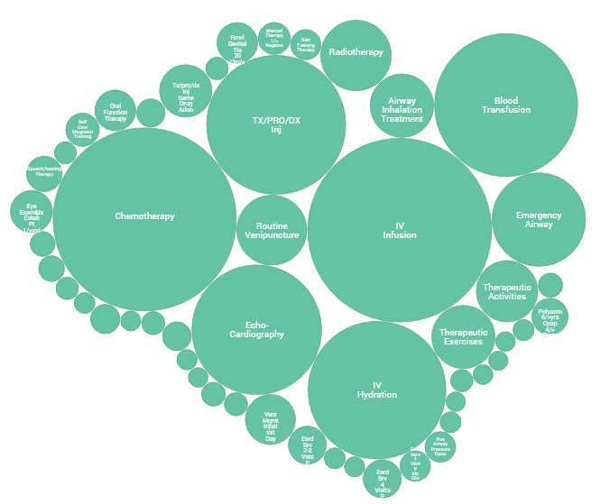
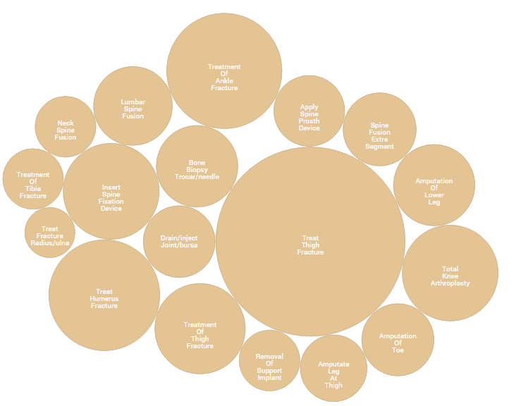
END OF LIFE
Costs, Procedures, Frequency
COST BY PROCEDURE
All cost are average cost per person in the overall population

