Slide 1
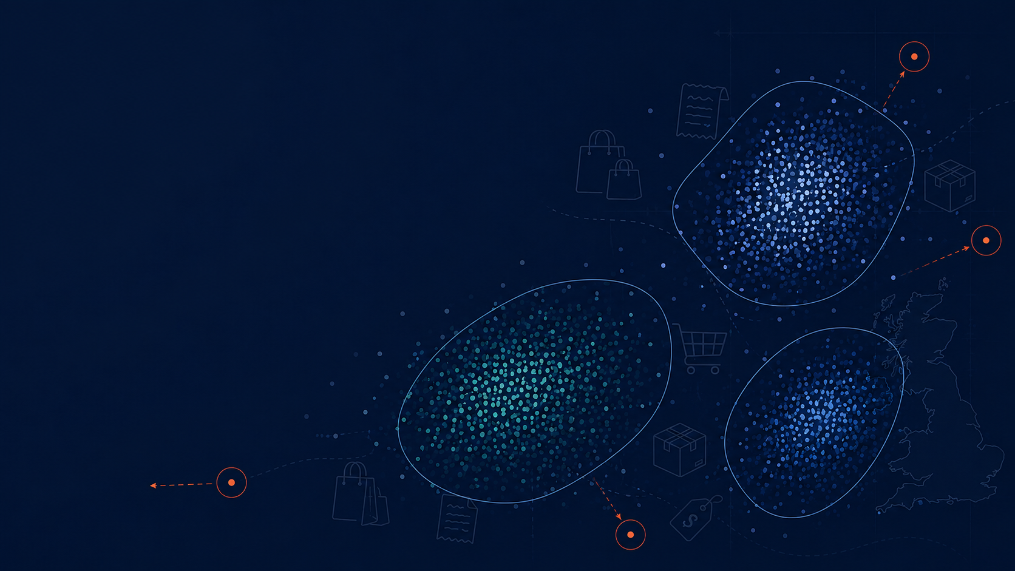
Discovering Unusual Customer Purchasing Behavior
PROJECT PROPOSITION
Data Mining Project
CSCA 5522
Simon S.
sash1081@colorado.edu
University of Colorado, Boulder

Slide 2
Abstract
Investigates unusual customer purchasing behavior in UK online retail transactions
Invoice-level dataset: each transaction’s own features + aggregated customer-level behavior
Goal: discover/characterize behavioral segments, then find transactions & customers that don’t fit any of them
Not a predictive-modelling exercise; clustering is a means, not the end
Main axes of interest: cancellation behavior and order total

Slide 3
Motivation: Business Value
Identify high-value customers
Identify segments associated with frequent cancellations
Detect emerging changes in purchasing patterns
Supports retention, marketing, and operational decisions

Slide 4
Objective
Identify and characterize purchasing behavior that differs substantially from the major segments
Trace those outliers back to the customers who produced them
Example: if 3 well-defined clusters emerge - which transactions/customers fit none of them?

Slide 5
Related Work
Customer Segmentation & Retention Strategy (Kaggle) - segments as end product for retention
Online Retail Cohort Analysis (Kaggle, same dataset) - descriptive cohorts/trends, not segmentation+outliers
Enhanced RFM / RFMT (Kaggle) - adds Inter-Purchase-Time to RFM; segmentation is the end goal there
Recommendation Systems (Kaggle) - association rules & collaborative filtering, different question entirely
This project differs: segmentation is a baseline, not the deliverable - the deliverable is what doesn’t fit
How this work differs from the existing work:
There is plenty of work related to retail data. It can largely be divided into three main categories: customer segmentation, prediction tasks (e.g., customer churn, likelihood of cancellation), and recommendation systems.
I chose to do something distinct - something with a deeper affinity to the "Data Mining" discipline itself: intentionally avoiding pure classification, regression, and clustering as an end goal, and instead focusing on discovering unknown patterns and analyzing the data.

Slide 6
Proposed Work: Feature Engineering
Filter to UK, drop guest transactions
Build customer-level features:
Timing: day of week, hour, avg. shopping trips per month
Spending: avg/min/max/std of transaction totals
Product: avg/min/max/std of items purchased, most frequent products
Cancellations: % of cancelled transactions
Join customer-level features back onto invoice-level records
Feasibility: ~50 engineered features, ~40,500 invoices, ~5,400 customers

Slide 7
Proposed Work: Analysis Flow
Explore segmentation using engineered behavioral features
Characterize the common patterns found in each segment
Identify transactions/customers whose behavior differs significantly from the majority or from any segment
Particular focus: spending, purchase composition, cancellation behavior

Slide 8
Evaluation: Clustering
Baseline: KMeans (quick, cheap, first impression - cannot produce outliers)
Working model: DBSCAN (produces outliers - the “working horse” of this research)
Two distance metrics evaluated: euclidean and cosine
DBSCAN supports cosine natively; “cosine KMeans” approximated via L2-normalization + euclidean KMeans
Evaluated on: silhouette score (direction, not verdict), stability under hyper-parameter changes, interpretability
Target: stable, 2-3 interpretable clusters, manageable/interpretable outliers

Slide 9
Evaluation: Characterizing Differences
Question: how does cluster A differ from cluster B? How do outliers differ from inliers?
Raw mean differences aren’t comparable across features on different scales
Solution: Cohen’s d - standardized mean difference, comparable across features
Take the top 5-10 features with |Cohen’s d| > 0.8 to characterize/define each population

Slide 10
Timeline
Week 1: ✅ [Completed] EDA, preprocessing, and feature engineering
Week 2: ✅ [Completed] Unusual purchasing behavior analysis
Week 3: 🔄 [Work in progress] Report preparation
The project is too large to fully capture in the slides/report format: it includes many plots with accompanying commentary that are interlinked and not meaningful in isolation.
For the full analysis, see the notebooks on GitHub.

Slide 11
References
Jolliffe, I. T. (2002). Principal Component Analysis (2nd ed.). Springer.
ISLR2, Ch12_Unsupervised_Learning.pdf
scikit-learn.org, silhouette_score
MacQueen, J. (1967). Some methods for classification and analysis of multivariate observations.
scikit-learn User Guide: DBSCAN and parameter sensitivity. https://scikit-learn.org/stable/modules/clustering.html#dbscan
Ester, M., Kriegel, H.-P., Sander, J., Xu, X. (1996). A Density-Based Algorithm for Discovering Clusters in Large Spatial Databases with Noise.
Schubert, E., Sander, J., Ester, M., Kriegel, H.-P., Xu, X. (2017). DBSCAN Revisited, Revisited: Why and How You Should (Still) Use DBSCAN.
scikit-learn DBSCAN documentation
Cohen, J. (1988). Statistical Power Analysis for the Behavioral Sciences (2nd ed.). Lawrence Erlbaum.
Li, Z., Zhu, Y., & van Leeuwen, M. (2023). A Survey on Explainable Anomaly Detection. ACM Transactions on Knowledge Discovery from Data. arXiv:2210.06959.

