Slide 1
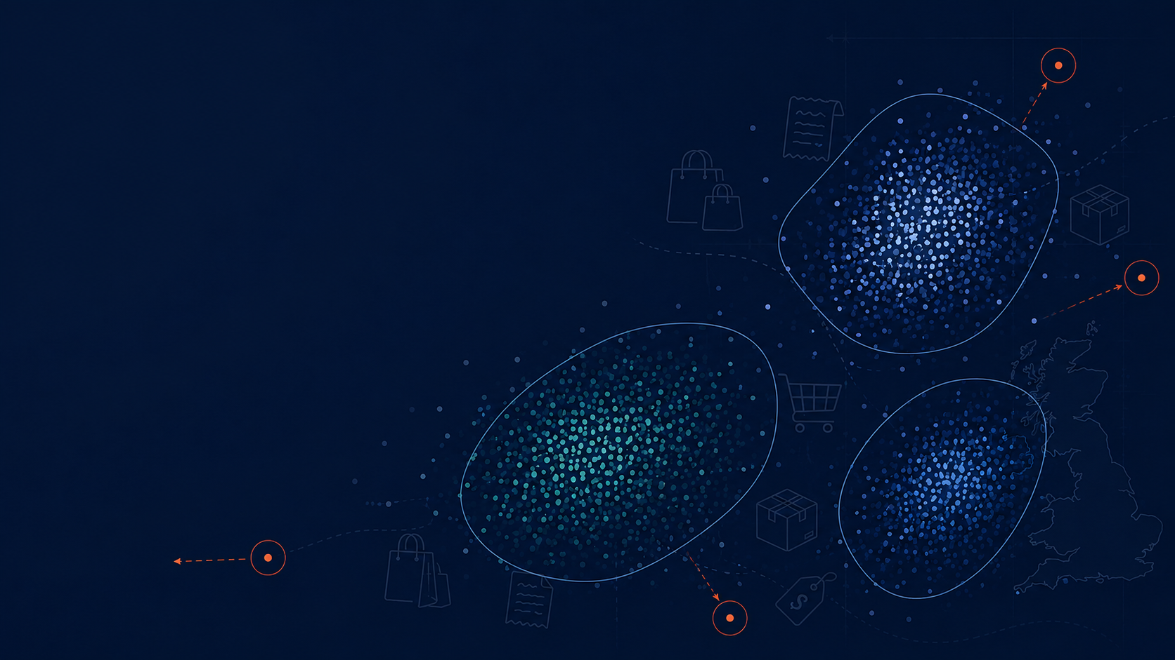
Discovering Unusual Customer Purchasing Behavior
PROJECT PROPOSITION
Data Mining Project
CSCA 5522
Simon S.
sash1081@colorado.edu
University of Colorado, Boulder

Slide 2
Abstract
Investigates unusual customer purchasing behavior in UK online retail transactions
Invoice-level dataset: each transaction’s own features + aggregated customer-level behavior
Goal: discover/characterize behavioral segments, then find transactions & customers that don’t fit any of them
Not a predictive-modelling exercise; clustering is a means, not the end
Main axes of interest: cancellation behavior and order total

Slide 3
Motivation: Business Value
Identify high-value customers
Identify segments associated with frequent cancellations
Detect emerging changes in purchasing patterns
Supports retention, marketing, and operational decisions

Slide 4
The Dataset
online_retail_II.csv (Kaggle) - transaction log, Dec 2009 - Dec 2011
~1.07M line-item rows, 43 countries
UK-only: 94.7% of all transactions; other countries too sparse for safe inference
~1/4 of UK rows are guest purchases (no Customer ID) - dropped
After filtering: ~741,000 transaction rows -> ~40,500 invoices from ~5,400 customers

Slide 5
Unit of Analysis & Scope
Unit of analysis: the individual invoice
Described by its own transaction-level features + its customer’s aggregated behavior
A customer’s routine invoices can cluster normally while a few of their invoices stand out as outliers
Out of scope: regression on cancellation probability, basket prediction, clustering as an end in itself

Slide 6
Objective
Identify and characterize purchasing behavior that differs substantially from the major segments
Trace those outliers back to the customers who produced them
Example: if 3 well-defined clusters emerge - which transactions/customers fit none of them?

Slide 7
Related Work
Customer Segmentation & Retention Strategy (Kaggle) - segments as end product for retention
Online Retail Cohort Analysis (Kaggle, same dataset) - descriptive cohorts/trends, not segmentation+outliers
Enhanced RFM / RFMT (Kaggle) - adds Inter-Purchase-Time to RFM; segmentation is the end goal there
Recommendation Systems (Kaggle) - association rules & collaborative filtering, different question entirely
This project differs: segmentation is a baseline, not the deliverable - the deliverable is what doesn’t fit

Slide 8
Proposed Work: Feature Engineering
Filter to UK, drop guest transactions
Build customer-level features:
Timing: day of week, hour, avg. shopping trips per month
Spending: avg/min/max/std of transaction totals
Product: avg/min/max/std of items purchased, most frequent products
Cancellations: % of cancelled transactions
Join customer-level features back onto invoice-level records
Feasibility: ~50 engineered features, ~40,500 invoices, ~5,400 customers

Slide 9
Proposed Work: Analysis Flow
Explore segmentation using engineered behavioral features
Characterize the common patterns found in each segment
Identify transactions/customers whose behavior differs significantly from the majority or from any segment
Particular focus: spending, purchase composition, cancellation behavior

Slide 10
Evaluation: Clustering
Baseline: KMeans (quick, cheap, first impression - cannot produce outliers)
Working model: DBSCAN (produces outliers - the “working horse” of this research)
Two distance metrics evaluated: euclidean and cosine
DBSCAN supports cosine natively; “cosine KMeans” approximated via L2-normalization + euclidean KMeans
Evaluated on: silhouette score (direction, not verdict), stability under hyper-parameter changes, interpretability
Target: stable, 2-3 interpretable clusters, manageable/interpretable outliers

Slide 11
Evaluation: Characterizing Differences
Question: how does cluster A differ from cluster B? How do outliers differ from inliers?
Raw mean differences aren’t comparable across features on different scales
Solution: Cohen’s d - standardized mean difference, comparable across features
Take the top 5-10 features with |Cohen’s d| > 0.8 to characterize/define each population

Slide 12
Discussion & Conclusion
To be completed once clustering, outlier detection, and Cohen’s d analyses are finalized

Slide 13
References
Full reference list in the project proposition document (project_proposition_draft.md, Section 7)
Covers: PCA (Jolliffe 2002), KMeans (MacQueen 1967), DBSCAN (Ester et al. 1996; Schubert et al. 2017), silhouette score & DBSCAN docs (scikit-learn), Cohen’s d (Cohen 1988), explainable anomaly detection (Li et al. 2023)

