Slide 1
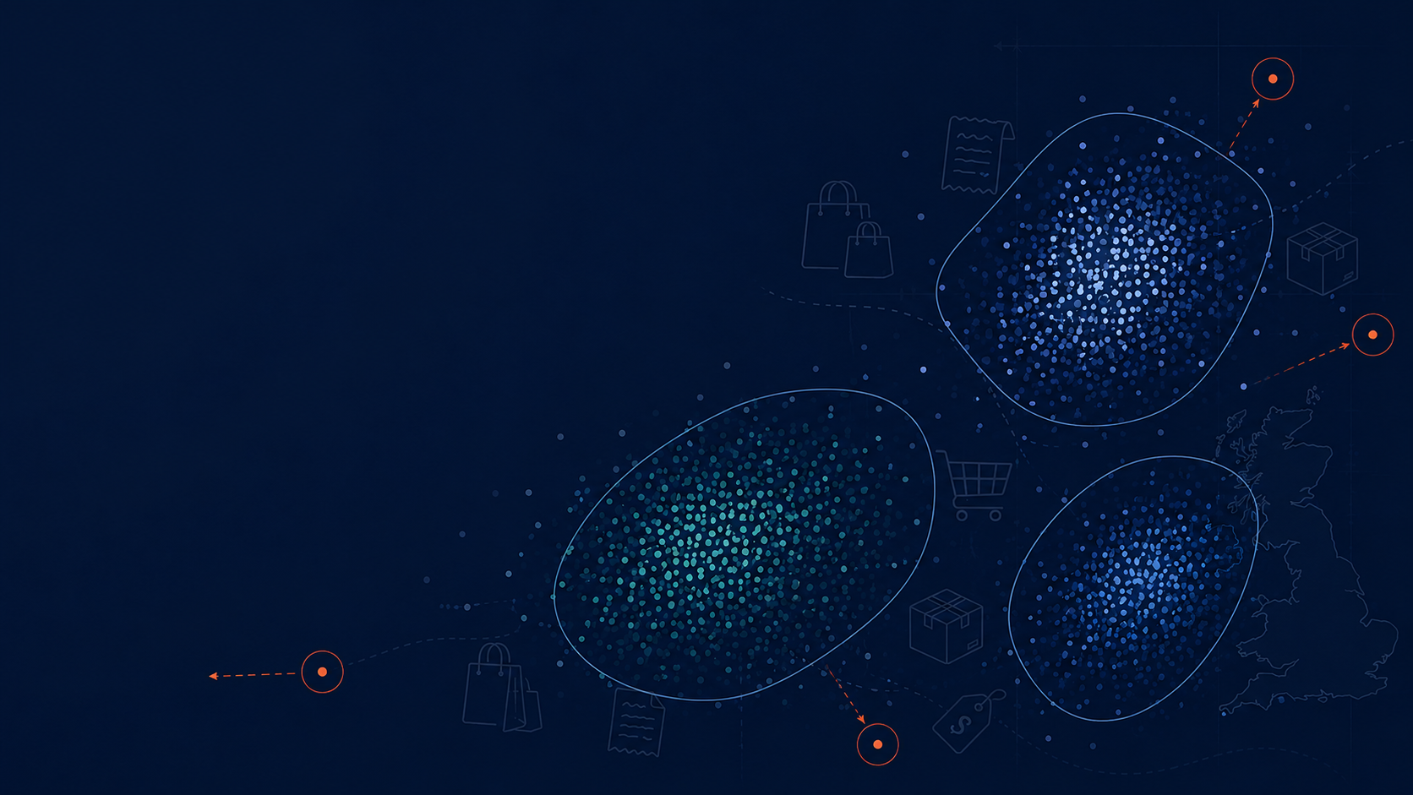
Discovering Unusual Customer Purchasing Behavior
PROJECT PROPOSITION
Data Mining Project
CSCA 5522
Simon S.
sash1081@colorado.edu
University of Colorado, Boulder

Slide 2
Abstract
Investigates unusual customer purchasing behavior in UK online retail transactions
Invoice-level dataset: each transaction’s own features + aggregated customer-level behavior
Goal: discover/characterize behavioral segments, then find transactions & customers that don’t fit any of them
Not a predictive-modelling exercise; clustering is a means, not the end
Main axes of interest: cancellation behavior and order total

Slide 3
Motivation: Business Value
Identify high-value customers
Identify segments associated with frequent cancellations
Detect emerging changes in purchasing patterns
Supports retention, marketing, and operational decisions

Slide 4
Objective
Identify and characterize purchasing behavior that differs substantially from the major segments
Trace those outliers back to the customers who produced them
Example: if 3 well-defined clusters emerge - which transactions/customers fit none of them?

Slide 5
Related Work
Customer Segmentation & Retention Strategy (Kaggle) - segments as end product for retention
Online Retail Cohort Analysis (Kaggle, same dataset) - descriptive cohorts/trends, not segmentation+outliers
Enhanced RFM / RFMT (Kaggle) - adds Inter-Purchase-Time to RFM; segmentation is the end goal there
Recommendation Systems (Kaggle) - association rules & collaborative filtering, different question entirely
This project differs: segmentation is a baseline, not the deliverable - the deliverable is what doesn’t fit
How this work differs from the existing work:
There is plenty of work related to retail data. It can largely be divided into three main categories: customer segmentation, prediction tasks (e.g., customer churn, likelihood of cancellation), and recommendation systems.
I chose to do something distinct - something with a deeper affinity to the "Data Mining" discipline itself: intentionally avoiding pure classification, regression, and clustering as an end goal, and instead focusing on discovering unknown patterns and analyzing the data.

Slide 6
Proposed Work: Feature Engineering
Filter to UK, drop guest transactions
Build customer-level features:
Timing: day of week, hour, avg. shopping trips per month
Spending: avg/min/max/std of transaction totals
Product: avg/min/max/std of items purchased, most frequent products
Cancellations: % of cancelled transactions
Join customer-level features back onto invoice-level records
Feasibility: ~50 engineered features, ~40,500 invoices, ~5,400 customers

Slide 7
Proposed Work: Analysis Flow
Explore segmentation using engineered behavioral features
Characterize the common patterns found in each segment
Identify transactions/customers whose behavior differs significantly from the majority or from any segment
Particular focus: spending, purchase composition, cancellation behavior

Slide 8
Evaluation: Clustering
Baseline: KMeans (quick, cheap, first impression - cannot produce outliers)
Working model: DBSCAN (produces outliers - the “working horse” of this research)
Two distance metrics evaluated: euclidean and cosine
DBSCAN supports cosine natively; “cosine KMeans” approximated via L2-normalization + euclidean KMeans
Evaluated on: silhouette score (direction, not verdict), stability under hyper-parameter changes, interpretability
Target: stable, 2-3 interpretable clusters, manageable/interpretable outliers

Slide 9
Evaluation: Characterizing Differences
Question: how does cluster A differ from cluster B? How do outliers differ from inliers?
Raw mean differences aren’t comparable across features on different scales
Solution: Cohen’s d - standardized mean difference, comparable across features
Take the top 5-10 features with |Cohen’s d| > 0.8 to characterize/define each population

Slide 10
Timeline
Week 1: EDA, preprocessing, and feature engineering
Week 2: Unusual purchasing behavior analysis
Week 3: Report preparation

Slide 11
References
Jolliffe, I. T. (2002). Principal Component Analysis (2nd ed.). Springer.
ISLR2, Ch12_Unsupervised_Learning.pdf
scikit-learn.org, silhouette_score
MacQueen, J. (1967). Some methods for classification and analysis of multivariate observations.
scikit-learn User Guide: DBSCAN and parameter sensitivity. https://scikit-learn.org/stable/modules/clustering.html#dbscan
Ester, M., Kriegel, H.-P., Sander, J., Xu, X. (1996). A Density-Based Algorithm for Discovering Clusters in Large Spatial Databases with Noise.
Schubert, E., Sander, J., Ester, M., Kriegel, H.-P., Xu, X. (2017). DBSCAN Revisited, Revisited: Why and How You Should (Still) Use DBSCAN.
scikit-learn DBSCAN documentation
Cohen, J. (1988). Statistical Power Analysis for the Behavioral Sciences (2nd ed.). Lawrence Erlbaum.
Li, Z., Zhu, Y., & van Leeuwen, M. (2023). A Survey on Explainable Anomaly Detection. ACM Transactions on Knowledge Discovery from Data. arXiv:2210.06959.

