Slide 1
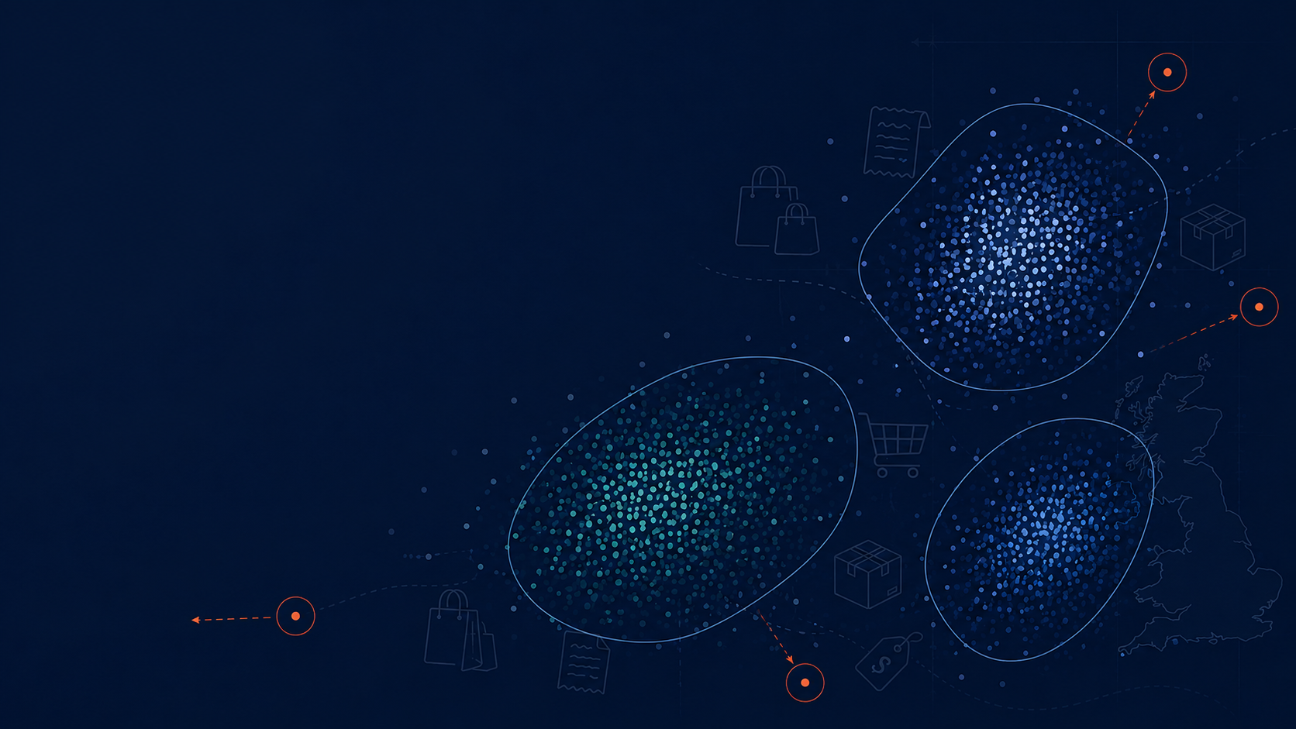
Discovering Unusual Customer Purchasing Behavior
PROJECT PROPOSITION
Data Mining Project
CSCA 5522
Simon S.
sash1081@colorado.edu
University of Colorado, Boulder

Slide 2
Abstract
Investigates unusual customer purchasing behavior in UK online retail transactions
Invoice-level dataset: each transaction’s own features + aggregated customer-level behavior
Goal: discover/characterize behavioral segments, then find transactions & customers that don’t fit any of them
Not a predictive-modelling exercise; clustering is a means, not the end
Main axes of interest: cancellation behavior and order total

Slide 3
Motivation: Business Value
Identify high-value customers
Identify segments associated with frequent cancellations
Detect emerging changes in purchasing patterns
Supports retention, marketing, and operational decisions

Slide 4
The Dataset
online_retail_II.csv (Kaggle) - transaction log, Dec 2009 - Dec 2011
~1.07M line-item rows, 43 countries
UK-only: 94.7% of all transactions; other countries too sparse for safe inference
~1/4 of UK rows are guest purchases (no Customer ID) - dropped
After filtering: ~741,000 transaction rows -> ~40,500 invoices from ~5,400 customers

Slide 5
Unit of Analysis & Scope
Unit of analysis: the individual invoice
Described by its own transaction-level features + its customer’s aggregated behavior
A customer’s routine invoices can cluster normally while a few of their invoices stand out as outliers
Out of scope: regression on cancellation probability, basket prediction, clustering as an end in itself

Slide 6
Objective
Identify and characterize purchasing behavior that differs substantially from the major segments
Trace those outliers back to the customers who produced them
Example: if 3 well-defined clusters emerge - which transactions/customers fit none of them?

Slide 7
Related Work
Customer Segmentation & Retention Strategy (Kaggle) - segments as end product for retention
Online Retail Cohort Analysis (Kaggle, same dataset) - descriptive cohorts/trends, not segmentation+outliers
Enhanced RFM / RFMT (Kaggle) - adds Inter-Purchase-Time to RFM; segmentation is the end goal there
Recommendation Systems (Kaggle) - association rules & collaborative filtering, different question entirely
This project differs: segmentation is a baseline, not the deliverable - the deliverable is what doesn’t fit

Slide 8
Proposed Work: Feature Engineering
Filter to UK, drop guest transactions
Build customer-level features:
Timing: day of week, hour, avg. shopping trips per month
Spending: avg/min/max/std of transaction totals
Product: avg/min/max/std of items purchased, most frequent products
Cancellations: % of cancelled transactions
Join customer-level features back onto invoice-level records
Feasibility: ~50 engineered features, ~40,500 invoices, ~5,400 customers

Slide 9
Proposed Work: Analysis Flow
Explore segmentation using engineered behavioral features
Characterize the common patterns found in each segment
Identify transactions/customers whose behavior differs significantly from the majority or from any segment
Particular focus: spending, purchase composition, cancellation behavior

Slide 10
Evaluation: Clustering
Baseline: KMeans (quick, cheap, first impression - cannot produce outliers)
Working model: DBSCAN (produces outliers - the “working horse” of this research)
Two distance metrics evaluated: euclidean and cosine
DBSCAN supports cosine natively; “cosine KMeans” approximated via L2-normalization + euclidean KMeans
Evaluated on: silhouette score (direction, not verdict), stability under hyper-parameter changes, interpretability
Target: stable, 2-3 interpretable clusters, manageable/interpretable outliers

Slide 11
Evaluation: Characterizing Differences
Question: how does cluster A differ from cluster B? How do outliers differ from inliers?
Raw mean differences aren’t comparable across features on different scales
Solution: Cohen’s d - standardized mean difference, comparable across features
Take the top 5-10 features with |Cohen’s d| > 0.8 to characterize/define each population

Slide 12
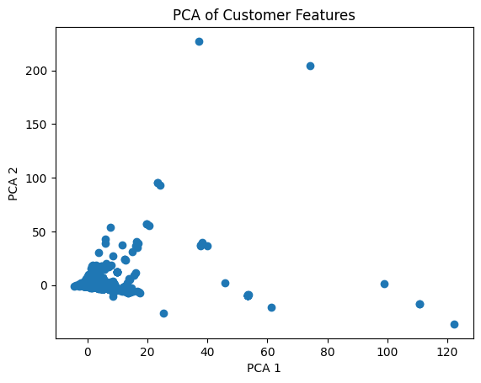
PCA: No Easy Shortcut
PCA fitted to retain 95% of variance
First 2 principal components explain only ~25% of total variance
No obvious low-dimensional cluster structure - full feature space needed for clustering
PCA of customer features, first 2 components

Slide 13
Model Selection: KMeans Baseline
Distance metric mattered: euclidean vs. cosine, both tested
Euclidean on standardized features: best k=3, silhouette = 0.486
Cosine on L2-normalized features: best k=5, silhouette = 0.161
Euclidean clearly stronger - cosine KMeans dropped from further analysis

Slide 14
DBSCAN: Parameter Selection
eps and min_samples swept systematically (k-distance plot + stability sweeps)
min_samples = 23: start of a stable region where silhouette/noise behavior stop swinging
eps = 9.0: chosen within that stable region for the best silhouette and an interpretable noise count
Cosine-metric DBSCAN also tried, but unstable (silhouette negative, noise count swings from 0 to 33k+) - dropped

Slide 15
Final Model: Locked DBSCAN Result
Metric: euclidean eps: 9.0 min_samples: 23
Clusters found: 2
Noise points (outliers): 134
Silhouette score: 0.65

Slide 16
Who Are the Outliers?
134 outlier invoices trace back to only 41 distinct customers
Only 13 of those 41 also appear in the main clusters
Most outlier customers are a separate population - not occasional lapses by otherwise-typical customers

Slide 17
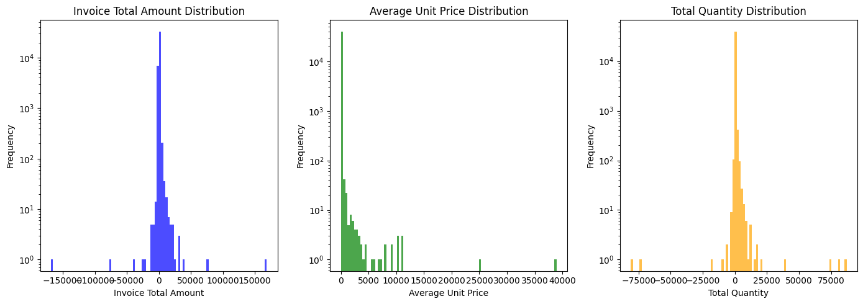
An Early Hint: Bulk Orders
Spotted during feature engineering, before any clustering: a long tail of very large quantities (25K+ items per invoice)
Suggested a mix of regular shoppers and business/reseller accounts - foreshadowing the outlier finding below
Distribution of invoice total, unit price, and quantity

Slide 18
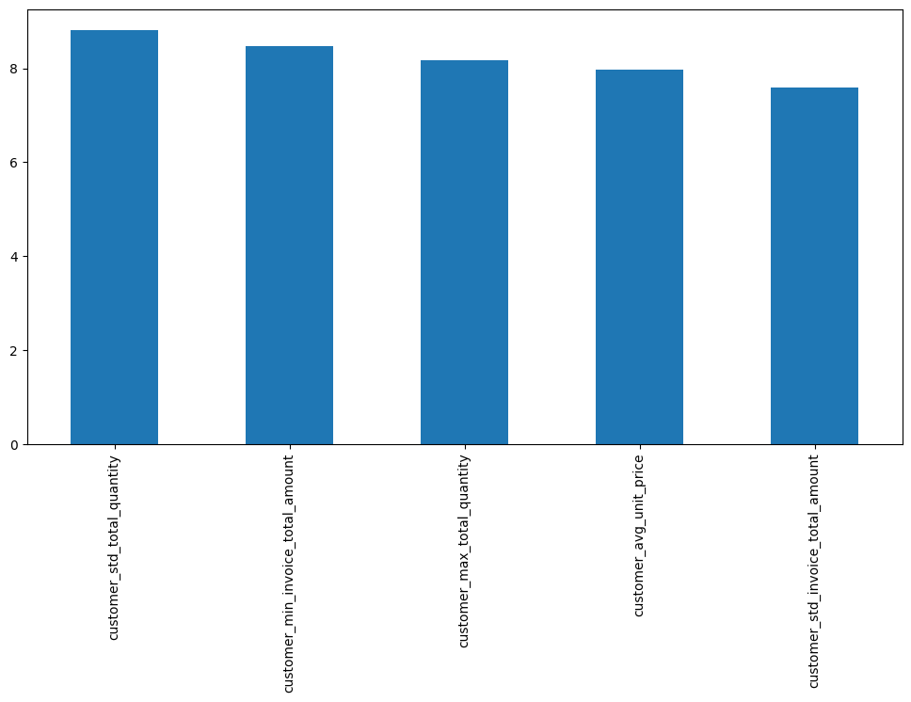
Outliers vs. Clusters: What Makes Them Different
Largest effect sizes are all variability measures: std. total quantity, std. invoice amount, max quantity
Plus one cancellation signal: extreme negative minimum invoice total
Label: high-volume, high-volatility wholesale transactions
Cohen’s d, outliers vs. clusters, top 5 features

Slide 19
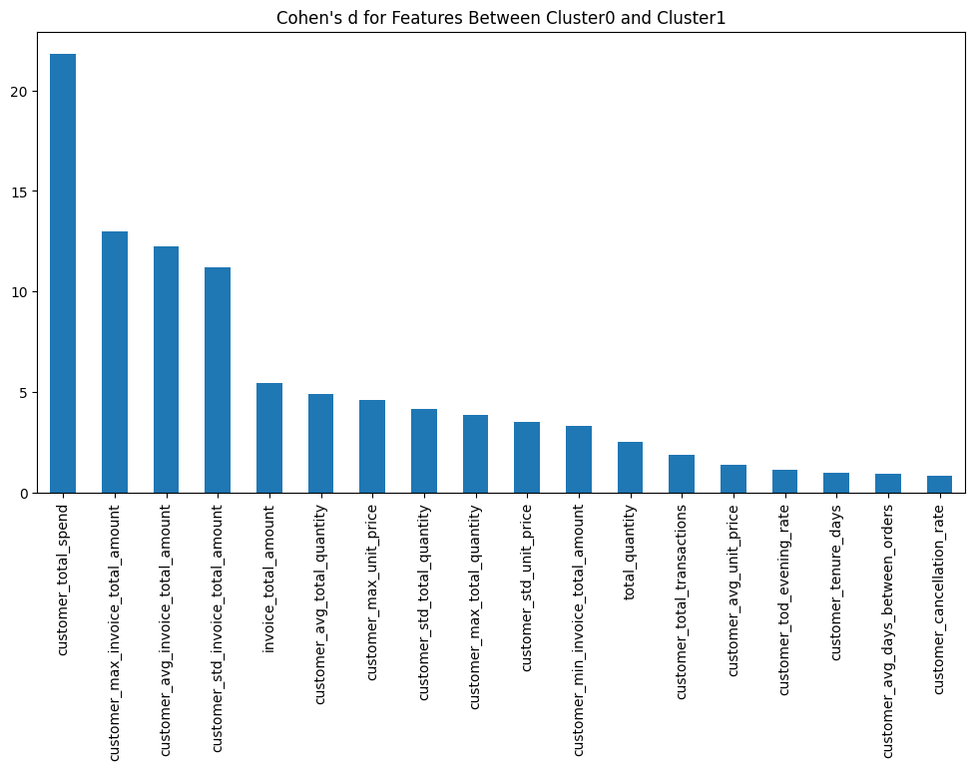
Cluster 0 vs. Cluster 1: What Splits Them
Single dominant driver: customer_total_spend - about 20 standard deviations apart
Cluster 0 avg. total spend: 13,158
Cluster 1 avg. total spend: 598,215
Label: Cluster 1 = high total spend customers
Cohen’s d, Cluster 0 vs. Cluster 1

Slide 20
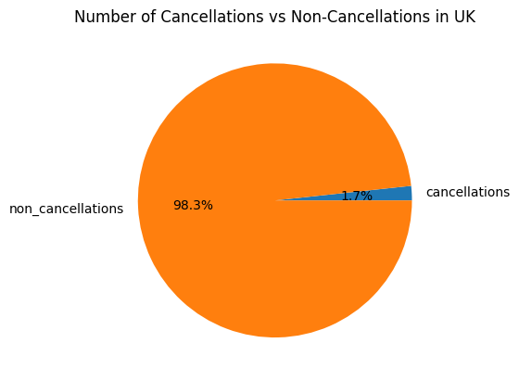
Cancellations, in Context
Only 1.7% of UK transactions are cancellations
Rare, but part of what defines the outlier profile above (extreme negative invoice minimums)
Cancellations vs. non-cancellations, UK

Slide 21
Conclusions
DBSCAN flagged 134 outlier invoices from 41 customers, falling into two profiles: high-volume wholesale accounts and high-value cancellation/adjustment records
Distinguishing features: customer_std_total_quantity, customer_min_invoice_total_amount, customer_max_total_quantity, customer_avg_unit_price, customer_std_invoice_total_amount
These outlier customers mostly do not have normal invoices in the main clusters - a genuinely separate population
A meaningful 2-cluster split also emerged, driven by total spend
Answers the original question: unusual behavior is concentrated in a small, identifiable customer population - not scattered noise across otherwise-typical customers

Slide 22
Future Work
Detecting sudden spikes in individual customer behavior: changes in amount spent, items purchased, or shopping trip timing.
Detecting changes in the population's purchasing behavior as a result of external events: natural disasters, economic crises, war, etc.
This kind of research would require significant effort, and **may not be achievable** with our dataset. Problems include:
Potential data scarcity: there are many invoices in **total**, but relatively few per individual customer.
Missing product information beyond the SKU
There are seasonal trends
Missing regional granularity.

Slide 23
References
Full reference list in the project proposition document (project_proposition_draft.md, Section 8)
Covers: PCA (Jolliffe 2002), KMeans (MacQueen 1967), DBSCAN (Ester et al. 1996; Schubert et al. 2017), silhouette score & DBSCAN docs (scikit-learn), Cohen’s d (Cohen 1988), explainable anomaly detection (Li et al. 2023)

