Slide 1



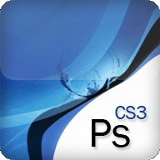
Adobe Photoshop
Processing and Exporting Images
Ivan Zhekov
Front-end Developer
http://joneff.info
Telerik Web Design Course
html5course.telerik.com

Slide 2

Table of Contents
Adobe Photoshop
Photoshop Toolboxes
Must know in Slicing
Image Formats
Exporting Images
Feathering

Slide 3
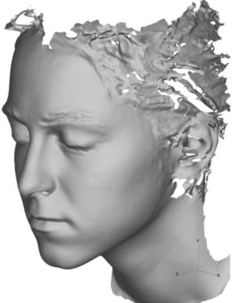
Adobe PhotoShop
Like paint, but better

Slide 4
Adobe Photoshop
What is Adobe Photoshop?
Image processing tool
Maybe the most powerful and used
A 'Must have' for any kind of Front-end Developer or Designer
What can Photoshop do?
Crop, resize, optimize and correct the colors of digital images
And it's done easy

Slide 5
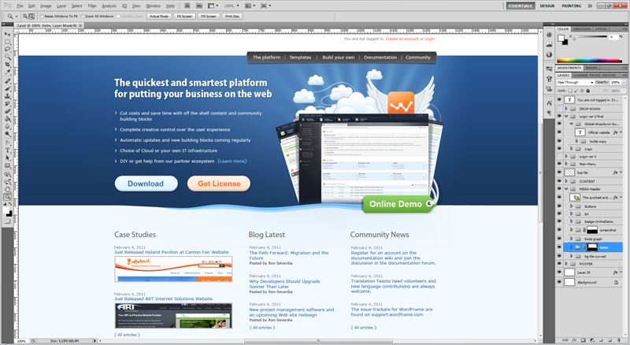
Adobe Photoshop (2)
It goes something like this…

Slide 6
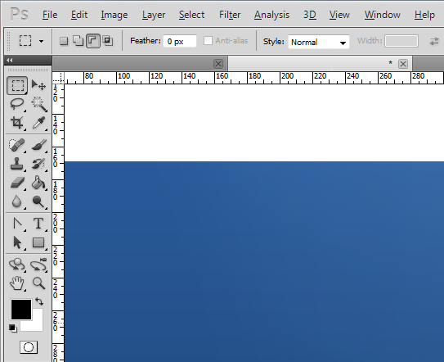
Let’s Look Closer
Parts of Photoshop
Menu
Tools
Documents
Indicators
Rulers

Slide 7
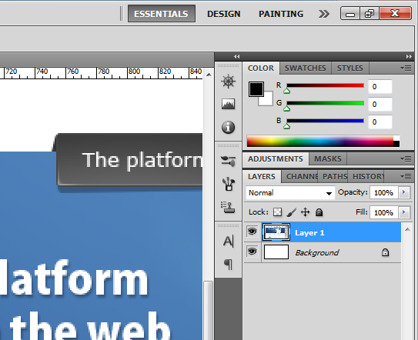
Let’s Look Closer (2)
Parts of Photoshop
Workspaces
Panels…
Lots of them

Slide 8
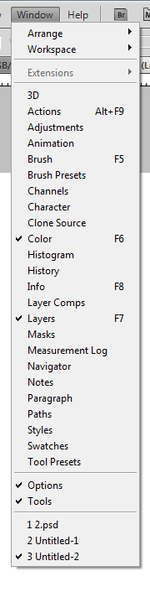
Let’s Look Closer (3)
And many many more
Including, but not limited to:
Actions
Adjustments
Brushes
Histogram
Masks
Swatches
Etc.

Slide 9
Sweating Already?
80% of the time you need just:
Tools toolbox
Layers and groups toolbox
History toolbox
Type toolbox
19% of the time you need practice
1 out of 100 times you’ll need a designer
It’s always useful to know shortcuts
Like CTRL+N to open a new file, etc.

Slide 10

Adobe Photoshop
Live Demo

Slide 11
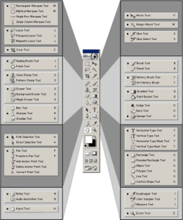
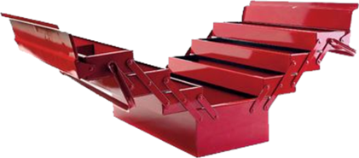

Photoshop Toolboxes
Tools, Layers and Groups,
History, Type

Slide 12
Tools Toolbox
The important part of Photoshop
But you’ll hang out mainly with:
Move to click around
Marquee to select
Crop to reduce size
Hand to pan around
Zoom to zoom

Slide 13
Selectors
How to select things in PS

Slide 14
Selectors in Photoshop
Three types of selectors
Marquee Tool
Select circles, ellipses and lines
Lasso Tool
Select not predefined shapes
Just draw on the image and select the drawn
Magic Want
Select by Color

Slide 15
Selectors
Live Demo

Slide 16
Layers and Groups

Slide 17
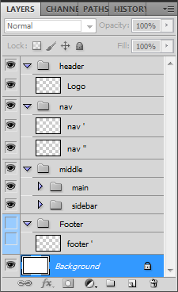
Layers and Groups Toolbox
Layers are the divs of Photoshop
Groups are other type of divs
A group can contain any number of layers
A group can contain other groups as well
You can use colors for visual hints
You can hide layers or groups of layers

Slide 18
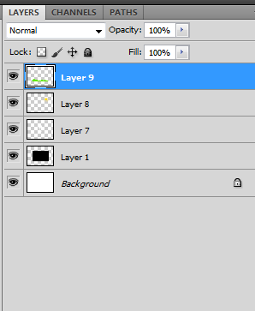
Layers and Groups
Layers are used to separate components in our image
And show/hide stuff that bugs us
Easier to hide the things on top
Without deleting them
Groups are kind of Layer of Layers
Can have many layers and/or groups
Interact with all of them at once

Slide 19
Layers and Groups
Live Demo

Slide 20
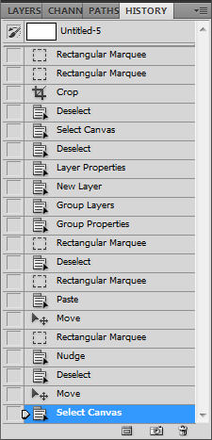
History Toolbox
If you mess up something use CTRL+Z
Note: Undo and Redo are a bit different than in the rest of the applications
Undo toggles between the last two steps
You can "stage" the file and switch between stages
Regardless of what goes wrong, you can always revert to the initial state

Slide 21
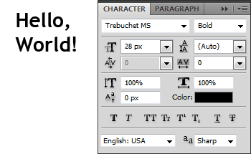
Type Toolbox
Use the type tool to get these:
Font name
Font size
Line height
Font weight
Text align
Letter spacing

Slide 22
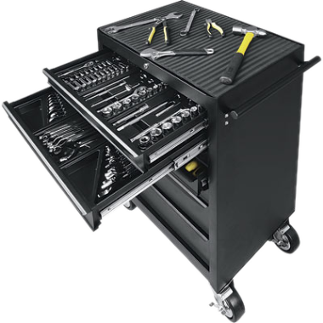


Photoshop Toolboxes
Live Demo

Slide 23


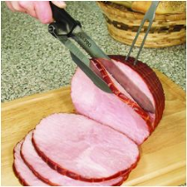

Slicing
Not like a piece of pie

Slide 24
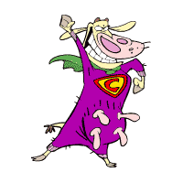
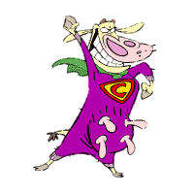
The Perfect Slice
Hide all other layers or duplicate in a new file
Crop
Export

Slide 25
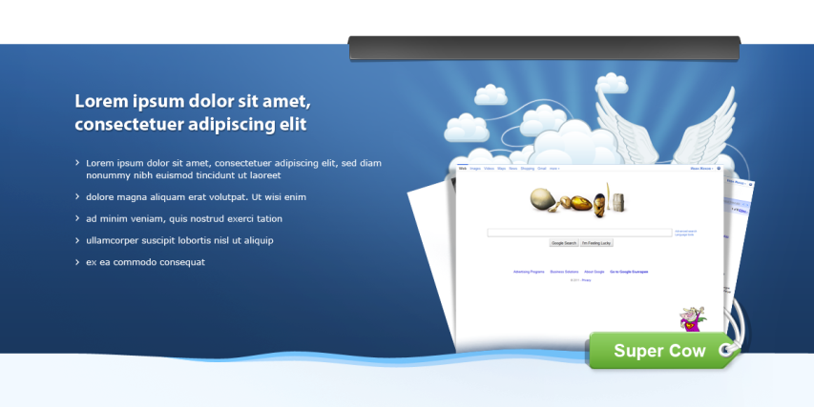
The Usual Slice
Slice this!

Slide 26

Slicing 101
Types of images
Backgrounds and Tiles
Backgrounds do not repeat in any direction
Tiles repeat in at least one direction
With and without transparency
Trivial and Tricky

Slide 27


Slicing Backgrounds
Easy to identify
Basically select, crop, save
Tend to be big in size
Depending on the case use JPG or PNG

Slide 28
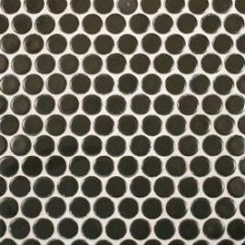
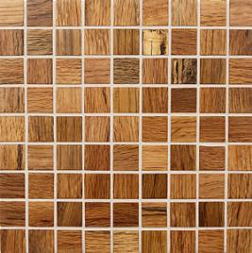
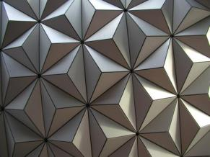
Slicing Tiles
Easy to identify
Sometimes harder to slice
Usually small in size
Depending on the case use PNG or GIF

Slide 29
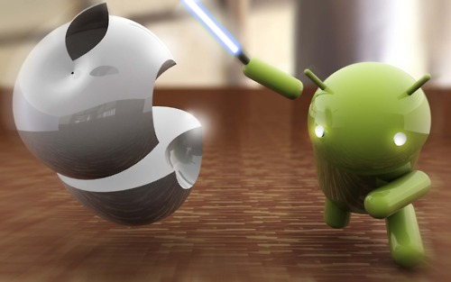
Slicing
Live Demo

Slide 30
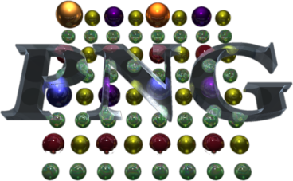
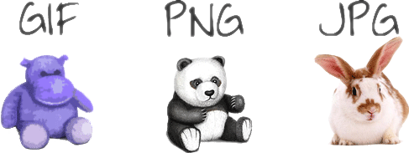
Image Formats
When to use PNG, GIF and JPEG

Slide 31
JPEG Format
JPEG is the type of compression, not the format itself
JPEG compression has high level of compression (almost 1:10)
A little percentage of quality loss
Useful with big images
Formats using JPEG
jpg, jpeg, jpe, jif, jfif, jfi
Disadvantages
JPEG does not support transparency
Loss of image quality

Slide 32
GIF Format
Graphics Interchange Format (GIF)
Rarely used
Supports only 8-bit colors
An image can have no more than 256 different colors
Supports animations
PNG and JPEG doesn't
Uses lossless compression

Slide 33
PNG
PNG is the descendant of GIF
PNG supports 24 and 36 bit colors
PNG is high quality image format
Supports transparency due to the so called 'alpha channel'
The compression is lossless
Disadvantages of PNG
When the image is with high resolution the image size gets a lot bigger compared to JPEG images

Slide 34
Image Formats
Live Demo

Slide 35

Exporting Images

Slide 36
Exporting images
Save as: not recommended
Less options
No preview
Save for web (and devices): preferred way
Much more options
Preview
More than one preview

Slide 37
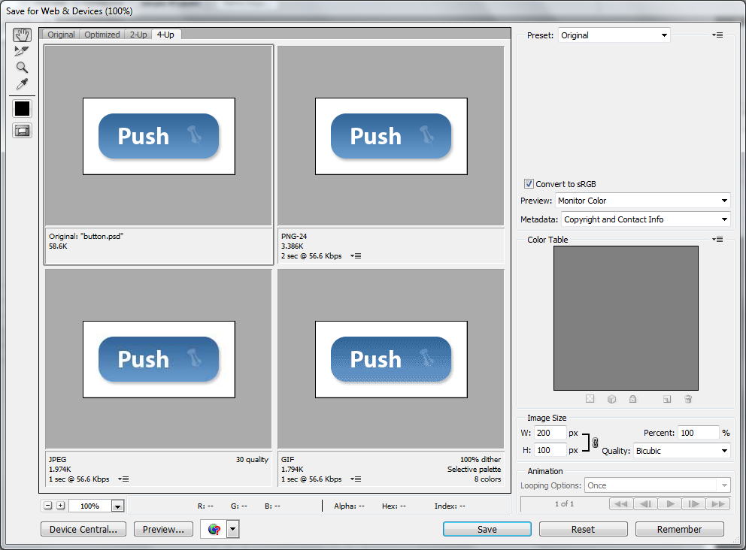
Exporting images (2)

Slide 38

Example: Slicing a Button
A typical button may have:
Text
Icon
Shadow

Slide 39
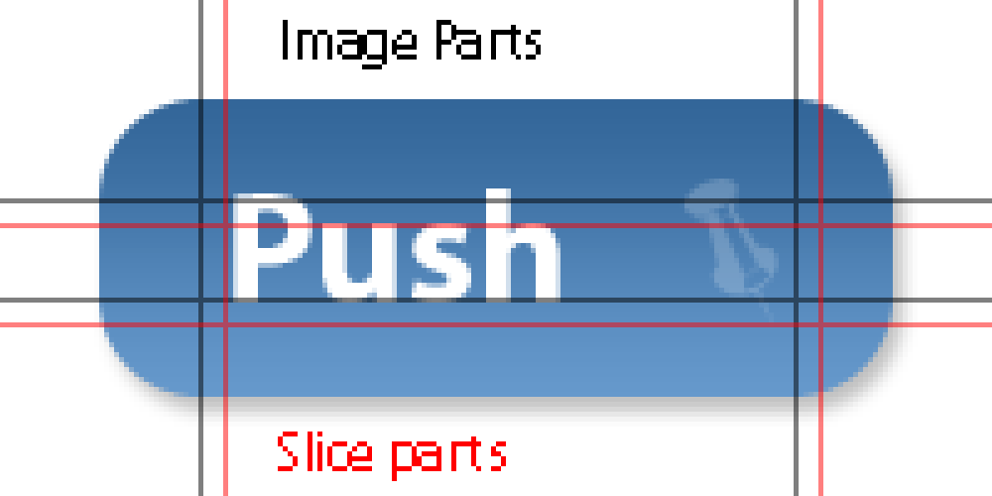
Example: Slicing a Button (2)
Let’s look closer

Slide 40
Example: Slicing a Button (3)
Image parts
One own tile or background
Four corner parts
Shadow parts
Two own tiles side and bottom
Three corner parts
Note: not all buttons have all parts
Some have less, and some have more

Slide 41
Exporting
Live Demo

Slide 42


Feathering
Which will tends to happen more than often

Slide 43
Beware of Feathering
Not birdy feathers, but shape feathering
Quote:
Feathering is a technique used in computer graphics software to smooth or blur the edges of a feature. The term is inherited from a technique of fine retouching using fine feathers.

Slide 44
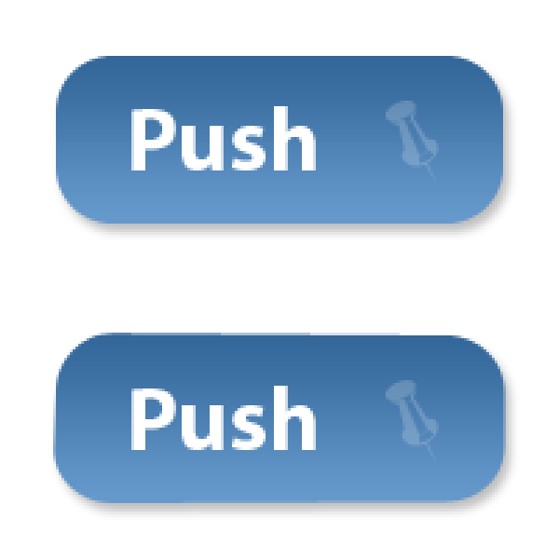
Beware of Feathering (2)

Slide 45
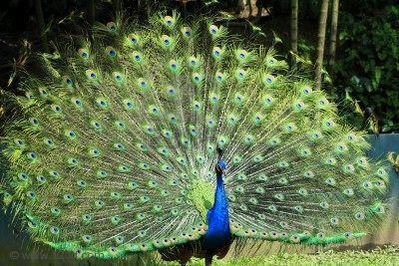
Feathering
Live Demo

Slide 46

Questions
Do you have them?

Slide 47

Exercises
Given the file button.psd create a Web page (HTML + CSS + images) that displays two buttons and a hyperlink:
[OK]
[Cancel]
View More Information
The buttons and the hyperlink should look like in the Photoshop file

Slide 48
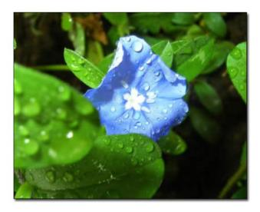

Exercises (2)
Given the file shadow.psd create a Web page (HTML + CSS + images) that displays few images (with different sizes) with a shadow.
Using the file menu-horizontal.psd create a Web page (HTML + CSS + images) that displays a horizontal menu with hyperlinks.

