Slide 1




Web Sites with XHTML and CSS
Slice and Dice: From PSD Image to XHTML+CSS
Svetlin Nakov
Technical Trainer
www.nakov.com
Telerik Web Design Course
html5course.telerik.com

Slide 2
Table of Contents
From Image to XHTML+CSS: Step by Step
Floating DIVs and DIVs Behaving Like Tables
Vertical Alignment of DIVs
Centering Site Contents
Web Site with Frames
Web Site with Tables
Web Site with DIVs
Slice and Dice: Showcases

Slide 3

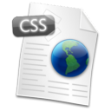
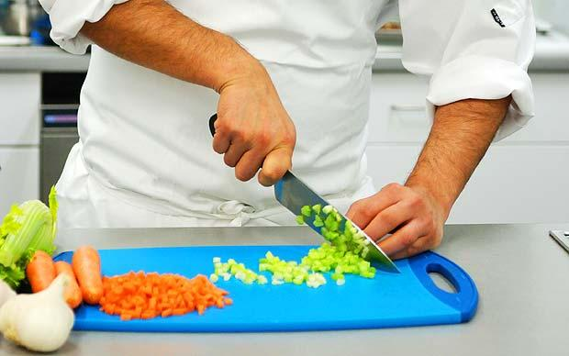
From Image to XHTML+CSS
Creating Web Sites Step by Step

Slide 4
From Image to XHTML+CSS
Steps for converting a Web site image to XHTML + CSS ( + JavaScript )
Decide on the layout type
Fixed width – what resolution (800, 1024, …)?
Fluid width – which parts will resize?
Identify site sections
Header, main, footer, columns, navigation, etc.
Decide on the layout model
DIVs vs. tables (any good reason to use tables?)

Slide 5
From Image to XHTML+CSS (2)
Steps for converting a Web site image to XHTML + CSS ( + JavaScript )
Distinguish between content and style
Text vs. images – which belongs to the content and which is part of the styling?
Create the page layout
Create the layout DIVs and define their CSS
Create the contents of each section
Test the site in different Web browsers

Slide 6
Fixed vs. Fluid Layout
Page layout can be fixed or fluid
Fixed width
Typical Web users use at least 1024 x 768 resolution → 900px-1000px page width is OK
Mobile devices have smaller screen
Fluid width
Ensure the main page content resizes correctly
Beware of very large screens (e.g. 1920 x 1200)
Fix the min-width for the main <div>

Slide 7
Identifying Site Sections
Typical Web sites consist of header, main section and footer
The main content usually has some main section, sidebars or navigation controls
The main section could be split in columns
Header
Main Section
Left Side Bar
Right Side Bar
Columns
Columns
Columns
Footer

Slide 8
Frames vs. Table vs. DIVs?
Site layout with frames is old-fashioned
Using tables for columned design is incorrect!
Tables are considered SEO unfriendly
The other option is to use <div> tags
To place them in columns they must be floating
When they are floating, you can fix their width, but height is determined by their content (or is fixed)
When height is determined by content, background may not be applied properly
Footer must also be floating with clear:left

Slide 9
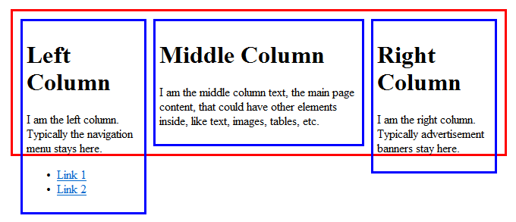
Floating DIVs
Floating DIVs are not part of their parent DIV
Their height is the height of their content
The parent container's height can be less
Floating-left <div>
Non-floating <div>
Floating-right <div>
The container <div> has height based on its non-floating content

Slide 10
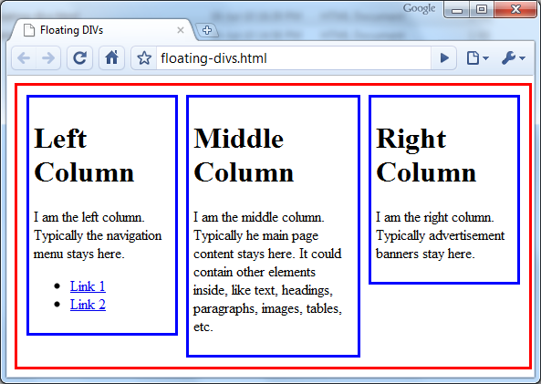

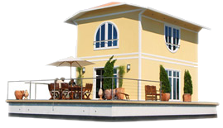
Floating DIVs
floating-divs.html
Live Demo

Slide 11
DIVs Behaving Like Tables
display:table makes DIVs behave like table:
Supported in all W3C-compliant browsers
Internet Explorer supports this since IE8
#div-table { display: table; }
#div-row { display: table-row; }
.div-cell { display: table-cell; }
<div id="container">
<div id="row">
<div class="div-cell">Left Column</div>
<div class="div-cell">Middle Column</div>
<div class="div-cell">Right Column</div>
</div>
</div>

Slide 12
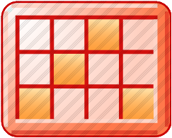
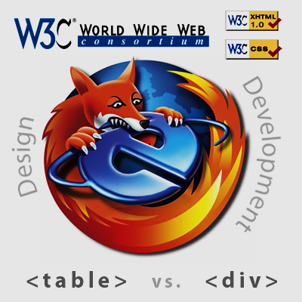
DIVs Behaving Like Tables
table-with-divs.html
Live Demo

Slide 13
Vertical Alignment of DIV
Aligning a DIV vertically is a complex task
You need three nested <div> elements:
#container { display: table; height: 400px; }
#row { display: table-row; }
#cell { display: table-cell; vertical-align: middle; }
<div id="container">
<div id="row">
<div id="cell">Vertically Centered</div>
</div>
</div>
XHTML DOCTYPE is requred, especially for IE!
<!DOCTYPE html PUBLIC "-//W3C//DTD XHTML 1.0 Transitional//EN" "http://www.w3.org/TR/xhtml1/DTD/ xhtml1-transitional.dtd">

Slide 14
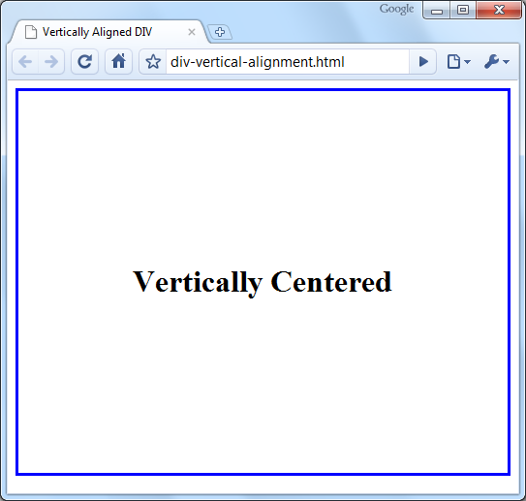
Vertical Alignment of DIVs
div-vertical-alignment.html
Live Demo

Slide 15
Distinguish between Content and Style
Separating content from presentation
The HTML content is the essential information published in the Web page, e.g. text + images
The presentation is the layout and styles used to format the content or decorate it
The content should live in the HTML
The presentation should live in the CSS
When the CSS is disabled, the site should look like an article with titles, lists and paragraphs

Slide 16
GIF, JPEG or PNG?
GIF, JPEG and PNG are the three most common image formats in the Web
JPEG is used for large images, e.g. photos
GIF and PNG support transparency
Used for bullets, icons and small images
Transparent PNG not supported by old browsers
PNG files are larger than GIF
GIF supports less colors than PNG
GIF supports animation

Slide 17
Centering a Fixed-Width Site
Several ways to center the content of the site:
Placing it in <center> tag – deprecated
Using CSS text-align:center
Will affect all child nodes too
Using CSS margin:0 auto
The width of the content is fixed
The left and right margins are set to automatic
width: 900px;
margin: 20px auto;

Slide 18
Centering Site Contents – Example
<html xmlns="http://www.w3.org/1999/xhtml">
<head>
<style type="text/css">
body { background-color: #CCCCCC; }
#site-contents {
width: 940px; margin: 20px auto; }
</style>
</head>
<body>
<div id="site-contents">
<h1>Welcome to our Web site!</h1>
...
</div>
</body>
</html>

Slide 19
Centered Site Contents
Live Demo

Slide 20
Web Site Based on Frames
Web sites based on frames
Easy-to-develop
Works for small and simple Web sites
Considered old-fashioned, not recommended!
<frameset rows="85,*" cols="*" frameborder="no" border="0"
framespacing="0">
<frame src="header.html" scrolling="no" noresize="yes" />
<frameset cols="126,*" frameborder="no" border="0"
framespacing="0">
<frame src="left.html" name="leftFrame" scrolling="no"
noresize="yes" />
<frame src="welcome.html" name="mainFrame" />
</frameset>
</frameset>

Slide 21
Web Site with Frames
Live Demo

Slide 22
Web Site Based on Tables
Web sites based on tables
Easy to layout the page elements
Semantically incorrect, not recommended!
<table class="siteTable">
<tr class="headerRow">
<td class="logoCell">Logo</td>
<td class="headerCell">Header Text</td>
</tr>
<tr valign="top">
<td class="menuCell">Menu</td>
<td class="mainContentCell">Main Content</td>
</tr>
<tr class="footerRow"><td colspan="2">Footer</td></tr>
</table>

Slide 23
Web Site with Tables
Live Demo

Slide 24
Web Site Based on DIVs
Web sites based on DIVs
The best, semantically correct approach
Sometimes is hard to implement
<div id="header">
<div id="headerLogo">Logo</div>
<div id="headerText">Header</div>
</div>
<div id="container">
<div id="leftSidebar">Menu</div>
<div id="mainContent">Main Content</div>
</div>
<div id="footer">Footer</div>

Slide 25
Web Site with DIVs
Live Demo

Slide 26
Creating a Web Site
Slice and Dice: Showcases

Slide 27
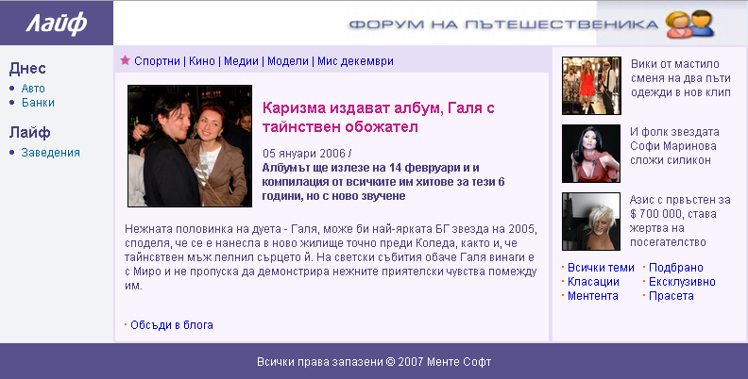
Slice and Dice Showcase
We should convert the following image to XHTML+CSS:

Slide 28
Layout and Style
Fixed width or fluid width?
Fixed width will work well
Need to center the content and use some background to fill the rest of the page
Frames, tables or DIVs?
DIVs with table layout will work best

Slide 29
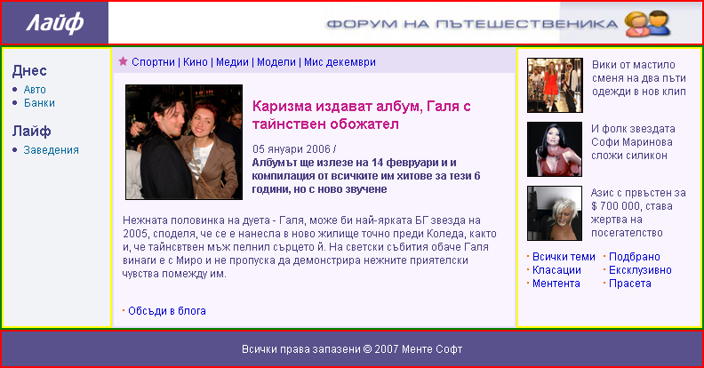
Step 1 – Determine the Pieces
First step is to determine the parts of the design

Slide 30
Step 1 – Determine the Pieces (2)
This is the logo –
should be image tag
the site header - div
This can be background image

Slide 31
Step 1 – Determine the Pieces (3)
3 columns design
Best way is – table, one row, three cells
Menu cell
Body cell
Right cell

Slide 32
Step 1 – Determine the Pieces (4)
Footer – div, center the text with CSS

Slide 33
Step 1 – Determine the Pieces (5)
DIV with links (A tags)
Article headings
(H1 and H2 tags)
Unordered lists, strong tags, links
two separate lists in table or two floating divs

Slide 34
Step 2 – Which Parts are Image and Which HTML?
Use HTML when possible to avoid images
Images are slower to download and render
Browsers do not support such font and effects so we have to place this text using image
This bullets can be either CSS background image or default list bullet
All elements backgrounds and borders are solid so we can use css colors instead of images

Slide 35
Step 3 – The Small Details
Look for the small details and decide if they should be in CSS, HTML or image
Example: this images have border that should be defined in the CSS, not part of the image

Slide 36
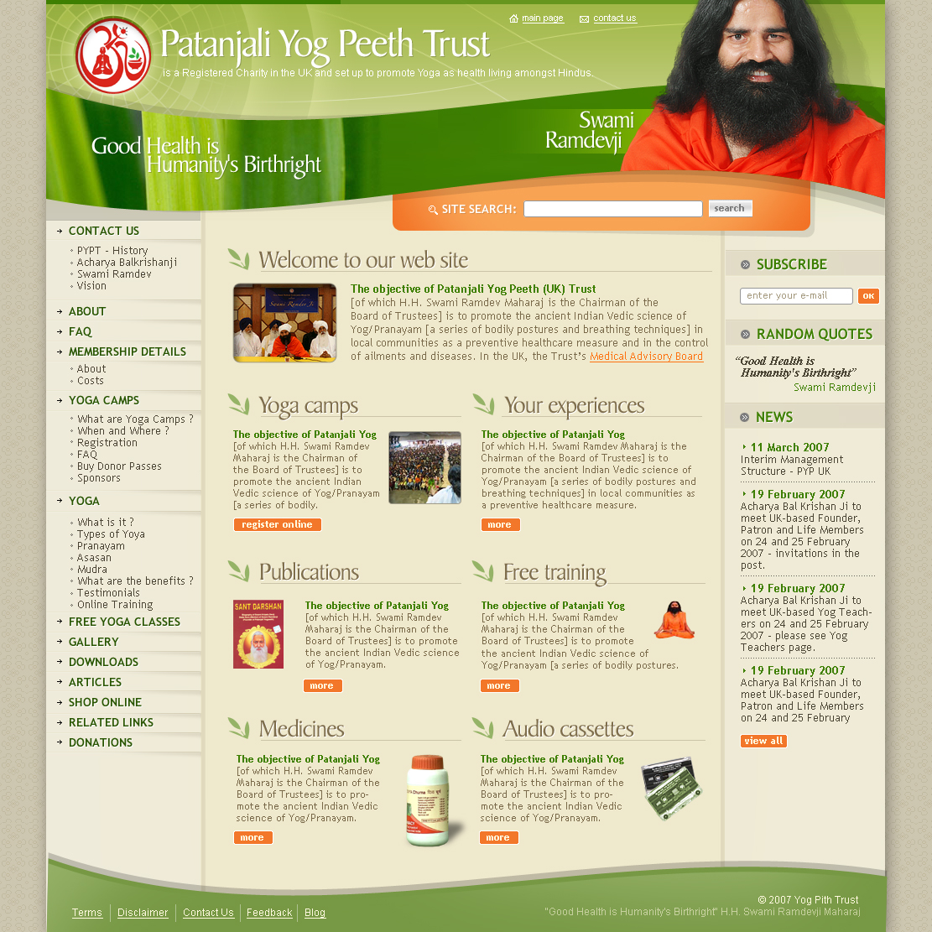
Case Study
Example site design
http://pypt.org/

Slide 37

Case Study: Text or Image
Three ways to create the top part:
Use text over background image, absolute positioned DIVs
Use table, slice the image to fit the needed rows and columns
Leave the text in the image

Slide 38

Case Study: Two Backgrounds
To achieve the underline and the leaf image we can use only CSS. We need two tags:
Outer tag has the leaf as background image, padding-left so the inner doesn’t cover it
Inner tag has the underline as background image, repeat-x, positioned in the bottom
Note: the underline background image is 1px wide to save bandwidth!

Slide 39

Case Study: Rounded Corners
Rounded border corners are supported by CSS3
Not yet supported by most browsers
But soon will be
We can create them with multiple images in table
Too much code

Slide 40
Web Sites with XHTML and CSS
html5course.telerik.com

Slide 41
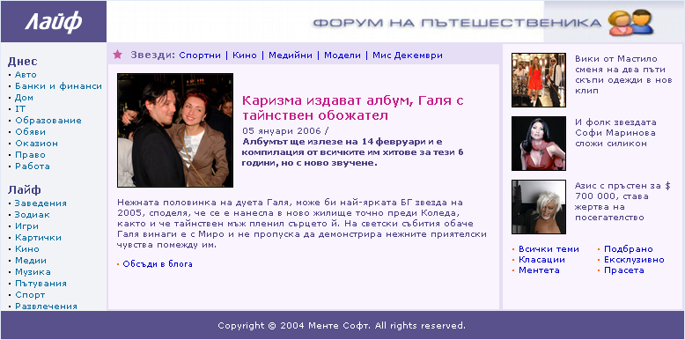
Homework
Create this with XHTML and CSS. Using tables and frames are not allowed!
See the file: site-sample.png

Slide 42

Homework (2)
Create this with XHTML and CSS. Using tables and frames is not allowed!
See the file: architecture.png

