Slide 1
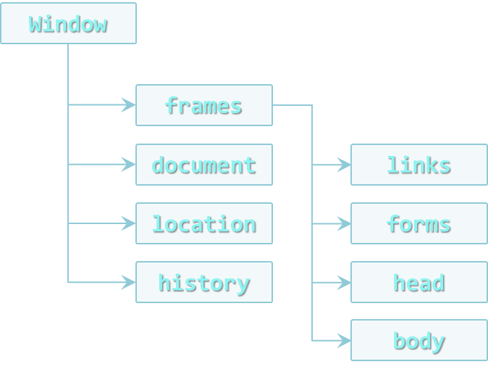

DOM and DOM Manipulation
Consuming the True Power of JavaScript!
Doncho Minkov
Technical Trainer
http://minkov.it
Telerik Software Academy
http://academy.telerik.com

Slide 2
Table of Contents
Document Object Model
DOM API, DOM Objects and HTML Elements
Selecting the DOM
getElementsBy and querySelector
Traversing the DOM
Parents, Children and Siblings
DOM manipulation
Adding, Removing and Altering Elements
Static and Live NodeLists

Slide 3
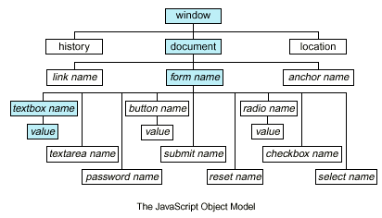
Document Object Model (DOM)

Slide 4
Document Object Model
The Document Object Model is an API for HTML and XML documents
Provides a structural representation of the document
Enables developers to modify the content and visual presentation of a web page

Slide 5
Document Object Model (2)
The Document Object Model consists of many objects to manipulate a web page
All the properties, methods and events are organized into objects
Those objects are accessible through programming languages and scripts
How to use the DOM?
Write JavaScript to interact with the DOM
JavaScript uses the DOM API (native implementation for each browser)

Slide 6
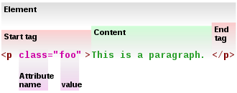
DOM API

Slide 7
DOM API
The DOM API consist of objects with methods to interact with the HTML page
Can add or remove HTML elements
Can apply styles dynamically
Can add and remove HTML attributes
DOM introduces objects that represent HTML elements and their properties
document.documentElement is <html>
document.body is the body of the page

Slide 8
DOM Objects
Each of the HTML elements have corresponding DOM object types
HTMLLIElement represents <li>
HTMLAudioElement represents <audio>
Each of these objects have the appropriate properties
HTMLAnchorElement has href property
HTMLImageElement has src property
The document object is a special object
It represents the entry point

Slide 9
HTML Elements
HTML elements have properties that correspond to the their attributes
id, className, draggable, style, onclick, etc…
Specific HTMLElements have their attributes
HTMLImageElement has property src
HTMLInputElement has property value
HTMLAnchorElement has property href

Slide 10
HTML Elements (2)
HTML also have properties corresponding to their content
innerHTML
Returns as a string the content of the element, without the element
outerHTML
Returns as a string the content of the element, with the element
innerText / textContent
Returns as a string the text content of the element, without the tags

Slide 11
DOM Objects
Live Demo

Slide 12
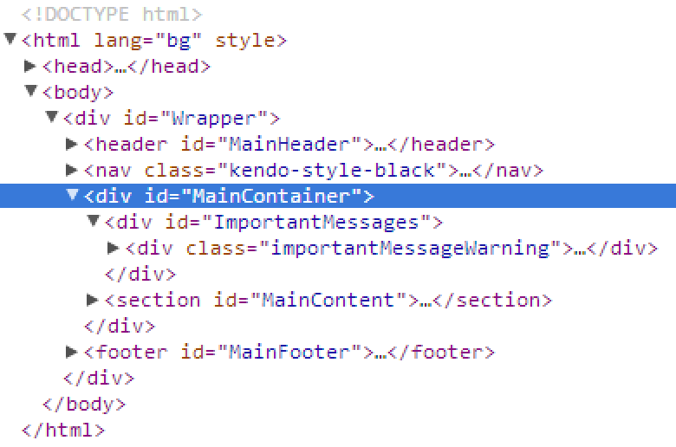
Selecting DOM Elements

Slide 13
Selecting HTML Elements
JavaScript can select HTML elements using the DOM API
Select single element
Select a collection of elements
Using predefined collections of elements
var header = document.getElementById("header");
var nav = document.querySelector("#main-nav");
var inputs = document.getElementsByTagName("li");
var header = document.querySelectorAll("#main-nav li");
var links = document.links;
var forms = document.forms;

Slide 14
Using getElementsBy Methods
DOM API contains methods for selecting elements based on some characteristic
By Id
By Class
By Tag Name
By Name
var header = document.getElementById("header");
var posts = document.getElementsByClassName("post-item");
var sidebars =document.getElementsByTagName("sidebar");
Var genderButtons = document.getElementsByName("gender");

Slide 15
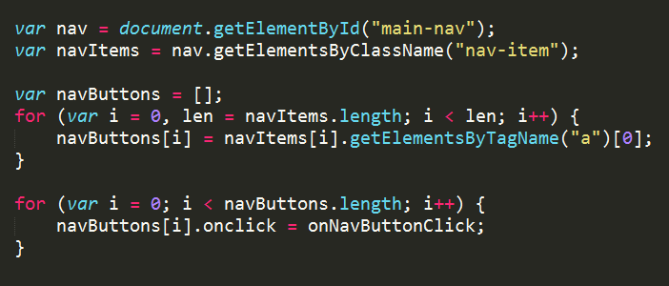
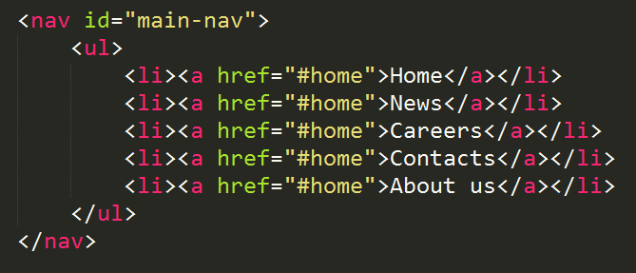
document.getElementsBy…
Live Demo

Slide 16
QuerySelector
HTML5 introduces a new selector methods
querySelector returns the first element that matches the selector
querySelectorAll returns a collection of all elements that match the selector
Not supported in older browsers
Both methods take as a string parameter the element to select
The parameter uses a css-like selectors
var header = document.querySelector("#header");
//the element with id="header"
var navItems = document.querySelectorAll("#main-nav li");
//li elements contained in element with id=main-nav

Slide 17
QuerySelector
Live Demo

Slide 18
Traversing the DOM
body
header
div#wrapper
footer
h1#logo
nav #main-nav
h2
nav

Slide 19
Traversing the DOM
HTML elements have properties about their position in the DOM three
Their parent
Their children
Their siblings
Elements before and after the element
These properties can be used to traverse through the DOM

Slide 20
Traversing the DOM (2)
element.parentNode
Returns the parent of the element
The parent of document is null
element.childNodes
Returns a nodeList of all the child nodes
Including the text nodes (whitespaces)
element.nextSibling / nextElementSibling
Returns the next sibling
element.previousSibling / previousElementSibling
Returns the previous sibling

Slide 21
Traversing the DOM - Example
var trainersList =
document.getElementsByClassName("trainers-list")[0];
var parent = trainersList.parentNode;
log("parent of trainers-list: " + parent.nodeName + "
with id: " + parent.id);
var children = trainersList.childNodes;
log("elements in trainers-list: " + children.length);
log("element in trainers-list");
for (var i = 0, len = children.length; i < len; i++) {
var subItem = children[i]
log(subItem.nodeName + " content: " +
subItem.innerText);
}

Slide 22
Traversing the DOM
Live Demo

Slide 23
Manipulating the DOM
Making a web page dynamic

Slide 24
Manipulating the DOM
DOM can be manipulated dynamically with JS
HTML elements can be created
HTML elements can be removed
HTML elements can be altered
Change their content
Change their styles
Change their attributes

Slide 25
Creating HTML elements
The document object has a method for creation of HTML elements
document.createElement(elementName)
Returns an object with the corresponding HTML element type
var liElement = document.createElement("li");
console.log(liElement instanceof HTMLLIElement); //true
console.log(liElement instanceof HTMLElement); //true
console.log(liElement instanceof HTMLDivElement); //false

Slide 26
Creating HTML Elements (2)
After an HTML element is created it can be treated as if it was selected from the DOM
When HTML elements are created dynamically they are just JavaScript objects
They are still not in the DOM (the web page)
New HTML elements must be appended to DOM
var studentsList = document.createElement("ul");
var studentLi = document.createElement("li");
studentsList.appendChild(studentLi);
document.body.appendChild(studentsList);

Slide 27
Creating HTML Elements
Live Demo

Slide 28
Appending Elements
Appending elements to the DOM is a slow operation
When an elements is appended to the DOM, it is rendered anew
Wouldn't It could be cool, if we can append all elements at once
Here comes the DocumentFragment element
It is a minimal HTML element, with no parent
It is used to store ready-to-append elements and append them at once to the DOM

Slide 29
Appending Elements (2)
Using DocumentFragment
Append the elements to a DocumentFragment
Appending DocumentFragment to the DOM appends only its child elements
http://jsperf.com/append-doc-fragment/2
dFrag = document.createDocumentFragment();
dFrag.appendChild(div);
…
document.body.appendChild(dFrag);

Slide 30
DocumentFragment
Live Demo

Slide 31
Removing Elements
Elements can be removed from the DOM
Using element.removeChild(elToRemove)
Pass the element-to-remove to their parent
<ul>
<li>Doncho Minkov</li> <li>Svetlin Nakov</li>
<li>Georgi Georgiev</li> <li>Nikolay Kostov</li>
<li>Asya Georgieva</li>
</ul>
//..
var trainers = document.getElementsByTagName("ul")[0];
var trainer = trainers.getElementsByTagName("li")[0];
trainers.removeChild(trainer);

Slide 32
Removing Elements
Live Demo

Slide 33
Altering the Elements
When an HTML element is selected with JS
It can be removed
Its children can be altered
The element can be altered as well
With DOM API each HTML node can be altered
Change its properties
Change its appearance

Slide 34
Altering the Elements (2)
Keep in mind that each HTML element is unique in the DOM
If JavaScript changes its appearance or its position, it is still the same element object
<div id="f"><p id="the-p">text</p></div>
<div id="s"></div>
…
var second = document.getElementById("s");
var theP = document.getElementById("the-p");
second.appendChild(theP);
…
//the DOM is:
<div id="f"></div>
<div id="s"><p id="the-p">text</p></div>

Slide 35
Altering HTML Elements
Live Demo

Slide 36
Altering the Style
The style of each HTML element can be altered using JavaScript
Meaning changing the style attribute
The inline styles, not CSS
var div = document.getElementById("content");
div.style.display = "block";
div.style.width = "123px";
Do not forget the unit

Slide 37
Altering HTML Element Style
Live Demo

Slide 38
NodeList

Slide 39
NodeLists
NodeList is the collection returned by the DOM selectors:
getElementsByTagName
getElementsByName
getElementsByClassName
querySelectorAll
var divs = document.getElementsByTagName("div");
var queryDivs = document.querySelectorAll("div");
for(var i=0; i< divs.length; i++){
//do stuff with divs[i]…
}

Slide 40
NodeLists (2)
NodeList looks like an array, but is not an array
It's an object with properties similar to array
Has length and indexer
Traversing an array with for-in loop works unexpected:
for (var i in divs) {
console.log("divs[" + i + "] = " + divs[i]);
}
//divs[0] = ...
//divs[1] = ...
//divs[length] = ...
//divs[item] = ...

Slide 41
NodeList
Live Demo

Slide 42
Static NodeList and Live NodeList

Slide 43
Static and Live NodeLists
There are two kinds of NodeLists
getElementsBy…() return a LiveNodeList
querySelectorAll() returns a StaticNodeList
Live list keeps track of the selected element
Even when changes are made to DOM
While static list keeps the elements at the execution of the method
Keep in mind that LiveNodeList is slower that regular array
Need to cache its length for better performance

Slide 44
Static NodeListand Live NodeList
Live Demo

Slide 45
DOM and DOM Manipulation
http://academy.telerik.com

Slide 46
Homework
Write a script that creates a number of div elements. Each div element must have the following
Random width and height between 20px and 100px
Random background color
Random font color
Random position on the screen (position:absolute)
A strong element with text "div" inside the div
Random border-radius
Random border color
Random border-width between 1px and 20px

Slide 47
Homework (2)
Write a script that creates 5 div elements and moves them in circular path with interval of 100 milliseconds
Write a script that shims querySelector and querySelectorAll in older browsers
Create a text area and two inputs with type="color"
Make the font color of the text area as the value of the first color input
Make the background color of the text area as the value of the second input

Slide 48
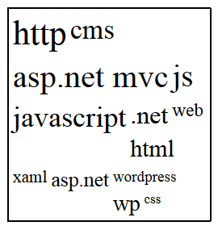
Homework (3)
Create a tag cloud:
Visualize a string of tags (strings) in a given container
By given minFontSize and maxFontSize, generate the tags with different font-size, depending on the number of occurrences
var tags = ["cms", "javascript", "js", "ASP.NET MVC", ".net", ".net", "css", "wordpress", "xaml", "js", "http", "web", "asp.net", "asp.net MVC", "ASP.NET MVC", "wp", "javascript", "js", "cms", "html", "javascript", "http", "http", "CMS"]
var tagCloud = generateTagCloud(tags,17,42);

Slide 49
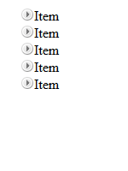
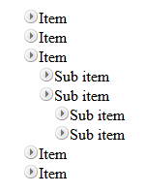
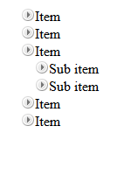
Homework (4)
*Create a TreeView component
Initially only the top items must be visible
On item click
If its children are hidden (collapsed), they must be made visible (expanded)
If its children are visible (expanded), they must be made hidden (collapsed)
Research about events
Initial
Sub item expanded
Top level expanded

