Slide 1

JavaScript APIs
Canvas, Workers, Web Storage and all the cool stuff
Doncho Minkov
Technical Trainer
http://academy.telerik.com
Telerik Software Academy
academy.telerik.com

Slide 2


Table of Contents
Canvas API
Rectangles, Ellipses and Paths
Web workers
Drag and Drop
Web Storages
Cookies
SessionStorage
LocalStorage
Geolocation

Slide 3
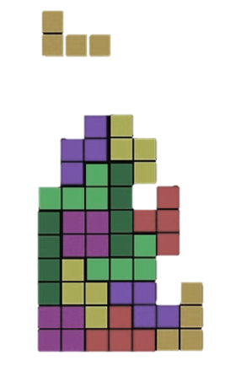
Canvas API
Dynamically Draw Images

Slide 4
The Canvas
<canvas> is kind of <img> drawn with JS
Can be styled as any other HTML element
Margins, padding, borders, background, etc..
The canvas has only two own properties
Width and height
<canvas id="the-canvas" width="200" height="200">
This text is displayed if your browser does not support
HTML5 Canvas.
</canvas>
If <canvas> is not supported (like the alt property of <img>)

Slide 5
The Canvas Rendering Context
Canvas creates a fixed size surface to draw with JavaScript
Like a whiteboard, but instead of markers we draw with JavaScript
The drawing is done using a rendering context
2d or 3d
3d context is based on OpenGL (WebGL) and is still experimental

Slide 6
The Canvas Grid
Canvas uses a grid for drawing
A coordinated space, where 1 unit on the canvas is 1 pixel on the page
The origin of this grid is positioned in the top left corner of the canvas
Coordinates (0, 0)
When drawing something it is positioned relative to the origin

Slide 7

Simple Canvas
Live Demo

Slide 8
Canvas Properties
Canvas has many properties for drawing
Methods to draw rectangles
Methods to draw paths
Ellipses, curves, etc.
Per-pixel manipulations
Fields to set colors

Slide 9
Properties for Color
context.fillStyle = color
Used for the fill color
context.strokeStyle = color
Used for setting the shape outline color
Possible values for color
ctx.fillStyle = "blue; //using color alias
ctx.fillStyle = "#00ff3a"; //using RGB literals
ctx.fillStyle = "rgb(123,222,3); //using css method rgb
ctx.fillStyle = "rgba(123,2,32,0.5)"; //with alpha channel

Slide 10
Canvas - Rectangle Methods
fillRect(x, y, width, height)
Fills rectangle with top-left corner at position (x, y) with size width x height
strokeRect(x, y, width, height)
Draws only the outline of the rectangle
clearRect(x, y, width, height)
Clears the specified area and makes it fully transparent

Slide 11
Drawing Rectangles with Canvas
Live Demo

Slide 12
Canvas – Paths
What is a path?
The path marks points to draw
Used to draw ellipse, curves, etc…
To use path we need a little preparation
Call beginPath() to mark the start of the draw
stroke() to draw the defined path
The methods to draw path:
moveTo(x, y), lineTo(x, y)
arc(x, y, radius, start, end, clockwise)

Slide 13
Drawing Paths
Live Demo

Slide 14
Canvas Per-pixel Manipulation

Slide 15
Canvas Per-pixel Manipulation
Canvas supports per-pixel manipulation
All the pixels can be manipulated one-by-one
Use the context.getImageData(x, y, w, h)
Returns the image data object
The image data is for the rectangle with top-left corner at (x, y) with width w and height h
The image data contains an array of numbers for each of the pixels

Slide 16
Canvas Per-pixel Manipulation (2)
The array of pixels holds values between 0 and 255
Each value represents a color component from RGB
The pixels are grouped in triples in the array
The color values for the i-th pixel are at positions:
pixels[i] holds the RED component
pixels[i+1] holds the GREEN component
pixels[i+2] holds the BLUE component

Slide 17
Canvas Per-pixel Manipulation: Example
Invert all the colors of an canvas
var imageData =
ctx.getImageData(150, 150, ctx.canvas.width, ctx.canvas.height);
for(var i = 0 ; i < imageData.data.length; i+=4){
imageData.data[i] = 255 - imageData.data[i];
imageData.data[i+1] = 255 - imageData.data[i+1];
imageData.data[i+2] = 255 - imageData.data[i+2];
}
ctx.putImageData(imageData, 0, 0);

Slide 18
Canvas Per-pixel Manipulation
Live Demo

Slide 19


Web Workers
Asynchronous Execution with JavaScript?!

Slide 20
Web Workers?
Dedicated Web Workers is API for running scripts in the background
Independently of any user interface scripts
Workers are expected to be long-lived
Have a high start-up performance cost and a high per-instance memory cost
Might be partially replaced by Window.setTimeout() function

Slide 21
Web Workers? (2)
Workers are separate JavaScript processes running in separate threads
Workers execute concurrently
Don’t block the UI
Cannot access the UI
Workers can be dedicated (single tab) or shared among tabs/windows
Workers will be persistent too (coming soon)
They’ll keep running after the browser is closed

Slide 22
Web Workers? (3)
If we call function by setTimeout, the execution of script and UI are suspended
When we call function in worker, it doesn’t affect UI and execution flow in any way
To create Worker, we put JavaScript in separate file and create new Worker object:
We can communicate with worker using postmessage function and onmessage events
var worker = new Worker('extra_work.js');

Slide 23
Web Workers? (4)
Messages can be sent to all threads in our application:
main.js:
var worker = new Worker('extra_work.js');
worker.onmessage = function (event) { alert(event.data); };
extra_work.js:
//do some work;
//when done post message
//data could be string, array, object etc.
postMessage(data);

Slide 24
Web Worker Methods and Events (2)
Web workers have a private method to send updates to the application script
postmessage(data)
A web worker object has a single event
onpostmessage
The application script can attach to this event and receive updates from the worker
The handler gets a data object where the posted data is stored

Slide 25
Web Worker Events
How does it work?
The app creates a worker and attaches an event handler to the onpostmessage event
The app starts the worker and continues its work
When the worker has some updates, it calls postmessage and sends the data to the app
The event handler receives the data
When the app sends data to the worker, this data is stringified into JSON and then passed to worker object
And vice versa

Slide 26
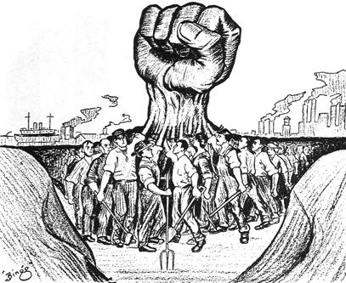
Web Workers
Live Demo

Slide 27

Drag and Drop
Native Drag and Drop with JavaScript

Slide 28
Drag and Drop
To make an HTML element draggable
Set the draggable attribute to true
Set an event listener for
dragstart that stores the data being dragged
Store data into the DataTransfer object
<div draggable="true" ondragstart="drag(event)">drag me</div>
<div draggable="true" ondragstart="drag(event)">drag me</div> <div draggable="true" ondragstart="drag(event)">drag me</div>
<script>
function drag(ev) {
ev.dataTransfer.setData("text", ev.target.id);
}
</script>

Slide 29
Drop Event
To accept a drop
The drop target has to listen to the ondrop event
One more event should be registered to
The dragover event
To specify what is to be shown to the user
To report whether the drop target is acceptable

Slide 30
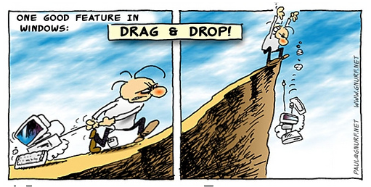
Drag And Drop
Live Demo

Slide 31
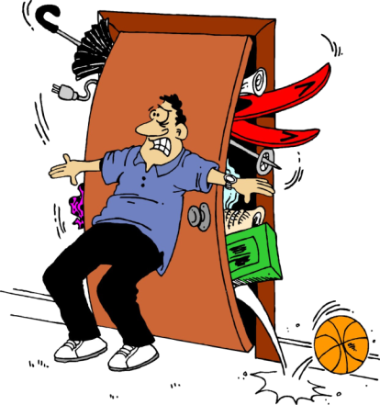

WebStorages
Cookies, Local and Session

Slide 32
WebStorages
WebStorages are places to store data
Save user settings, so next time he opens the application, they can be loaded
Three common types of Web Storage
Cookies
Accessible only from a single document
localStorage
Accessible only from a single document
sessionStorage
Accessible only while the document is opened

Slide 33

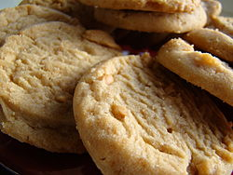
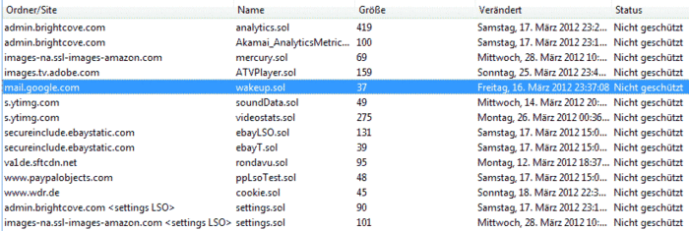
Cookies

Slide 34
Cookies
Cookies are small pieces of data
Accessible from a concrete application
Stored in the user's browsers
i.e. different cookies for different browsers
Cookies can store only plain text

Slide 35
Cookies (2)
Cookies are used to save some state of the user preferences and settings
If you have identified to the server once, it is not necessary to do so again
Cookies are attached to the headers of a HTTP request to the server
Cookies can be read and set by JavaScript

Slide 36
Cookies (3)
A cookie consists of three parts
A name-value pair that holds the cookie information
An expire date, after which this cookie is not available
A domain and path to the server, that the cookie belongs to

Slide 37
Cookies (4)
Name-value pairs hold the cookie's data
The name is used to reach the data stored in the value
To read a cookie, you must search for the name
Expire date
Used to give timeframe for the work of the cookie
If not set, the cookie is removed when closing the browser
To make a forever cookie, set the expire date after enough years

Slide 38
Working with Cookies
Cookies can be accessed with JavaScript
Use document.cookie property
Thought cookies are not strings, they are used as strings
//sets a cookie
document.cookie =
'c1=cookie1; expires=Thu, 30 Apr 2013 21:44:00 UTC; path=/'
//sets another cookie
document.cookie =
'c2=cookie2; expires=Tue, 29 Apr 2013 11:11:11 UTC; path=/'
//reads all cookies
console.log(document.cookie);

Slide 39
Working with Cookies
Read cookie (its information)
function readCookie(name) {
var allCookies = document.cookie.split(";");
for (var i = 0; i < allCookies.length; i++) {
var cookie = allCookies[i];
var trailingZeros = 0;
for (var j = 0; j < cookie.length; j++) {
if (cookie[j] !== " ") {
break;
}
}
cookie = cookie.substring(j);
if (cookie.startsWith(name + "=")) {
return cookie;
}
}
}

Slide 40

Cookies
Live Demo

Slide 41
localStorage
localStorage is per document storage
Accessible through document.localStorage
Similar to cookies
Can store much larger amount of data
Supported up to IE8
Needs a shim for IE7
Saves data as string
localStorage properties:
setItem(key, value), getItem(key)
removeItem(key), length

Slide 42
Local Storage Example
Local Storage
function saveState(text){
localStorage["text"] = text;
}
function restoreState(){
return localStorage["text"];
}
Same as
function saveState(text){
localStorage.setValue("text", text);
}
function restoreState(){
return localStorage.getValue("text");
}

Slide 43
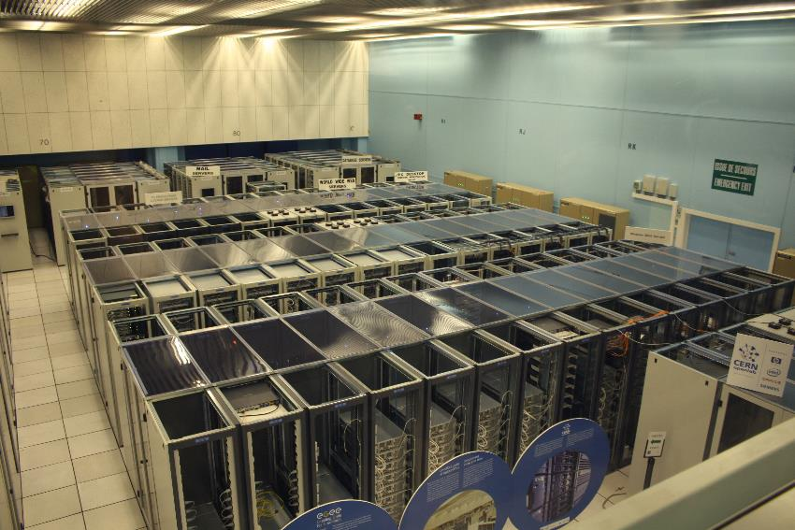
localStorage
Live Demo

Slide 44
Session Storage
Session Storage
Similar to localStorage
Lasts as long as browser is open
Opening page in new window or tab starts new session
Great for sensitive data (e.g. banking sessions)
Can store only strings

Slide 45
Session Storage Example
Session Storage
function incrementLoads() {
if (!sessionStorage. counter) {
sessionStorage.setItem(" counter ", 0);
}
var currentCount =
parseInt(sessionStorage.getItem("counter"));
currentCount++;
sessionStorage.setItem("counter",currentCount;
document.getElementById("countDiv").innerHTML =
currentCount;
}

Slide 46
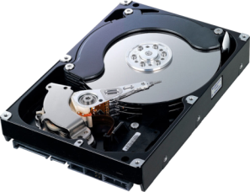

sessionStorage Storages
Live Demo

Slide 47
Saving Object in WebStorages
Local and session storage can only contain strings
If you try to save an object, its toString() method will be invoked
To save objects into web storages, need to extend the Storage prototype
Storage.prototype.setObject =
function setObject(key, obj){
this.setItem(key, JSON.stringify(obj));
};
Storage.prototype.getObject =
function getObject(key) {
return JSON.parse(this.getItem(key));
};

Slide 48
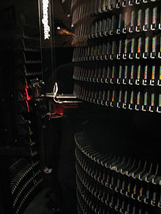
Saving Object in WebStorages
Live Demo

Slide 49

Geolocation

Slide 50
Geolocation
Geolocation is an API to provide the geographical location of the user
For privacy reason, the user must agree to share his location
Geolocation is not supported everywhere, so you need a polyfill to make it work everywhere

Slide 51
Geolocation (2)
Geolocation API has three primary methods:
getCurrentPosition(success, error)
watchPosition(success, error)
clearWatch(watchId)

Slide 52
Geolocation: getCurrentPosition
getCurrentPosition gets the current position of the user
It takes a success handler and an optional error handler
The success handler receives an position object, containing the position data
function geoSuccess(position){
console.log(position.coords);
}
function geoError(){
console.log(arguments);
}
navigator.geolocation.getCurrentPosition(geoSuccess,geoError);

Slide 53
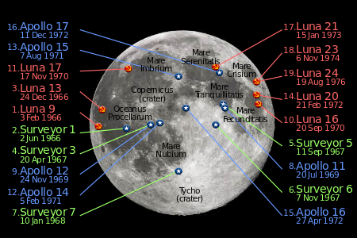
Geolocation: getCurrentPosition
Live Demo

Slide 54
Geolocation: watchPosition
watchPosition gets the position of the user
If the user changes his location it is updated
It takes a success handler and an optional error handler
The success handler receives an position object, containing the position data
Invoked every time the user changes his location
function geoSuccess(position){
console.log(position.coords);
}
function geoError(){
console.log(arguments);
}
var wid = navigator.geolocation.watchPosition(geoSuccess,geoError);

Slide 55
Geolocation: clearPosition
clearPosition stops a running watchPosition
Takes a watchPosition id
function geoSuccess(position){
console.log(position.coords);
}
function geoError(){
console.log(arguments);
}
var wid = navigator.geolocation.watchPosition(geoSuccess,geoError);
nagivator.geolocataion.clearPosition(wid);

Slide 56

Geolocation: watchPosition
Live Demo

Slide 57
JavaScript APIs

Slide 58
Homework
Write a client-side based web application that consists of a trash bucket and lots of trash items in the browser window. Implement the following functionality:
Drag trash items
Open the bucket when a trash item is being dragged over it and close when the trash is dragged out of the bucket, or is dropped in the bucket
To throw a trash item into the bucket, i.e. make it disappear from the browser window

Slide 59
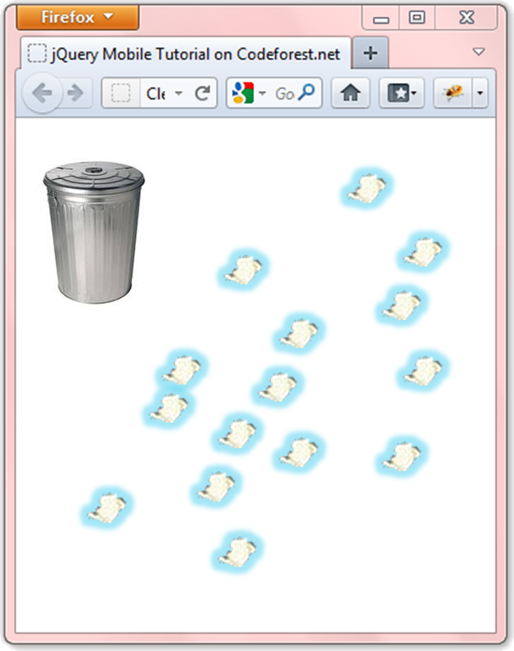
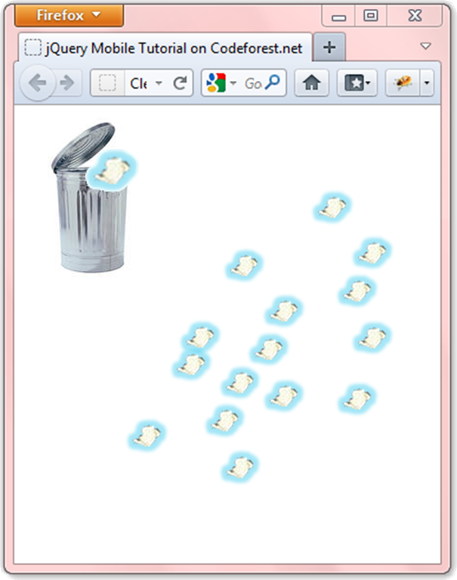
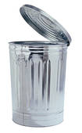

Homework (2)
With Drag
Clean the Trash example

Slide 60
Homework (3)
Using the exercise with the bucket implement functionality for high-score
When the user cleans all the trash, he is asked for a nickname and his score is saved in the local storage
The score of the user is the time that took him to clean the trash
Implement a high-score board, that is visible on page load and shows the top 5 scores
The 5 users that cleaned the trash fastest
Create shiv/shim/polyfill to enable localStorage and sessionStorage in browsers that do not support them

Slide 61


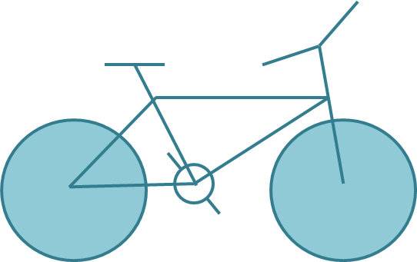
Homework (4)
Draw the following graphics using canvas:

Slide 62
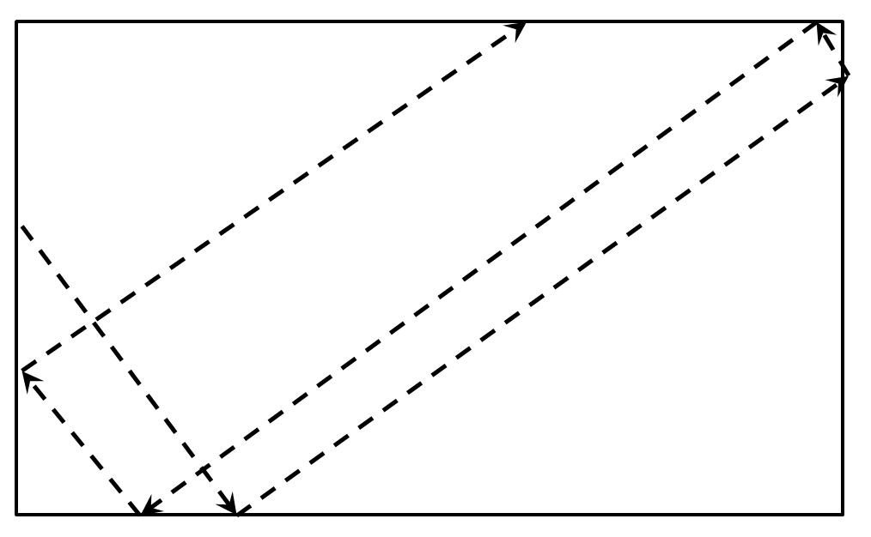
Homework (5)
Draw a circle that flies inside a box
When it reaches an edge, it should bounce that edge

Slide 63
Homework (7)
*Create the famous game "Snake"
The snake is a sequence of rectangles/ellipses
The snake can move left, right, up or down
The snake dies if it reaches any of the edges or when it tries to eat itself
A food should be generated
When the snake eats the food, it grows and new food is generated at random position
Implement the game using OOP and canvas
Implement a high-score board, kept in localStorage

