Slide 1


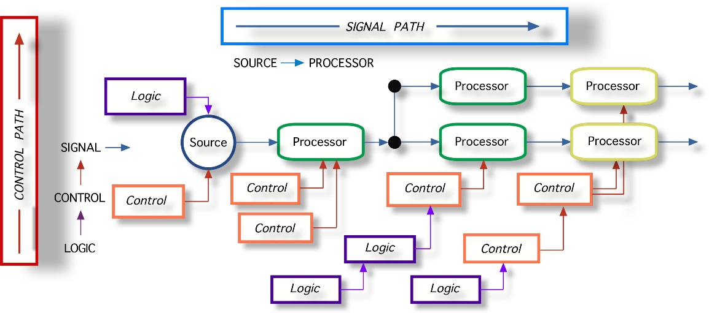
RequireJS
Splitting JavaScript into Dependent Modules
Doncho Minkov
Senior Technical Trainer
http://minkov.it
Telerik Software Academy
http://academy.telerik.com

Slide 2
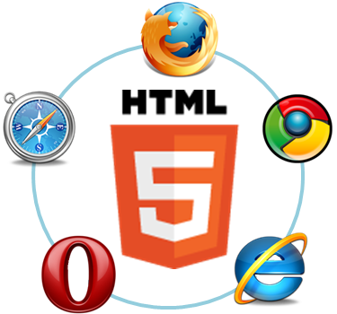
Table of Contents
RequireJS Overview
RequireJS configuration
Defining modules with RequireJS
Defining Dependent modules

Slide 3

RequireJS Overview

Slide 4
RequireJS Overview
RequireJS is a JavaScript file and module loader
It is optimized for in-browser use
Yet it can be used in other JavaScript environments, like Rhino and Node
Modular loaders improve the speed and quality of code
Inspire lazy-loading of JS files
Makes files dependent on other files

Slide 5
Using RequireJS
Using RequireJS makes code more simpler and optimized
Instead of loading all the JavaScript files on the page load, load them when needed
RequireJS needs a configuration file to load other files
The config file is the single JavaScript file in the web page

Slide 6
Using RequireJS (2)
RequireJS loads all code relative to a baseUrl
The url given in data-main
RequireJS assumes by default that all dependencies are scripts
Suffix ".js" is not expected

Slide 7
RequireJS Config
The web page should load only the app config file:
<!DOCTYPE html>
<html>
<head>
<script data-main="scripts/app-config"
src="Scripts/require.js"></script>
</head>
<body>
…
</body>
</html>
App config loads the other JS files

Slide 8
app-config
The app-config is the file, loading other files
//app-config
(function () {
require.config({
paths: {
"jquery": "libs/jquery-2.0.3"
}
});
require(["jquery"], function () {
//write your jQuery-dependent code here
});
}());

Slide 9
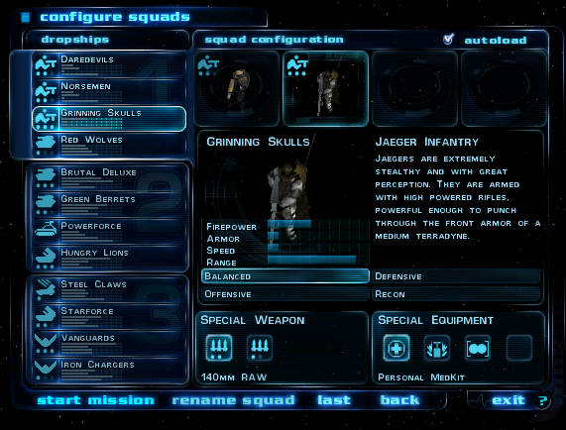
app-config
Live Demo

Slide 10

Defining Modules

Slide 11
Modules
A module is a well-scoped object that avoids polluting the global namespace
It can explicitly list its dependencies and get a handle on those dependencies
Dependencies are received as arguments to the define function
Modules in RequireJS are an extension of the Module Pattern

Slide 12
Modules (2)
The RequireJS syntax for modules allows them to be loaded as fast as possible
Even out of order, yet evaluated in the correct dependency order
Since global variables are not created it is possible to load multiple versions of a module
There should only be one module definition in a single JavaScript file!
The modules can be grouped into optimized bundles by an optimization tool

Slide 13
Defining Modules
Defining modules is done using the define function of RequireJS:
The name of the modules is the path of the file
//in file "libs/module1.js"
define(function(){
//do stuff
return result; }
define({ properties });
Not all modules need dependencies
If no dependencies are needed, just pass a function handler or an object

Slide 14
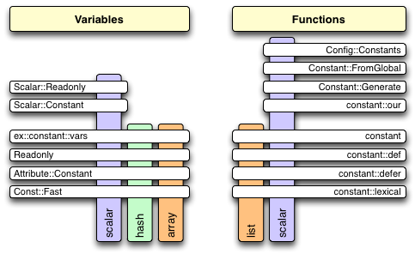
Defining Simple Modules
Live Demo

Slide 15
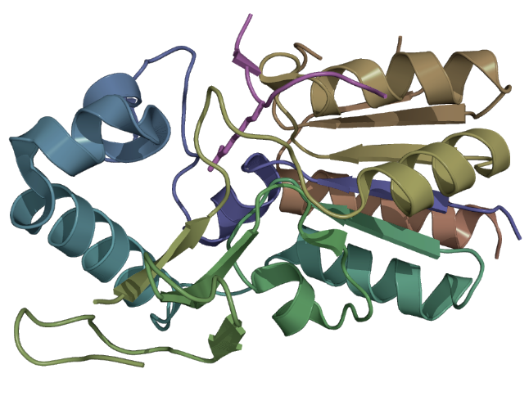
Defining Modules with Dependencies

Slide 16
Defining Dependencies
Some modules use another modules
RequireJS can "request" a file to be loaded
Pass the names of the required module as an array in the define function
If any of them is not loaded, RequireJS will load it

Slide 17
Defining Dependencies
Live Demo

Slide 18
RequireJS
http://academy.telerik.com

Slide 19
Homework
Create the following web services:
GET api/students - returns all students
Students have id, name and grade
GET api/students/{studentId}/marks - returns the marks of a student
Marks have subject and score
No need to use a database, xml file or any other kinds of data storage. You can use a regular array.

Slide 20
Homework (2)
Using the web services develop a client application with two "pages"
On the first page show all students
The second page shows the marks of a student
Load the second page when a student from the first is clicked
Separate the application in the following modules:
HttpRequester - performs HTTP GET and HTTP POST requests
DataPersister - uses HttpRequester to fetch data from the storage (the web services)
Controls - renders objects to HTML elements
Application - handles event handlings, page load, etc…

Slide 21
Homework (2)
(cont.) Using the web services develop a client application with 2 "pages"
Use promises for the HTTP requests
You can use Q.js, RSVP.js or any other library
Use RequireJS to define and use your modules
Use mustache.js for templating the data
Use jQuery, prototype.js or native XmlHttpRequest to make the AJAX calls

Slide 22
Homework (3)
Implement a ComboBox control (like a dropdown list)
The ComboBox holds a set of items (an array)
Initially only a single item, the selected item, is visible (the ComboBox is collapsed)
When the selected item is clicked, all other items are shown (the ComboBox is expanded)
If an item is clicked, it becomes the selected item and the ComboBox collapses
Each of the items in a ComboBox can contain any valid HTML code

Slide 23
Homework (4)
(cont.) Implement a ComboBox control (like a dropdown list)
Use RequireJS and mustache.js
jQuery is not obligatory (use it if you will)
The ComboBox should have the following usage:
var people = [
{ id: 1, name: "Doncho Minkov", age: 18, avatarUrl: "images/minkov.jpg" },
{ id: 2, name: "Georgi Georgiev", age: 19, avatarUrl: "images/joreto.jpg" }];
var comboBox = controls.ComboBox(people);
var template = $("#person-template").html();
var comboBoxHtml = comboBox.render(template);
container.innerHTML = comboBoxHtml;
//sample template
<div class="person-item" id="person-item-{{id}}">
<strong class="person-name">{{name}}</strong><p class="person-age">{{age}}</p>
<img src="{{avatarUrl}}" width="100px" />
</div>

Slide 24
Homework (5)
*Using the ComboBox from the previous task, add the following:
A way to attach to the expanding and collapsing of the ComboBox (onCollapsing and onExpanding events)
An event onSelectionChanged event, that fires when the selected item is changed
The onSelectionChanged event, must pass the new and the old selected HTML item

