Slide 1



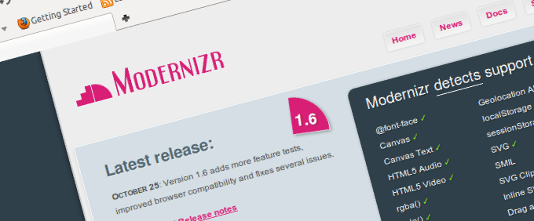
Modernizr.js
Modernize Your Old Browser to Support HTML5
Svetlin Nakov
Senior Technical Trainer
www.Nakov.com
Telerik Software Academy
academy.telerik.com

Slide 2

Table of Contents
What is Modernizr.js?
Using Modernizr.js
Installing Modernizr
Detecting HTML5 Features
Fallbacks for Missing CSS3 Features
Loading Polyfills for Missing Features

Slide 3

What is Modernizr.js?
JS Library to Detect Native HTML5 Features

Slide 4
The Modernizr
Modernizr is a JavaScript library that detects HTML5 and CSS3 features in the browser
http://modernizr.com
Modernizr has three primary tasks
Adds html5shiv if needed (HTML5 tags in old IE)
Detects html 5 support through adding classes to the HTML element
Class js for "js is supported" and "no-js" otherwise
Yep / nope loading of polyfills
If a features is not supported → load a polyfill

Slide 5
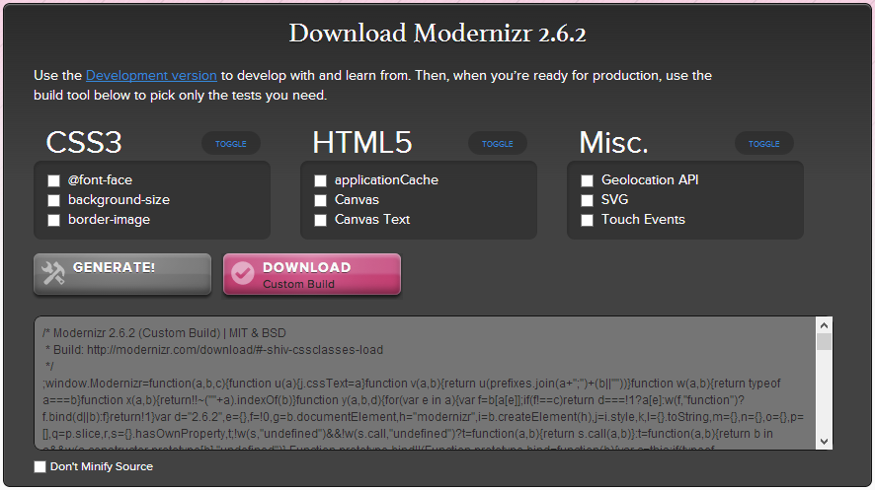
Installing and Configuring Modernizr

Slide 6
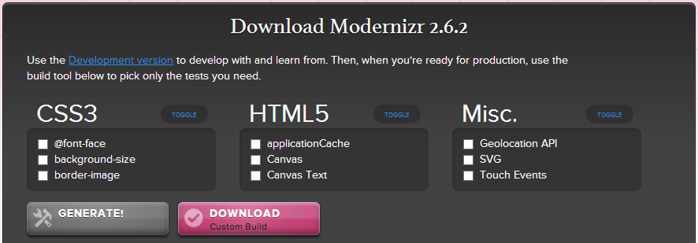
Installing Modernizr
Steps to install Modernizer:
Go to http://modernizr.com/download/
Select features you want to use
Generate and download your customized Modernizr JS code

Slide 7
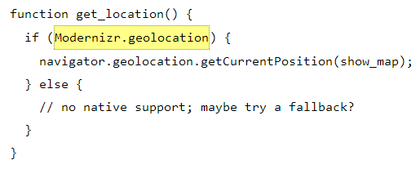
Modernizr: Detecting HTML5 Features

Slide 8
Detecting HTML5 Features
Modernizer can check for HTML5 / CSS3 features through JavaScript:
Features detected by Modernizr:
http://modernizr.com/docs/#s2
if (Modernizr.canvas) {
alert('HTML5 canvas is supported');
} else {
alert('HTML5 canvas is NOT supported');
}

Slide 9
Modernizr: Detecting HTML5 Features
Live Demo

Slide 10
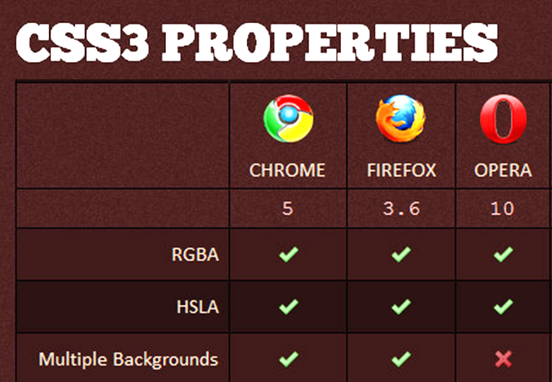
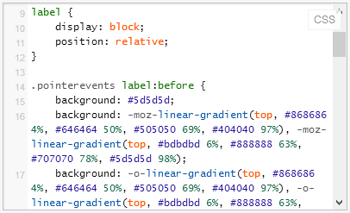
Modernizr: Detecting CSS3 Features & Fallbacks

Slide 11
Modernizr: Detecting CSS3 Features & Fallbacks
On document load Modernizr detects which features are supported
Adds classes "feature" / "no-feature" for the features to the HTML element
Example features:
canvas, rgba, sessionstorage, etc.
If the features are supported
no-canvas, no-rgba, no-sessionstorage, etc.
If the features are not supported

Slide 12
CSS3 Fallbacks
If CSS gradients are not supported, use a fallback gradient with PNG repeated by X:
<script src="modernizr.js"></script>
<style>
.box {
width: 150px;
height: 150px;
border: 1px solid black;
}
.cssgradients .box {
// css gradients code
}
.no-cssgradients .box {
background: url(gradient.png) 0 0 repeat-x;
}
</style>

Slide 13
Modernizr: Detecting CSS3 Features & Fallbacks
Live Demo

Slide 14
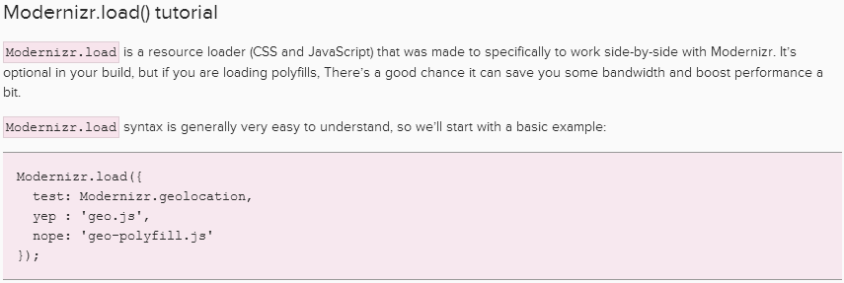
Modernizr Load
Yep / Nope Loading of JS Polyfills for Missing HTML5 Features

Slide 15
Modernizr Load
Modernizr can test for features and load resources depending on their support
Used to load polyfills for unsupported features
<script src="modernizr.js"></script>
<script>
Modernizr.load({
test: Modernizr.audio,
nope: 'http://api.html5media.info/1.1.5/ html5media.min.js'
});
</script>

Slide 16
Modernizr Load
Live Demo

Slide 17




Free Trainings @ Telerik Academy
HTML5 Courses @ Telerik Academy
html5course.telerik.com
Telerik Software Academy
academy.telerik.com
Telerik Academy @ Facebook
facebook.com/TelerikAcademy
Telerik Software Academy Forums
forums.academy.telerik.com

Slide 18
Problems
Create a HTML page to display the current Web browser and the supported and not supported HTML5 and CSS3 features. Use ua-parser-js to detect the browser type, version, OS and device. Use Modernizr.js to detect the features (see an example here: http://fiddle.jshell.net/ncuesta/NHTyT/show/).
Create a simple HTML5 application by choice that uses Canvas, GeoLocation and LocalStorage APIs. Using Modernizr.load() provide fallbacks for older browsers. Use polyfills by choice (e.g. https://github.com/Modernizr/Modernizr/wiki/HTML5-Cross-Browser-Polyfills). Test in old browsers.

Slide 19
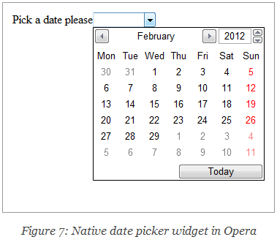
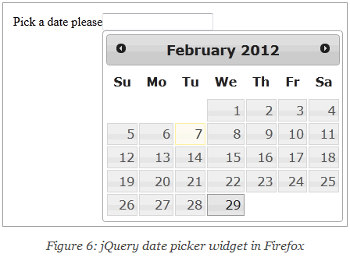
Problems (2)
Using HTML5 and CSS3 create a page to display a date field with a date picker. Use Modernizr to load the jQueryUI date picker only if the browser does not provide a native date picker.

