Slide 1
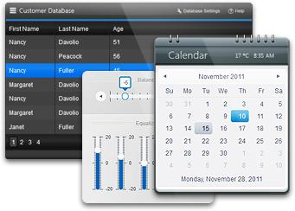


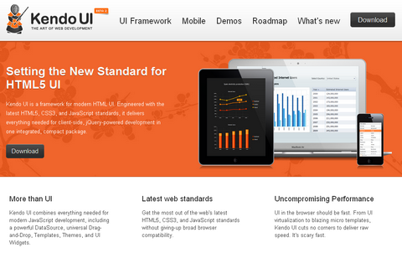
Kendo UI Web
Telerik Web Framework
UI-lo KenDov
Technical Assistant
Telerik Software Academy
http://academy.telerik.com

Slide 2

Table of Contents
Installation
DataSource
Templates
Model - View - View Model (MVVM)
Single Page Application (SPA)
Validator
UI Widgets
Bonus – Server Side Wrappers and Mobile

Slide 3

Installation
Getting ready for Kendo UI

Slide 4

Installation
First include the style sheets
kendo.common.min.css (common css first)
kendo.{theme}.min.css (theme css)
Then include the JavaScript files
jquery.min.js (jQuery is needed first)
kendo.web.min.js (Kendo Ui web)
Enable intellisence
kendo.web.min.intellisense.js in scripts folder

Slide 5
Installing Kendo UI
Live Demo

Slide 6

DataSource
Data, data, data

Slide 7

DataSource
Abstraction over local or remote data
Play central role in Kendo UI applications
Retrieve data from local or remote end point
Provides CRUD operations and serialization
Provides filtering, grouping, page sizing
Synchronizing updates (batch and normal)
And many more

Slide 8

DataSource
Initialization with new kendo.data.DataSource
Takes an JSON object as parameter
The JSON object contains variable options
data option – array of same objects or string
var cars = [
{ make: 'Opel', model: 'Insignia' , year: '2009'},
{ make: 'Audi', model: 'A5', year: '2008'},
{ make: 'BMW', model: 'M3', year: '2010'},
{ make: 'Mercedes', model: 'CL', year: '2011'}
];
var carsDataSource = new kendo.data.DataSource({
data: cars
});

Slide 9

DataSource
columns option – array of objects
field, width, title
aggregate option – array of objects
field, aggregate
"average", "count", "max", "min", "sum"
…
columns: [
{ field: 'make', width: 50, title: 'Make' },
{ field: 'model', width: 50, title: 'Model' }
],
aggregate: [
{ field: 'power', aggregate: 'sum' },]
…

Slide 10

DataSource
filter option – array of objects
logic option: ‘and’, ‘or’
filters option: array of objects
field, operator, value
operators: "eq", "neq", "lt", "lte", "gt", "gte"
…
filter: {
logic: 'and',
filters: [
{ field: 'make', operator: 'eq', value: 'Audi' },
{ field: 'year', operator: 'gt', value: 2006 }
]
}
…

Slide 11

DataSource
group option – array of objects
field, dir, aggregates
dir: ‘asc’ and ‘desc’
…
group: {
field: 'make',
dir: 'desc',
aggregates: [
{ field: 'power', aggregate: 'max' },
{ field: 'make', aggregate: 'count' }
]
}
…

Slide 12

DataSource
sort option – array of objects
field, dir
dir: ‘asc’ and ‘desc’
…
sort: {[
{ field: 'year', dir: 'desc' },
{ field: 'make', dir: 'asc' }
]}
…

Slide 13

DataSource
transport option – array of objects
create, read, update, destroy
url, dataType
parameterMap – function for parsing data
…
transport: {
read: {
url: 'http://someurl.com/api/read',
dataType: 'json'
},
…

Slide 14

DataSource
batch option – boolean
page option – number
pageSize option – number
serverPaging option – boolean
serverSorting option - boolean
events – change, error, sync
…
change: function (e) {
…
}
…

Slide 15

DataSource
Methods
add – object or Kendo.data.model
aggregate – get or set configuration
aggregates – returns result
at – indexator
data – gets or sets the data array
fetch – reads the data, needs ready function
filter – gets or sets the configuration
group – gets or sets the configuration
indexOf – return the index of an object in data

Slide 16
DataSource
Methods
insert – inserts data at specified index
page – gets or sets the current page
pageSize – gets or sets the page size
read – reads the data
remove – removes item
sort – gets or sets the configuration
sync – syncs data with remote service
total – number of items in data
view – return corresponding data (with fetch)

Slide 17
DataSource
Live Demo

Slide 18

Templates
Mustache, Beard, Eyebrows

Slide 19
Templates
Kendo UI templates – in script tags
Type of tag – “text/x-kendo-template”
Should have id attribute
Initialized with kendo.template($('#id').html())
Takes object parameter with data
Appended to other DOM (jQuery) elements
<script type="text/x-kendo-template" id="some-id">
// template </script>
var tmpl = kendo.template($('#some-id').html());
$('#some-tag').append(template({ /* data obj */ }));

Slide 20

Templates
Syntax
Normal HTML syntax
# Between number sign you can write JS code
#: Takes a string from a parameter
#= Takes the value from a parameter
<script type="text/x-kendo-template" id="car">
<div>
<span>#: make #, </span>
<a href="/cars/#= id #">#: model #</a>
</div>
</script>
var carTemplate = kendo.template($('#car').html());
$('#some-tag').append(template({
id: i, make: car.make, model: car.model }));

Slide 21
Templates
Live Demo

Slide 22
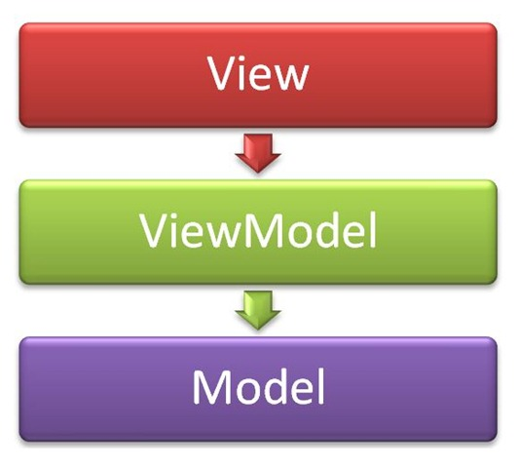
MVVM in KendoUI
Model – View – View Model

Slide 23
MVVM in KendoUI
Model
Represents data (database, objects, etc.)
View Model
Knows of the data
Transforms the data as the View needs it
May have logic and functionality
View
Knows of the View Model
Represents UI (buttons, inputs, etc.)

Slide 24
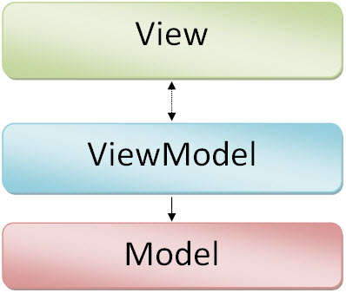
MVVM in KendoUI
Model – kendo.data.DataSource
View Model – kendo.observable(object)
Object – has properties for the View
May have functions for manipulating data
Layout - kendo.Layout(string)
String to render (HTML text)
Displays views

Slide 25

MVVM in KendoUI
View - kendo.View
string (template id)
string (template id) and View Model
var layout = new kendo.Layout(
'<div id="no-model">' + '</div>' +
'<div id="model">' + '</div>');
var first = new kendo.View(‘tmpl');
var second = new kendo.View(‘tmpl-model',
{ model: carViewModel });
layout.render($('#main-layout'));
layout.showIn('#no-model', carListView);
layout.showIn('#model', carDetailView);

Slide 26
MVVM in KendoUI
Data Binding
Add attribute “data-bind” to tags in template
Value of attribute is “{type} : {property}”
<script type="text/kendo-tmpl" id="car-template">
<div>
<img data-bind="attr: { src: image }" />
<span data-bind="text: make"></span>
<input data-bind="value: power“ />
<input type="checkbox" data-bind="checked: agreed" />
<div data-bind="visible: added">
</div>
</script>

Slide 27

MVVM in KendoUI
Events Data Binding
Add attribute “data-bind” to tags in template
Value of attribute is “events: {object of events}”
<button data-bind="events: { click: onClick }">B</button>
var viewModel = kendo.observable({
onClick : function(e) {
console.log("Event: " + e.type);
}
});

Slide 28
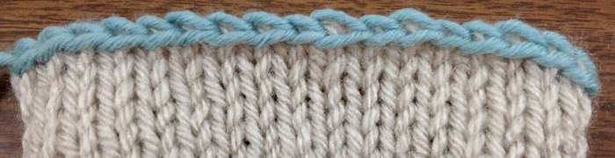
MVVM in KendoUI
Bind View Model To View
Done through kendo.bind(template, viewModel)
Template is jQuery object
View Model is kendo.observable
kendo.bind($("#example"), viewModel);

Slide 29
MVVM in KendoUI
Live Demo

Slide 30

Routing and SPA
The awesomeness start here

Slide 31

Routing and SPA
Routing in KendoUI
Initialized with kendo.Router()
Routes are added with .route(string, function)
Parameters are passed in the string with “:”
Executed with .start()
var router = new kendo.Router();
router.route("home", function () {
$("#content").html("home");
});
router.start();

Slide 32
Routing in KendoUI
Live Demo

Slide 33


Routing and SPA
Single Page Application
Main HTML (logo, menu, header, footer, etc.)
Templates for different “pages”
DataSource as model
ViewModels for binding data to templates
Layout and Views for UI
Events for redirecting to different “pages”
Routing for all “pages”

Slide 34
SPA in KendoUI
Live Demo

Slide 35

Validator
Client-side data validation

Slide 36
KendoUI Validator
Validator
Data is validated through attributes on tags
required – makes field required
pattern – defines RegEx for validation
min – defines minimum value
max – defines maximum value
validationMessage – message if not valid
<input type="tel" id="tel" name="tel" placeholder="Phone"
pattern="\d{10}"
required
validationmessage="Phone should have 10 digits"
/>

Slide 37
KendoUI Validator
Validator
Initialized on jQuery object with .kendoValidator().data('kendoValidator');
Validity is checked with .validate()
var validator =
$('#id').kendoValidator().data('kendoValidator');
if (validator.validate()) {
// do something
}
else {
// do something else ☺
}

Slide 38
Validator
Live Demo

Slide 39
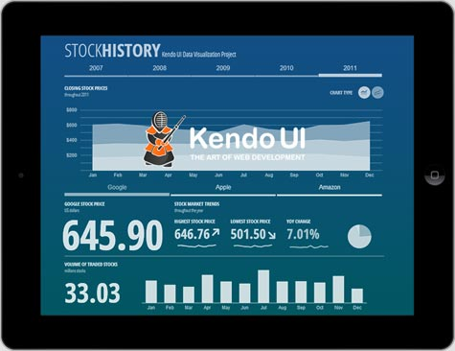
Widgets
The cool stuff!

Slide 40
Widgets
Widgets
Appended to jQuery objects (DOM elements)
May have additional options depending on the widget and the usage of it
$('#menu').kendoMenu();
$('#grid').kendoGrid({
dataSource: carsDataSource,
editable: true,
toolbar: ['create']});

Slide 41
Widgets
Live Demo

Slide 42

Additional Info
More is better!

Slide 43
Additional Info
Documentation
http://docs.kendoui.com/
Demos
http://demos.kendoui.com/
Training room
http://try.kendoui.com/
Downloads
http://www.kendoui.com/download.aspx

Slide 44
Mobile and MVC Demo
It is not only JavaScript!

Slide 45
Kendo UI Web
http://academy.telerik.com

Slide 46
Homework
Create a Single Page Application using Kendo UI Web for online banking management. The application should have home page, about page, register and login. After login the user can deposit money, withdraw money and see a log of all transactions.
Create EverLive cloud-based database
Create DataSource for the database tables
Create routes for each module
Create templates and view models where necessary
Use KendoGrid for the log. Use at least two other widgets from the framework
Use Kendo Validator for all the inputs

