Slide 1







Data Access with ADO.NET
Accessing SQL Server and MySQL from .NET and C#
Svetlin Nakov
Manager Technical Training
http://nakov.com
Telerik Software Academy
http://academy.telerik.com

Slide 2

Table of Contents
Data Access Models
Connected, Disconnected, ORM
ADO.NET Architecture
Data Providers, DB Interfaces and Classes
Accessing SQL Server from ADO.NET (Connected Model)
Connecting with SqlConnection
Using SqlCommand and SqlDataReader
Parameterized Queries

Slide 3
Table of Contents (2)
SQL Injection
What is SQL Injection and How to Avoid It?
Connecting to Other Databases
Connecting to MySQL
Connecting to MS Access through OLE DB
Working with Dates and Images through ADO.NET

Slide 4
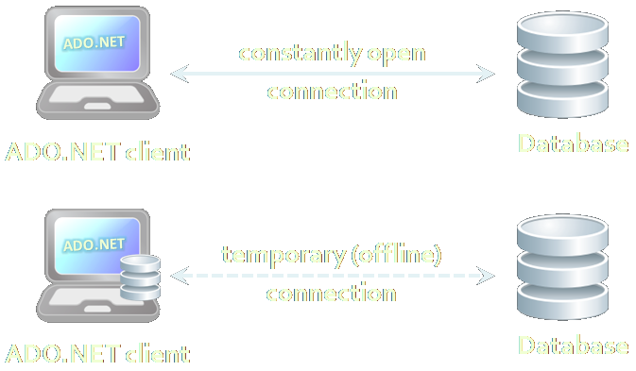

Data Access Models

Slide 5


Connected Model
Connected data access model
Applicable to an environment where the database is constantly available
ADO.NET
constantly open
connection
DB
DB
ADO.NET client
Database

Slide 6
Connected Model: Benefits and Drawbacks
Connected data access model (SqlClient)
Benefits:
Concurrency control is easier to maintain
Better chance to work with the most recent version of the data
Drawbacks:
Needs a constant reliable network
Problems when scalability is an issue

Slide 7

Disconnected Model
Disconnected data access model (DataSet)
A subset of the central database is copied locally at the client and he works with the copy
Database synchronization is done offline
Legacy technology (deprecated)
ADO.NET
temporary (offline)
connection
DB
DB
ADO.NET client
Database

Slide 8
Disconnected Model: Benefits and Drawbacks
Benefits:
The client connects to DB from time to time
Works with the local copy the rest of the time
Other clients can connect during that time
Has superior scalability
Drawbacks:
The data you work with is not always the latest data in the database
Additional efforts to resolve the conflicts caused by different versions of the data

Slide 9
ORM Model
ORM data access model (Entity Framework)
Maps database tables to classes and objects
Objects can be automatically persisted in the database
Can operate in both connected and disconnected modes
OO
Programming
Language
ORM
Framework
Database

Slide 10
ORM Model – Benefits and Problems
ORM model benefits
Increased productivity – writing less code
Use objects with associations instead of tables and SQL commands
Integrated object query mechanism
ORM model drawbacks:
Less flexibility
SQL is automatically generated
Performance issues (sometimes)

Slide 11
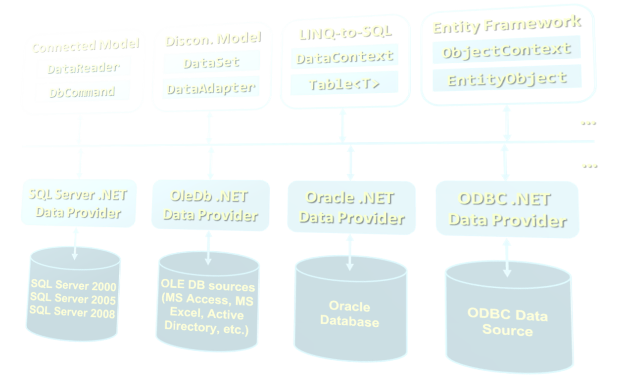
ADO.NET Architecture

Slide 12
What Is ADO.NET?
ADO.NET is a standard .NET class library for accessing databases, processing data and XML
A program model for working with data in .NET
Supports connected, disconnected and ORM data access models
Excellent integration with LINQ, XML and WCF
Allows executing SQL in RDBMS systems
DB connections, data readers, DB commands
Allows accessing data in the ORM approach
LINQ-to-SQL and ADO.NET Entity Framework

Slide 13
Namespaces In ADO.NET
System.Data
ADO.NET core classes
System.Data.Common
Common classes for all ADO.NET technologies
System.Data.Linq
LINQ-to-SQL framework classes
System.Data.Entity
Entity Framework classes
System.Xml
XML processing classes

Slide 14
Components of ADO.NET
Connected Model
Disconn. Model
LINQ-to-SQL
Entity Framework
DataReader
DataSet
DataContext
ObjectContext
DbCommand
DataAdapter
Table<T>
EntityObject
ADO.NET
Programming Model
…
…
SQL Server .NET Data Provider
OleDb .NET Data Provider
Oracle .NET Data Provider
ODBC .NET Data Provider

Slide 15
Data Providers In ADO.NET
Data Providers are collections of classes that provide access to various databases
For different RDBMS systems different Data Providers are available
Each provider uses vendor-specific protocols to talk to the database server
Several common objects are defined:
Connection – to connect to the database
Command – to run an SQL command
DataReader – to retrieve data

Slide 16
Data Providers in ADO.NET (2)
Several standard ADO.NET Data Providers come as part of .NET Framework
SqlClient – accessing SQL Server
OleDB – accessing standard OLE DB data sources
Odbc – accessing standard ODBC data sources
Oracle – accessing Oracle database
Third party Data Providers are available for:
MySQL, PostgreSQL, Interbase, DB2, SQLite
Other RDBMS systems and data sources
SQL Azure, Salesforce CRM, Amazon SimpleDB, …

Slide 17
Data Provider Classes
System.Data.SqlClient and System.Data.SqlTypes
Data Provider classes for accessing SQL Server
System.Data.OleDb
Classes for accessing OLE DB data sources
System.Data.Odbc
Classes for accessing ODBC data sources
System.Data.Oracle
Classes for accessing Oracle databases

Slide 18
Primary Provider Classes and Interfaces in ADO.NET
Generic Interface | Base Classes | SqlClient Classes
IDbConnection | DbConnection | SqlConnection
IDbCommand | DbCommand | SqlCommand
IDataReader / IDataRecord | DbDataReader | SqlDataReader
IDbTransaction | DbTransaction | SqlTransaction
IDbDataParameter | DbParameter | SqlParameter
IDataParameterCollection | DbParameterCollection | SqlParameterCollection
IDbDataAdapter | DbDataAdapter | SqlDataAdapter
 | DbCommandBuilder | SqlCommandBuilder
 | DBDataPermission | SqlPermission

Slide 19
ADO.NET: Connected Model
Retrieving data in connected model
Open a connection (SqlConnection)
Execute command (SqlCommand)
Process the result set of the query by using a reader (SqlDataReader)
Close the reader
Close the connection
SqlDataReader
SqlParameter
SqlParameter
SqlCommand
SqlParameter
SqlConnection
Database

Slide 20
ADO.NET: Disconnected Model
Disconnected model: the data is cached in a DataSet
Open a connection (SqlConnection)
Fill a DataSet (using SqlDataAdapter)
Close the connection
Modify the DataSet
Open a connection
Update changes into the DB
Close the connection
DataSet
SqlDataAdapter
SqlConnection
Warning:
DataSets / DataAdapters are legacy technology (not in use since .NET 3.5)
Database

Slide 21
ADO.NET: LINQ-to-SQL
LINQ-to-SQL is ORM framework for SQL Server
Create object models mapping the database
Open a data context
Retrieve data with LINQ / modify the tables in the data context
Persist the data context changes into the DB
Connection is auto-closed
Table
Table
Table
DataContext
SqlConnection
Database

Slide 22
ADO.NET: Entity Framework
Entity Framework is generic ORM framework
Create entity data model mapping the database
Open an object context
Retrieve data with LINQ / modify the tables in the object context
Persist the object context changes into the DB
Connection is auto-closed
Entity
Entity
Entity
ObjectContext
EntityClient
Data Provider
SqlConnection
Database

Slide 23

SQL Client Data Provider
SQL

Slide 24
SqlClient Data Provider
SqlConnection
Establish database connection to SQL Server
SqlCommand
Executes SQL commands on the SQL Server through an established connection
Could accept parameters (SQLParameter)
SqlDataReader
Retrieves data (record set) from SQL Server as a result of SQL query execution

Slide 25
The SqlConnection Class
SqlConnection establish connection to SQL Server database
Requires a valid connection string
Connection string example:
Connecting to SQL Server:
Data Source=(local)\SQLEXPRESS;Initial Catalog=Northwind;Integrated Security=SSPI;
SqlConnection con = new SqlConnection(
"Server=.\SQLEXPRESS;Database=Northwind;
Integrated Security=true");
con.Open();

Slide 26
DB Connection String
Database connection string
Defines the parameters needed to establish the connection to the database
Settings for SQL Server connections:
Provider – name of the DB driver
Data Source / Server – server name / IP address + database instance name
Database / Initial Catalog – database name
User ID / Password – credentials

Slide 27
DB Connection String (2)
Settings for SQL Server connections:
AttachDbFilename=some_db.mdf
Attaches a local database file
Supported by SQL Express only
Server=server_name\database_instance
"." or "(local)" or "SOME_SERVER"
Database instance is "MSSQL", "SQLEXPRESS" or other SQL Server instance name
Integrated Security – true / false

Slide 28
Connection Pooling
By default SqlClient Data Provider uses connection pooling for improved performance
Connection pooling works as follows:
When establishing a connection an existing one is taken from the so called "connection pool"
If there is no free connection in the pool, a now connection is established
When closing a connection it is returned to the pool, instead of being closed

Slide 29
Working with SqlConnection
Explicitly opening and closing a connection
Open() and Close() methods
Works through the connection pool
DB connections are IDisposable objects
Always use the using construct in C#!
Implicitly opening and closing the connection
Done automatically by DataAdapters, DataContexts and ObjectContexts
EF opens / closes the DB connection implicitly

Slide 30
SqlConnection – Example
Creating and opening connection to SQL Server (database TelerikAcademy)
SqlConnection dbCon = new SqlConnection(
"Server=.\\SQLEXPRESS; " +
"Database=TelerikAcademy; " +
"Integrated Security=true");
dbCon.Open();
using (dbCon)
{
// Use the connection to execute SQL commands here …
}

Slide 31
ADO.NET Classes for the Connected Model
SqlDataReader
XmlReader
SqlCommand
SqlParameter
SqlParameter
SqlConnection
SqlParameter
Database

Slide 32
SqlClient and ADO.NET Connected Model
Retrieving data in connected model
Open a connection (SqlConnection)
Execute command (SqlCommand)
Process the result set of the query by using a reader (SqlDataReader)
Close the reader
Close the connection
SqlDataReader
SqlParameter
SqlParameter
SqlCommand
SqlParameter
SqlConnection
Database

Slide 33
The SqlCommand Class
Executes an SQL statement or a stored procedure
More important properties
Connection – gets / sets the SqlConnection of the command
CommandType – the type of the command
CommandType.StoredProcedure
CommandType.TableDirect
CommandType.Text
CommandText – the body of the SQL query or the name of the stored procedure
Parameters

Slide 34
The SqlCommand Class (2)
More important methods
ExecuteScalar()
Returns a single value (the value in the first column of the first row of the result set)
The returned value is System.Object but can be casted to the actual returned data type
ExecuteReader()
Returns a SqlDataReader
It is a cursor over the returned records (result set)
CommandBehavior – assigns some options

Slide 35
The SqlCommand Class (3)
More important methods
ExecuteNonQuery()
Used for non-query SQL commands, e.g. INSERT
Returns the number of affected rows (int)
ExecuteXmlReader()
Returns the record set as XML
Returns an XmlReader
Supported in SqlClient Data Provider only

Slide 36
The SqlDataReader Class
SqlDataReader retrieves a sequence of records (cursor) returned as result of an SQL command
Data is available for reading only (can't be changed)
Forward-only row processing (no move back)
Important properties and methods:
Read() – moves the cursor forward and returns false if there is no next record
Item (indexer) – retrieves the value in the current record by given column name or index
Close() – closes the cursor and releases resources

Slide 37
SqlCommand – Example
SqlConnection dbCon = new SqlConnection(
"Server=.\\SQLEXPRESS; " +
"Database=TelerikAcademy; " +
"Integrated Security=true");
dbCon.Open();
using(dbCon)
{
SqlCommand command = new SqlCommand(
"SELECT COUNT(*) FROM Employees", dbCon);
int employeesCount = (int) command.ExecuteScalar();
Console.WriteLine( "Employees count: {0} ", employeesCount);
}

Slide 38
SqlDataReader – Example
SqlConnection dbCon = new SqlConnection(…);
dbCon.Open();
using(dbCon)
{
SqlCommand command = new SqlCommand(
"SELECT * FROM Employees", dbCon);
SqlDataReader reader = command.ExecuteReader();
using (reader)
{
while (reader.Read())
{
string firstName = (string)reader["FirstName"];
string lastName = (string)reader["LastName"];
decimal salary = (decimal)reader["Salary"];
Console.WriteLine("{0} {1} - {2}",
firstName, lastName, salary);
}
}
}

Slide 39



Using SqlCommand and SqlDataReader
Live Demo

Slide 40

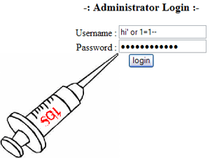

SQL Injection
What is SQL Injection and How to Prevent It?

Slide 41
What is SQL Injection?
bool IsPasswordValid(string username, string password)
{
string sql =
"SELECT COUNT(*) FROM Users " +
"WHERE UserName = '" + username + "' and " +
"PasswordHash = '" + CalcSHA1(password) + "'";
SqlCommand cmd = new SqlCommand(sql, dbConnection);
int matchedUsersCount = (int) cmd.ExecuteScalar();
return matchedUsersCount > 0;
}
bool normalLogin =
IsPasswordValid("peter", "qwerty123"); // true
bool sqlInjectedLogin =
IsPasswordValid(" ' or 1=1 --", "qwerty123"); // true
bool evilHackerCreatesNewUser = IsPasswordValid(
"' INSERT INTO Users VALUES('hacker','') --", "qwerty123");

Slide 42
How Does SQL Injection Work?
The following SQL commands are executed:
Usual password check (no SQL injection):
SQL-injected password check:
SQL-injected INSERT command:
SELECT COUNT(*) FROM Users WHERE UserName = 'peter' and PasswordHash = 'XOwXWxZePV5iyeE86Ejvb+rIG/8='
SELECT COUNT(*) FROM Users WHERE UserName = ' ' or 1=1 -- ' and PasswordHash = 'XOwXWxZePV5iyeE86Ejvb+rIG/8='
SELECT COUNT(*) FROM Users WHERE UserName = '' INSERT INTO Users VALUES('hacker','') --' and PasswordHash = 'XOwXWxZePV5iyeE86Ejvb+rIG/8='

Slide 43
SQL Injection
Live Demo

Slide 44
Preventing SQL Injection
Ways to prevent the SQL injection:
SQL-escape all data coming from the user:
Not recommended: use as last resort only!
Preferred approach:
Use parameterized queries
Separate the SQL command from its arguments
string escapedUsername = username.Replace("'", "''");
string sql =
"SELECT COUNT(*) FROM Users " +
"WHERE UserName = '" + escapedUsername + "' and " +
"PasswordHash = '" + CalcSHA1(password) + "'";

Slide 45

The SqlParameter Class
What are SqlParameters?
SQL queries and stored procedures can have input and output parameters
Accessed through the Parameters property of the SqlCommand class
Properties of SqlParameter:
ParameterName – name of the parameter
DbType – SQL type (NVarChar, Timestamp, …)
Size – size of the type (if applicable)
Direction – input / output

Slide 46
Parameterized Commands – Example
private void InsertProject(string name, string description,
DateTime startDate, DateTime? endDate)
{
SqlCommand cmd = new SqlCommand("INSERT INTO Projects " +
"(Name, Description, StartDate, EndDate) VALUES " +
"(@name, @desc, @start, @end)", dbCon);
cmd.Parameters.AddWithValue("@name", name);
cmd.Parameters.AddWithValue("@desc", description);
cmd.Parameters.AddWithValue("@start", startDate);
SqlParameter sqlParameterEndDate =
new SqlParameter("@end", endDate);
if (endDate == null)
sqlParameterEndDate.Value = DBNull.Value;
cmd.Parameters.Add(sqlParameterEndDate);
cmd.ExecuteNonQuery();
}

Slide 47
Primary Key Retrieval
Retrieval of an automatically generated primary key is specific to each database server
In MS SQL Server IDENTITY column is used
Obtained by executing the following query:
Example of obtaining the automatically generated primary key in ADO.NET:
SELECT @@Identity
SqlCommand selectIdentityCommand =
new SqlCommand("SELECT @@Identity", dbCon);
int insertedRecordId = (int)
(decimal) selectIdentityCommand.ExecuteScalar();

Slide 48



Parameterized Queries
Live Demo

Slide 49


Connecting to Non-Microsoft Databases

Slide 50
Connecting to Non-Microsoft Databases
ADO.NET supports accessing various databases via their Data Providers:
OLE DB – supported internally in ADO.NET
Access any OLE DB-compliant data source
E.g. MS Access, MS Excel, MS Project, MS Exchange, Windows Active Directory, text files
Oracle – supported internally in ADO.NET
MySQL – third party extension
PostgreSQL – third party extension

Slide 51

ADO.NET Data Interfaces
ADO.NET Data Providers implement the following interfaces:
IDbConnection
IDbCommand, IDataParameter
IDataReader
IDbDataAdapter

Slide 52


ADO.NET Base Classes
ADO.NET provides the following base classes:
DbConnection
DbCommand / DbParameter
DbDataReader
DbTransaction
DbParameterCollection
DbDataAdapter
DbCommandBuilder
DbConnectionStringBuilder
DBDataPermission

Slide 53
OLE DB Data Provider
OleDbConnection – establishes a connection to an OLE DB source of data
OleDbCommand – executes an SQL commands through an OLE DB connection to a DB
OleDbParameter – parameter for a command
OleDbDataReader – to retrieve data from a command, executed through OLE DB
OleDbConnection dbConn = new OleDbConnection(
@"Provider=Microsoft.Jet.OLEDB.4.0;Data
Source=C:\MyDB.mdb;Persist Security Info=False");

Slide 54

Connecting To OLE DB – Example
Suppose we have MS Access database C:\Library.mdb
We have the table Users:
We use the "Microsoft Jet 4.0 Provider" to connect in ADO.NET through OLE DB
We create a connection string component:
Provider=Microsoft.Jet.OLEDB.4.0;Data Source= C:\Library.mdb;Persist Security Info=False

Slide 55

Connecting to MS Access Database
Live Demo

Slide 56
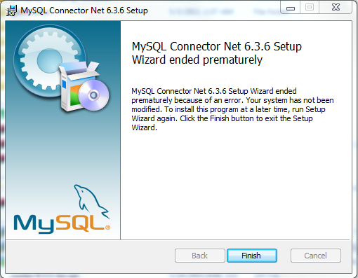
Connecting to MySQL
Accessing MySQL from ADO.NET

Slide 57
Connecting to MySQL from C#
Download and install MySQL Connector/Net
http://dev.mysql.com/downloads/connector/net/
Add reference to MySQL.Data.dll
Available also from NuGet (see http://nuget.org/packages/Mysql.Data/)
Connecting to MySQL:
MySqlConnection dbConnection =
new MySqlConnection("Server=localhost; Port=3306; Database=world; Uid=root; Pwd=root; pooling=true");

Slide 58
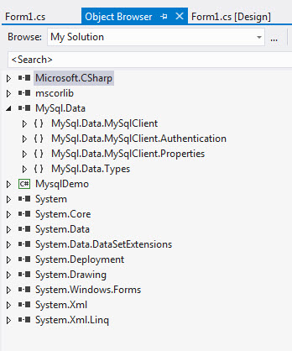
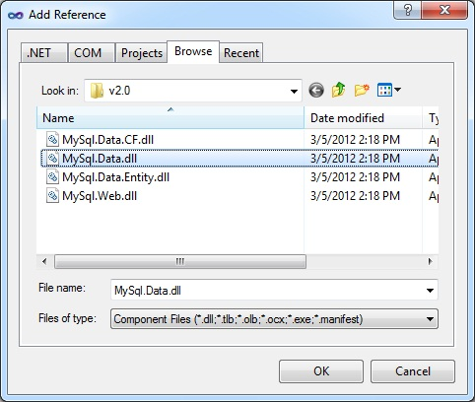
Connecting to MySQL
Live Demo

Slide 59






Working with Dates and Images
Best Practices

Slide 60
Working with Dates: Best Practices
Use the date-specific types in the database and never varchar / nvarchar
Some databases support more than one type for storing dates
Two types in MS SQL Server: datetime (8 bytes) and smalldatetime (4 bytes)
When working with dates use string only when displaying the date to the user

Slide 61
Working with Dates: Best Practices (2)
Use the System.DateTime structure to work with dates in .NET
Use parameterized queries to pass the dates to the database
If you need to convert use IFormatProvider to define the rules for the conversion
When needed use the neutral culture settings: CultureInfo.InvariantCulture

Slide 62
Working with Dates – Example
CREATE TABLE Messages
(
MsgId int identity not null primary key,
MsgText nvarchar(1000),
MsgDate datetime –- Don’t use varchar for dates!
)
public void AddMsg(string text, DateTime date)
{
SqlCommand cmdInsertMsg = new SqlCommand(
"INSERT INTO Messages(MsgText, MsgDate) " +
"VALUES (@MsgText, @MsgDate)", dbCon);
cmdInsertMsg.Parameters.AddWithValue(
"@MsgText", text);
cmdInsertMsg.Parameters.AddWithValue(
"@MsgDate", date);
cmdInsertMsg.ExecuteNonQuery();
}

Slide 63

Working With Dates
Live Demo

Slide 64
Storing Images in the DB
Store images in the file system or in the DB?
Have a good reason to use the DB!
DB field types for large binary objects:
Type "image" in MS SQL Server
Type "blob" in Oracle
Type "OLE Object" in MS Access
Map the image columns to byte[]
When the files are large, use stream-based access to the binary database fields

Slide 65


Images in the Database
Live Demo

Slide 66
Data Access with ADO.NET
?
?
?
?
?
Questions?
?
?
?
?
?
?

Slide 67
Exercises
Write a program that retrieves from the Northwind sample database in MS SQL Server the number of rows in the Categories table.
Write a program that retrieves the name and description of all categories in the Northwind DB.
Write a program that retrieves from the Northwind database all product categories and the names of the products in each category. Can you do this with a single SQL query (with table join)?
Write a method that adds a new product in the products table in the Northwind database. Use a parameterized SQL command.

Slide 68
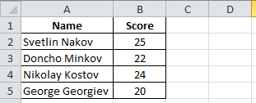
Exercises (2)
Write a program that retrieves the images for all categories in the Northwind database and stores them as JPG files in the file system.
Create an Excel file with 2 columns: name and score:
Write a program that reads your MS Excel file through the OLE DB data provider and displays the name and score row by row.
Implement appending new rows to the Excel file.

Slide 69
Exercises (3)
Write a program that reads a string from the console and finds all products that contain this string. Ensure you handle correctly characters like ', %, ", \ and _.
Download and install MySQL database, MySQL Connector/Net (.NET Data Provider for MySQL) + MySQL Workbench GUI administration tool . Create a MySQL database to store Books (title, author, publish date and ISBN). Write methods for listing all books, finding a book by name and adding a book.
Re-implement the previous task with SQLite embedded DB (see http://sqlite.phxsoftware.com).

Slide 70



Free Trainings @ Telerik Academy
"Web Design with HTML 5, CSS 3 and JavaScript" course @ Telerik Academy
html5course.telerik.com
Telerik Software Academy
academy.telerik.com
Telerik Academy @ Facebook
facebook.com/TelerikAcademy
Telerik Software Academy Forums
forums.academy.telerik.com

