Slide 1

OpenAccess ORM
Modeling, API, tools and best practices
Viktor Zhivkov
Senior Software Developer, OpenAccess ORM
Telerik Software Academy
http://academy.telerik.com

Slide 2
Table of Contents
Hello to OpenAccess
Features
Components
OpenAccess API
Working with LINQ
Bulk Operations
Code generation wizards

Slide 3
Supported database servers
MS SQL 2000+ |  | SQL Compact Edition
 | Oracle 9+ | LocalDb | SQL Anywhere
SQLite |  | My SQL 5.0+ | MariaDb
 | PostgreSQL |  | SQL Azure
VistaDB | Firebird |  | ADS

Slide 4
OpenAccess features over EF 5.0
Batch Operations over metadata
Code generation for Services
Runtime model modifications
Build-in validation framework
.Net 3.5 Framework support
Pessimistic concurrency control
Level 2 caching
Advanced connection pooling
Notes:
Source: http://www.telerik.com/products/orm/getting-started/openaccess-vs-entity-framework.aspx

Slide 5
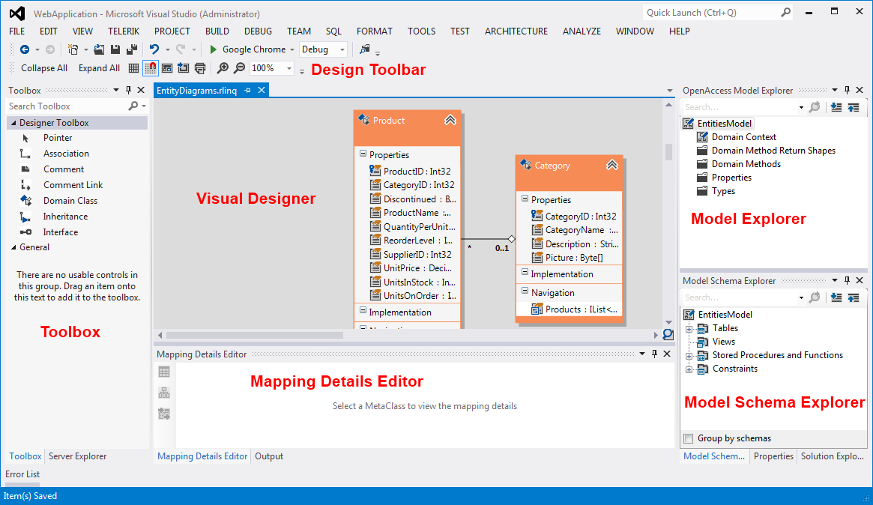
First encounter with OpenAccess
Notes:
More information at: http://documentation.telerik.com/openaccess-orm/documentation/feature-reference/tools/visual-designer/developemnt-environment-wizards-dialogs-model-tools-designer-designer

Slide 6
Components
Visual Designer – design surface where you can compose your data model
Toolbox – contains model building block – classes, associations and etc.
Model Explorer – view over the conceptual data model
Model Schema Explorer – view over the relational data model
Mapping details editor – tool used to map domain classes to relational tables
Notes:
More information at: http://documentation.telerik.com/openaccess-orm/documentation/feature-reference/tools/visual-designer/developemnt-environment-wizards-dialogs-model-tools-designer-designer

Slide 7
First OpenAccess model
DEMO!

Slide 8
Model Settings
Model settings dialog allows you to set up:
Your model, model names, database names,
Code generation options
Runtime configuration, logging, caching, connection pooling
Schema updates
Notes:
More information at http://documentation.telerik.com/openaccess-orm/feature-reference/tools/model-settings-dialog/feature-ref-tools-visual-designer-model-settings-overview

Slide 9
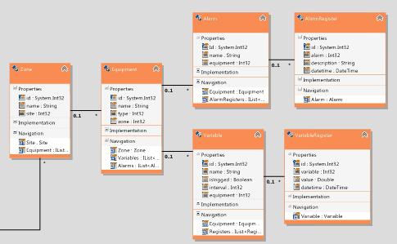

Update from Database
Pull changes made in the database into the existing conceptual model
DEMO

Slide 10
Update Database from Model
Push changes made to the conceptual model to the database in form of SQL DDL script
DEMO

Slide 11
Fluent mapping
Define your model using code-only mapping
Possible scenarios:
Code-first with lots of manual coding
Database-first with one-time code generation
DEMO
Notes:
More information at http://documentation.telerik.com/openaccess-orm/documentation/developers-guide/code-generation/developer-guide-domain-model-class-mapping-fluent-mapping

Slide 12
What is a model?
Metadata Container
Contains all required metadata that describes the model, like:
Domain Classes
Domain Methods
Class1
Class2
ClassN
Class1
Runtime Configuration
.CS
.CS
.CS
.CS
.CS
.CS

Slide 13
What is a model?
Metadata Container
Meta Persistent Type:
Describes a domain class with all its properties, settings and mappings
Class1
Class2
ClassN
Class1
Runtime Configuration
.CS
.CS
.CS
.CS
.CS
.CS

Slide 14
What is a model?
Metadata Container
Configuration of the runtime, all switches available in Model Settings dialog
Class1
Class2
ClassN
Class1
Runtime Configuration
.CS
.CS
.CS
.CS
.CS
.CS

Slide 15
What is a model?
Metadata Container
Code file that defines the .Net class representing the model (derived from OpenAccessContext)
Class1
Class2
ClassN
Class1
Runtime Configuration
.CS
.CS
.CS
.CS
.CS
.CS

Slide 16
What is a model?
Metadata Container
Plain .Net class (POCO) that defines an entity (Domain Class)
Class1
Class2
ClassN
Class1
Runtime Configuration
.CS
.CS
.CS
.CS
.CS
.CS

Slide 17
Model internals - Enhancer
Entities bound to a data context need change tracking in order to be used in Create, Update, Delete operations (CUD operations)
Enhancer is the behind the scenes tool that does that for you with minimum interruption
Uses MSIL code weaving to inject the necessary code in your types
Required some changes in the default build process!

Slide 18
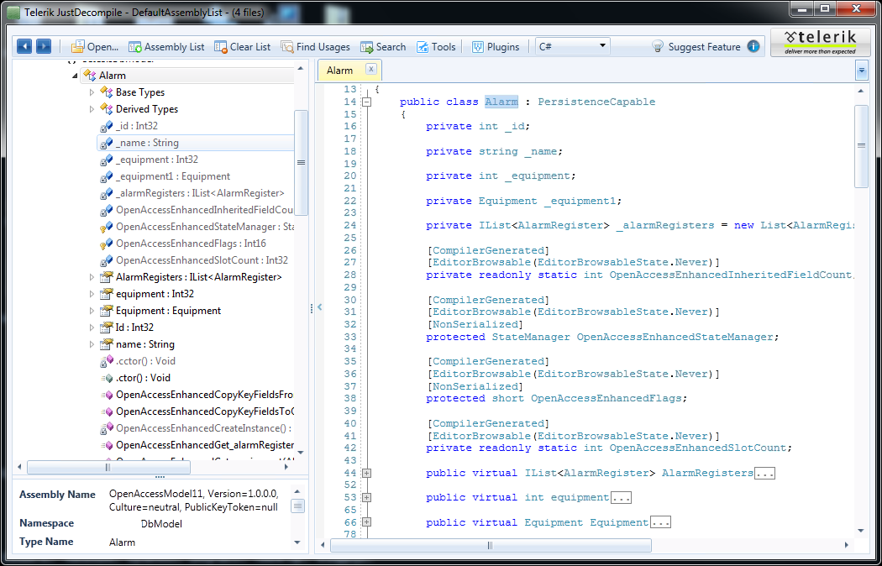
Enhancer – reflection time
Demo – see the original code and the enhanced one side by side
DEMO

Slide 19
CRUD Operations
Create
1: new Entity();
2: context.Add();
3: context.SaveChanges();
Read – context.Entities.First(o => o.Id == id);
Update
1: entity.Name = entity.Name + “1”;
2: context.SaveChanges();
Delete
1: context.Remove(entity);
2: context.SaveChanges();
DEMO
Notes:
Demo!

Slide 20
Entity States
NotManaged
Add()
New
Hollow
SaveChanges()
SaveChanges()
Dirty
Remove()
Load data
Remove()
change
Attach()
Clean
Deleted
Detached
Remove()
Detach()
Notes:
Important points – most of the objects are in hollow state – only ID and type are known
SaveChanges() wipes all present data and makes object Hollow
Detach makes objects detached
Attach makes objects either New, Dirty or Clean

Slide 21
Lazy Loading
Entity properties are loaded lazily by default!
Simple properties will have their data in-memory
Navigation properties will have the target entity in Hollow state
DEMO

Slide 22
Fetch API
Load related objects eagerly
Different approaches
Fetch Strategy – applied to the OpenAccessContext and used for every delete that is included in the strategy
Include<T>() – applied to a LINQ query
Optimizes the way data is loaded – can solve N+1 loading problems
DEMO

Slide 23
Caching
Two levels of object caching:
Per context (Level 1 Cache) – in memory set of all loaded entities.
Per database (Level 2 Cache) – in memory set of all loaded entities across all context instances in the Application Domain
Also works in web farm scenarios using MSMQ synchronization
Prepared statement cache for SQL statements
Query cache for LINQ queries
Notes:
L1 Cache is always enabled
L2 Cache can be switched On and Off using Model Settings or BackendConfiguration
More about L2 Cache at http://documentation.telerik.com/openaccess-orm/documentation/feature-reference/api/context-api/feature-ref-api-context-api-cache

Slide 24
Attach/Detach
API for linking an entity to context or breaking the same link
One entity can be managed by only one context at a time
In order to persist an entity it should be detached
Attached entities are not suited to travel across application levels or service boundaries
Detached entities can track changes in their state

Slide 25
Best Practices
Use short living context instances
L1 Cache can grow indefinitely
Entities can be included in wrong transaction
Best – use “using” block
Avoid FlushChanges
Opens transaction and keeps it active until SaveChanges() or ClearChanges() are called

Slide 26
LINQ and OpenAccess
OpenAccess supports almost all of the features of LINQ to SQL and LINQ to EF
Some differences:
Queries that will be ineffective due client side execution of filters will throw exception rather than running as it does in EF
Generic property accessors using FieldValue<T>() method
Support for 3 special names to access internal OA properties
Somewhat better DateTime and bitwise operations support
DEMO

Slide 27
Dynamic LINQ
String-based LINQ API that mirrors parts of the original LINQ API
Useful with UI components that allow user-defined filtering, sorting and grouping
Used in OpenAccess to query artificial types
More on ScottGu’s blog
DEMO
Notes:
Dynamic LINQ articles: http://weblogs.asp.net/scottgu/archive/2008/01/07/dynamic-linq-part-1-using-the-linq-dynamic-query-library.aspx
Samples: http://msdn.microsoft.com/en-US/vstudio/bb894665.aspx

Slide 28
Common LINQ Mistakes
Calling .ToList() too early or to hammer out errors
Using .Net specific or user-defined methods, types and properties
Missing FetchStrategy or Include()
Too broad FetchStrategy
Dispose the context before data is materialized
DEMO

Slide 29
Important Considerations
Use variables for filter criteria rather than in-place calculated values or literals and constants
Variables enable OpenAccess to cache
the compiled query and reuse it with different value
the query result
Avoid non-trivial projections. Any return type outside of the known entity types will cause the result not to be cached. When tempted to reduce the network traffic by reducing the number of returned columns consider how this can affect L1 and L2 caches and ideally test the performance with and without the projection for your whole scenario

Slide 30
How to check your queries
Use OpenAccessProfiler
Use openAccessContext.Log
Use IQueryable<T>.ToString()
Use your favorite profiler provided by the database server vendor

Slide 31
Bulk Operations
Update and Delete operations that operate on matching rows on the server side without loading data in the application’s memory
Matching rows are defined as the result of a LINQ query
Delete or update operations are performed efficiently on the database server
Normally a temporary table is used to how some intermediate data that is required for the operation. The tables is deleted when the transaction is complete
Behavior is similar to the normal delete and update of entities using OpenAccess context API
Notes:
More information can be found at http://documentation.telerik.com/openaccess-orm/Feature%20Reference/API/Context%20API/Bulk%20Operations/featureref-contextapi-bulk-ud-operations-overview

Slide 32
Bulk Update
Discount rental cars that are manufactured before 1990 by 20%:
Context.Cars.Where(c => c.Year < 1990)
.UpdateAll(u => u.Set(c => c.Prize, c => c.Prize * 0,8));
Roughly equivalent in SQL to:
update Cars c set(c.Prize = c.Prize * 0,8) where c.Year < 1990
DEMO

Slide 33
Bulk Delete
Remove discontinued products from the database:
Context.Products.Where(p => p.Discontinued)
.DeleteAll();
Roughly equivalent in SQL to:
delete from Products p where p.Discontinued = 1
DEMO

Slide 34
Bulk Operations details
Each operation has its own transaction separate from the one in the OpenAccessContext
Bulk operations will invalidate any cached instances in the Level 2 Cache. Eviction is done by type and will affect usually a lot of objects.
A temporary table will be used. Appropriate permissions are required. If creation of temp table fails the required temporary data will be put in memory.

Slide 35
Bulk Operation details (2)
Source queries and update descriptors should be 100% pushable to the database server
Setting reference navigation properties is possible but dangerous
Setting collection navigation properties is forbidden
Using symbolic names is allowed

Slide 36
Add OpenAccess Service wizard
Can generated for you an entire service layer that exposes your data model in a few clicks
Supports generation of:
Plain WCF services with DTOs
Data Services
Web API
RESTful Collection Services
AtomPub
DEMO

Slide 37
Dynamic Data wizard
Can generate for you a Dynamic Data Web Application that gives you generic interface for CRUD operations over your data model
DEMO

Slide 38
Resources
OpenAccess product
http://www.telerik.com/products/orm.aspx
OpenAccess online documentation
http://www.telerik.com/products/orm/getting-started.aspx
OpenAccess Samples Kit
http://www.telerik.com/products/orm/features/samples-kit.aspx
OpenAccess Forum
http://www.telerik.com/community/forums/orm.aspx

Slide 39



OpenAccess ORM
Questions?

Slide 40
Exercises
1. Customize code generation
Customize the OpenAccess Code Generation T4 templates so that all the generated classes inherit from a single non-persistent class. Then generate a model out of a Northwind database and demonstrate that with the generated OpenAccessContext and persistent classes you are able to retrieve and update data in a small console application (under the same solution but in a separate project).

Slide 41
Exercises
2. Implement entity cloning using binary serialization
Define a function that can clone single entity loaded from the database (for more fame – a graph of entities, starting with from one of the nodes). Test that all properties of the original instance have the same values as the ones on the cloned.

Slide 42
Exercises
3. Compare Bulk Delete with normal delete operation
Insert 100 000 entities in single table. Delete each row that has ID where ID mod 7 == 1
Once delete the entities using OpenAccessContext.Remove() method.
Then delete the entities using DeleteAll() bulk operation.
Both times track the SQL statements that are sent to the server. Both times measure the time required to complete the operation(s). For bonus points measure the memory consumption in addition to the time. Output the measurements in text file including timestamp and machine name

Slide 43
Exercises
4. Do code review of the code generated by Add OpenAccess Service wizard for Web API services
Make critical code review (peer review) of the code generated by Add OpenAccess Service wizard for Web API services: Base controller, Concrete controllers, Base repository, Concrete repositories, Global asax routes definition
Watch for bad practices in handling data-related task, bad design decisions, incorrect implementation of design patterns, code smells, bad code formatting, inefficient code and etc. List at least 3 issues with the generated code.

Slide 44
Exercises
5. List 5 suggestions for improvements all over OpenAccess (issues described in Exercise 4 do not count!).
Issues can be anything that made working with OpenAccess unpleasant – bugs, missing documentation, missing features, bad menu positioning, unexpected outcome, visual glitches…
As with any bug/issue can you define the steps to reproduce it?

Slide 45



Free Trainings @ Telerik Academy
"Web Design with HTML 5, CSS 3 and JavaScript" course @ Telerik Academy
html5course.telerik.com
Telerik Software Academy
academy.telerik.com
Telerik Academy @ Facebook
facebook.com/TelerikAcademy
Telerik Software Academy Forums
forums.academy.telerik.com

