Slide 1

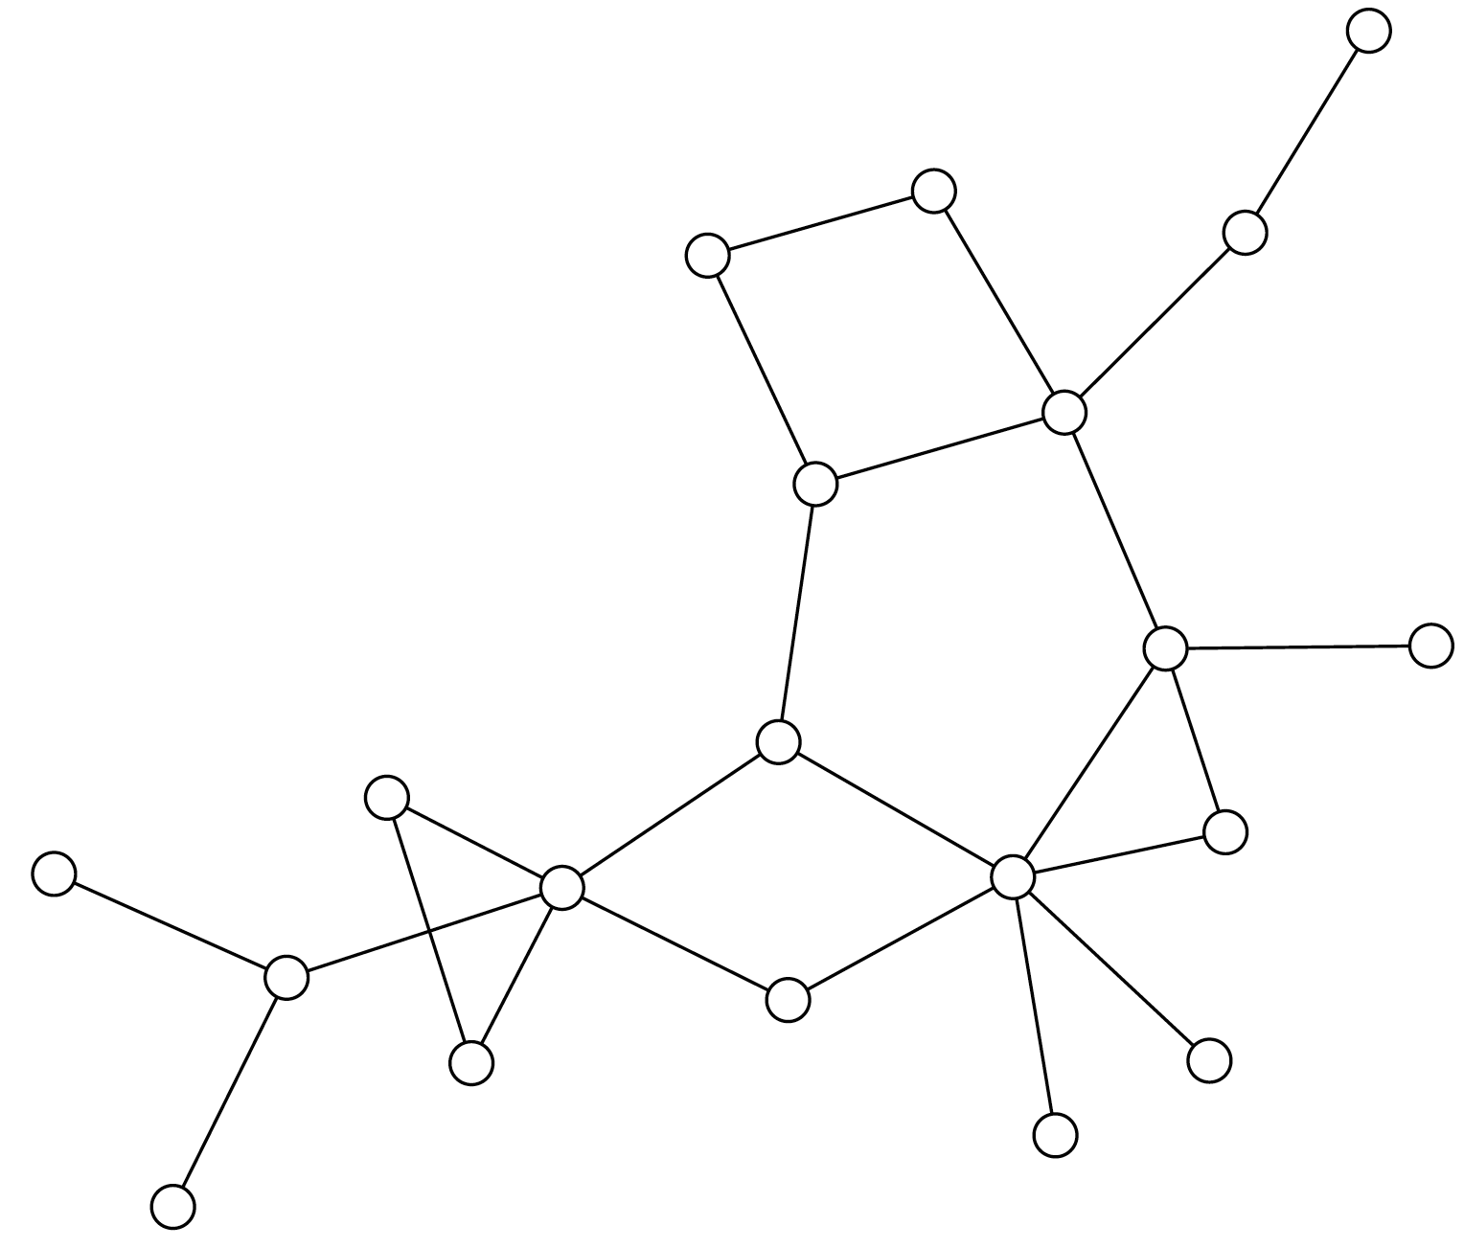

Distribution System Operator (DSO)
Transaction
Permission
Signal
Transaction
Permission
Signal
Power

