Slide 1
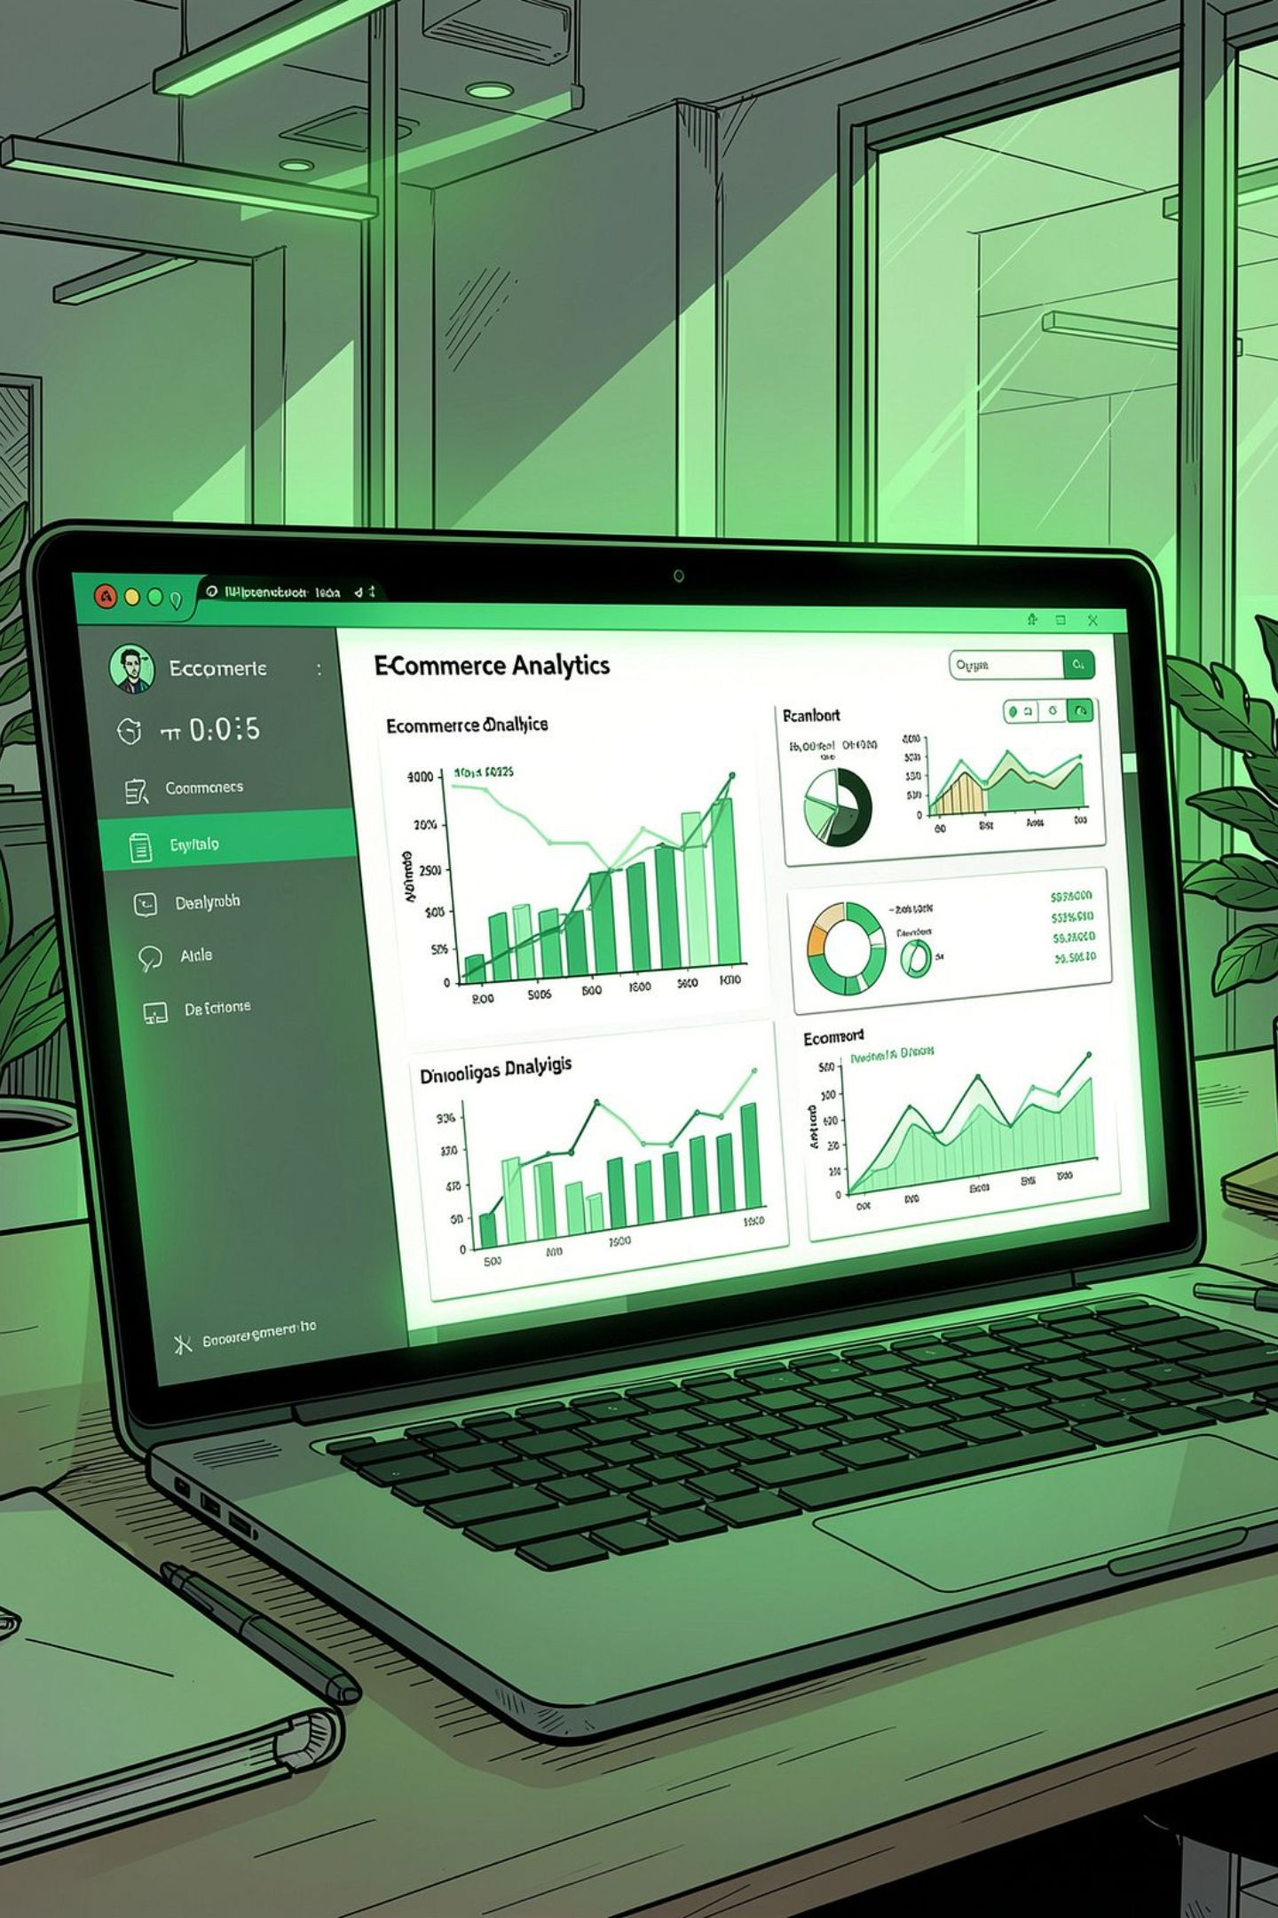
Sales & E-Commerce Analytics
Business Analytics Project Report — analyzing sales performance, profitability, product categories, regional distribution, and customer payment preferences across 12K orders.
MICROSOFT EXCEL
SQL
POWER BI
DAX

Slide 2
Executive Summary
355.65M
66.54M
48K
Total Sales
Total Profit
Units Sold
12K
23%
Total Orders
Profit Margin
The dashboard reveals strong business health — 355.65M in sales and 66.54M in profit across 12K orders. Cash on Delivery dominates at 43.74% of payment share, with UPI (20.61%), Debit Card (13.10%), Credit Card (12.04%), and EMI (10.51%) completing the mix. Consistent monthly sales, diversified category contributions, and visible regional distribution support data-driven decisions in inventory, marketing, and operations.

Slide 3

Project Overview
Analytics Workflow
A structured pipeline converts raw e-commerce transaction data into meaningful insights across five stages: data preparation, modeling, metric calculation, visualization, and interpretation.
01
02
03
Excel
SQL
Power BI + DAX
Data cleaning & preparation
Extraction & aggregation
Dashboard & BI reporting

Slide 4
Business Challenges Addressed
Without centralized analytics, e-commerce businesses struggle to track performance and identify where improvements are needed.
Sales Visibility
Profitability Control
Track monthly trends to identify stable, growing, or declining revenue.
Measure profit and margin — 66.54M profit at 23% margin confirms business success.
Category Evaluation
Payment Behavior
Identify high-performing categories to improve assortment and procurement.
COD at 43.74% creates operational needs around cash collection and delivery reconciliation.

Slide 5
Project Objectives
Primary & Analytical Goals
Business Value
Analyze overall sales performance and business scale
Evaluate profitability through total profit and margin
Identify high-performing product categories
Rank top 10 products by sales value
Track monthly sales trends for performance monitoring
Measure payment mode share across COD, UPI, cards, and EMI
Improve revenue visibility through centralized KPI monitoring
Optimize inventory planning using category-level insights
Improve payment strategy by analyzing customer preferences
Support regional growth planning through geographic analysis
Increase profitability by focusing on high-margin products
Enhance management reporting through interactive visuals

Slide 6
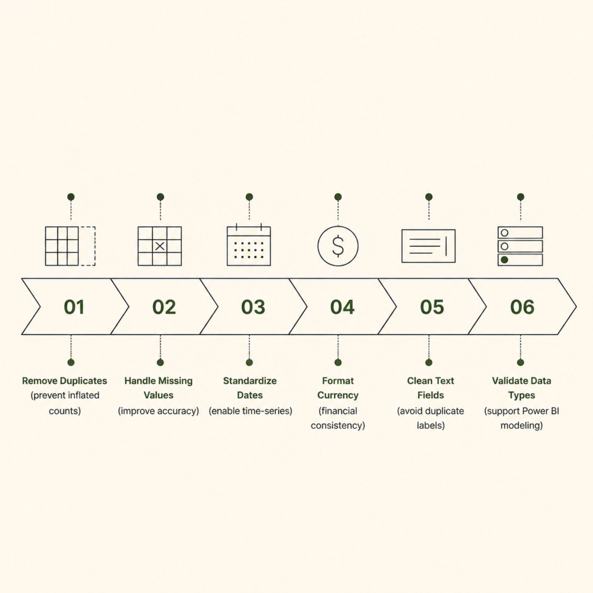

Data Cleaning & Preparation
Why It Matters
Data cleaning in Excel ensured accurate KPIs, reliable visuals, and meaningful insights. Without proper preparation, dashboards can display misleading values, duplicated metrics, or fragmented categories.
Clean data is the foundation — every dashboard metric depends on it.

Slide 7



Excel & SQL Analysis
Excel Pivot Analysis
Pivot tables validated sales by category, region, and payment mode. Pivot charts confirmed monthly trends. Key metrics — 355.65M sales, 66.54M profit, 23% margin, 29,637.50 avg order value — were verified before Power BI.
SQL Aggregation
Queries used SUM, COUNT DISTINCT, and GROUP BY to calculate KPIs, category sales, regional performance, payment share, and top 10 products. SQL outputs validated all Power BI dashboard figures.

Slide 8
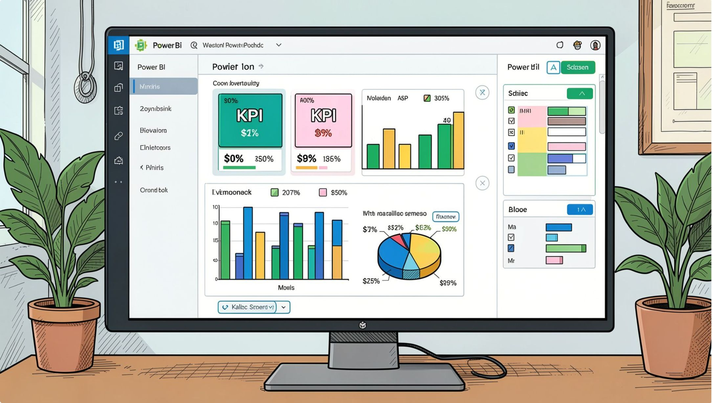

Power BI Dashboard
Dashboard Components
KPI Cards
Sales, Profit, Quantity, Orders, Margin, Avg Order Value
Monthly Trend Chart
Tracks revenue consistency and seasonality
Category & Regional Charts
Compare sales and profit by dimension
Payment Mode Pie
COD 43.74%, UPI 20.61%, Cards, EMI
Top 10 Products
Horizontal bar chart ranking bestsellers

Slide 9




Key Business Insights
Stable Monthly Sales
Diversified Categories
Regional Distribution
COD Dominance
Consistent performance supports reliable forecasting and inventory planning.
Multiple categories contribute to revenue, reducing single-category dependency.
Geographic analysis identifies strong markets and expansion opportunities.
COD at 43.74% requires strong delivery and cash handling. UPI at 20.61% shows growing digital adoption.

Slide 10

Recommendations & Conclusion
Payment Strategy
Strengthen COD infrastructure; incentivize UPI and EMI to reduce cash dependency.
Regional Growth
Invest in high-performing regions; develop targeted campaigns for underperforming areas.
Product Prioritization
Maintain optimal inventory for top 10 products; review low-performers for repositioning.
Margin Protection
Focus on high-margin categories; monitor category-level profit to guide pricing and promotions.
The project demonstrates how raw e-commerce data transforms into actionable intelligence — supporting strategic decisions in sales, operations, finance, and marketing across a competitive landscape.

