Slide 1
Project 3: Air Pollution
Christina Chau
Nitin Dhiman
Rasika Patil
Sam Mohan
Notes:
Sam

Slide 2
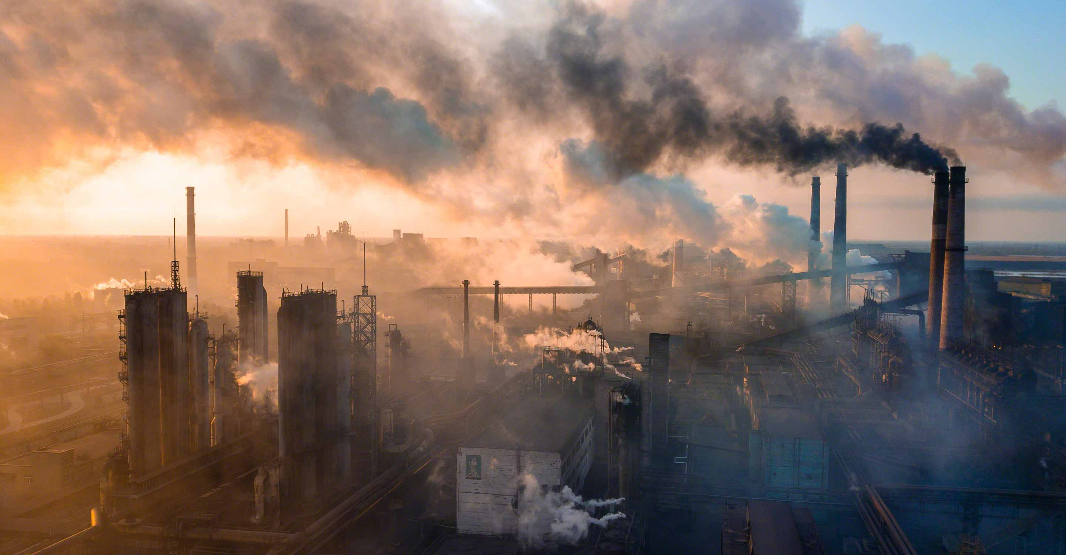
Air pollution Levels in Los Angeles and Manhattan
Nitrogen Dioxide (NO₂)
Ozone (O)
Carbon Monoxide (CO)
Notes:
Sam

Slide 3

Air pollution Levels in Los Angeles and Manhattan
Python API
Postgres
Python Flask
HTML
Java Script
CSS- Cascading Style Sheet
Notes:
Sam

Slide 4
Air pollution Levels in Los Angeles and Manhattan
Using Python, pull API data from:
http://api.openweathermap.org/data/2.5/air_pollution/history?lat={la}&lon={lo}&start={start}&end={end}&appid={app_key}
Input to API:
Longitude, Latitude, Date Range
Receive Data from API
Carbon Monoxide, Nitrogen, and Ozone levels (Daily)
Data Modification: Add “city” names based on Longitude/Latitude (LA-Manhattan) and converted Unix Date → Datetime
STEP 1
Use Python to retrieve data from API
Notes:
Christina

Slide 5
Air pollution Levels in Los Angeles and Manhattan
STEP 2
Store API data in Postgres
Using SQL, create a table, and store API data into Postgres
Server: air_pollution
Table: air_pollution_forecast
Notes:
Christina

Slide 6
Air pollution Levels in Los Angeles and Manhattan
Use Python Flask to publish API
Created 2 APIs
get_air_pollution: call to this API to send CO, NO₂, Ozone, City, and Date to the caller application
get_max_by_city
Calling this API sends maximum CO levels for Los Angeles & Manhattan
STEP 3
Python Flask
Notes:
Christina

Slide 7
Air pollution Levels in Los Angeles and Manhattan
Used Html to render the data
Used CSS to style and layout the data
Used Java Script to read the data from Flask API
JavaScript libraries used are
Plotly
Fusion Chart
Added a dropdown for user to select various types of air pollutant
STEP 4
HTML,CSS and JavaScript
Notes:
Christina

Slide 8
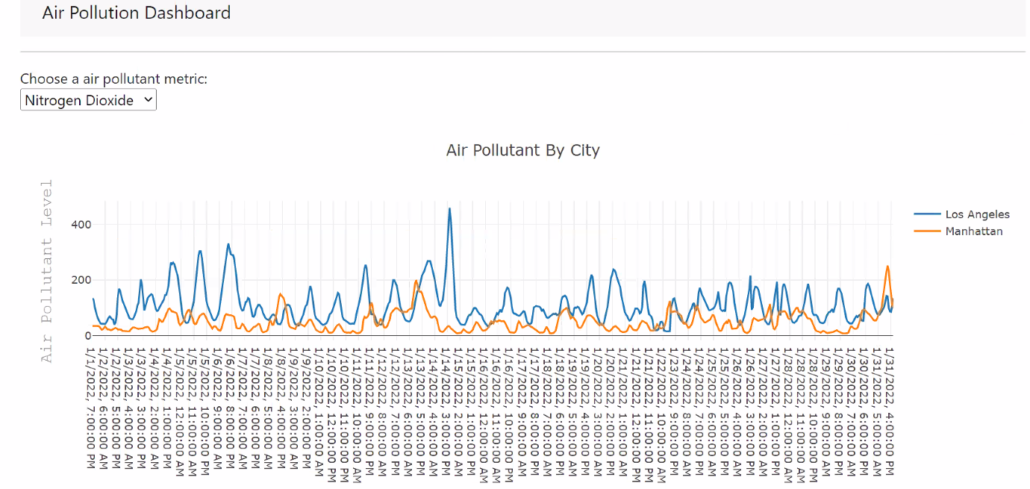
View 1 : Nitrogen DIOXIDE bY CITY
The graph below indicates that Los Angeles has a higher average Nitrogen dioxide level than Manhattan
Notes:
Rasika

Slide 9
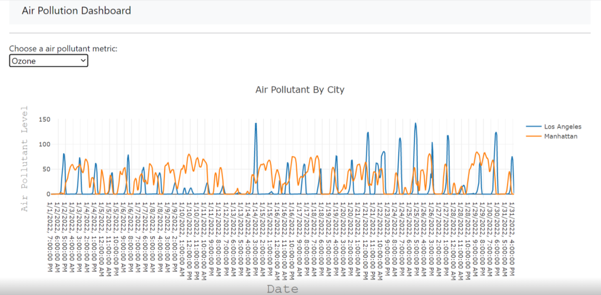
View 2 : Ozone LEVEL bY CITY
The graph below indicates that Los Angeles has a higher peaks of Ozone, but also lower valleys than Manhattan
Notes:
Rasika

Slide 10
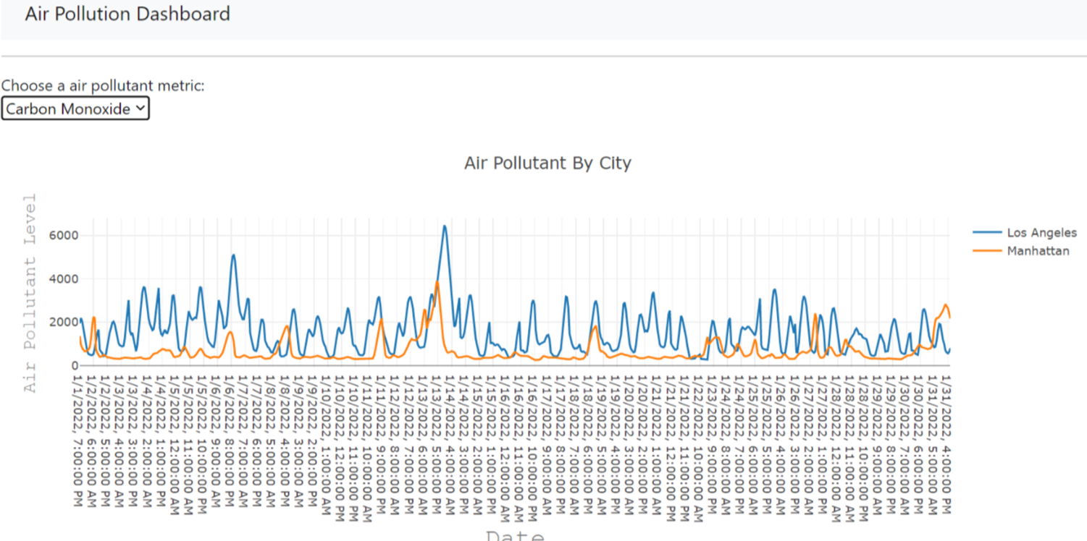
View 3 : Carbon Monoxide bY CITY
The graph below indicates that Los Angeles has higher Carbon Monoxide levels than Manhattan
Notes:
Rasika

Slide 11
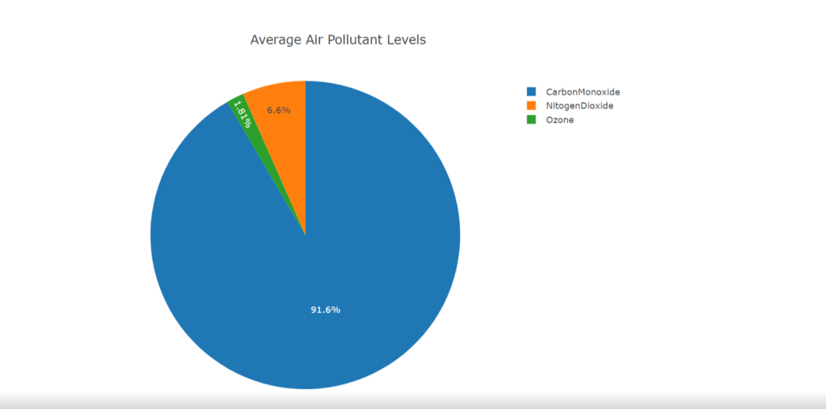
View 4 : Air Pollutants
The chart below indicates that Carbon Monoxide levels account for the majority of air pollutants
Notes:
Sam

Slide 12
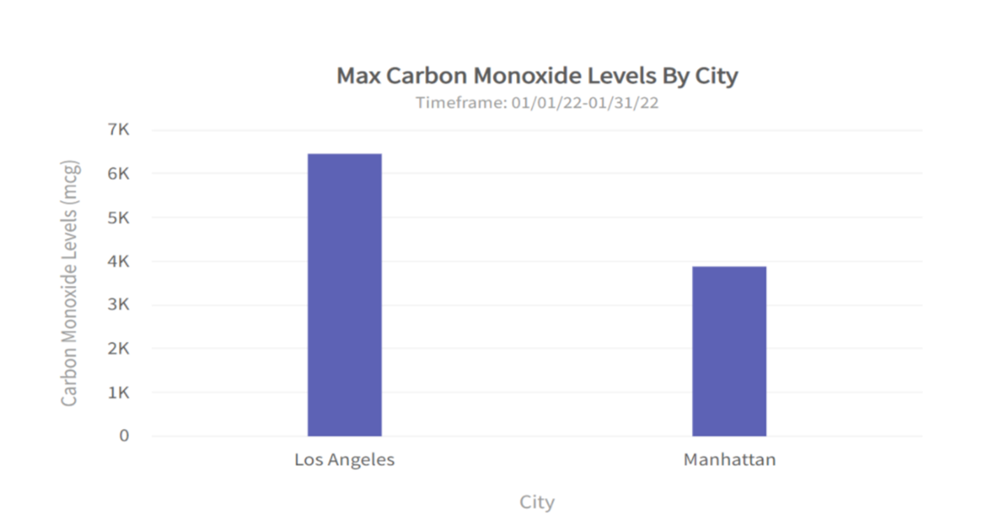
View 5 : Levels of Carbon Monoxide bY CITY
The chart below indicates that Los Angeles has more Carbon Monoxide (01-2022) in the air than Manhattan
Notes:
Sam

Slide 13

Data Insights
Carbon Monoxide & Nitrogen Dioxide levels
Los Angeles > Manhattan
Ozone levels peak in Los Angeles, but have higher averages in Manhattan
Carbon Monoxide is more common than Ozone/Nitrogen Dioxide
Air pollutant measurements differ (1PPM → 1,000 Mcg)
Parts Per Million (PPM)
Carbon Monoxide
Micrograms (Mcg)
Ozone / Nitrogen Dioxide
All Air Pollutants peak in Los Angeles around 01/14/22
Possibly due to people returning from Winter Vacation
Notes:
Nitin

Slide 14

Project Limitations
Visualization Aesthetics
Pie chart shading / Line graph x-axes (timestamp removal)
Only displayed a single month (01-2022)
Only investigated 2 major cities (Los Angeles & Manhattan)
Notes:
Nitin

Slide 15

Thank you for letting us clear the air
Notes:
Nitin

