Slide 1

Apache Flex ...
… and the imperfect Web
Presented by
Sebastian Mohr
July 5th 2012, Berlin

Slide 2
About me
HTML / Javascript Developer (2000 - 2006)
Flex Developer since Summer 2006
Mate, Robotlegs, Parsley, Spring AS, Swiz
Study of Cognitive Science, Osnabrueck
W3C Fan, Semantic Web, Open Web Technologies
Apache Flex PPMC since November 2011
Homepage: http://www.masuland.com/
Twitter: http://twitter.com/masuland
LinkedIn: http://www.linkedin.com/in/masuland

Slide 3



The imperfect Web
Gary Oldman explains why “Graffiti“ - or the “imperfect Web“ respectively - is great for the world ...
Watch video: http://www.youtube.com/watch?v=Tt1W0F0yObg

Slide 4
The imperfect Web is:
Webbrowsers: Firefox, Chrome, Safari, Opera
Markups: XHTML, SVG, SMIL, MXML (Flex), XAML (Silverlight), FXML (JavaFX), WebGL, X3D, XForm, XPath, XML, XSLT, XQuery, RDF, OWL, ...
Script-Engines: ECMAScript, Javascript, Actionscript, JScript
Ajax & JS-Libs: JQuery, ExtJS, Dojo, Prototype, MochiKit, PhoneGap, Rhomobile, Sencha, ...
Devices: Desktop, Mobile, TV
Mobile OS: iOS, Android, Windows Mobile

Slide 5
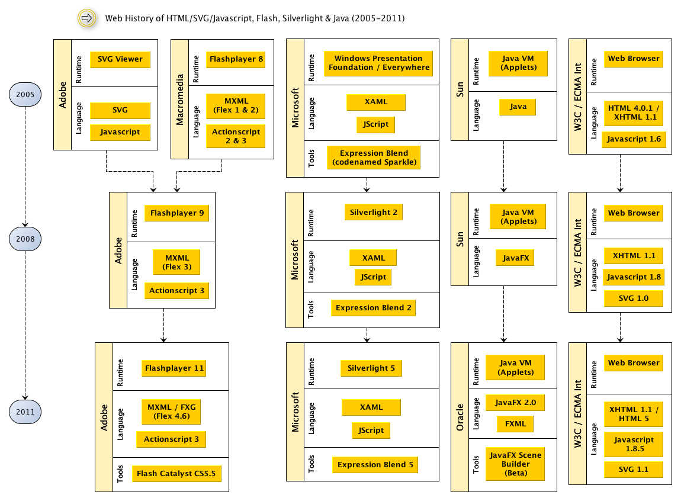
Web History (2005 - 2011)
Read article:
http://code.google.com/p/masuland/wiki/WhatsWrongWithFlex

Slide 6
The Web Today
 | HTML / Javascript | Flashplayer 11 | Silverlight 5 | Java (Applets)
Runtime Features | Dependent on Web Browser | GPU support | GPU support, Multithreading | GPU support, Multithreading
Markup Language | XHTML 1.1, HTML5, SVG | FXG 2.0, MXML | XAML | FXML
Scripting Language | Javascript | Actionscript | JScript | Java, JRuby, Groovy
Interaction Design Tools | Adobe Muse, Adobe Edge, Adobe Proto | Adobe Flash Catalyst, Adobe Flash Pro | Microsoft Expression Blend | JavaFX Scene Builder
Developer Tools | Eclipse, Adobe Dreamweaver | Adobe Flash Pro, Adobe Flash Builder | Microsoft Visual Studio | Eclipse
Read article: http://code.google.com/p/masuland/wiki/WhatsWrongWithFlex

Slide 7

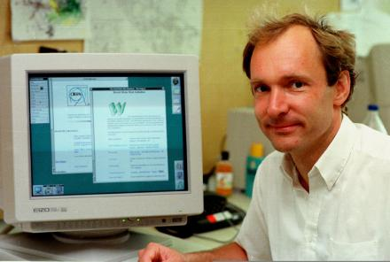

Thank you Tim for ...
+++ HTTP
+++ www.domain.com
http://www.emca-international.org
--- HTML
http://www.w3c.org
Tim Berners-Lee, http://en.wikipedia.org/wiki/Tim_Berners-Lee

Slide 8
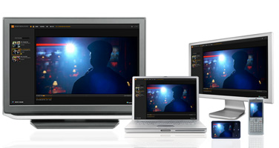
Flash Everywhere?
Adobe AIR 4+ for Mobile
Flashplayer 12+ with Multithreading and better GPU-support
Flashplayer 12+ great for Flash-Games and Apache Flex
Adobe Open Screen Project?
Faster Mobile-CPUs each year → Flashplayer 12+ for Mobile again?
Flash-2-HTML Converter?

Slide 9




What should we occupy?
Occupy Wallstreet
Occupy Flash & Occupy HTML 5
Occupy W3C & Occupy ECMA Int.
http://www.occupywallst.org
http://www.occupyflash.org
http://www.occupyhtml.org
Not occupied yet:
http://www.w3c.org
Not occupied yet:
http://www.emca-international.org
Read article:
http://masuland.wordpress.com/2011/11/28/where-could-flash-coding-be-in-the-year-2050/

Slide 10
Where is Apache Flex in 2050?
Apache Flex might not be necessary if:
  Single Webbrowser / Webengine (Webkit?)
  RIA-HTML (Audio, Video, 3D, Text) (HTML 6?)
  Binary HTML (like SWF?)
  Semantic Web interface included into HTML
  Stronger Javascript / ECMAScript - Engine
    Typed Objects
    Packages / OOP
Read article: http://masuland.wordpress.com/2011/11/28/where-could-flash-coding-be-in-the-year-2050/

Slide 11
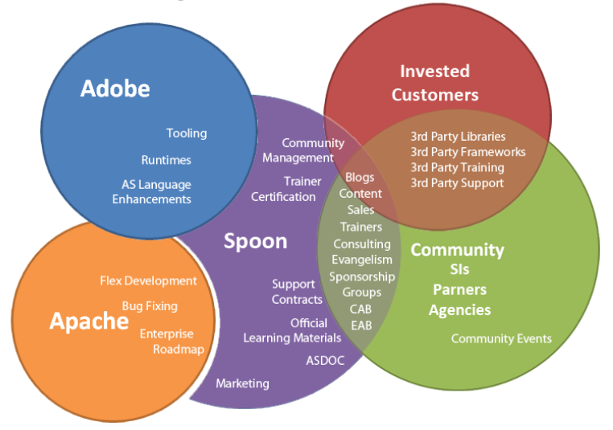
Spoon Foundation Ecosystem
See presentation by Justin Mclean: https://docs.google.com/presentation/pub?id=1SsVcr2SLkBJMXk1N6U3-HpxloSUUa4pBX-2f4GrRL5M#slide=id.p57

Slide 12
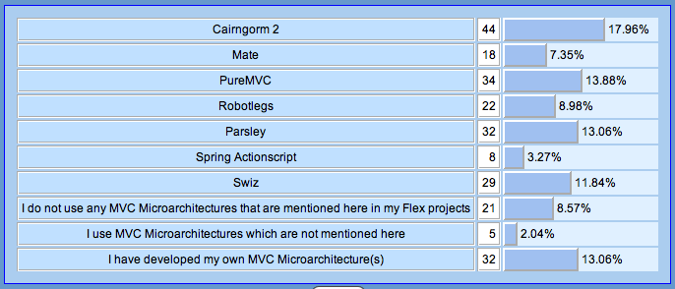
Personal Survey (1)
Which Model-View-Controller (MVC) Microarchitectures have you used in your Flex projects?
See personal survey: http://code.google.com/p/masuland/wiki/Statistics

Slide 13
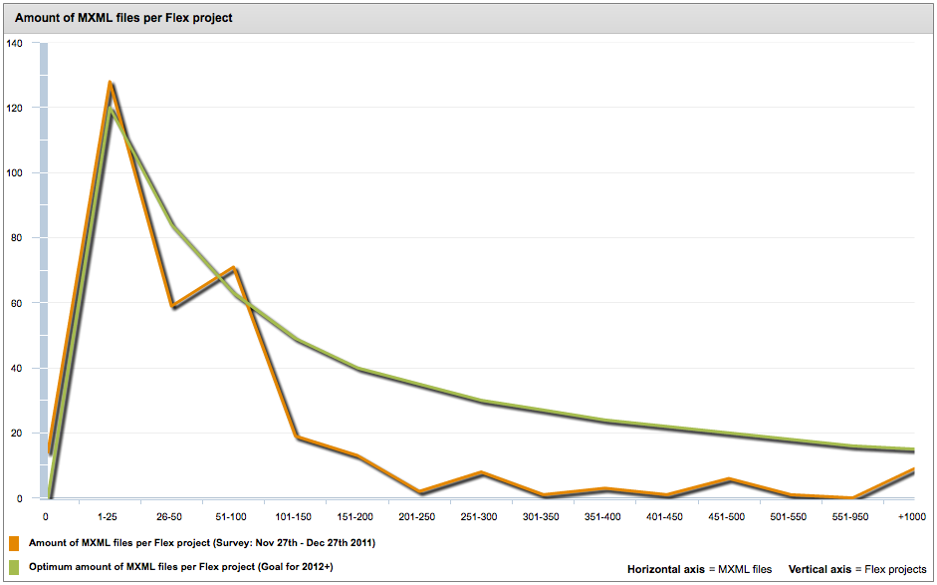
Personal Survey (2)
How many MXML files do you have in your latest Flex projects?
See personal survey: http://code.google.com/p/masuland/wiki/Statistics

Slide 14
Goals for Apache Flex
Strengthening large-scale Flex applications
Highly productive and fast development environment
Flex code should be easily mergeable across different flex projects worldwide
Flex code should be based on coding standards
Flex code should be sustainable and easily maintainable
There should be more highly skilled Flex Developers around
Developer tools should be easy to be used and should help the designer/developer to be more productive
The Flashplayer - "Actionscript Virtual Machine" (AVM) respectively - should be as powerful as the "Java Virtual Machine" (JVM)
The Adobe Flash Catalyst should be as powerful as Microsoft Expression Blend
Read article: http://code.google.com/p/masuland/wiki/WhatsWrongWithFlex

Slide 15
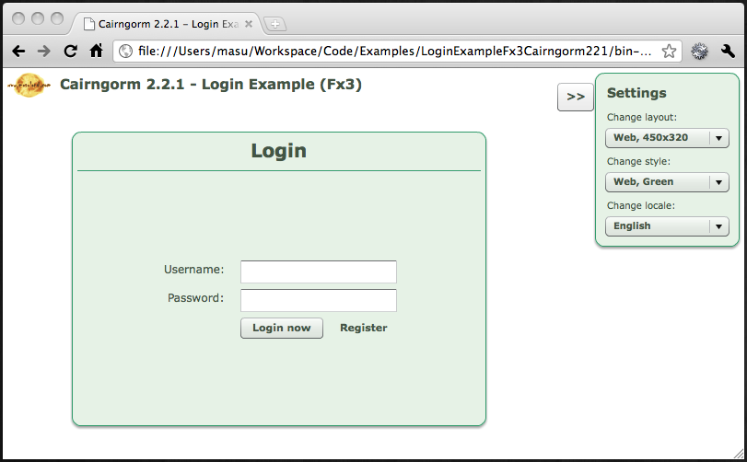
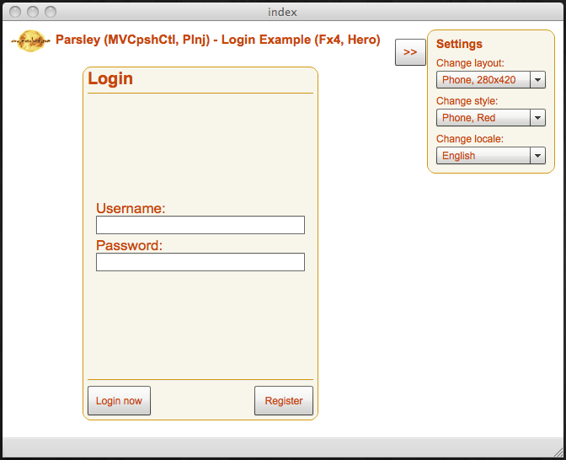
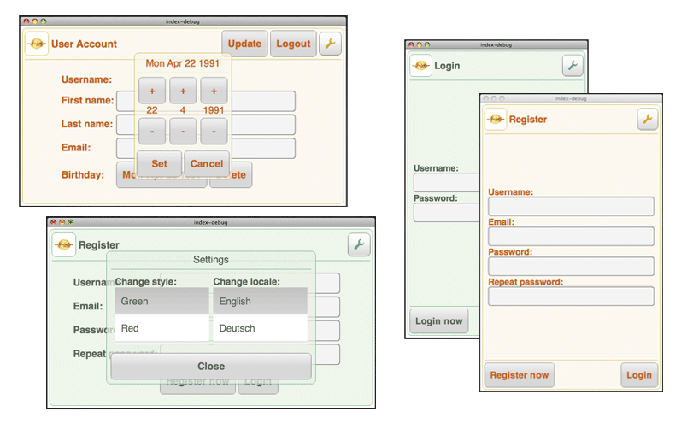
Masuland „Login Example“ for Web, Desktop and Mobile
See code examples:
http://code.google.com/p/masuland/wiki/LoginExample

Slide 16
Is coding „fun“?
At the beginning … probably true!
Coding is work
Goal-Driven Development … work, work, work, work, work, work -> HAPPY
Social-Driven Development – mental hygiene & social hygiene
An architecture often proves its quality at the end of the project
Desirable: Less frustrations and high success/motivation while working on bugs and features of your app
The more features in your app, the more dependencies you have to deal with
Testability of your code
Optimal development environment and configuration
Anarchy vs. coding conventions / design patterns
Artistic freedom of your software engineers

Slide 17
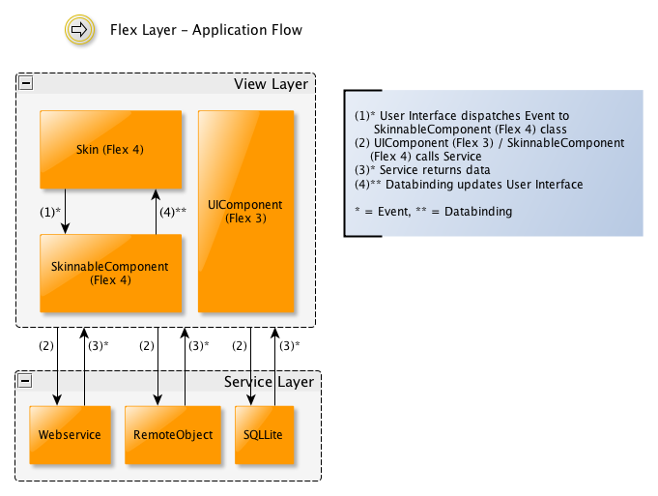
Apache Flex Layers
Read article: http://code.google.com/p/masuland/wiki/WhatsWrongWithFlex

Slide 18
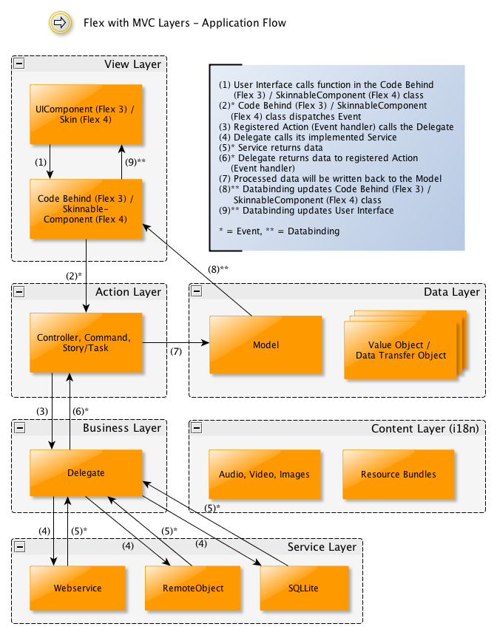
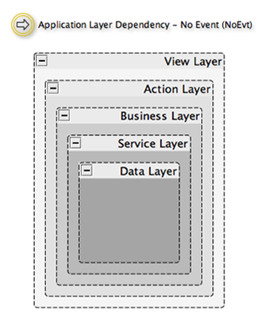
Architectural Pattern / Nanoarchitectures
See Nanoarchitectures:
http://code.google.com/p/masuland/wiki/Nanoarchitecture

Slide 19
Application Development Procedure
1. Application Code that shows the working application with source code available
2. Specification Document which explains the purpose of the application and collects all its requirements
3. Application Coding Standard which consists of a collection of Architectural Patterns and underlying Coding Conventions in the code
  3.1. Architectural Patterns just like "Model-View-Controller" (MVC), "Model-View-Presenter" (MVP), "Presentation Model" (PM) ... etc.
  3.2. Coding Conventions on the basis of Flex 3 or Flex 4
Read definition page: http://code.google.com/p/masuland/wiki/ApplicationDevelopmentProcedure

Slide 20
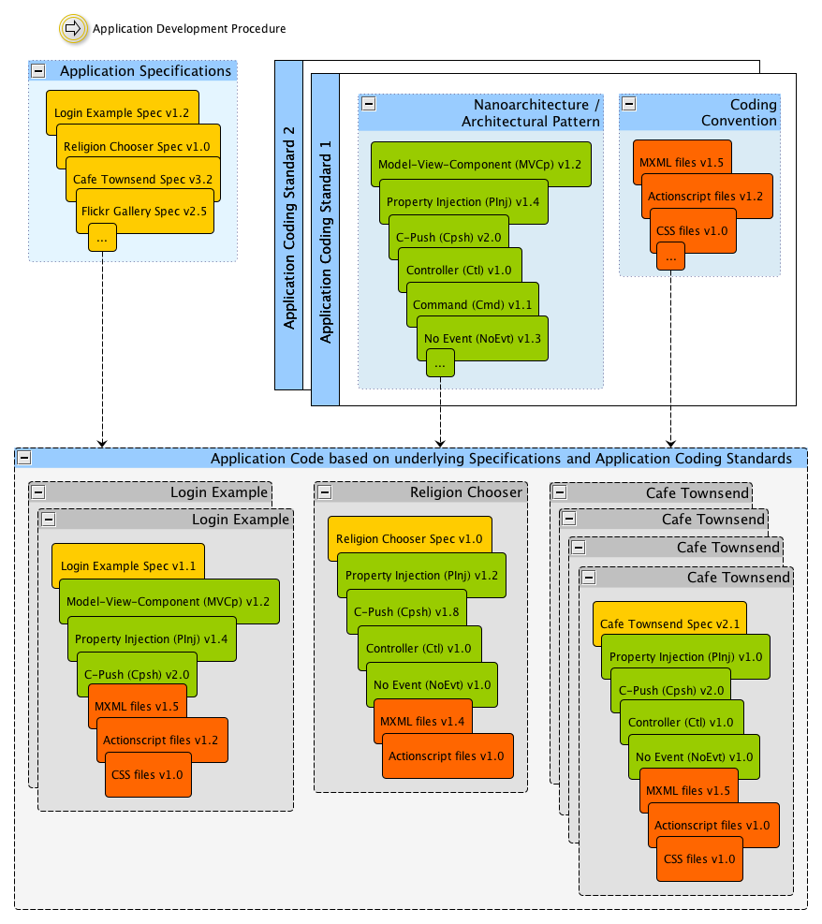
Read definition page:
http://code.google.com/p/masuland/wiki/ApplicationDevelopmentProcedure

Slide 21
Thank you!
Questions?

Slide 22
References
Apache Flex Community Revue July 2012, http://www.spoon.as/2012/apache-revue-july-2012/
Apache Flex 4.8 Release Candidate, http://people.apache.org/~cframpton/ApacheFlexRC/current/
Apache Flex News, http://incubator.apache.org/flex/news.html
Apache Flex Wiki,https://cwiki.apache.org/confluence/display/FLEX/Apache+Flex+(incubating)+Wiki
Apache Flex Mailing Lists, http://incubator.apache.org/flex/mailing-lists.html
Apache Flex JIRA, https://issues.apache.org/jira/browse/FLEX
Apache Flex Blog, http://blogs.apache.org/flex/
Adobe Flex, http://sourceforge.net/adobe/flexsdk/wiki/About/
Adobe Flex Roadmap, http://www.adobe.com/devnet/flex/whitepapers/roadmap.html
Adobe Flashplayer Roadmap, http://www.adobe.com/devnet/flashplatform/whitepapers/roadmap.html
Masuland „Login Example“, http://code.google.com/p/masuland/wiki/LoginExample

