Slide 1

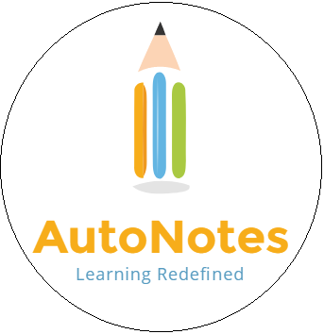

Slide 2
YouTube Lecture to PDF
Can convert any video lecture to printable content
Get visual context along with related text content
MOOCs just became simpler
Missed the lecture? Retrieve the hard copy
Next big thing in Education
Based on Watson Cognitive Recognition

Slide 3
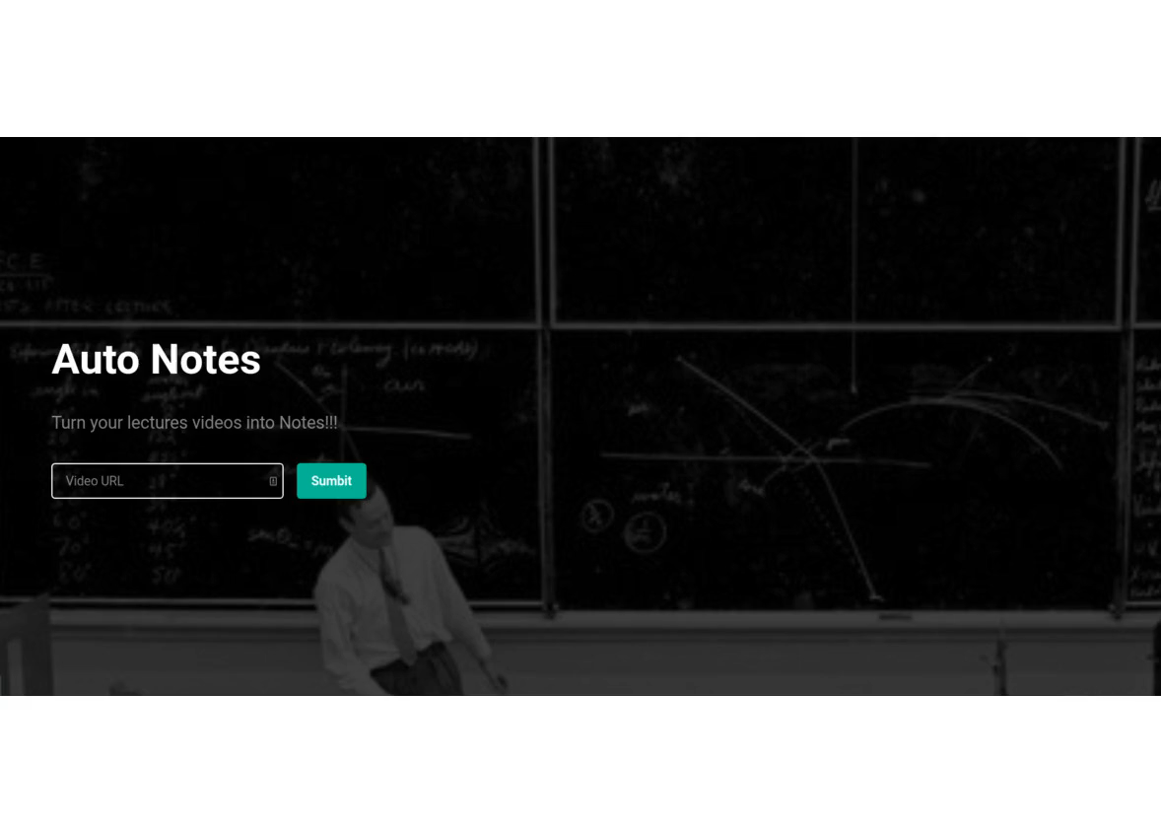
Don’t Believe Watch

Slide 4
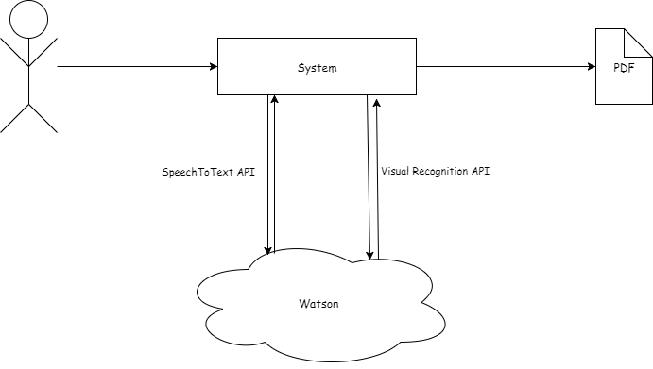
Process Flow

Slide 5
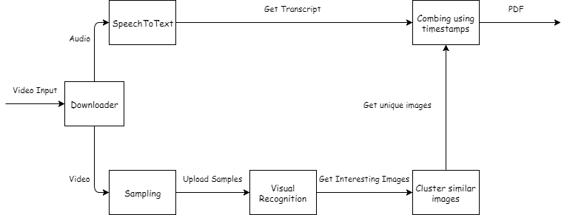
System Diagram

Slide 6
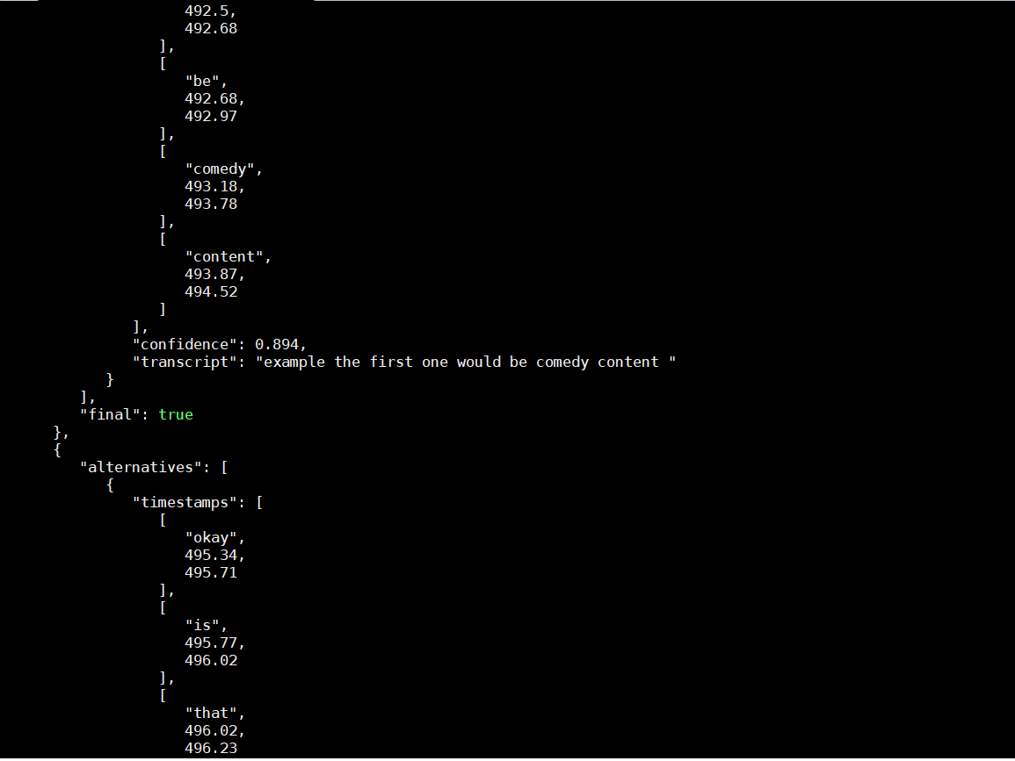
SpeechToText API
Transcript with timestamp

Slide 7
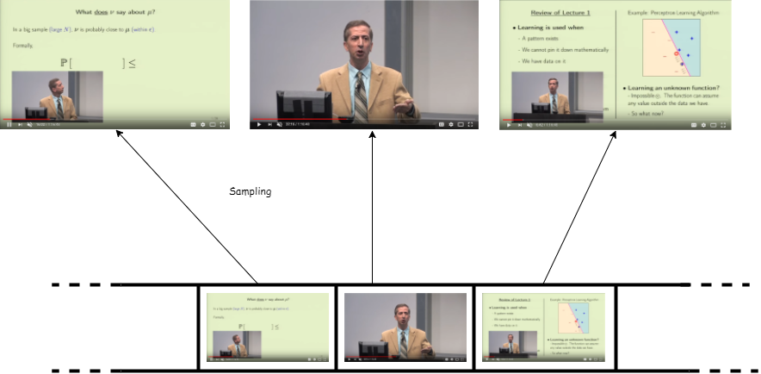
Sampling Video

Slide 8
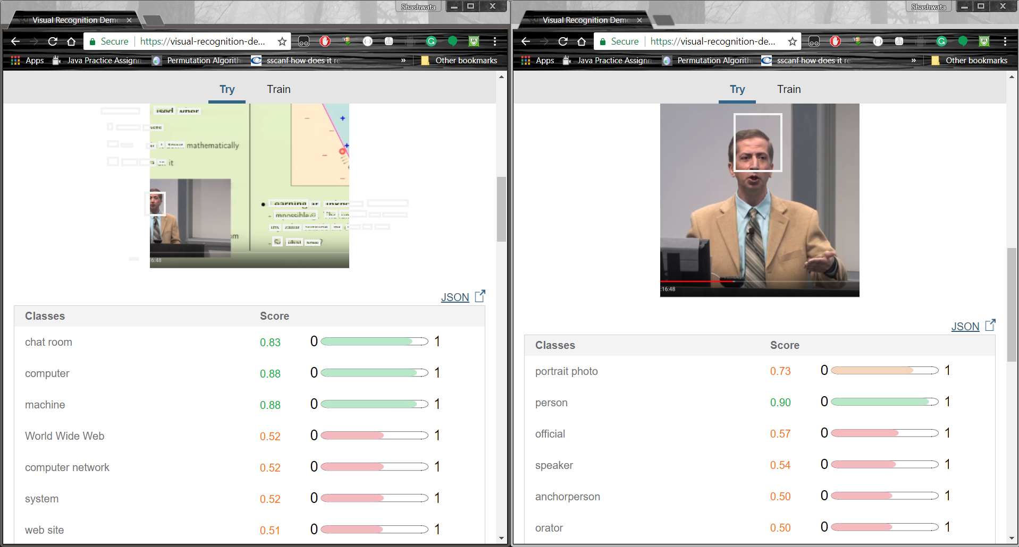
Visual Recognition API
Distinguishing between images to eliminate irrelevant data

Slide 9
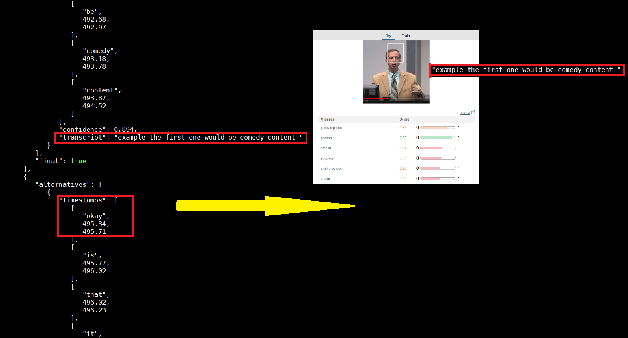
Putting them Together

Slide 10
The End
QA

