Slide 1
Making Presentations NewIbe’ System
Tuyen Pham

Slide 2

Content
Architecture of the system
Operating Principle of the Services
Restructure of the Services
Architecture of the system will be change ???
Discussion

Slide 3
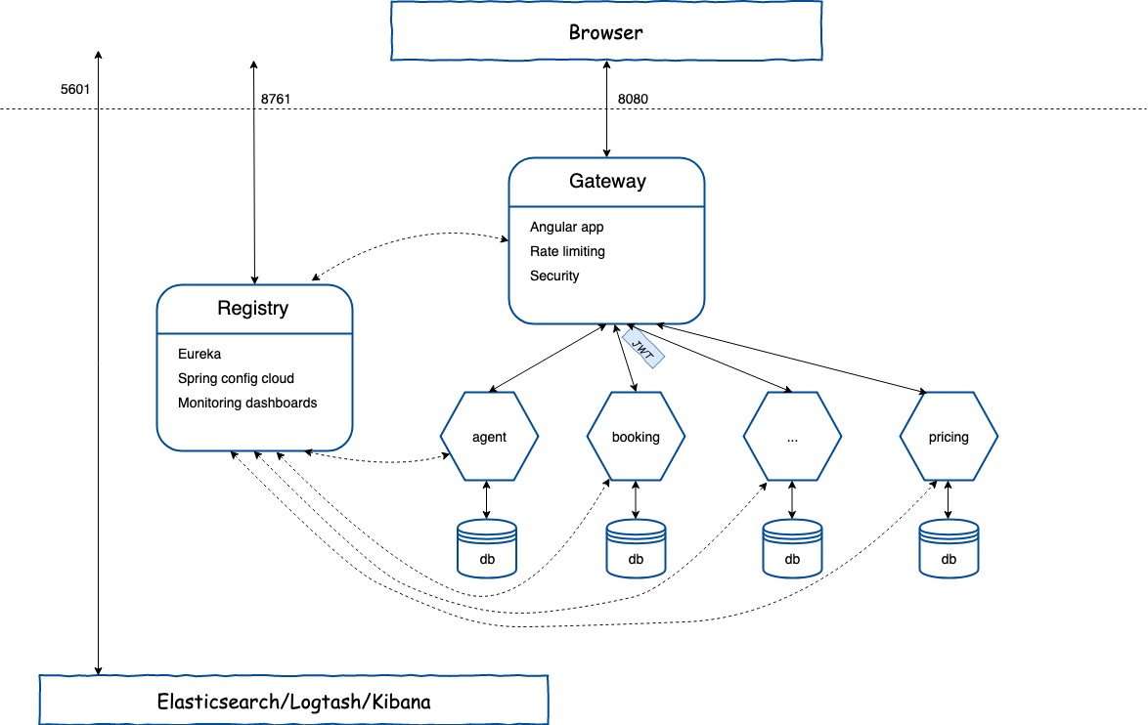
Overview
Architecture of the system

Slide 4
Architecture(Services)
B2B
B2C
Agent
Customer
Booking
Pricing
Ticket
Meta
WebUIAd
Hotel

Slide 5
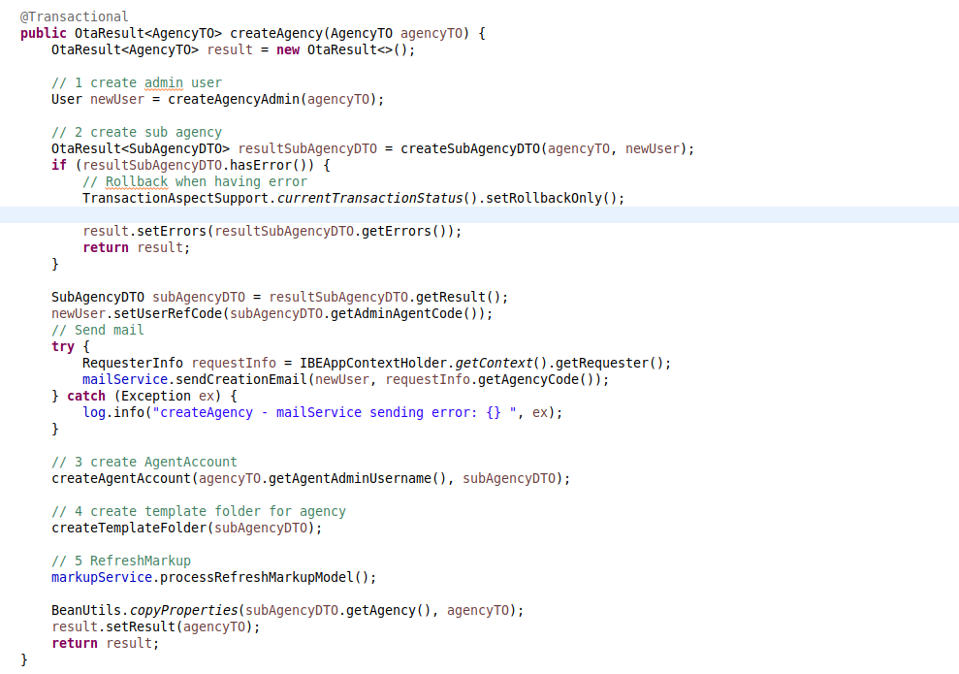
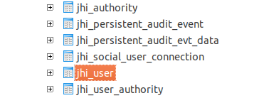
Operating Principle - gateway(b2b, b2c)
Logic handler ??? Authentication ???

Slide 6
Operating Principle - gateway(b2b, b2c)
Logic => Break
Merge Authentication(b2b, b2c) => User Account and Authentication (UAA)

Slide 7
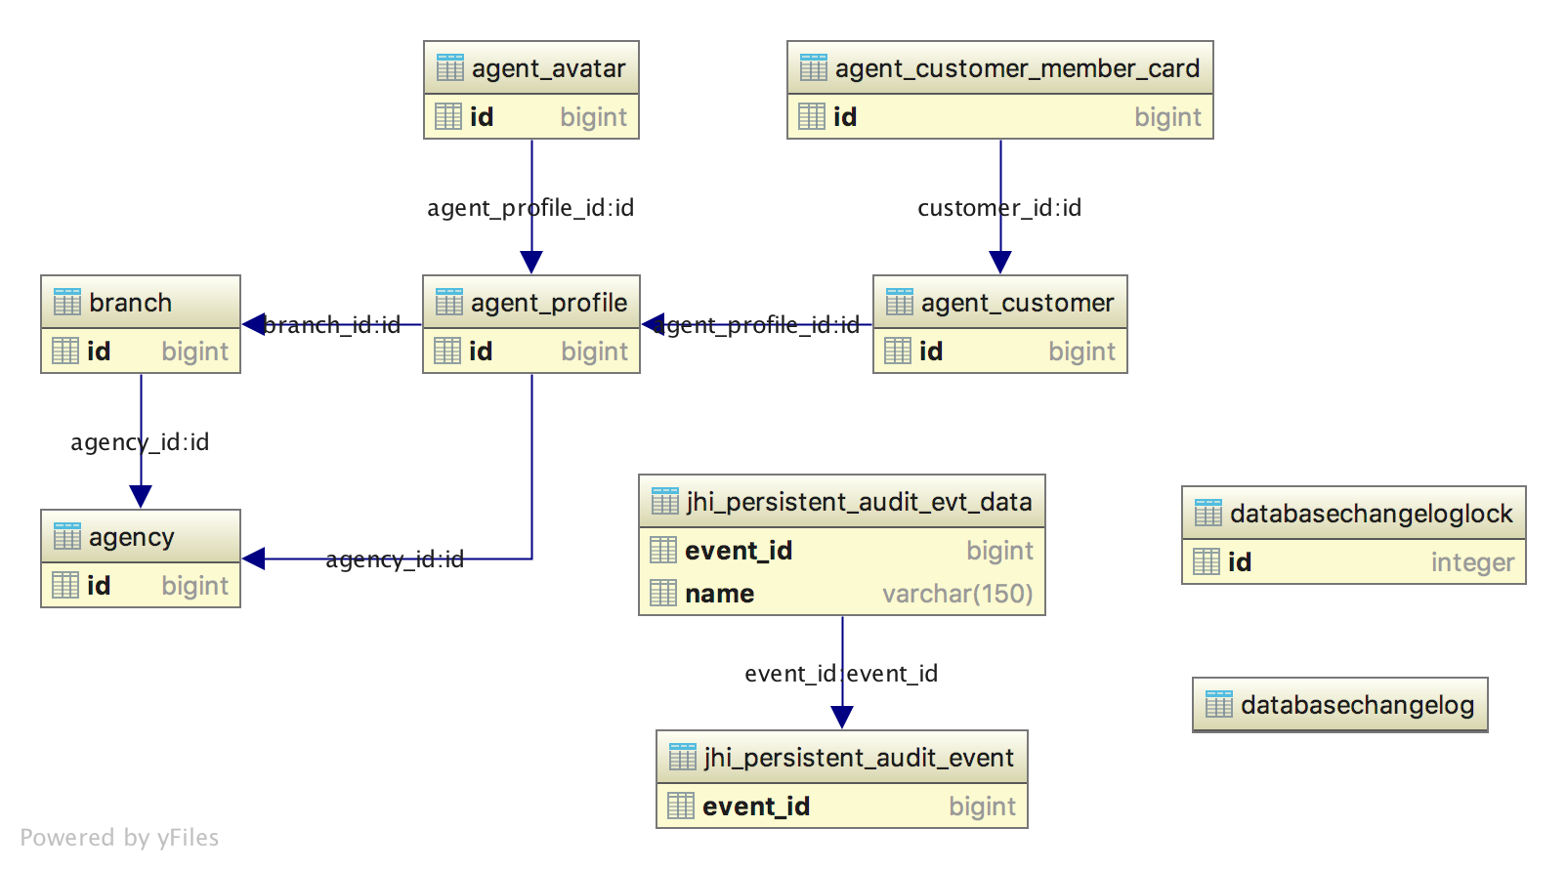
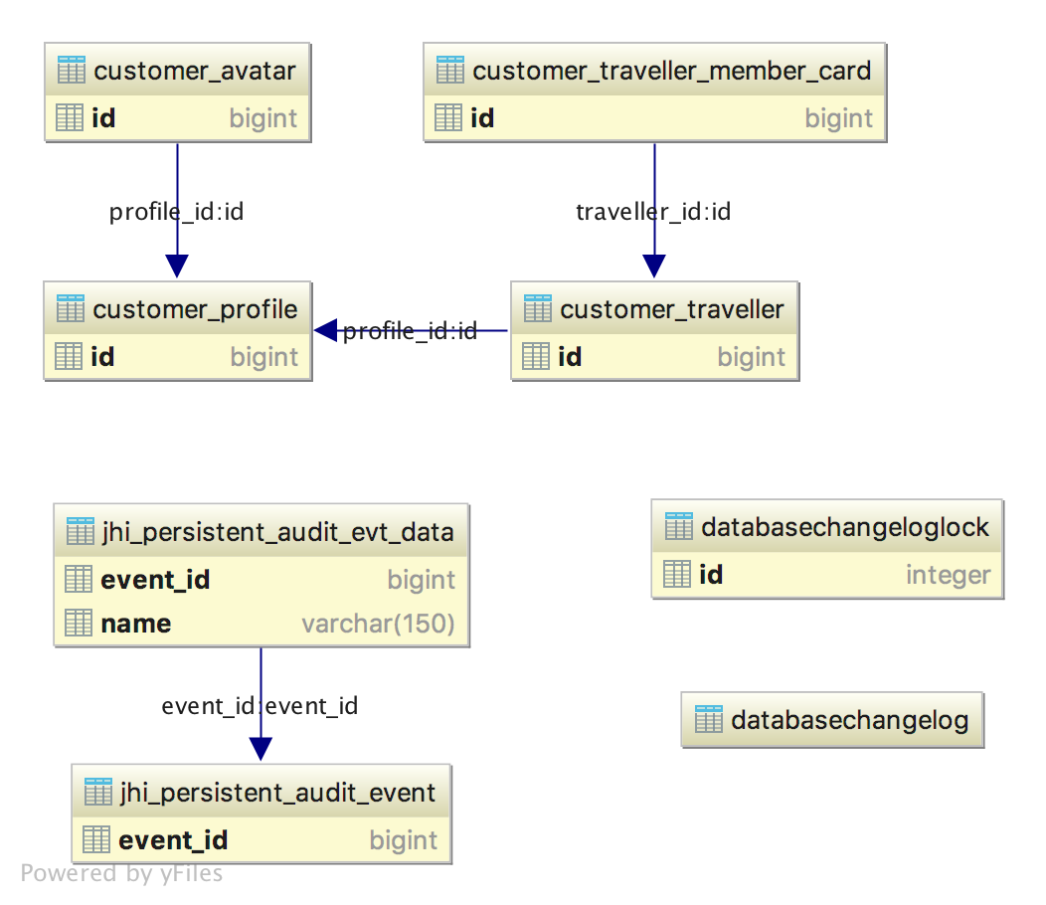
Operating Principle - Account(agent, customer)

Slide 8
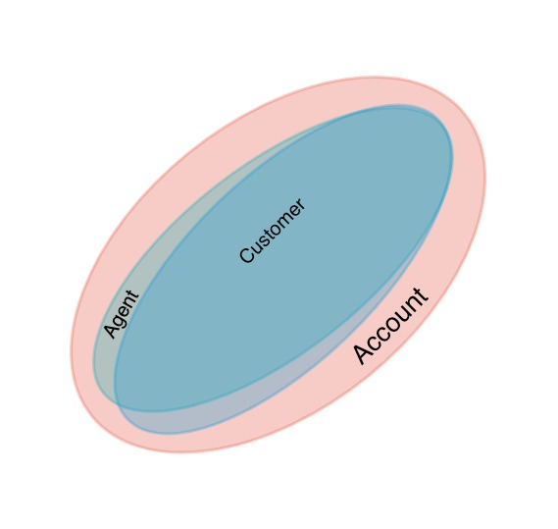

Operating Principle - Account(Agent, Customer)

Slide 9
Operating Principle - Booking
Booking(draft)
DTOs
Query(performance) b2b(booking, trans, revenue … ) b2c(BookingHistory … )
Audit(booking related to Agents, Partners …)

Slide 10
Operating Principle - Booking
Review, restructure and refactor code
Index data(Elasticsearch)

Slide 11
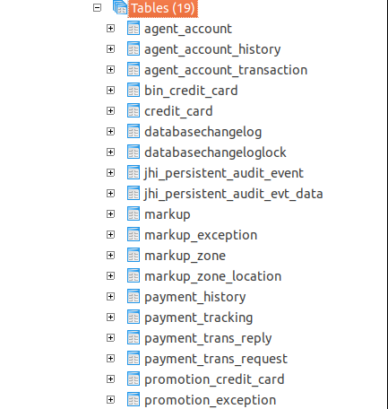
Operating Principle - Pricing
Agent(balance) Markup Voucher/Promotion
Credit_Card

Slide 12
Operating Principle - Pricing
Pricing will be divided as below
payment
payment-gateway
markup
promotion/voucher
XXX

Slide 13
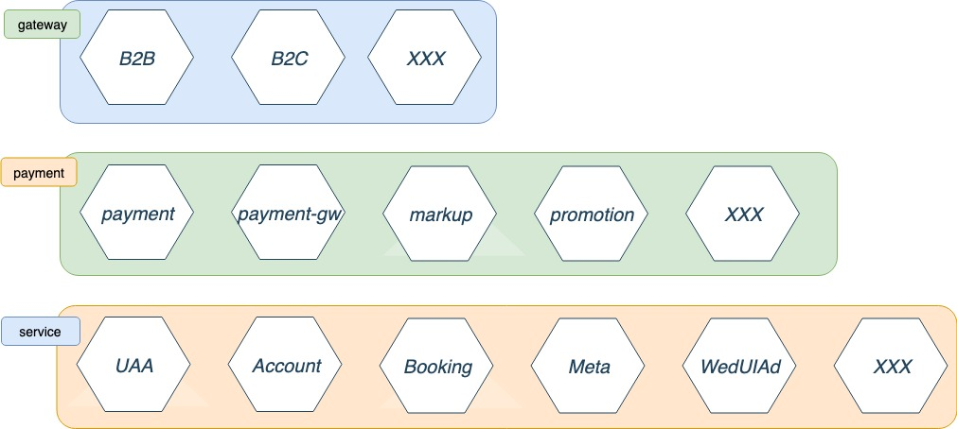
Restructure of the Services

Slide 14
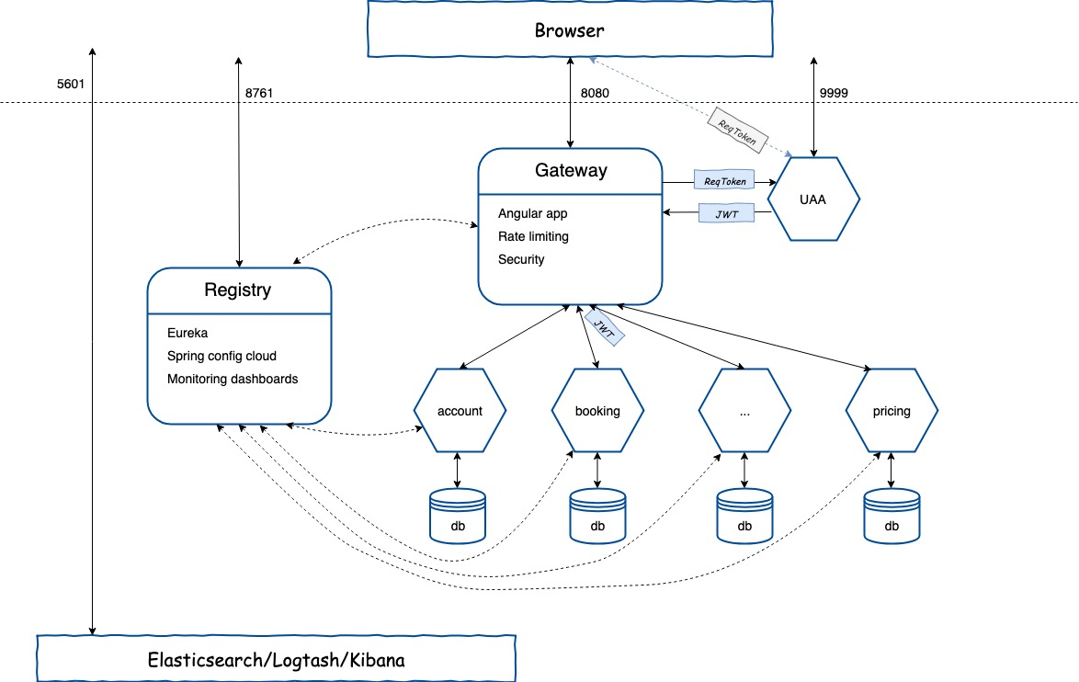
Architecture of the system will be changed
Notes:
User Account and Authentication (UAA)

Slide 15
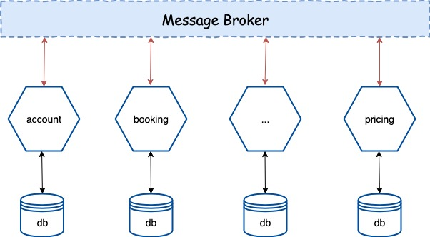
Architecture of the system will be changed

Slide 16
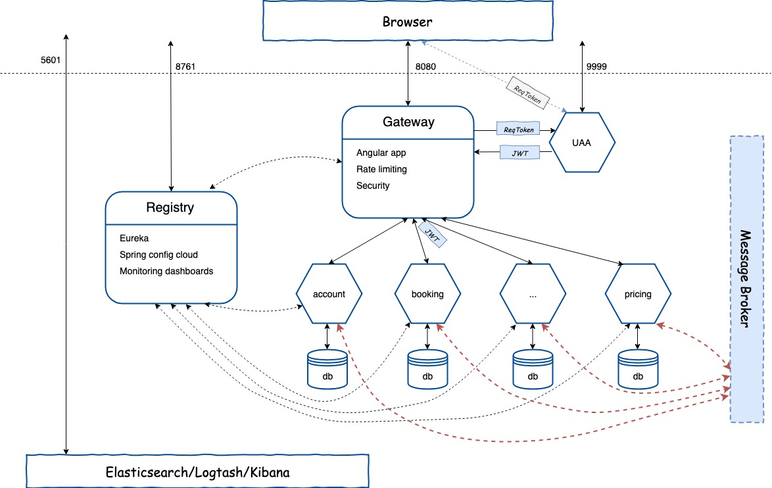
Architecture of the system will be changed

Slide 17
Appendix(Interaction Styles)
 | One-to-One | One-to-Many
Synchronous | Request/response | —
Asynchronous | Notification | Publish/subscribe
 | Request/async response | Publish/async responses
Notes:
There are the following kinds of one‑to‑one interactions:
Request/response – A client makes a request to a service and waits for a response. The client expects the response to arrive in a timely fashion. In a thread‑based application, the thread that makes the request might even block while waiting.
Notification (a.k.a. a one‑way request) – A client sends a request to a service but no reply is expected or sent.
Request/async response – A client sends a request to a service, which replies asynchronously. The client does not block while waiting and is designed with the assumption that the response might not arrive for a while.
There are the following kinds of one‑to‑many interactions:
Publish/subscribe – A client publishes a notification message, which is consumed by zero or more interested services.
Publish/async responses – A client publishes a request message, and then waits a certain amount of time for responses from interested services
Ref: https://www.nginx.com/blog/building-microservices-inter-process-communication/

Slide 18
Appendix(Interaction Styles)
There are the following kinds of one‑to‑one interactions:
Request/response – A client makes a request to a service and waits for a response. The client expects the response to arrive in a timely fashion. In a thread‑based application, the thread that makes the request might even block while waiting.
Notification (a.k.a. a one‑way request) – A client sends a request to a service but no reply is expected or sent.
Request/async response – A client sends a request to a service, which replies asynchronously. The client does not block while waiting and is designed with the assumption that the response might not arrive for a while.
There are the following kinds of one‑to‑many interactions:
Publish/subscribe – A client publishes a notification message, which is consumed by zero or more interested services.
Publish/async responses – A client publishes a request message, and then waits a certain amount of time for responses from interested services.
Notes:
Ref: https://www.nginx.com/blog/building-microservices-inter-process-communication/

Slide 19
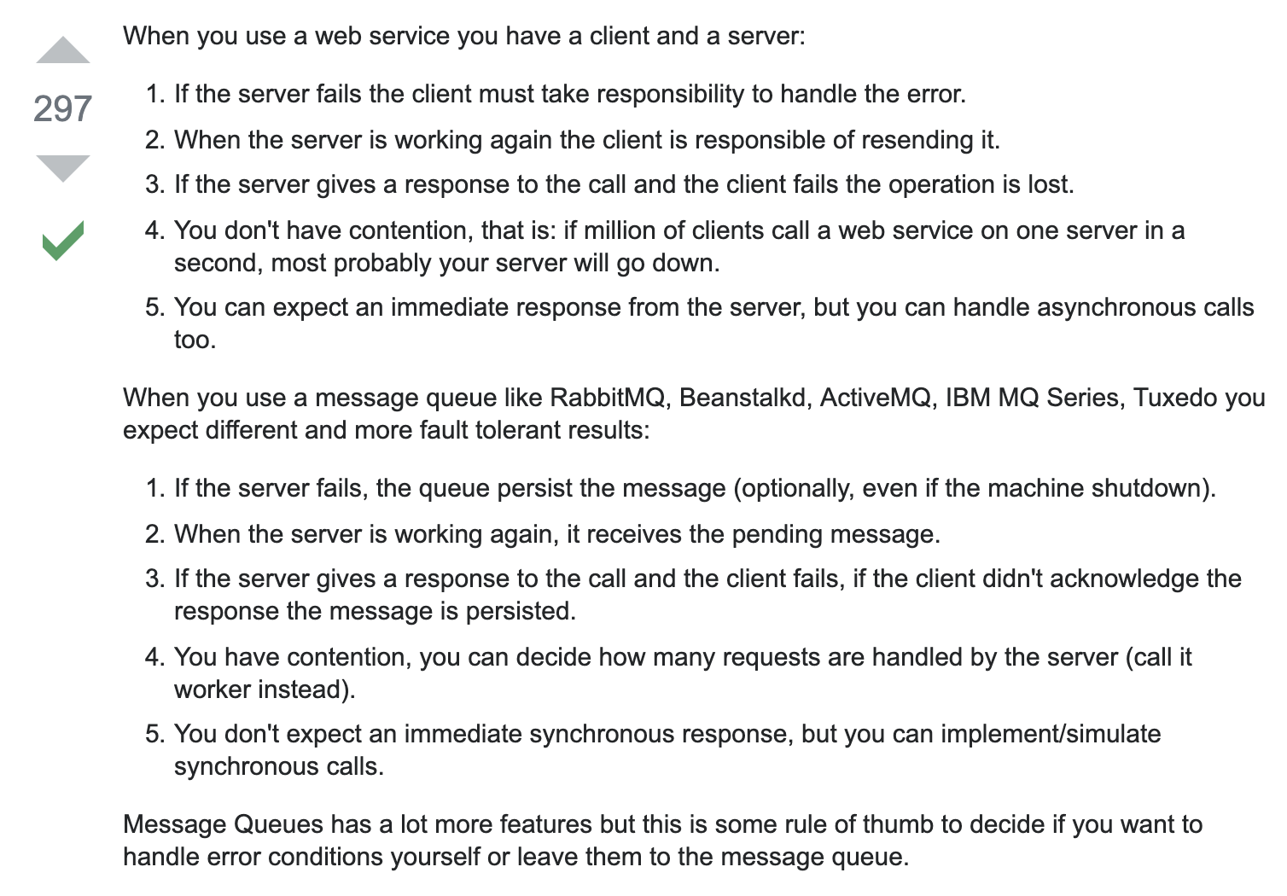
Appendix(Interaction Styles)
Notes:
Ref: https://stackoverflow.com/questions/2383912/message-queue-vs-web-services

Slide 20
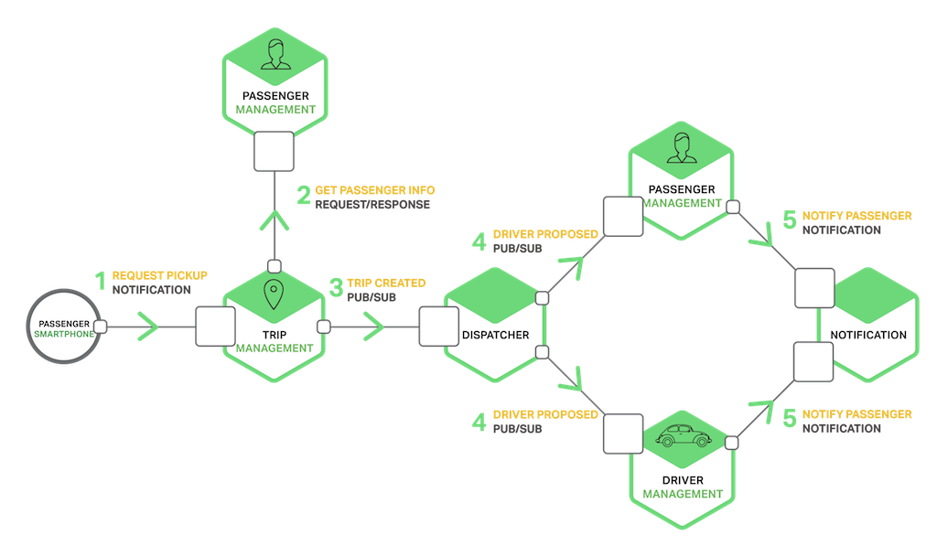
Appendix(Interaction Styles)
Notes:
The services use a combination of notifications, request/response, and publish/subscribe. For example, the passenger’s smartphone sends a notification to the Trip Management service to request a pickup. The Trip Management service verifies that the passenger’s account is active by using request/response to invoke the Passenger Service. The Trip Management service then creates the trip and uses publish/subscribe to notify other services including the Dispatcher, which locates an available driver.
Ref: https://www.nginx.com/blog/building-microservices-inter-process-communication/

Slide 21
Discussion

