Slide 1
Implementing File System Simulation in Operating System
Understanding File System Structures and Simulative Techniques
Presented By: Shudarsan Poudel

Slide 2
What is File System Simulation
File system simulation is a software-based model that replicates how an operating system manages files and storage.
It mimics real file system operations such as creating, reading, writing, and deleting files using simulated disk blocks.
The simulation maintains metadata and data allocation using structures like bitmaps to track used and free disk space.
This approach enables development and testing without risk to actual storage hardware.
It helps understand how file systems allocate space, manage directories, and handle file metadata behind the scenes.

Slide 3
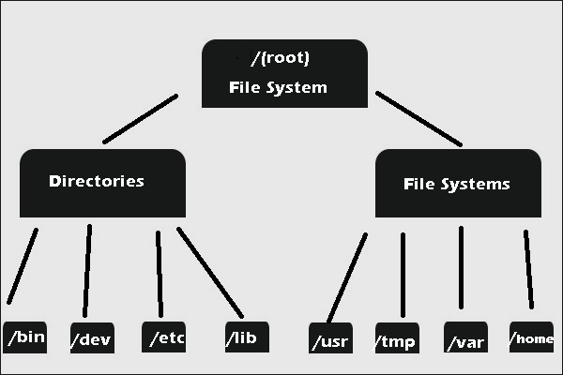
File System Hierarchy (Linux)

Slide 4
Key Components
Kernel Layer: Implements system calls for file operations (open, close, read, write, delete).
Disk Blocks: The smallest storage units simulated on a virtual disk file.
Inode (IndexNode): Stores metadata (file size, permissions, pointers to data blocks).
Directory Entries: Link filenames to their respective inodes, enabling file lookup.
SuperBlock: Contains global file system info (total blocks, block size, free space count).
BitMap: Tracks free and occupied blocks to manage disk space efficiently.
Utility programs (e.g., ls, mkdir) interact with the simulation to perform file and directory operations.

Slide 5
Benifits
Provides hands-on understanding of OS internals.
Safe environment for experimentation.
Helps in visualizing storage management.
Applied in teaching, research, and prototyping.

Slide 6
Practical Implementaion of File System
Programming Languages: C, C++, Rust, Go
Disk Representation:
Use a binary file or large array to act as the “disk”
Data Structures:
FAT (File Allocation Table), Inodes, Linked Lists, Trees
Supported Operations:
create, open, read, write, delete
Directory navigation (cd, ls)
Example: Simulating a 100-block disk where each block = 1 KB

