Slide 1

GCU Eye – Assistive Navigation App for Visually Impaired Students
Presented by: Ahtisham Tasawar & Danish Mustafa Awan
Supervisor: Ma’am Qurra-Tul-Ann

Slide 2
Outline
Introduction to GCU Eye
User Interfaces
Problem Statement
Implementation
Research Objectives
Challenges & Limitation
System Overview
Conclusion
Architecture
Future Work

Slide 3
GCU Eye: An Accessible Campus Companion
A smart, offline, and inclusive navigation assistant for blind students at GCU.
  Real-time Object Detection using YOLOv8
  VR Indoor Navigation with step-based Dijkstra paths
  Voice Reminders & SOS for safety and scheduling
  Multimodal Feedback (Audio + Vibration)
  Gesture-Only Control (Triple tap, Long press, Swipe)

Slide 4

Problem Statement
Blind students face:
Need: A unified mobile solution for safe & independent campus navigation.
Obstacles & Hazards (stairs, chairs, people).
Disorientation indoors (GPS fails).
Dependence on others for navigation.
Lack of accessible reminder & SOS tools.

Slide 5
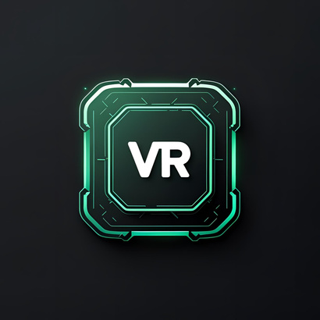
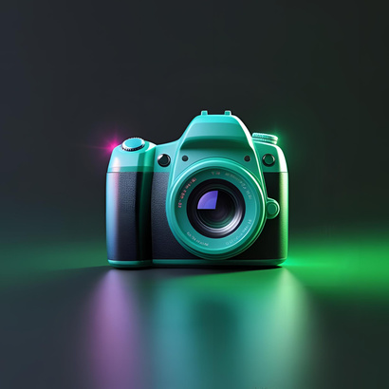

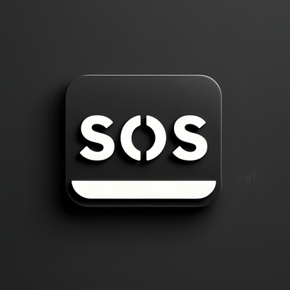

Research Objectives
  Develop VR indoor routing without GPS/Bluetooth.
  Build an AI-powered object detection system.
  Enable gesture-based control (screenless navigation).
  Add voice-controlled reminders & SOS system.
  Provide voice + vibration feedback for clarity.

Slide 6
System Overview
Flutter App
Gestures voice
Accessibility UI
Flask Backend + YOLOv8
Real-time object detection
VR Indoor Navigation
Graph-based pathfinding
Reminders System
Voice scheduling + alerts
SOS Feature
Long press for instant SMS + call

Slide 7
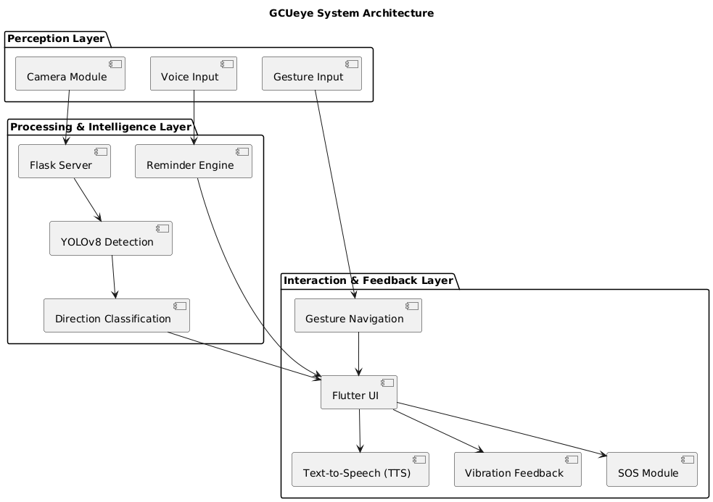
Architecture
Perception Layer – Camera + YOLOv8 (Flask)
Interaction Layer – Gestures, TTS, Haptics (Flutter)
Intelligence Layer – JSON → Direction mapping → Feedback
Offline VR Navigation – Dijkstra Algorithm
  GCU-EYE System Architecture

Slide 8
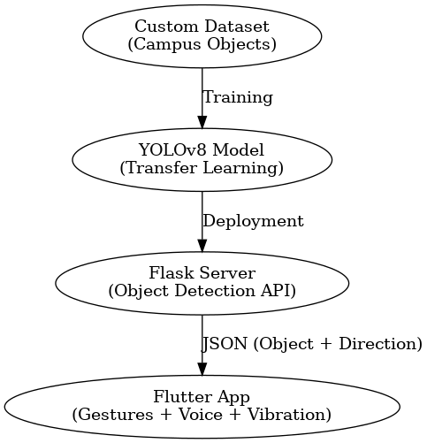
Data Model & Training
  Model Used: YOLOv8 (lightweight version for real-time use).
  Dataset: Custom campus-specific images (stairs, chairs, bags, people, obstacles).
  Training: Transfer learning with pretrained weights → optimized for mobile speed.
  Performance: ~81% mAP accuracy, ~400 ms inference time.
  Deployment: Flask server processes frames → returns object & direction (left/center/right) → voice + vibration feedback.
  Model Training Pipeline

Slide 9
Implementation
Tech Stack: Flutter, Flask, YOLOv8, SQLite
Performance:
mAP ≥ 77%
Inference ≤ 440ms
Gesture accuracy ≥ 98%
UI/UX: High contrast, swipe cards, neon theme

Slide 10
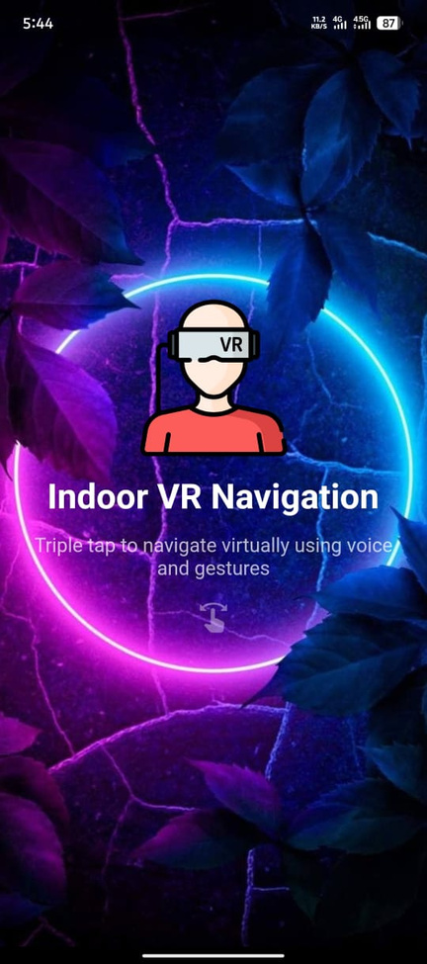
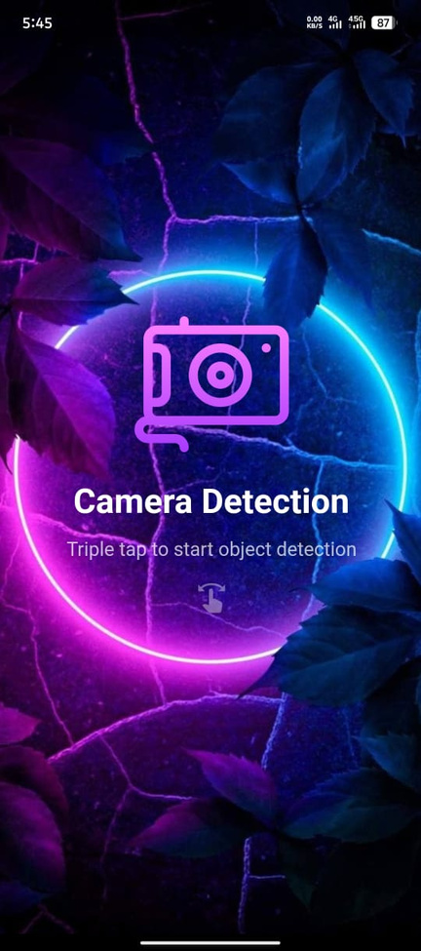
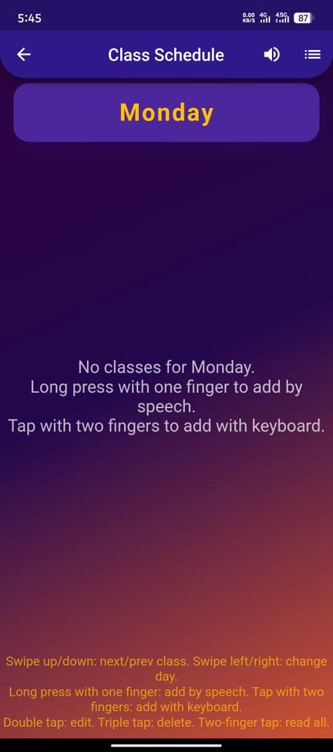
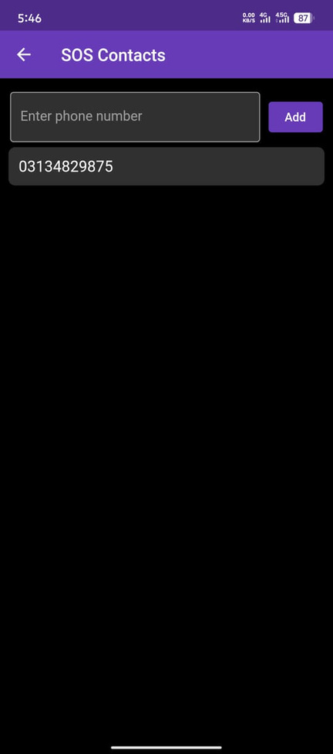
User Interfaces
VR-Screen
Camera Detection-Screen
Scheduling- Screen
SOS-Screen

Slide 11
Challenges & Limitations
  Real-time AI vs Mobile Hardware limits
  Offline operation across entire campus
  Avoiding cognitive overload with too much feedback
  Dataset scope – trained mainly on GCU obstacles

Slide 12

Conclusion
GCU Eye = safety, independence & accessibility for blind students.
Combines AI + Gestures + Voice in one mobile solution.
Proves low-cost assistive tech can transform campus life.

Slide 13
Future Work
  Campus-wide indoor maps & outdoor GPS navigation
  Indoor Positioning System (IPS) with real-time tracking
  On-device YOLOv8 (no server dependency)
  Multilingual voice support
  Customizable gesture mapping
  Deployment at GCU & other institutions

Slide 14
Thank you

